Slide 1



Nuove terapie di associazione nell’ipertensione arteriosa:
«doublete», «triplete»
Renato Nami
Docente di Cardiologia
Scuola di Specializzazione di Malattie Apparato Cardiovascolare
Università di Siena

Slide 2


Nella pratica clinica quotidiana, l’approccio clinico verso il paziente iperteso è quello di ridurre la pressione arteriosa, utilizzando uno o più farmaci a disposizione della classe medica.
La terapia del paziente iperteso non è mirata soltanto alla normalizzazione dei valori pressori, ma soprattutto alla regressione, ove possibile, del danno d’ organo e alla riduzione del rischio CV globale, bersagli clinici essenziali per ottenere una riduzione della mortalità e morbilità CV

Slide 3
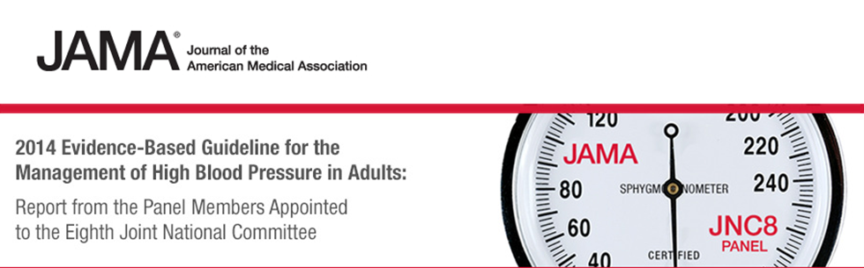
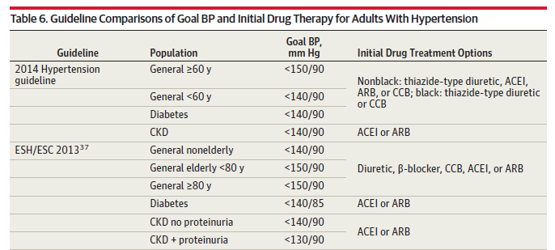

Slide 4
INVEST
(CAD pts)
ONTARGET
(high risk pts, mainly with CAD)
CV events (%)
CV events (%)
Adjusted HR
110
>110
to 120
>120
to 130
>130
to 140
>140
to 150
>150
to 160
>160
On-treatment SBP (mmHg)
On-treatment SBP (mmHg)
VALUE
(High risk pts)
TNT
(CAD pts)
Cardiac events (%)
CV events (%)
Adjusted HR
< 120
>120
to 130
>130
to 140
>140
to 150
>150
to 160
>160
to 170
>170
to 180
≥ 180
≤ 60
61-70
71-80
81-90
91-100
> 100
On-treatment SBP (mmHg)
On-treatment DBP (mmHg)
Notes:
4

Slide 5

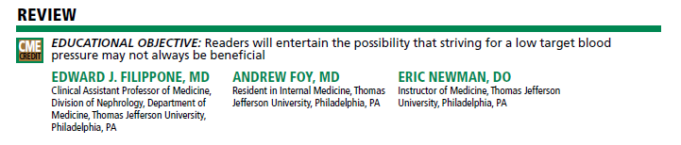

Slide 6
Incremento di effetto ipotensivo osservato/atteso ottenuto aggiungendo un farmaco o raddoppiando la dose rispetto alla classe terapeutica
1.5
1.16
(0.93-1.39)
1.04
(0.88-1.20)
1.00
(0.76-1.24)
0.89
(0.69-1.09)
1.01
(0.90-1.12)
Adding a drug from another class (on average standard doses)
Doubling dose of same drug (from standard dose to twice standard)
1.0
Incremental SBP reduction ratio
of observed to expected additive effects
0.37
(0.29-0.45)
0.5
0.23
(0.12-0.34)
0.19
(0.08-0.30)
0.20
(0.14-0.26)
0.22
(0.19-0.25)
0.0
Thiazide
Beta-
blocker
ACE-
inhibitor
Calcium channel
blocker
All
classes
* The expected incremental effect is the incremental blood pressure reduction of the added (or doubled drug), assuming an additive effect and allowing for the smaller reduction from 1 drug (or dose of 1 drug) given the lower pretreatment blood pressure because of the other
Wald DS et al., Am J Med 2009; 122: 290

Slide 7
Multiple antihypertensive agents are needed to achieve target BP
Average number of antihypertensive agents
Trial
Target BP (mm Hg)
1
2
3
4
UKPDS DBP <85
ABCD DBP <75
MDRD MAP <92
HOT DBP <80
AASK MAP <92
IDNT SBP/DBP 135/85
DBP, diastolic BP; SBP, systolic BP; MAP, mean arterial pressure; UKPDS, United Kingdom Prospective Diabetes Study; ABCD, Appropriate Blood Pressure Control in Diabetes; MDRD, Modification of Diet in Renal Disease; HOT, Hypertension Optimal Treatment; AASK, African American Study of Kidney Disease;
IDNT, Irbesartan Diabetic Nephropathy Trial
Bakris GL et al. Am J Kidney Dis 2000;36:646–661
Notes:
Multiple antihypertensive agents are needed to achieve target BP
Content points:
In order to achieve lower BP targets, multiple antihypertensive agents are necessary.
In six large, double-blind, placebo-controlled studies,^{1–6} more than one antihypertensive agent was required to achieve target BP goals.⁷
1. UK Prospective Diabetes Study Group. Tight blood pressure control and risk of macrovascular and microvascular complications in type 2 diabetes: UKPDS 38. BMJ 1998; 317: 703–713
2. Estacio RO, Schrier RW. Antihypertensive therapy in type 2 diabetes: implications of the Appropriate Blood pressure Control in Diabetes (ABCD) trial. Am J Cardiol 1998; 82(9B): 9R–14R
3. Lazarus JM, Bourgoignie JJ, Buckalew VM et al. Achievement and safety of a low blood pressure goal in chronic renal disease. Hypertension 1997; 29: 641–650
4. Hansson L, Zanchetti A, Carruthers SG et al. Effects of intensive blood-pressure lowering and low-dose aspirin in patients with hypertension: principal results of the Hypertension Optimal Treatment (HOT) randomised trial. Lancet 1998; 351: 1755–1762
5. Kusek JW, Lee JY, Smith DE et al. Effect of blood pressure control and antihypertensive drug regimen on quality of life: the African American Study of Kidney Disease and Hypertension (AASK) Pilot Study. Control Clin Trials 1996; 16(suppl 4): 40S–46S
6. Lewis EJ, Hunsicker LG, Clarke WR et al. Renoprotective effect of the angiotensin-receptor antagonist irbesartan in patients with nephropathy due to type 2 diabetes. N Engl J Med 2001; 345: 851–860
7. Bakris GL, Williams M, Dworkin L et al. Preserving renal function in adults with hypertension and diabetes: a consensus approach. Am J Kidney Dis 2000; 36: 646–661

Slide 8
Perchè la terapia di combinazione?
Il controllo insufficiente della pressione è una delle principali cause di mortalità, responsabile di 7.1 milioni di mortiper anno
63.4% degli ipertesi non sono coscienti della loro situazione
Circa il 45.3% sono sottotrattati
Solo il 29.3% raggiunge valori di SBP/DBP sotto i 140/90 mmHg
The Seventh Report of the Joint National Committee on Prevention, Detection, Evaluation, and Treatment of High Blood Pressure 2003,
NHANES Survey, 2005
Notes:
The Seventh Report of the Joint National Committee on Prevention, Detection, Evaluation, and Treatment of High Blood Pressure, 2003
NHANES Survey, 2005

Slide 9
Perchè preferire un’associazione fissa
ad una estemporanea?

Slide 10
L’associazione migliora l’aderenza alla terapia
1
L’associazione fissa riduce il rischio di non aderenza alla terapia del 24% vs l’associazione libera
Bangalore S et al. Fixed-Dose Combinations Improve Medication Compliance: A Meta-Analysis.
Am J Med. 2007;120:713-719.

Slide 11
…..non mi piacciono le associazioni precostituite, le voglio personalizzare liberamente ed a mio piacimento, basandomi sulle diverse caratteristiche cliniche di ciascun paziente iperteso (Tailored therapy)….

Slide 12
Criteri per l’associazione di
farmaci antiipertensivi
Associare farmaci con lo stesso profilo farmacocinetico in termini di tempo di picco e di durata d’azione
Associare farmaci che hanno meccanismi d’azione diversi, ma complementari
L’efficacia antiipertensiva dell’associazione deve essere superiore all’ efficacia di ciascun singolo componente (effetto additivo o di potenziamento)
L’associazione deve minimizzare gli effetti metabolici indesiderati
L’associazione deve minimizzare gli effetti collaterali indesiderati
Notes:
Un’ associazione razionale deve essere costituita da farmaci con lo stesso profilo farmacocinetico. L’ associazione deve cominciare con dosi ridotte di ciascun farmaco. Tuttavia, ciascun farmaco deve essere somministrato a una dose che copra le 24 ore, condizione che talvolta non viene rispettata in alcune associazioni con gli ACE-inibitori. Un altro parametro estremamente importante è che bisogna associare farmaci che hanno meccanismi d’ azione diversi, ma complementari (ad es. un farmaco che attiva il SRA con un farmaco che lo inibisce). E’ ovvio che non bisogna mai associare due farmaci della stessa classe o sottoclasse. E’ infine necessario fare molta attenzione a non associare farmaci con effetto d’ azione opposto (tipico errore è l’ associazione di un alfa-1 antagonista con un simpatico-modulatore alfa-agonista quale la clonidina), in quanto i due farmaci annullano reciprocamente il proprio effetto. Infine l’ associazione deve minimizzare gli effetti umorali indesiderati (ad es. l’ associazione dell’ ACE-inibitore o dell’ AT1-antagonista riduce l’ ipopotassiemia causata dal diuretico tiazidico) e minimizzare gli effetti collaterali (ad es. gli ACE-inibitori riducono l’ edema premalleolare dei calci antagonisti, mentre i calcio-antagonisti riducono la tosse da ACE-inibitori).

Slide 13
Associazioni fisse vs estemporanee: Dati di metanalisi
Studio
Dezii CM et al, 2000
Dezii CM et al, 2000
NDC Dataset, 2003
Taylor AA et al, 2003
Dato globale
Rapporto del rischio
(IC 95%)
0.74 (0.65, 0.84)
0.71 (0.62, 0.80)
0.81 (0.77, 0.86)
0.74 (0.67, 0.81)
0.76 (0.71, 0.81)
0.1
1
10
Rapporto del rischio
A favore delle associazioni fisse
A favore delle associazioni estemporanee
Bangalore S et al. Am J Med 2007; 120: 713-19
Notes:
Associazioni fisse vs estemporanee
L’aderenza al trattamento è una condizione indispensabile per una cura efficace di condizioni croniche quali l’ipertensione. Le terapie di combinazione a dosaggio fisso sono state realizzate per semplificare i regimi terapeutici e potenzialmente migliorare la compliance da parte dei pazienti. Comunque i dati relativi al paragone tra combinazioni farmacologiche a dose fissa ed estemporanee sul miglioramento dell’aderenza alla terapia, sono limitati.
La terapia di combinazione a dosaggio fisso riduce il rischio di non aderenza al trattamento e può essere presa in considerazione in pazienti con patologie croniche come l’ipertensione, al fine di migliorare la compliance, evenienza che può condurre inoltre ad un miglioramento del decorso clinico del paziente.

Slide 14
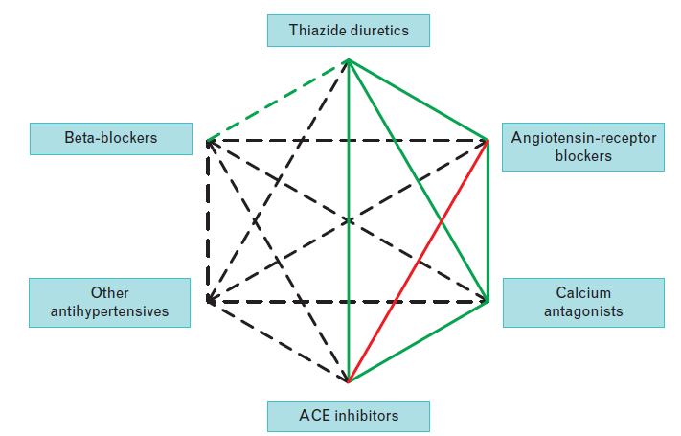
Possible combinations of different classes of antihypertensive agents
2013 ESH/ESC Guidelines for the management of arterial hypertension

Slide 15
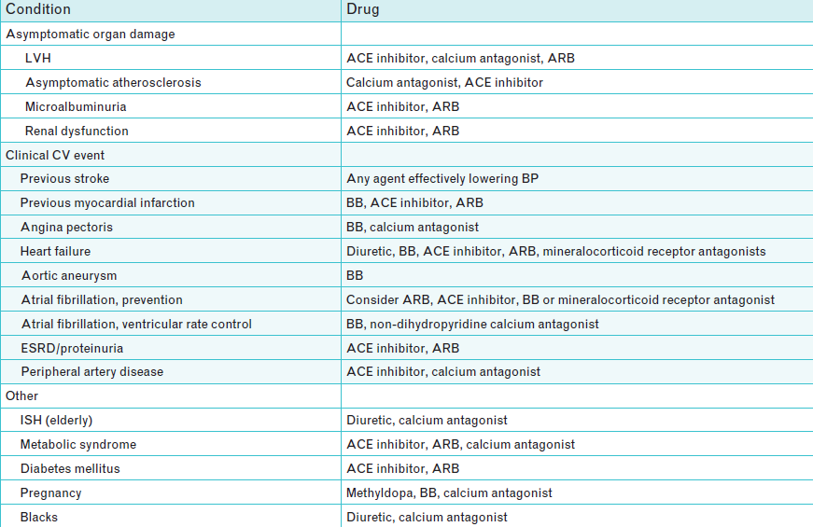
Drugs to be preferred in specific conditions
2013 ESH/ESC Guidelines for the management of arterial hypertension

Slide 16
Tutte le associazioni sono uguali in termini di raggiungimento del target pressorio e riduzione del rischio CV?

Slide 17
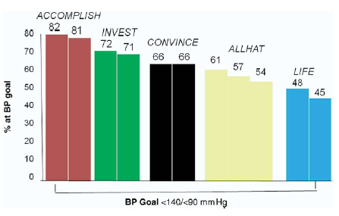
Percent of Patients Reaching BP Goals

Slide 18
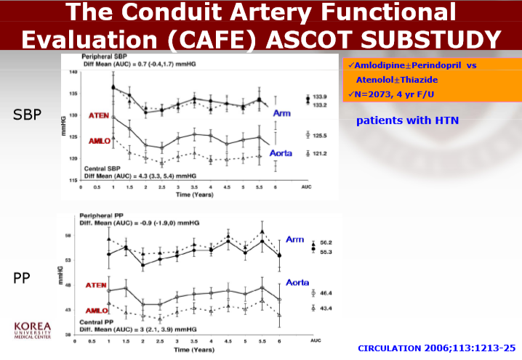

Slide 19

Fatal and non-fatal stroke
%
5.0
Atenolol ± thiazide
(No. of events 422)
4.0
3.0
Amlodipine ± perindopril
(No. of events 327)
2.0
1.0
HR = 0.77 (0.66­0.89)
p = 0.0003
0.0
0.0
1.0
2.0
3.0
4.0
5.0
Years
Number at risk
Amlodipine ± perindopril 9639 9483 9331 9156 8972 7863
Atenolol ± thiazide 9618 9461 9274 9059 8843 7720

Slide 20
Total coronary end point
%
10.0
Atenolol ± thiazide
(No. of events 852)
8.0
6.0
Amlodipine ± perindopril
(No. of events 753)
4.0
2.0
HR = 0.87 (0.79­0.96)
p = 0.0070
0.0
0.0
1.0
2.0
3.0
4.0
5.0
Years
Number at risk
Amlodipine ± perindopril 9639 9400 9204 8984 8744 7614
Atenolol ± thiazide 9618 9373 9136 8864 8591 7470

Slide 21
CV mortality
%
3.5
3.0
Atenolol ± thiazide
(No. of events 342)
2.5
2.0
1.5
Amlodipine ± perindopril
(No. of events 263)
1.0
HR = 0.76 (0.65­0.90)
p = 0.0010
0.5
0.0
0.0
1.0
2.0
3.0
4.0
5.0
Years
Number at risk
Amlodipine ± perindopril 9639 9544 9441 9322 9167 8078
Atenolol ± thiazide 9618 9532 9415 9261 9085 7975

Slide 22
CAFE Study Conclusions
Central aortic pressure may be an important independent determinant of clinical outcomes
Results of the CAFE study suggest that the “central aortic blood pressure hypothesis” is a plausible mechanism to explain the better clinical outcomes for hypertensive patients treated with amlodipine ± perindopril-based therapy in ASCOT

Slide 23
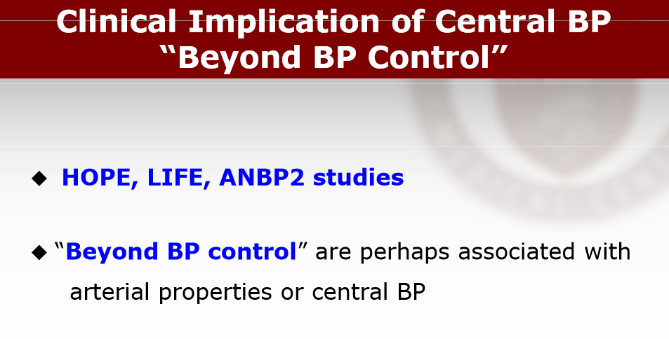
HOPE, LIFE, ACCOMPLISH studies

Slide 24

HOPE - BP Effects
Outcome Baseline Change at 1 Change at 2 Change at end
(mmHg) month (mmHg) months (mmHg) (mmHg)
Ramipril SBP 139 -6.0 -3.0 -2.0
Placebo SBP 139 -2.0 0.00 0.00
Ramipril DBP 79 -3.0 -3.0 -3.00
Placebo DBP 79 -1.0 -1.0 -2.00
N Engl J Med, January 20, 2000

Slide 25
HOPE - Kaplan-Meier Estimates of the Composite Endpoint of CV Death, MI or Stroke in the Ramipril and Placebo Groups
P<0.001
N Engl J Med, January 20, 2000

Slide 26

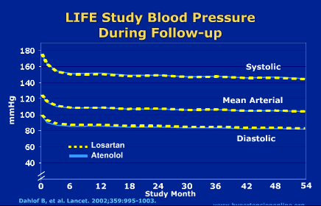
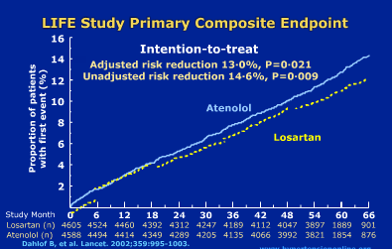

Slide 27

The ACCOMPLISH Trial

Slide 28
Results: Improved BP Control
 | Amlodipine | HCTZ
Mean SBP | 131.6 | 132.5
Mean DBP | 73.3 | 74.4
% BP <140/90 | 75.4 | 72.4
Both benazepril/ amlodipine and benazepril/ HCTZ combination therapy improved blood pressure control

Slide 29
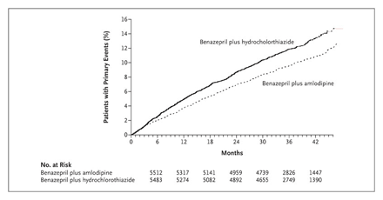
Kaplan-Meier Curve:
Time to First Primary Composite Endpoint

Slide 30
….Non si può escludere la possibilità che i risultati dello studio ACCOMPLISH possano essere legati ad una maggiore riduzione della BP centrale indotta dall’associazione di un bloccante del RAS con un calcioantagonista….
Linee Guida Europee ESH/ESC 2013

Slide 31
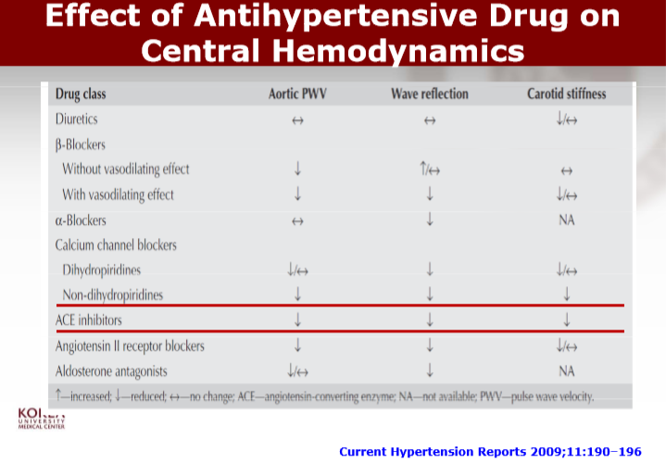


Slide 32
Perché una triplice associazione?

Slide 33
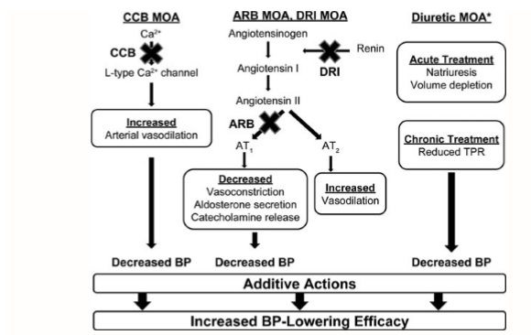
Complementary mechanism of triple combination antihypertensive therapy
Joel M. Neutel & David H. G. Smith , Cardiovascular Therapeutics 31 (2013) 251–258

Slide 34
Effetto sulla riduzione pressoria
1
Riduzione della pressione arteriosa (95% CI)
*
1 Farmaco
2 Farmaci
3 Farmaci
Pressione arteriosa sistolica (mmHg)
6.7
(Da 6.1 a 7.2)
13.3
(Da 12.4 a 14.1)
19.9
(Da 18.5 a 21.3)
Pressione arteriosa diastolica (mmHg)
3.7
(Da 3.1 a 4.3)
7.3
(Da 6.2 a 8.3)
10.7
(Da 9.1 a 12.4)
*
Riduzioni della pressione arteriosa regolata a un usuale pretrattamento del valore di 150/90 mm Hg,
la media della pressione arteriosa in persone di 50-69 anni che hanno avuto eventi di ictus o
cardiopatia ischemica .
Law M R et al. Value of low dose combination treatment with blood pressure lowering drugs: analysis of 354 randomised trials. BMJ. 2003;326:1427-1434

Slide 35
Effetto sulla riduzione dell’incidenza di ictus e CAD
1
Percentuale (95% CI) riduzione d’incidenza
1 Farmaco
2 Farmaci
3 Farmaci
ICTUS
29
49
63
(Da 26 a 31)
(Da 42 a 55)
(Da 55 a 70)
CARDIOPATIA ISCHEMICA
19
34
46
(Da 17 a 21)
(Da 29 a 40)
(Da 39 a 53)
Effetti di farmaci antiipertensivi sulla riduzione nell’incidenza di ictus ed eventi ischemici quando utilizzati separatamente e in combinazione a metà dose standard
Rielaborazione grafica della tabella da Law M R et al. Value of low dose combination treatment with blood pressure lowering drugs: analysis of 354 randomised trials. BMJ. 2003;326:1427-1434

Slide 36
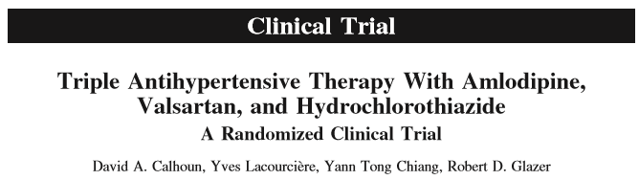
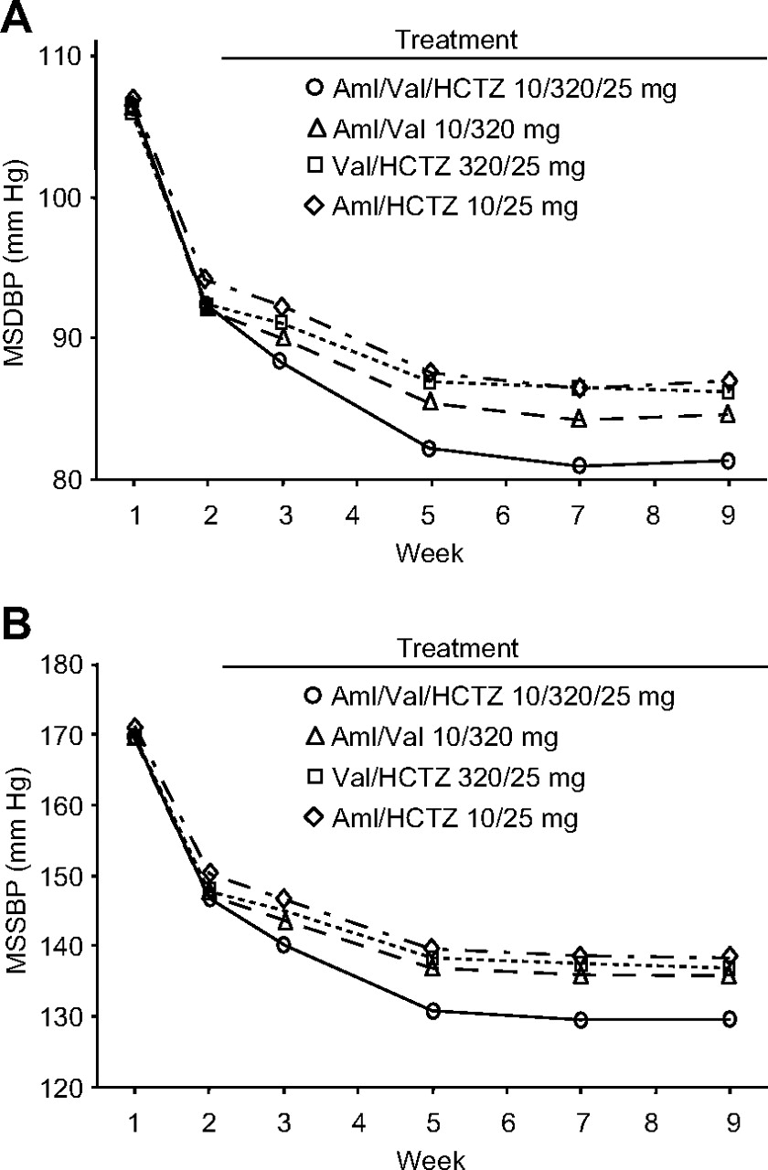

(Hypertension. 2009;54:32-39.)
Copyright © American Heart Association, Inc. All rights reserved.

Slide 37
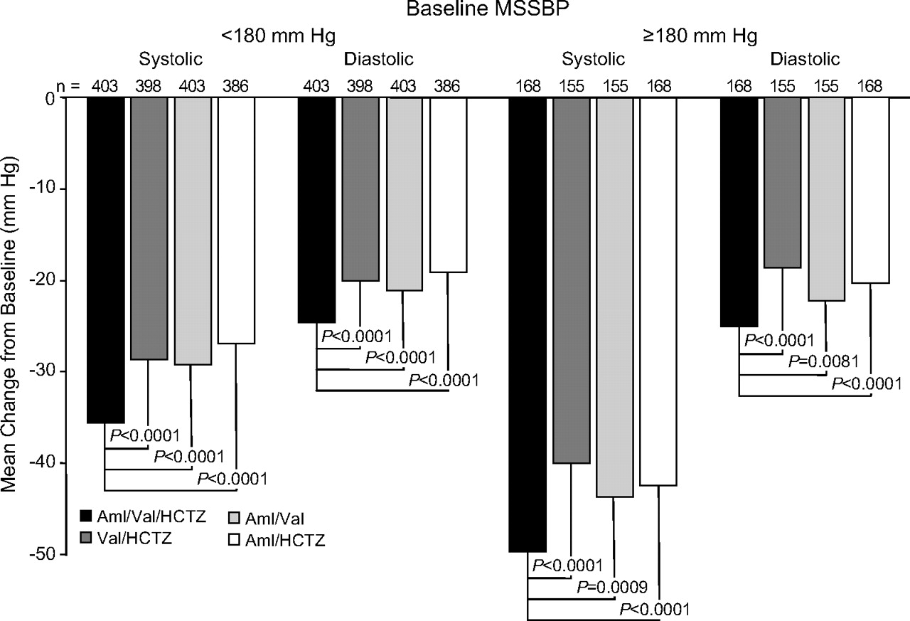
Figure 4. Between-treatment comparisons for change from baseline to end point in mean sitting BP (mm Hg) by baseline MSSBP. Data presented are least-square mean changes.
David A. Calhoun et al. Hypertension. 2009;54:32-39
Copyright © American Heart Association, Inc. All rights reserved.
Notes:
Figure 4. Between-treatment comparisons for change from baseline to end point in mean sitting BP (mm Hg) by baseline MSSBP. Data presented are least-square mean changes.

Slide 38
The TRINITY study: design
OLM/AML 40/10
(n=600)
OLM/AML 40/10 (n=800)
OLM/AML/HCTZ 40/10/25
(n=200)
Washout Run-In
(N=2400)
OLM/HCTZ 40/25
(n=600)
Primary endpoint:
Δ SeDBP
from Week 0
OLM/HCTZ 40/25 (n=800)
OLM/AML/HCTZ 40/10/25
(n=200)
AML/HCTZ 10/25 (n=800)
AML/HCTZ 10/25
(n=600)
OLM/AML/HCTZ 40/10/25
(n=200)
3 weeks
4 weeks
8 weeks
Wk -3
Wk 0
Wk 4
Wk 12
Period I
Washout
Period II
12-week double-blind, parallel group
Oparil S, et al. Clin Ther 2010;32:1252-69.
Notes:
38
TRINITY: Comparing OLM/AML/HCTZ with each dual combination in patients with moderate-to-severe hypertension
Oparil et al. Clin Therap 2010;32 (7):1252–69
Design of the TRINITY study

Slide 39
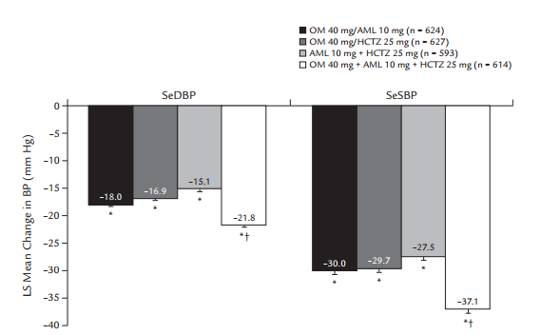
TRINITY: mean change in SeDBP and SeSBP
after 12 weeks of treatment‡
Mean change from baseline in seated diastolic blood pressure (SeDBP) and
seated systolic BP (SeSBP) after 12 weeks of treatment with dual combination treatment or triple combination treatment.
Oparil S, et al. Clin Ther 2010;32:1252-69.

Slide 40
TRINITY: significantly better BP goal† achievement with triple combination therapy
*
10/25 mg
40/25 mg
40/10 mg
40/10/25 mg
*p<0.001 vs. dual combination
†BP goal defined as <140/90 mmHg
Oparil S, et al. Clin Ther 2010;32:1252-69.

Slide 41
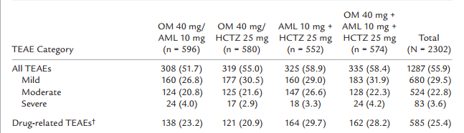
Overview of treatment-emergent adverse events (TEAEs).* Values are number (%) of patients
Oparil S, et al. Clin Ther 2010;32:1252-69.

Slide 42
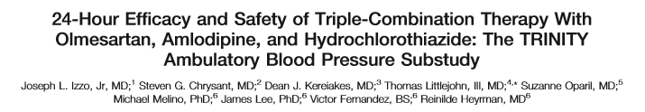
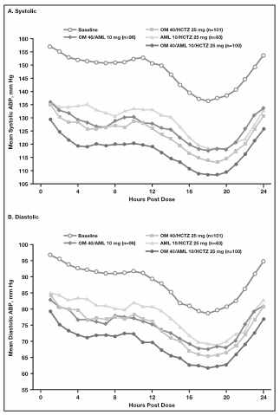
J Clin Hypertens (Greenwich). 2011;13:873– 880

Slide 43
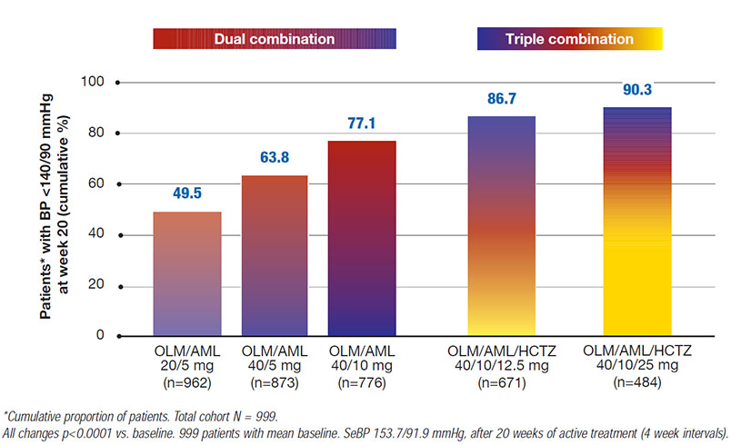
Cumulative percentage of patients achieving blood pressure control in a stepwise treatment intensification protocol.
Weir MR, Hsueh WA, Nesbitt SD, et al. A titrate-to-goal study of switching patients uncontrolled on antihypertensive monotherapy to fixeddose combinations of amlodipine and olmesartan medoxomil ± hydrochlorothiazide. J Clin Hypertens (Greenwich) 2011;13:404-12.

Slide 44
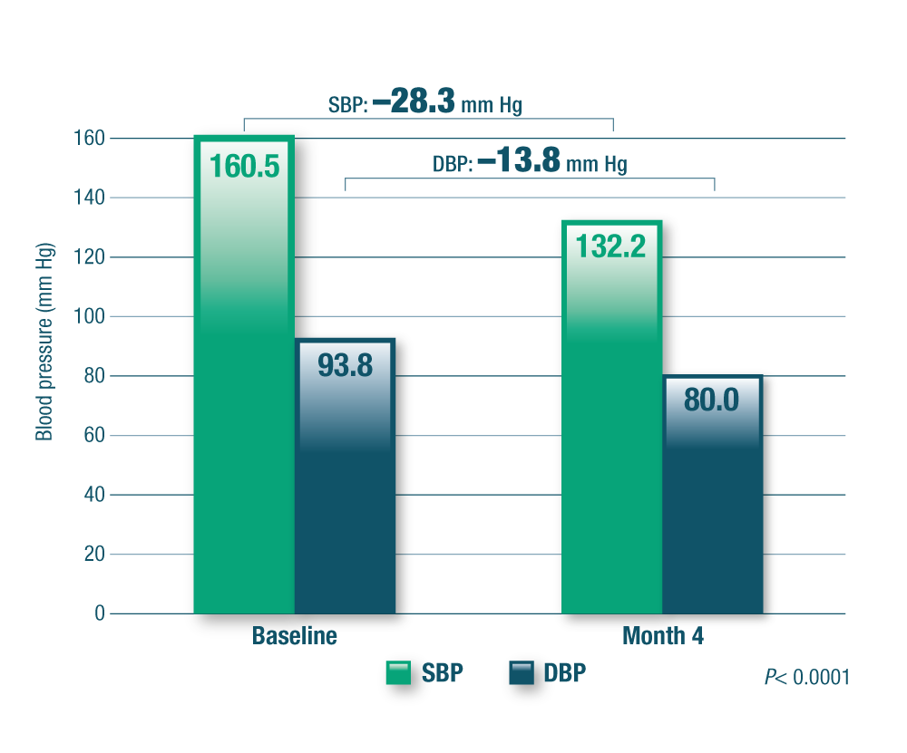

Riduzione della pressione arteriosa con
Perindopril/Amlodipina/Indapamide dopo 4 mesi
1
Mean
Baseline
Dopo 4 Mesi
Tòth K, on behalf of PIANIST Investigators.Anthypertensive Efficacy of Triple Combination Perindopril/Indapamide Plus Amlodipine in High-Risk Hypertensives: Results of the PIANIST Study ( Perindopril-Indapamide plus Amlodipine in High risk hypertensive patients ). 2014 Am J Cardiovasc Drugs

Slide 45

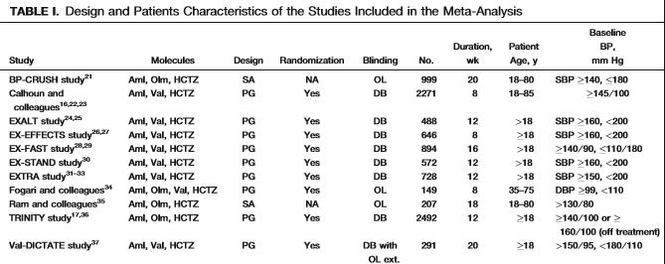
Pinar Kizilirmak et al, J Clin Hypertens (Greenwich). 2013; 15:193–200

Slide 46
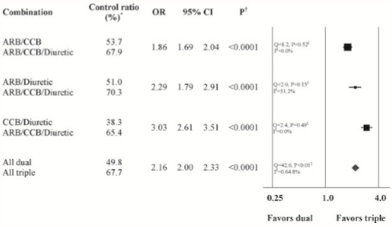
Odds ratios for blood pressure control rate in dual and triple combination groups
Pinar Kizilirmak et al, J Clin Hypertens (Greenwich). 2013; 15:193–200

Slide 47
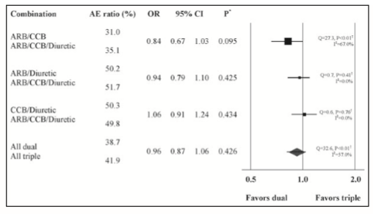
Odds ratios for adverse events in dual and triple combination groups
Pinar Kizilirmak et al, J Clin Hypertens (Greenwich). 2013; 15:193–200

Slide 48
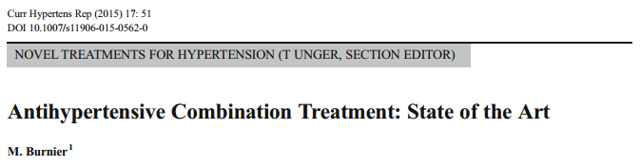
Advantages and limits of the use of single-pill combinations in hypertension
Advantages
• Reduction of the pill burden
• Simplification of the treatment schedule
• Increased adherence to therapy (better long-term persistence)
• Improved efficacy with reduced incidence of side effects
• Better prevention of cardiovascular events
(to be demonstrated prospectively)
Limits
• Reduction of the prescription flexibility
• Difficulty to identify the precise cause of an unexpected side effect
• Difficulty to memorize the exact content of the single-pill combinations
• Risk of a more pronounced rebound hypertension in case of
repeated omissions
• Risk of acute hypotension when restarting a triple combination
after interruptions
• Increased cost versus free combinations of generics

Slide 49
FINE

Slide 50
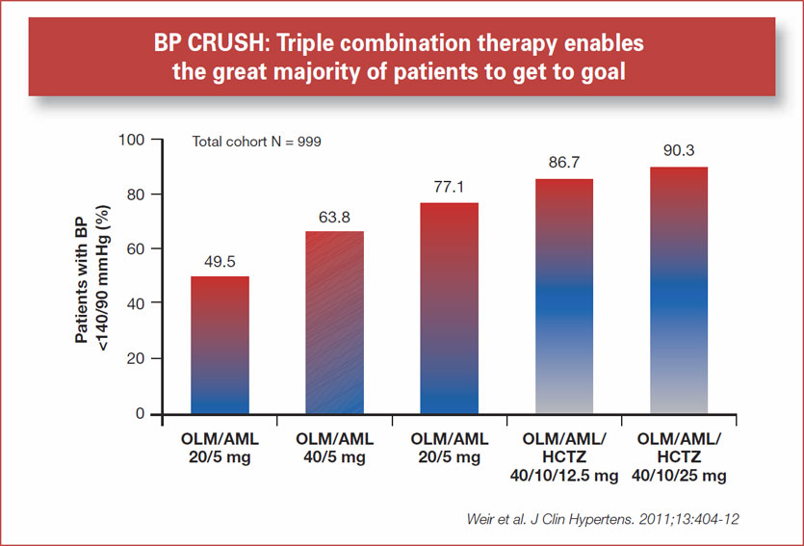

Slide 51
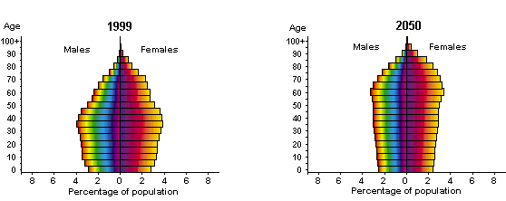
The world population will be older
more developed countries
Age
1999
Age
2050
100+
Males
Females
100+
Males
Females
80
80
60
60
40
40
20
20
0
0
8
6
4
2
0
2
4
6
8
8
6
4
2
0
2
4
6
8
Percentage of population
Percentage of population

Slide 52

Avoiding Cardiovascular Events through
COMbination Therapy in Patients
LIving with Systolic Hypertension
Kenneth Jamerson¹, George L. Bakris², Bjorn Dahlof³, Bertram Pitt¹,
Eric J. Velazquez⁴, and Michael A. Weber⁵
for the ACCOMPLISH Investigators
University of Michigan Health System, Ann Arbor, MI¹; University of Chicago-Pritzker School of Medicine, Chicago, IL²; Sahlgrenska University Hospital, Gothenburg, Sweden³; Duke University School of Medicine, Durham, NC⁴; SUNY Downstate Medical College, Brooklyn, NY⁵
Notes:
52

Slide 53
ACCOMPLISH: Design
Free add-on antihypertensive agents*
Amlodipine 10 +
benazepril 40 mg
Amlodipine 5 mg +
benazepril 40 mg
Amlodipine 5 mg +
benazepril 20 mg
Screening
Randomization
Benazepril 20 mg + HCTZ 12.5 mg
Benazepril 40 mg + HCTZ 12.5 mg
Titrated to achieve BP<140/90 mmHg; <130/80 mmHg in patients with diabetes or renal insufficiency
Benazepril 40 mg + HCTZ 25 mg
Free add-on antihypertensive agents*
14 Days
Day 1
Month 1
Month 2
Month 3
Year 5
*Beta blockers; alpha blockers; clonidine; (loop diuretics).
Jamerson KA et al. Am J Hypertens. 2003;16(part2)193A
Notes:
53
Patients will be randomized to amlodipine/benazepril 5/20 mg or benazepril/HCTZ 20/12.5 mg, and will have their doses force-titrated to standard maintenance doses of amlodipine/benazepril 5/40 mg, and benazepril/HCTZ 40/12.5 mg during the first 2 months. The doses can be increased to 10/40 mg or 40/25 mg, respectively, and after 3 months other antihypertensive agents (excluding the drug classes involved in the primary treatments) may be added to achieve blood pressure <140/90 mmHg (<130/80 mmHg for patients with diabetes or renal insufficiency). Investigators will be strongly encouraged to reach target blood pressure in all patients. Patients will be seen at 3 months, 6 months, and thereafter at 6-month intervals until the end of the trial.¹ (Jamerson et al. Am J Hypertens. 2004;17: Page 796-A)
ACCOMPLISH is an event-driven trial: patients will be treated until 1,642 primary cardiovascular events have been reported. It is estimated this will take approximately 5 years, including the 18 months of recruitment.
1. Jamerson KA, Bakris GL, Wun CC, et al. Rationale and design of the Avoiding Cardiovascular events through COMbination therapy in Patients LIving with Systolic Hypertension (ACCOMPLISH) trial: the first randomized controlled trial to compare the clinical outcome effects of first-line combination therapies in hypertension. Am J Hypertens. 2004;17:793–801.

Slide 54
Baseline Demographics
 | ACEI / HCTZ N=5741 (%) | CCB / ACEI N=5721 (%)
Gender Male Female | 3509 (61.1) 2226 (38.8) | 3436 (60.1) 2283 (39.9)
Race Caucasian Black Asian Other | 4789 (83.4) 699 (12.2) 27 (0.5) 220 (3.8) | 4814 (84.1) 675 (11.8) 22 (0.4) 208 (3.6)
Age Mean (years) < 70 ≥ 70 | 68.3 3407 (59.3) 2328 (40.6) | 68.4 3367 (58.9) 2351 (41.1)
Region Nordic countries* United States | 1676 (29.2) 4059 (70.7) | 1677 (29.3) 4042 (70.7)
*Denmark, Finland, Norway or Sweden

Slide 55
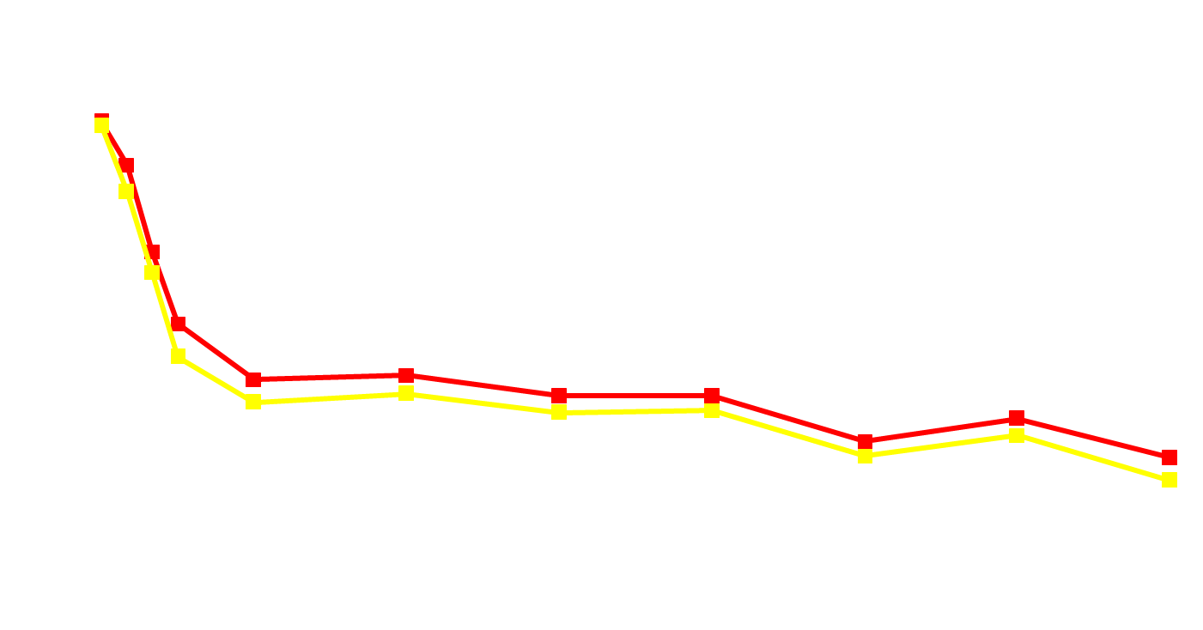

Systolic Blood Pressure Over Time
ACEI / HCTZ
N=5733
CCB / ACEI
N=5713
mm Hg
130mmHg
Difference of 0.7 mmHg p<0.05*
129.3 mmHg
Month
5731 5387 5206 4999 4804 4285 2520 1045
5709 5377 5154 4980 4831 4286 2594 1075
Patients
*Mean values are taken at 30 months F/U visit
DBP: 71.1
DBP: 72.8

Slide 56

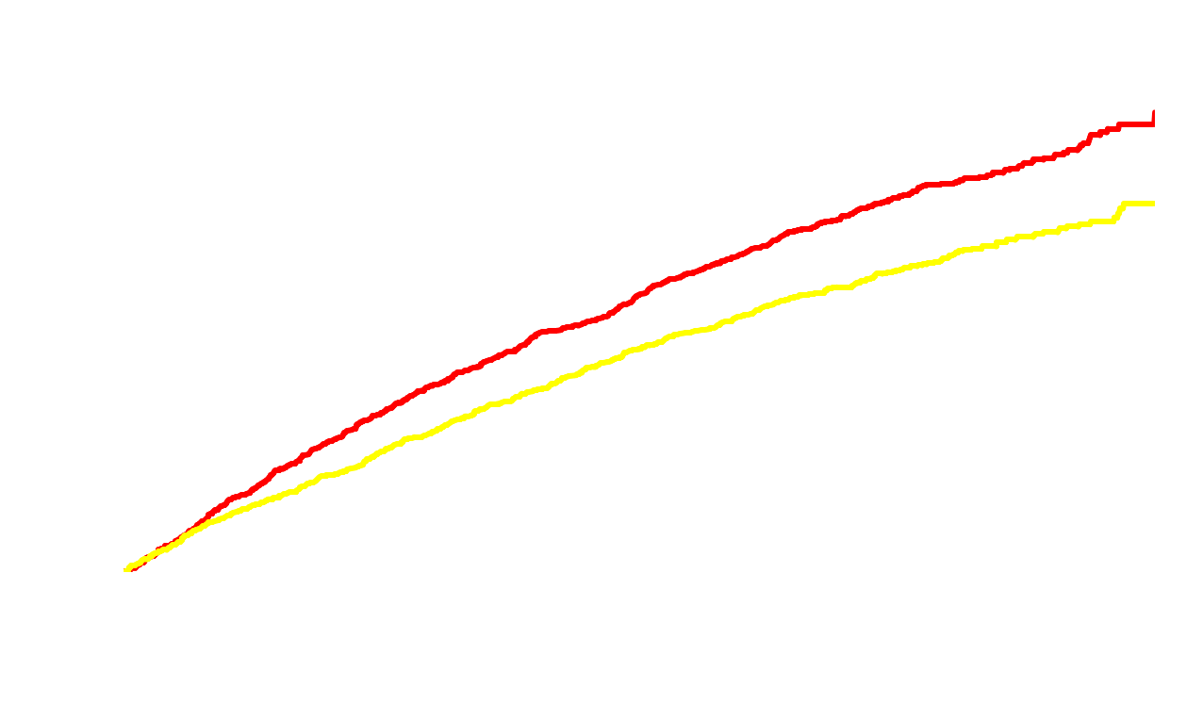
Kaplan Meier for Primary Endpoint
ACEI / HCTZ
20% Risk Reduction
650
CCB / ACEI
Cumulative event rate
526
p = 0
.0
0
0
2
Time to 1st CV morbidity/mortality (days)
HR (95% CI): 0.80 (0.72, 0.90)
Notes:
56

Slide 57
Primary Endpoint and Components
Incidence of adjudicated primary endpoints, based upon cut-off analysis date 3/24/2008
(Intent-to-treat population)
Risk Ratio
(95%)
Composite CV mortality/morbidity
Cardiovascular mortality
Non-fatal MI
Non-fatal stroke
Hospitalization for unstable angina
Coronary revascularization procedure
Resuscitated sudden death
0.80 (0.72–0.90)
0.81 (0.62-1.06)
0.81 (0.63-1.05)
0.87 (0.67-1.13)
0.74 (0.49-1.11)
0.85 (0.74-0.99)
1.75 (0.73-4.17)
0.5
1.0
2.0
Favors
CCB / ACEI
Favors
ACEI / HCTZ
Notes:
57
57
57

Slide 58
Primary and Other Endpoints
Incidence of adjudicated primary endpoints, based upon cut-off analysis date 3/24/2008
(Intent-to-treat population)
Risk Ratio
(95%)
Composite CV mortality/morbidity
Primary w/o revascularization
Hard CV endpoint
(CV death, non-fatal MI, non-fatal stroke)
All cause mortality
0.80 (0.72–0.90)
0.79 (0.68–0.92)
0.80 (0.68–0.94)
0.90 (0.75–1.08)
0.5
1.0
2.0
Favors
CCB / ACEI
Favors
ACEI / HCTZ
Notes:
58
58

Slide 59
TRINITY: mean change in SeDBP
(primary parameter) after 12 weeks of treatment‡
10/25 mg
40/25 mg
40/10 mg
40/10/25 mg
*
*
*
*†
*P<0.0001 vs. baseline
†P<0.0001 vs. dual combination
‡LS (Least Squares) mean change from baseline in SeDBP after 12 weeks of treatment with dual or triple combination
Oparil S, et al. Clin Ther 2010;32:1252-69.

Slide 60
Il triplice paradosso dell’ipertensione arteriosa:
Facile da diagnosticare spesso non viene diagnosticata
Facile da trattare spesso non è trattata
Quando trattata, spesso non viene raggiunto il target pressorio

Slide 61
Should guidelines also indicate a BP value
not to go below
in order to avoid harm?
Notes:
61

Slide 62
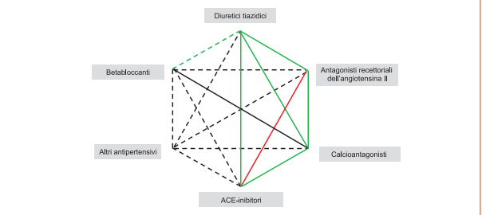
Possibili associazioni tra le diverse classi di farmaci antipertensivi
Linee Guida Europee ESH/ESC 2013

Slide 63
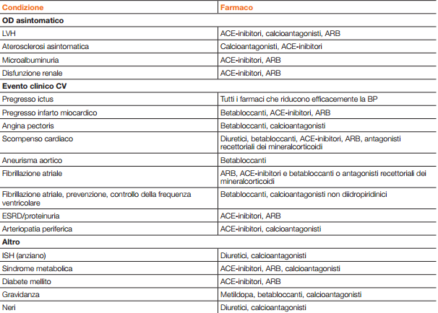
Farmaci di scelta in condizioni specifiche
Linee Guida Europee ESH/ESC 2013

Slide 64
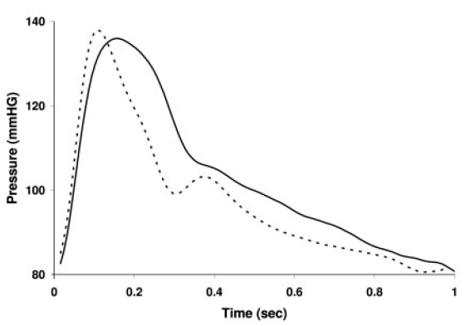
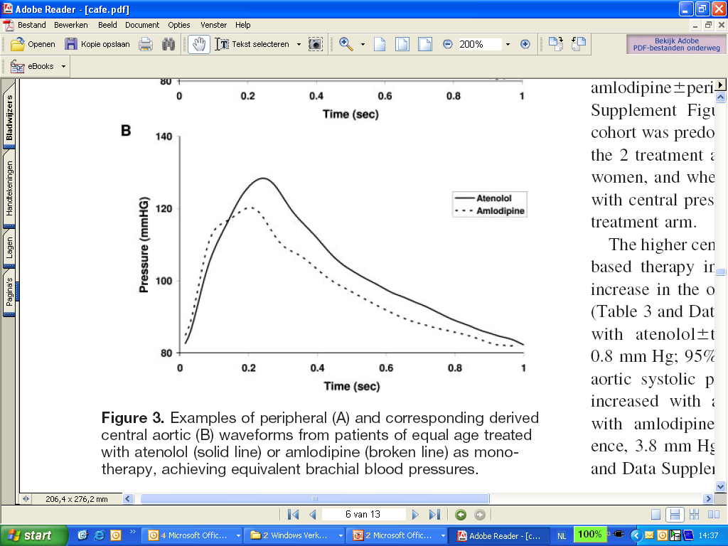
CAFE Study: Different waveforms demonstrate lower central BP in CCB/ACEI arm
amlodipine ± perindopril
atenolol ± bendroflumethiazide
Peripheral waveform
Central aortic waveform
Williams B. Circulation 2006.

Slide 65
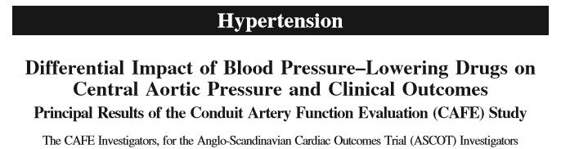
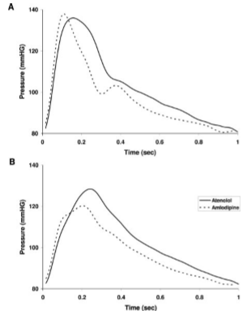
(Circulation. 2006;113:1213-1225.)

Slide 66
