Slide 1



  Stenosi aortica severa a rischio intermedio: a chi TAVI?
  Crotone 12-13 Ottobre 2018
  Hotel Lido degli Scogli
Carmen Spaccarotella
Divisione di Cardiologia
Università Magna Graecia
Catanzaro
spaccarotella@unicz.it
Regional Excellence Center for Interventional Treatment of Cardiovascular Diseases

Slide 2
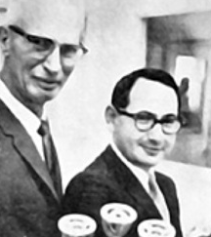

1958: First Cardiac Valve
Ing. Miles “Lowell” Edwards
Dr. Albert Starr
University of Oregon Medical School

Slide 3
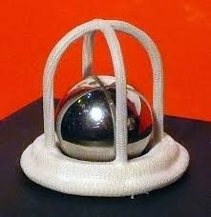
Albert Starr in 1960 implanted the first cardiac valve
STARR-EDWARDS

Slide 4

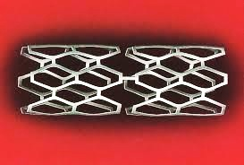
TAVI IS THE GREATEST INNOVATION OF THE CARDIOLOGY AFTER CORONARY STENTS

Slide 5
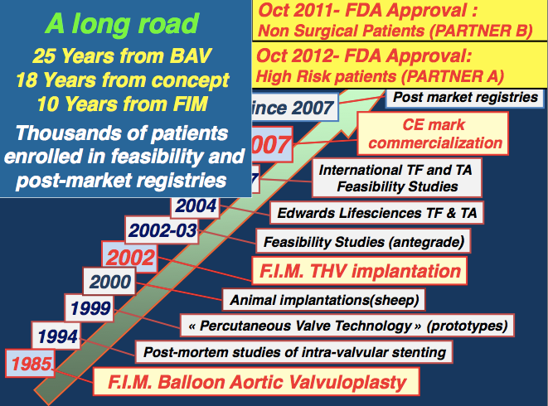
2014- FDA Approval
Extreme Risk & High Risk (Pivotal Trial)

Slide 6
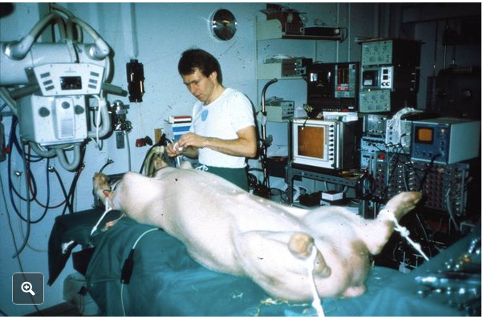
1989: Henning Rud Andersen of Aarhus University in Jutland

Slide 7
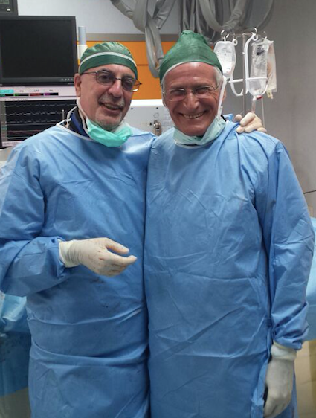
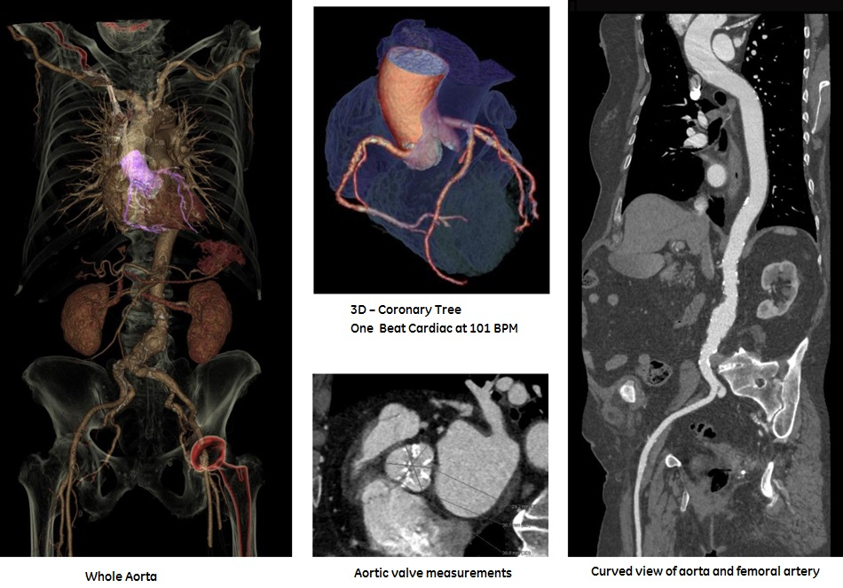
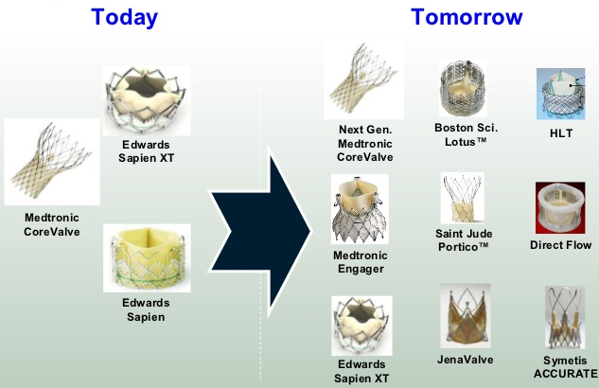

Slide 8
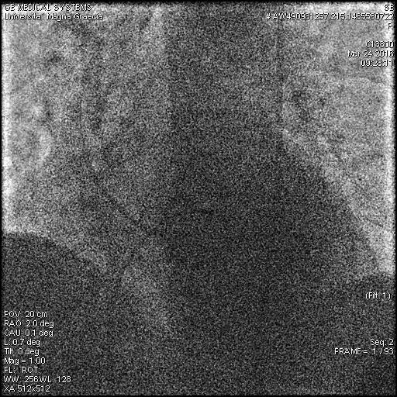
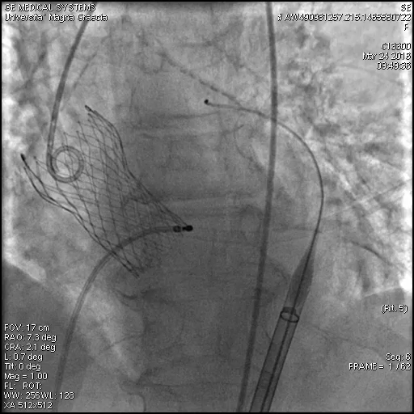
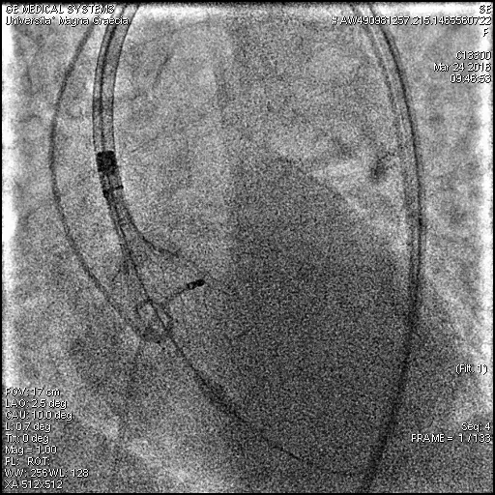

Slide 9
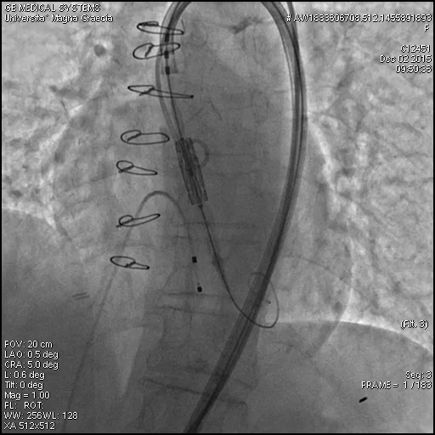
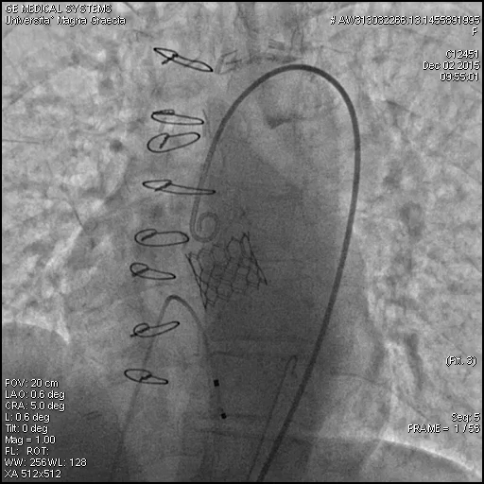

Slide 10
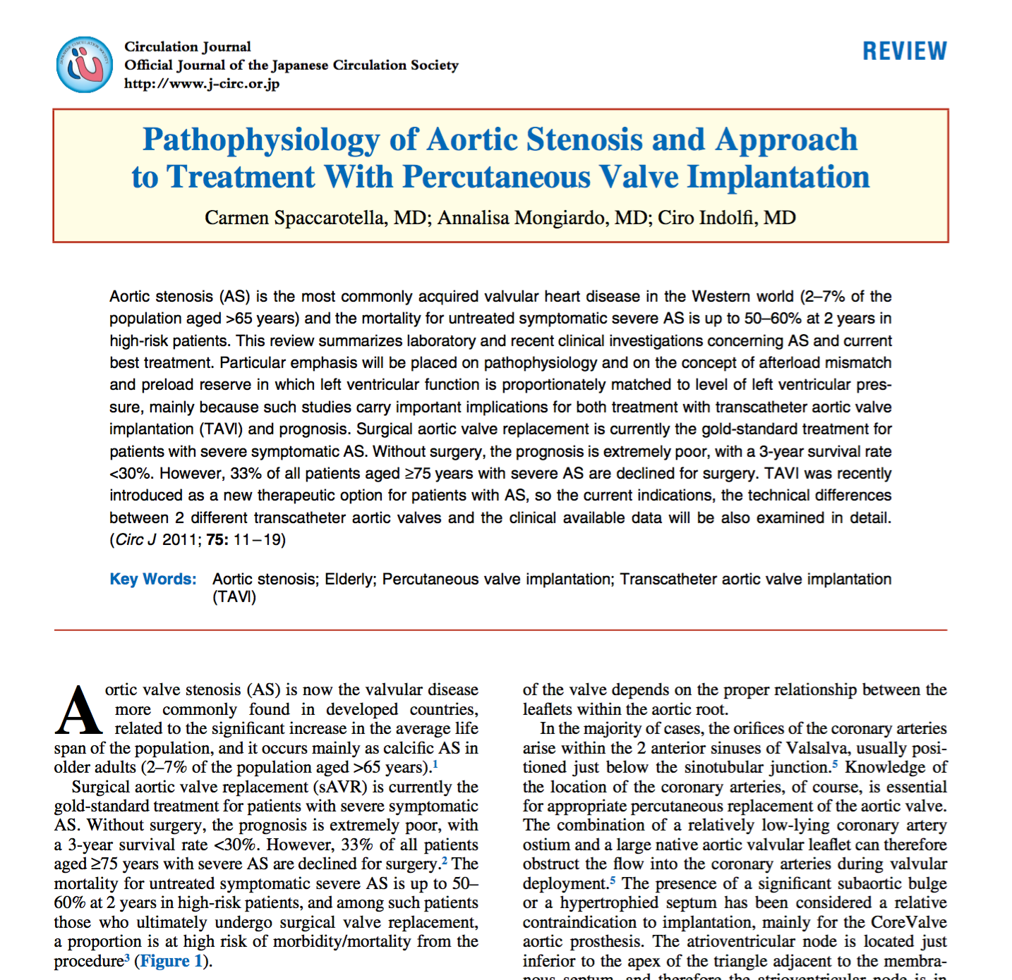
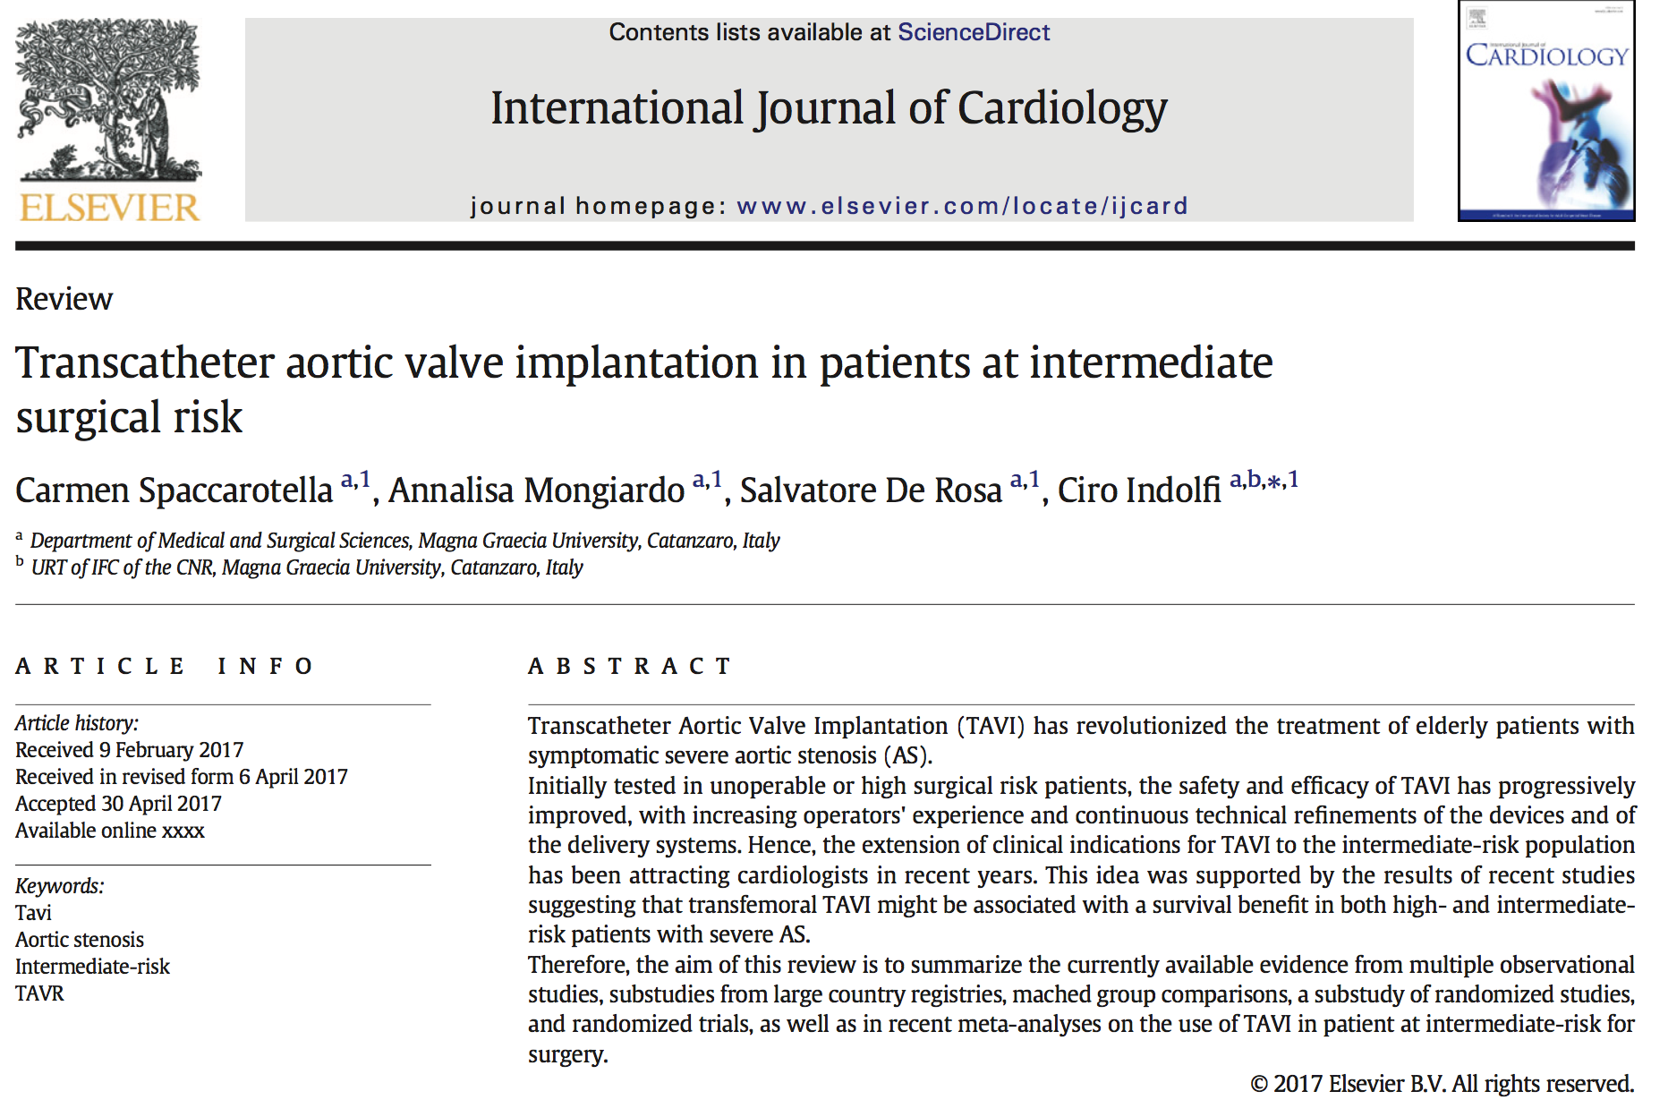
The dogma is changed
Year 2011
Year 2017

Slide 11
TAVI Vs SURGERY IN HIGH RISK PATIENTS

Slide 12
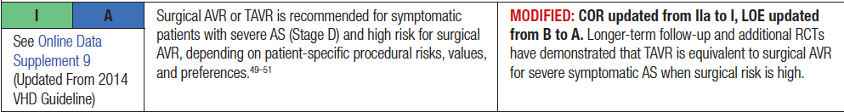
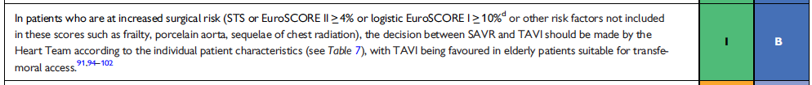
AHA
TAVI IN HIGH SURGICAL RISK
ESC

Slide 13
THE NEWS IN 2017
TAVI IN PATIENTS AT INTERMEDIATE RISK (STS>4)

Slide 14
The PARTNER 2A Trial
Study Design
Symptomatic Severe Aortic Stenosis
ASSESSMENT by Heart Valve Team Operable (STS ≥ 4%)
Randomized Patients
n = 2032
Yes
ASSESSMENT:
Transfemoral Access
No
Transfemoral (TF)
Transapical (TA) / TransAortic (TAo)
1:1 Randomization (n = 1550)
1:1 Randomization (n = 482)
TF TAVR
(n = 775)
VS.
Surgical AVR
(n = 775)
TA/TAo TAVR
(n = 236)
Surgical AVR
(n = 246)
VS.
Primary Endpoint: All-Cause Mortality or Disabling Stroke at Two Years

Slide 15
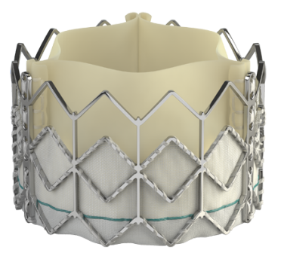
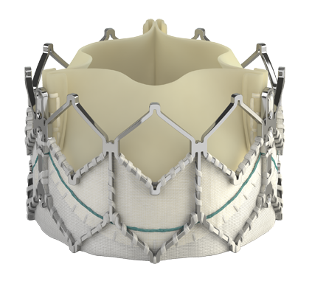
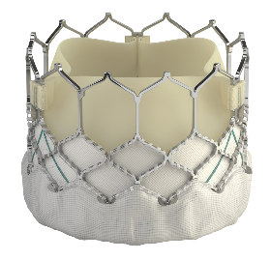
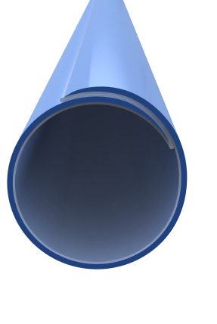










PARTNER SAPIEN Platforms
Device Evolution
Valve Technology | SAPIEN |  | SAPIEN XT |  |  | SAPIEN 3
Sheath Compatibility
Available Valve Sizes
 | 23 mm | 26 mm |  |  |  | 20 mm | 23 mm | 26 mm | 29 mm
22-24F
16-20F
14-16F
  23mm
  26mm
  29mm*
*First Implant Oct 30, 2012

Slide 16
Baseline Patient Characteristics
Demographics and Vascular Disease
Characteristic | TAVR (n = 1011) | Surgery (n = 1021) | p-value
Age - yrs | 81.5 ± 6.7 | 81.7 ± 6.7 | 0.63
Male - % | 54.2 | 54.8 | 0.79
STS Score - % | 5.8 ± 2.1 | 5.8 ± 1.9 | 0.29
NYHA Class III or IV - % | 77.3 | 76.1 | 0.53
CAD - % | 69.2 | 66.5 | 0.20
Prior CABG - % | 23.6 | 25.6 | 0.33
Cerebrovascular Disease - % | 32.1 | 31.0 | 0.60
PVD - % | 27.9 | 32.9 | 0.02

Slide 17
Procedural Complications (AT)
Complication | TAVR (n = 994) | Surgery (n = 944)
Procedural deaths (0-3 days) | 12 (1.2%) | 10 (1.1%)
≥ 2 transcatheter valves* | 26 (2.6%) | NA
Valve embolization | 10 (1.0%) | NA
Annular rupture | 3 (0.3%) | NA
Coronary obstruction | 4 (0.4%) | 6 (0.6%)
Access site infections | 15 (1.2%) | 12 (1.3%)
* Valve-in-valve (22) or with valve embolization (4)

Slide 18
Primary Endpoint (ITT)
All-Cause Mortality or Disabling Stroke
1
50
Surgery
HR [95% CI] = 0.89 [0.73, 1.09]
TAVR
p (log rank) = 0.253
40
30
All-Cause Mortality or Disabling Stroke (%)
21.1%
20
16.4%
19.3%
10
8.0%
14.5%
6.1%
0
0
3
6
9
12
15
18
21
24
Number at risk:
Months from Procedure
Surgery
1021
838
812
783
770
747
735
717
695
TAVR
1011
918
901
870
842
825
811
801
774

Slide 19
TF Primary Endpoint (AT)
All-Cause Mortality or Disabling Stroke
1
50
TF Surgery
HR: 0.78 [95% CI: 0.61, 0.99]
TF TAVR
p (log rank) = 0.04
40
30
All-Cause Mortality or Disabling Stroke (%)
20.0%
20
15.8%
7.5%
16.3%
10
11.7%
0
4.5%
0
3
6
9
12
15
18
21
24
0
Number at risk:
Months from Procedure
TF Surgery
722
636
624
600
591
573
565
555
537
TF TAVR
762
717
708
685
663
652
644
634
612

Slide 20
Other Clinical Endpoints (ITT)
At 30 Days and 2 Years
Events (%) | 30 Days |  |  | 2 Years
 | TAVR (n = 1011) | Surgery (n = 1021) | p-value* | TAVR (n = 1011) | Surgery (n = 1021) | p-value*
Rehospitalization | 6.5 | 6.5 | 0.99 | 19.6 | 17.3 | 0.22
MI | 1.2 | 1.9 | 0.22 | 3.6 | 4.1 | 0.56
Major Vascular Complications | 7.9 | 5.0 | 0.008 | 8.6 | 5.5 | 0.006
Life-Threatening / Disabling Bleeding | 10.4 | 43.4 | <0.001 | 17.3 | 47.0 | <0.001
AKI (Stage III) | 1.3 | 3.1 | 0.006 | 3.8 | 6.2 | 0.02
New Atrial Fibrillation | 9.1 | 26.4 | <0.001 | 11.3 | 29.3 | <0.001
New Permanent Pacemaker | 8.5 | 6.9 | 0.17 | 11.8 | 10.3 | 0.29
Re-intervention | 0.4 | 0.0 | 0.05 | 1.4 | 0.6 | 0.09
Endocarditis | 0.0 | 0.0 | NA | 1.2 | 0.7 | 0.22
*Event rates are KM estimates, p-values are point in time

Slide 21
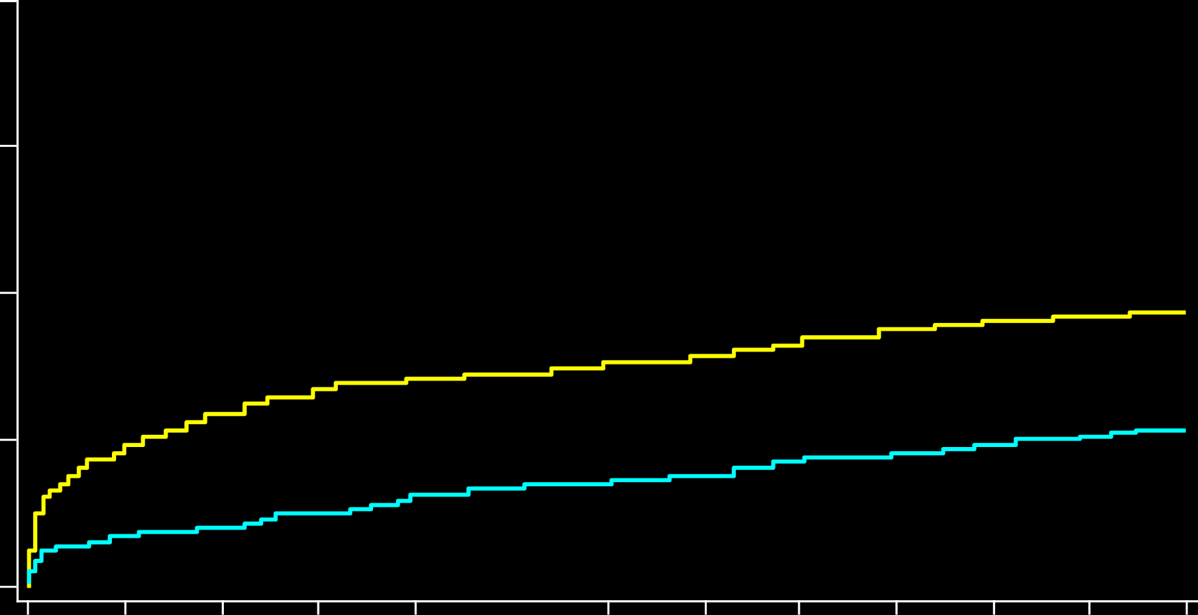
Unadjusted Time-to-Event Analysis
All-Cause Mortality and All Stroke (AT)
40
P2A Surgery
SAPIEN 3 TAVR
30
20
18.8%
All-Cause Mortality / Stroke Rate (%)
9.7%
10.8%
10
3.7%
0
0
3
6
9
12
Months from Procedure
Number at risk:
P2A Surgery
944
805
786
757
743
S3 TAVR
1077
1012
987
962
930

Slide 22
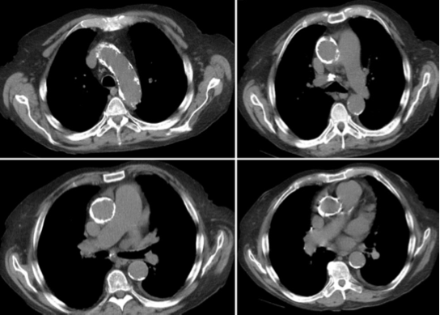
Eurointervention 2012; 8: 782-795

Slide 23
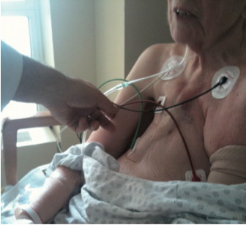
Eurointervention 2012; 8: 782-795

Slide 24
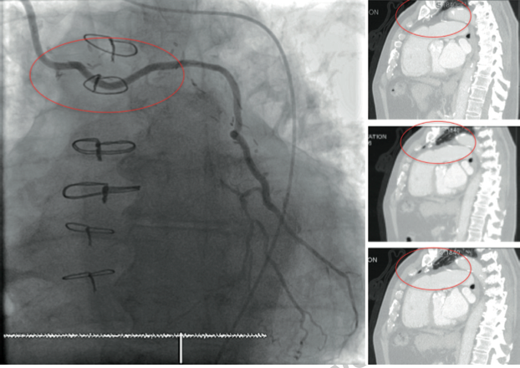
Eurointervention 2012; 8: 782-795

Slide 25
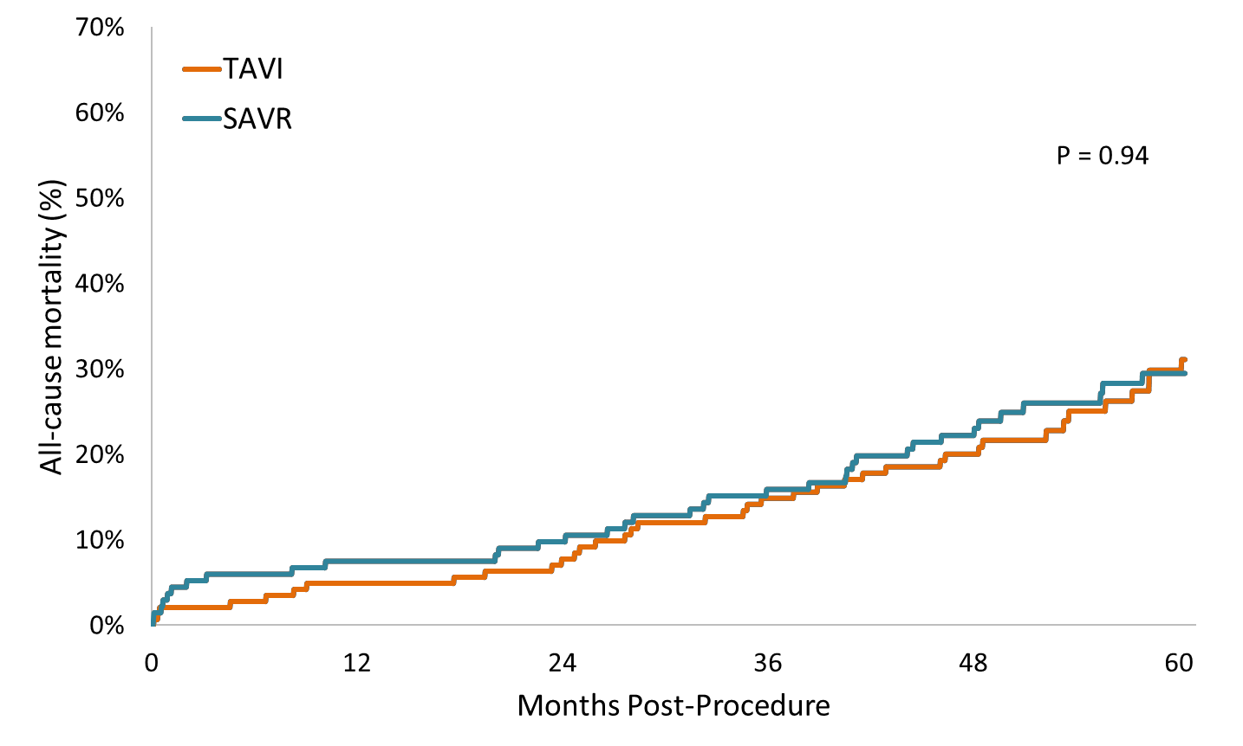
The NOTION Trial all-cause mortality
31.1%
29.4%
Number at risk:
142 139 | 138 | 135 | 130 | 119 | 100 | 52
134 128 | 125 | 123 | 118 | 110 | 92 | 58

Slide 26
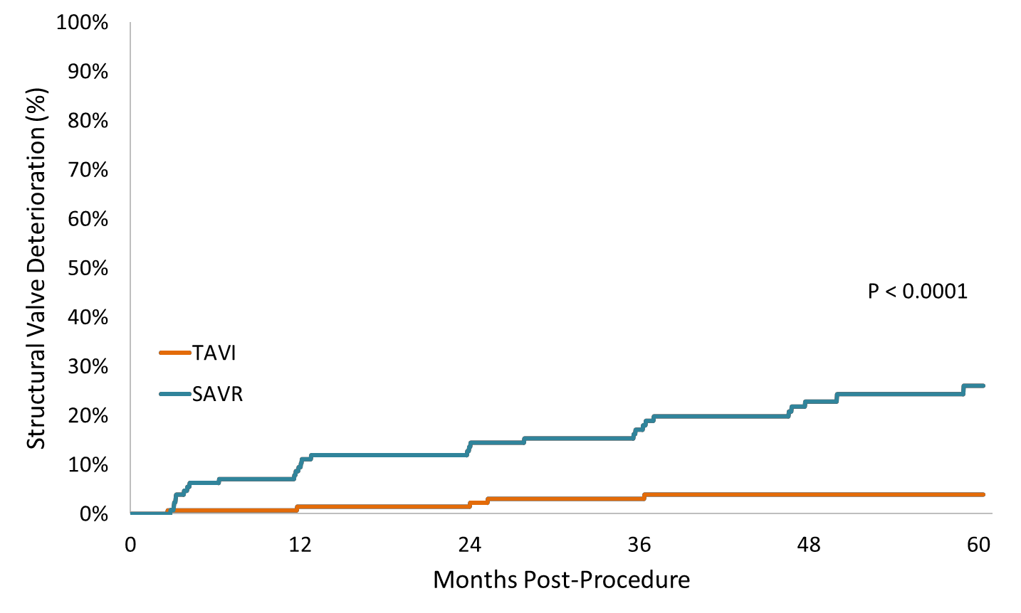
The NOTION Trial structural valve deterioration
 | TAVI | SAVR
 | n=139 | n=135
SVD
Moderate haemodynamic SVD | 2.9% (4/139) | 20.7% (28/135)
Severe haemodynamic SVD | 0.7% (1/139) | 3.0% (4/135)
26.1%
3.9%
Number at risk:
139 | 134 | 130 | 124 | 112 | 94 | 50
135 | 118 | 112 | 101 | 92 | 74 | 41

Slide 27
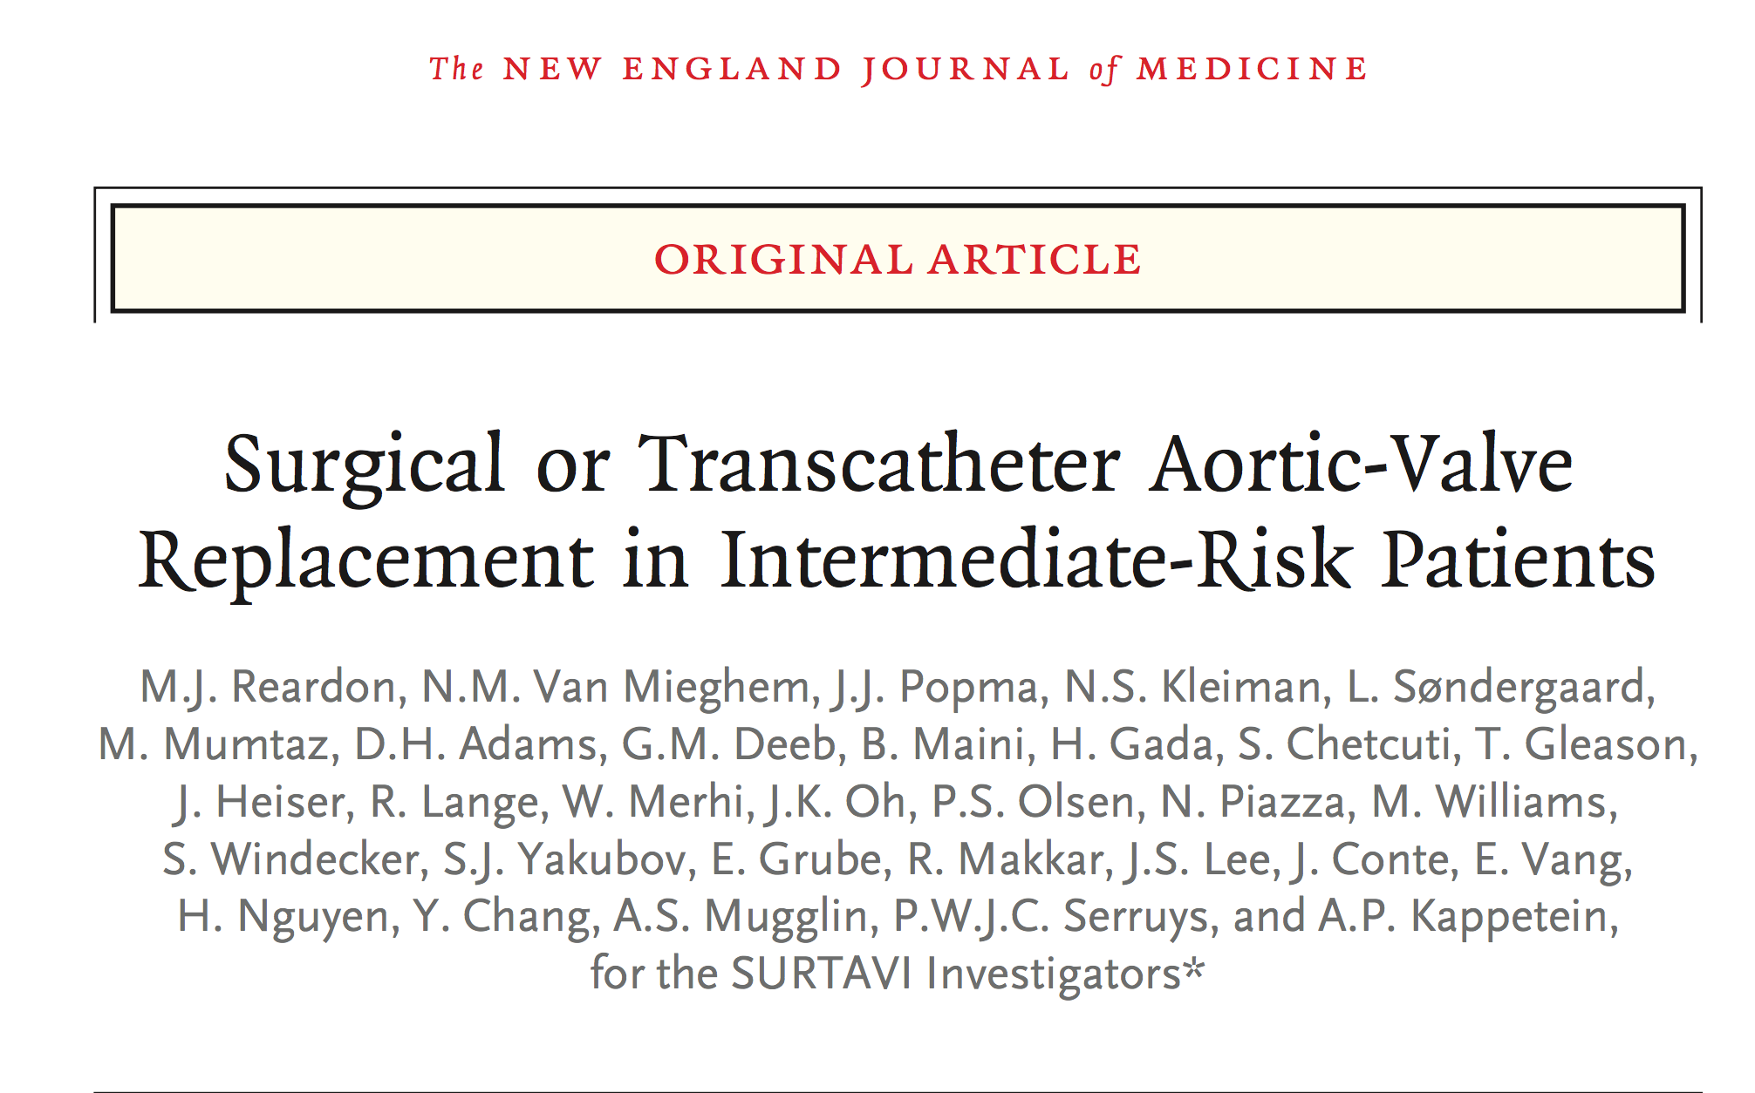
^{March 17, 2017}

Slide 29
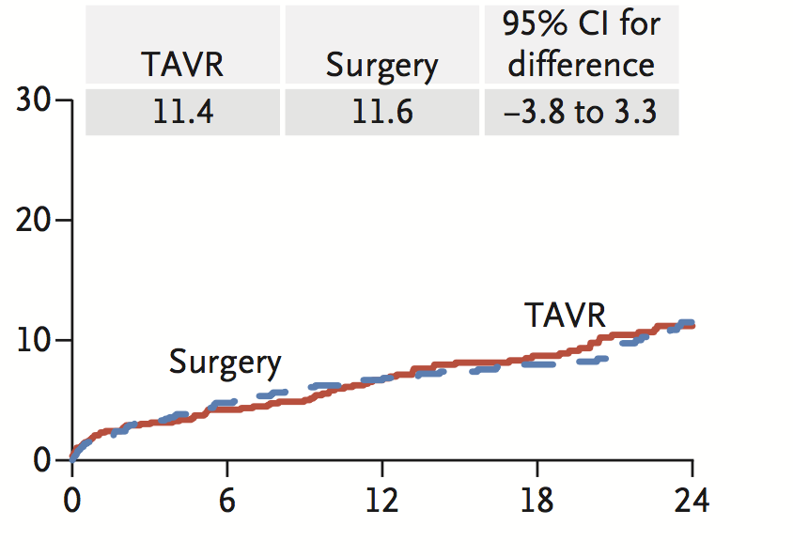
Death from Any Cause
^{Reardon, NEJM, 2017}

Slide 30
INTERMEDIATE RISK
META-ANALYSIS

Slide 31
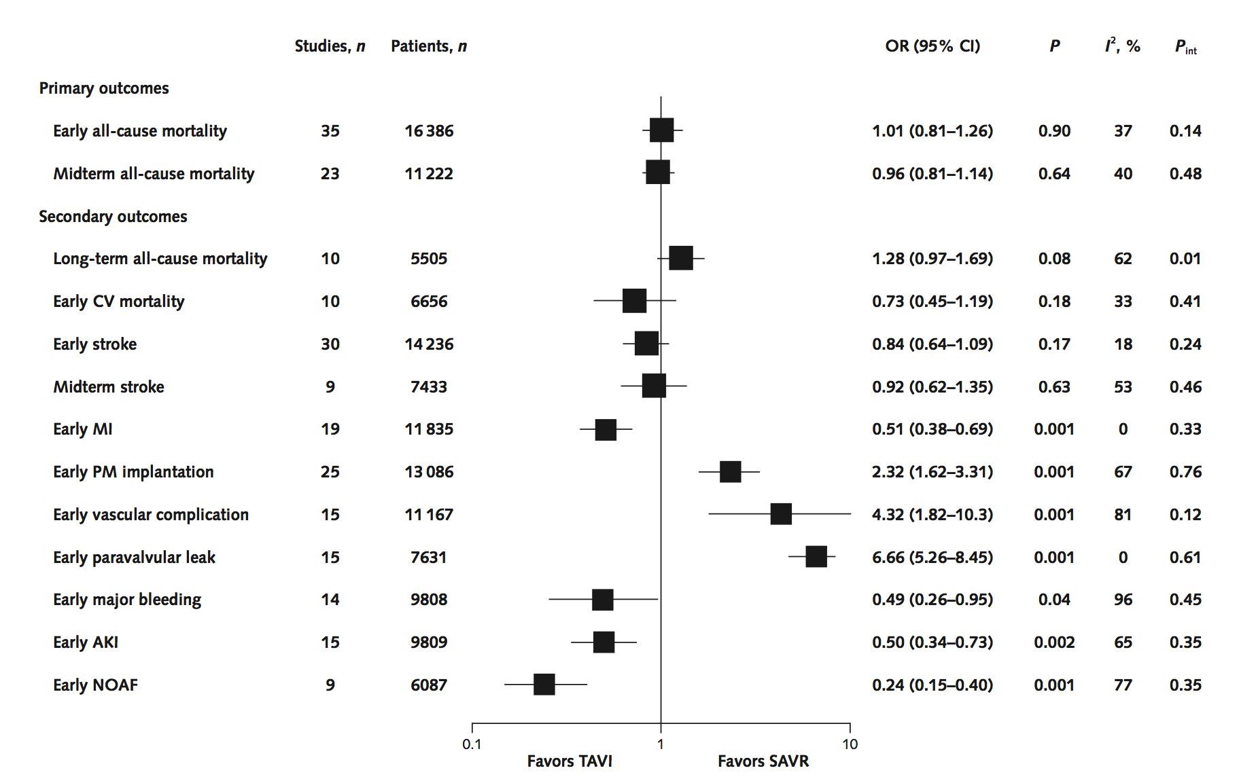
Forest plot for all outcomes in patients with intermediate risk
Gargiulo et al, Ann Intern Med. 2016

Slide 32
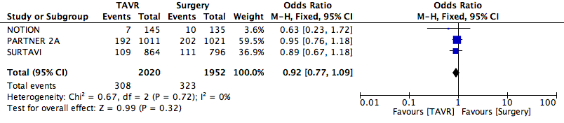
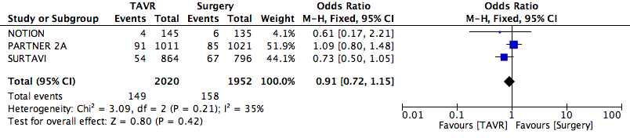
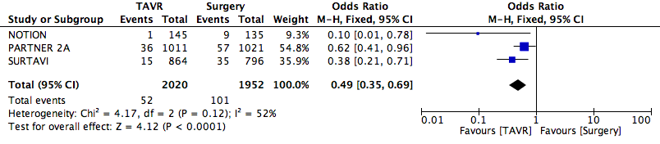
TAVI Vs Surgery: Outcomes in patients with intermediate risk
All-cause death
Stroke
Acute Kidney Failure
Gargiulo 2016

Slide 33
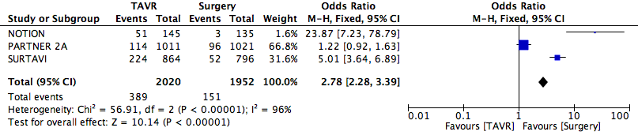
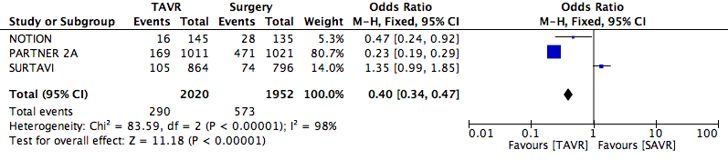
TAVI Vs Surgery: Outcomes in patients with intermediate risk
Pacemaker implantation
Bleedings
Gargiulo et al, Ann Intern Med. 2016

Slide 34
All outcomes in patients with intermediate risk
Gargiulo 2016

Slide 35
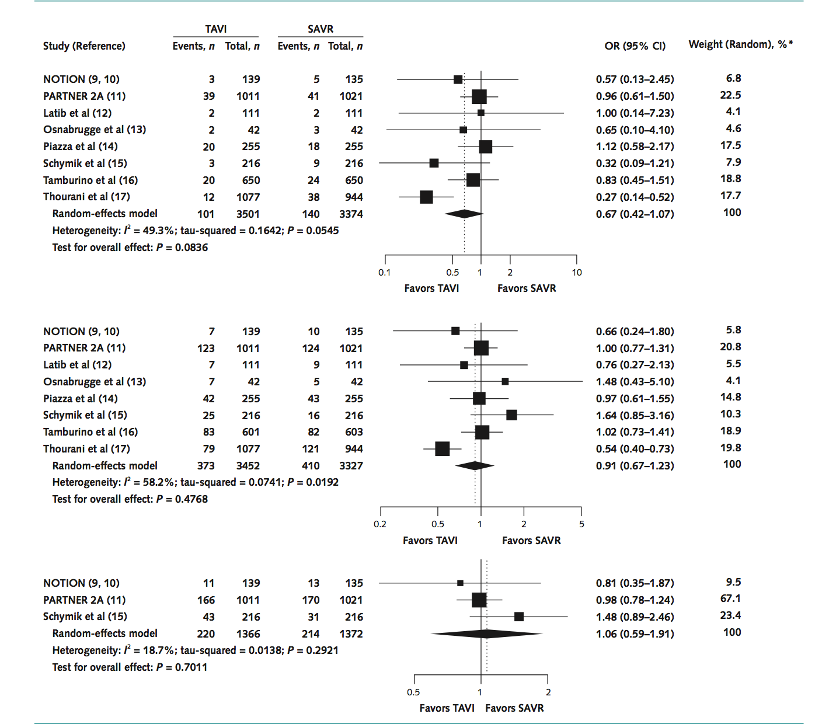
All-cause mortality in the low- to intermediate-risk population
short-term
(30 days)
mid-term
long-term
Gargiulo 2016
Notes:
Knapp–Hartung random-effects OR and 95% CI for 30-day (top), midterm (middle), and long-term (bottom) all-cause mortality in patients at low to intermediate risk. NOTION = Nordic Aortic Valve Intervention; OR = odds ratio; PARTNER = Placement of Aortic Transcatheter Valves; SAVR = surgical aortic valve replacement; TAVI = transcatheter aortic valve implantation.
* Percentages do not sum to 100% for early all-cause mortality because of rounding.
In patients at low to intermediate risk showed a statistically nonsignificant reduction in early (8 studies, 6875 patients; OR, 0.67 [CI, 0.42 to 1.07]) and midterm (8 studies, 6779 patients; OR, 0.91 [CI, 0.67 to 1.23]) mortality with TAVI compared with SAVR. From Gargiulo²⁹.

Slide 36
All-cause mortality in the low- to intermediate-risk population
Gargiulo 2016
Notes:
Knapp–Hartung random-effects OR and 95% CI for 30-day (top), midterm (middle), and long-term (bottom) all-cause mortality in patients at low to intermediate risk. NOTION = Nordic Aortic Valve Intervention; OR = odds ratio; PARTNER = Placement of Aortic Transcatheter Valves; SAVR = surgical aortic valve replacement; TAVI = transcatheter aortic valve implantation.
* Percentages do not sum to 100% for early all-cause mortality because of rounding.
In patients at low to intermediate risk showed a statistically nonsignificant reduction in early (8 studies, 6875 patients; OR, 0.67 [CI, 0.42 to 1.07]) and midterm (8 studies, 6779 patients; OR, 0.91 [CI, 0.67 to 1.23]) mortality with TAVI compared with SAVR. From Gargiulo²⁹.

Slide 37
TRANSFEMORAL OR TRANSAPICAL TAVI ?

Slide 38
Gargiulo et al, Ann Intern Med. 2016

Slide 39
Gargiulo 2016

Slide 40
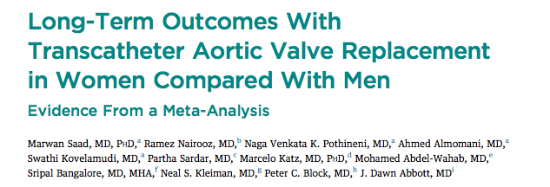
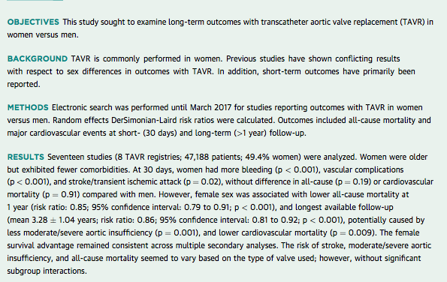

Slide 41
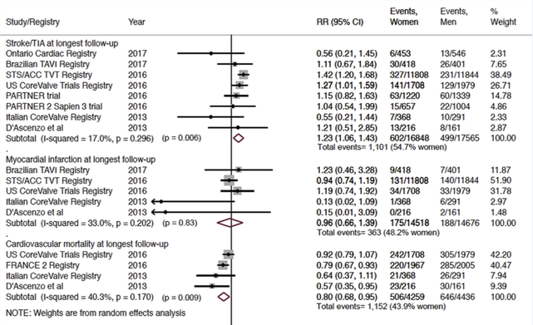
Saad et al, JACC 2017

Slide 42
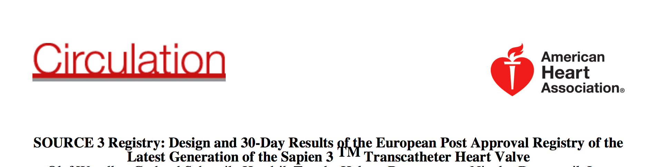
^{January 19, 2017}
30-day Adverse Events Sapien 3
1950 patients from 80 centres in 10 countries
Mean age 81.6 ± 6.6 years, 48.1% female
All-cause mortality: 2.2%
Cardiovascular mortality 1.1%
Stroke 1.4%
Major vascular complication 4.1%
Life-threatening bleeding 5%
Post TAVI pacemaker 12%
Moderate or greater PR 3.1%

Slide 43
What tell us the new ESC Guidelines on TAVI ?

Slide 44
2017 EUROPEAN GUIDELINES ON TAVI
ESC 2017

Slide 45
CONCLUSION
The data from randomized studies, registries, ESC guidelines and patient experience dictate that TAVI, if feasible with transfemoral access, should be the initial therapy of choice.

Slide 46
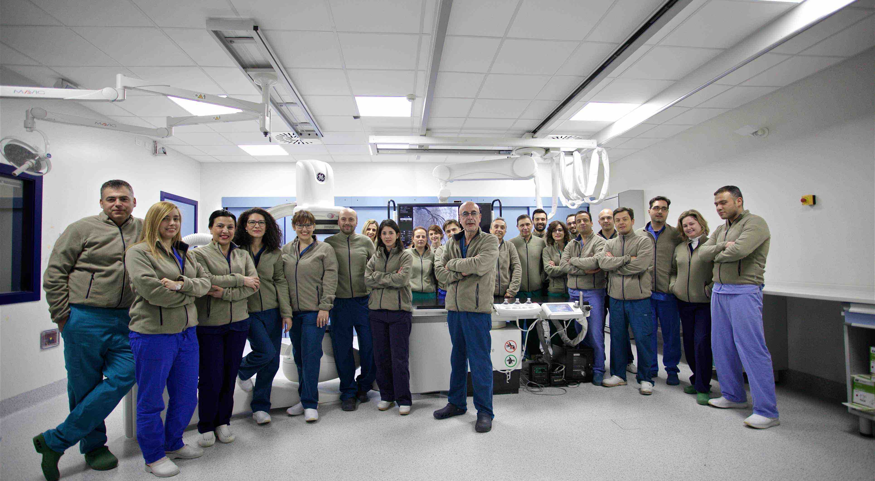
Interventional Team @UMG 2017

