Slide 1
Aderenza alla terapia antipertensiva: è sempre cosa buona e giusta? E nell’anziano?
Andrea Corsonello
IRCCS-INRCA Cosenza

Slide 2
Aderenza alla terapia antipertensiva
“aderenza” al trattamento prescritto?
“aderenza” alle linee guida?

Slide 3
Aderenza alla terapia antipertensiva
“aderenza” al trattamento prescritto?
“aderenza” alle linee guida?

Slide 4
The challenge of prescribing medications in older patients
Comorbidity
Polypharmacy
Interactions
Iatrogenic risk
Medication adherence
Many people are not benefiting properly from the medicines they are prescribed. Additionally, this also represents a costly waste for health services.
Does evidence-based recommendations from disease-specific clinical practice guidelines can be applied to older patients with multiple comorbidity?
Inappropriate medications
Therapeutic goals

Slide 5
Medication adherence risk factors
WHO Report 2003

Slide 6
Medication adherence risk factors

Slide 9
Medication adherence risk factors
Osterberg et al, N Engl J Med 2005

Slide 10
Medication adherence interventions
Osterberg et al, N Engl J Med 2005

Slide 11
Regimen complexity and medication adherence
Corsonello et al, Ther Clin Rsk Manag 2009

Slide 12
Conclusioni
In questo senso l’aderenza è si cosa buona e giusta
Tenere presente la necessità di superare le barriere ad un’aderenza adeguata significa creare un clima di collaborazione con famiglia e caregivers
Tutto questo vale se la prescrizione di farmaci antipertensivi è guidata da…

Slide 13
Aderenza alla terapia antipertensiva
“aderenza” al trattamento prescritto?
“aderenza” alle linee guida?

Slide 14
Clinical practice guidelines and older patients with multimorbidity
Schuling et al. BMC Family Practice 2012

Slide 15
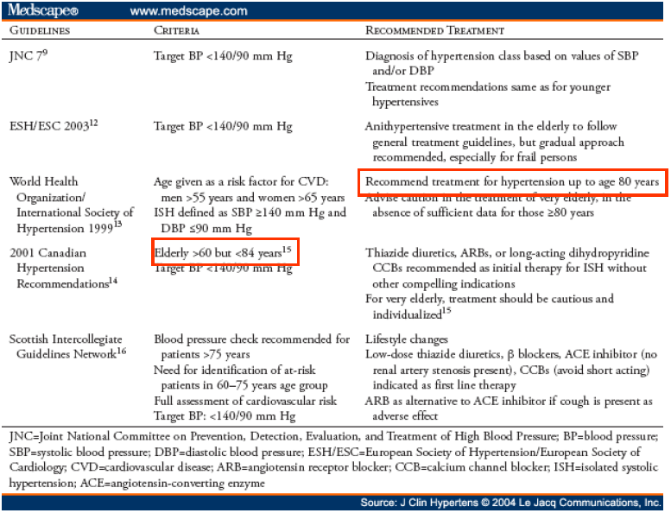

Slide 16
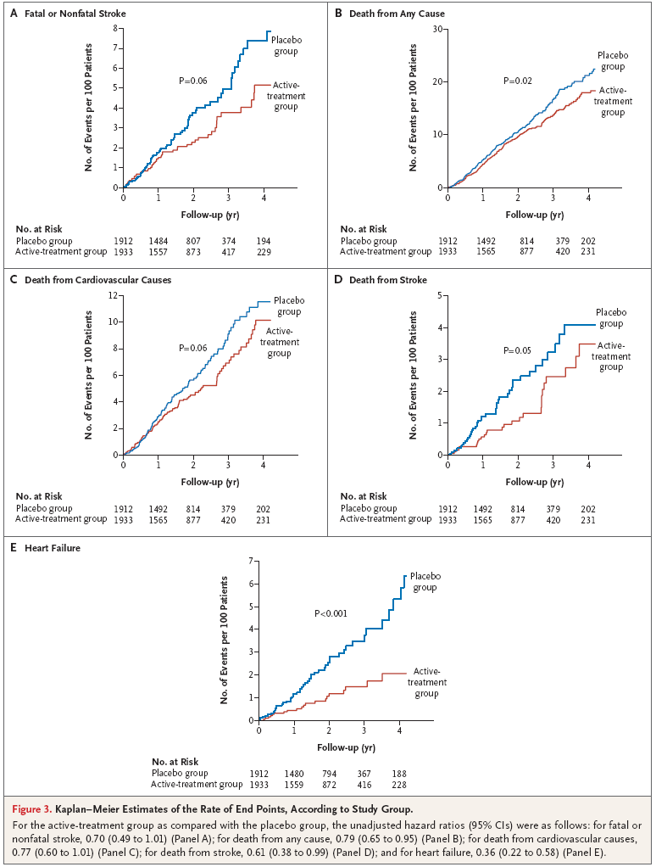
2008 The Hyvet study
Beckett et al, NEJM 2008
Notes:
E i dati erano inequivocabili considerando che sia il rischio di stroke fatale o non fatale che il rischio di morte per stroke si riducevano in maniera significativa, oltre all’evidente impatto su altri outcomes tra cui la mortalità totale.

Slide 17
2008 - The Hyvet study
HYVET provides unique evidence that hypertension treatment based on indapamide (sustained release), with or without perindopril, in the very elderly, aimed to achieve a target blood pressure of 150/80 mm Hg, is beneficial and is associated with reduced risks of death from stroke, death from any cause, and heart failure.
In applying the findings of this trial, we should keep in mind that the patients in HYVET were healthier than normal for their age. Aging affects people to various degrees, depending on inherited characteristics, lifestyle, and disease. Like all clinical trials, those involving old persons with hypertension must also involve individualized treatment that takes into account the factors that are associated with aging as well as individual preference.
The results of HYVET prove that it is not too late to start antihypertensive therapy in older people and expands the upper limit of the age spectrum for which there is evidence from clinical trials of a treatment benefit.
Beckett et al, NEJM 2008
Kostis, NEJM 2008
Notes:
Alcune considerazioni meritano di essere fatte su questo studio. Innanzitutto il target pressorio era 150/80 mmHg, che pare un target di buon senso vista l’età media della popolazione studiata. Visto il target che lo studio Hyvet ha usato ci sarebbe da aspettarsi una riduzione ancora maggiore dei rischi in caso di raggiungimento di target pressori leggermente più bassi. Inoltre, il tipo di trattamento scelto (indapamide come primo step) fa pensare che sia proprio l’effetto di riduzione della PA a determinare i risultati più che la classe di farmaco utilizzato (visto che perindopril era il secondo step terapeutico e non in tutti i pazienti si era reso necessario solo in quelli che non raggiungevano il target previsto dallo studio). Quindi, l’evidenza fornita da questo studio sembra suggerire che non sia mai troppo tardi per iniziare un trattamento antipertensivo e per fare prevenzione in popolazioni che abbiano sufficiente aspettativa di vita nonostante l’età avanzata.

Slide 18
The SPRINT study

Slide 20
The SPRINT study

Slide 21
The SPRINT study

Slide 22
The SPRINT study
However, these analyses should be interpreted cautiously. The analyses were not prespecified in the trial protocol and were possibly underpowered because SPRINT was designed to consider only the ability to detect a treatment effect in participants aged 75 years or older as a whole.

Slide 23
Treatment Initiation
The 2013 ESH/ESC guidelines state that in individuals aged≥80 years with an initial SBP≥160 mm Hg, SBP should be reduced by drug treatment provided that patients are in good physical and mental conditions. We believe that this recommendation should be accompanied by (1) a more precise definition of the meaning of the term good physical and mental conditions and (2) an indication of how physical conditions, mental conditions, and the frailty status can be assessed
Treatment Goals
The 2013 ESH/ESC guidelines recommend treatment to lower SBP to <150 mm Hg in octogenarians in good physical and mental conditions. We believe that this might be usefully complemented by mentioning that, while keeping <150 mm Hg SBP as the evidence-based target, for safety reasons antihypertensive drugs should be reduced or even stopped if SBP is lowered to <130 mm Hg, thus keeping the 150 to 130 mm Hg on-treatment SBP values as a safety range.

Slide 24
Frail Very Old Patients (People Living in Nursing Homes or Needing Assistance on a Daily Basis for Their Basic Activities)
The 2013 ESH/ESC guidelines state that “in frail older patients, it is recommended to leave decisions on antihypertensive therapy to the treating physician, and base them on monitoring of the clinical effects of treatment.” We suggest that in these patients, therapeutic decisions should be preceded by (1) accurate information on their functional capacity, cognitive status. Although notoriously difficult, an estimate of patient’s prognosis should also be attempted; (2) attention to multiple drug administration so common in this age stratum; (3) stratification of the frailty status by one of the available rapid methods; and (4) identification and correction of factors that predispose to an excessive BP reduction, orthostatic hypotension, and other hypotensive episodes, such as concomitant treatments, malnutrition, and dehydration.

Slide 25
Geriatric medicine: is it still evidence-biased medicine?

Slide 26
Geriatric medicine: is it still evidence-biased medicine?

Slide 29
The multi-dimensional health risks of older hypertensive patients

Slide 30
Conclusioni
La generalizzazione delle linee guida alla popolazione anziana non è sempre buona e giusta
Se l’anziano con aspettativa di vita lunga può essere assimilato all’adulto e trattato in maniera aggressiva, dall’altra parte l’anziano complesso con multimorbilità necessita di una approccio “patient-oriented”
Individuazione delle priorità di trattamento
Personalizzazione della terapia
Considerazione delle preferenze del paziente
Facilitazione dell’aderenza alla terapia prescritta

