Slide 1


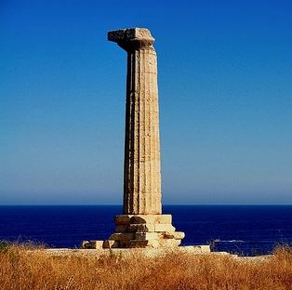

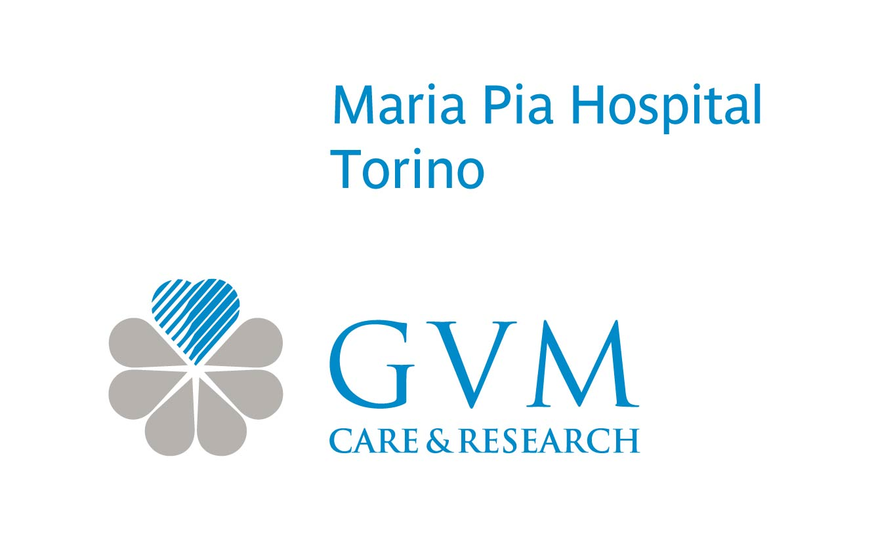
Crotone
14-15 Ottobre 2016
GIORNATE MEDICHE PITAGORICHE
"La complessità delle malattie in età adulta"
TAVI (sostituzione valvolare aortica transcatetere)
Cosa c’è di nuovo?
Prof. Luigi Inglese
DIRETTORE MEDICO
DIPARTIMENTO MALATTIE CARDIOVASCOLARI
MARIA PIA HOSPITAL TORINO

Slide 2
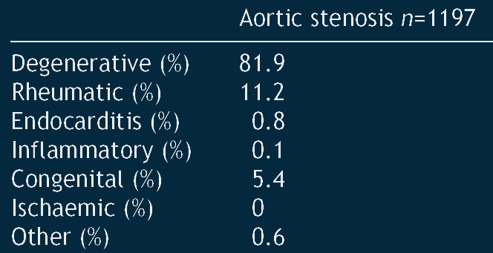
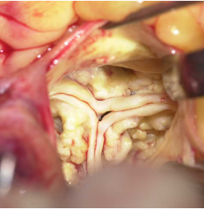

Sostituzione valvolare aortica transcatetere (TAVI)
Cosa c’è di nuovo?
Eziologia della stenosi valvolare aortica
The Euro Heart Survey on Valvular Heart disease
Iung B, EHJ (2003); 24: 1231-1243

Slide 3
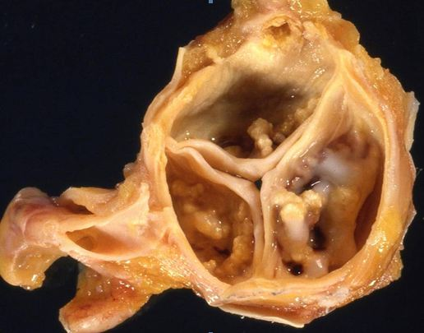
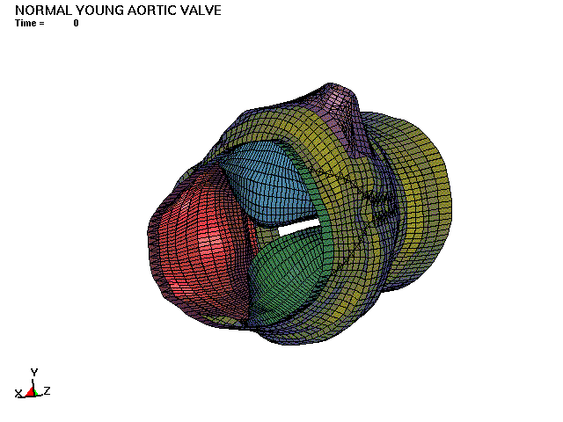
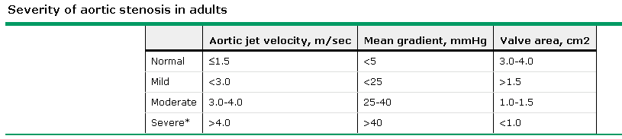
Sostituzione valvolare aortica transcatetere (TAVI)
Cosa c’è di nuovo?
Stenosi valvolare aortica

Slide 4
Sostituzione valvolare aortica transcatetere (TAVI)
Cosa c’è di nuovo?
Prevalence of Valvular Heart Disease
The incidence of valvular heart disease is steeply increasing with age
In a patient population of ≥75 years, the prevalence of valvular aortic stenosis is approximately 8-10% (as shown in a large population-based study)
Nkomo VT, Gardin JM, Skelton TM, Gottdiener JS, Scott CG, Enriquez-Sarano M. Burden of valvular heart diseases: a population-based study. Lancet 2006; 368: 1005-1011

Slide 5

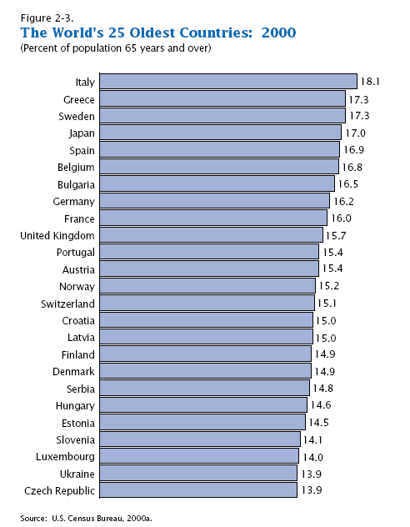
Sostituzione valvolare aortica transcatetere (TAVI)
Cosa c’è di nuovo?
Incremento della popolazione anziana in Italia
< 65 anni
> 65 anni
> 80 anni
2001
2025
2050
Fonte ISTAT

Slide 6
Sostituzione valvolare aortica transcatetere (TAVI)
Cosa c’è di nuovo?
Treatment Options
Conventional
Surgery
TAVI
(TF, TA)
Medical
Treatment
Balloon-
valvuloplasty

Slide 7
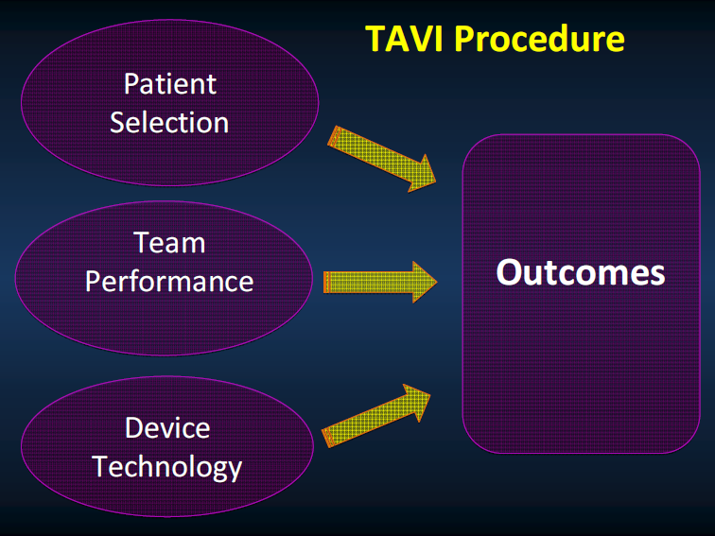
La TAVI trans-femorale
indicazioni e risultati

Slide 8

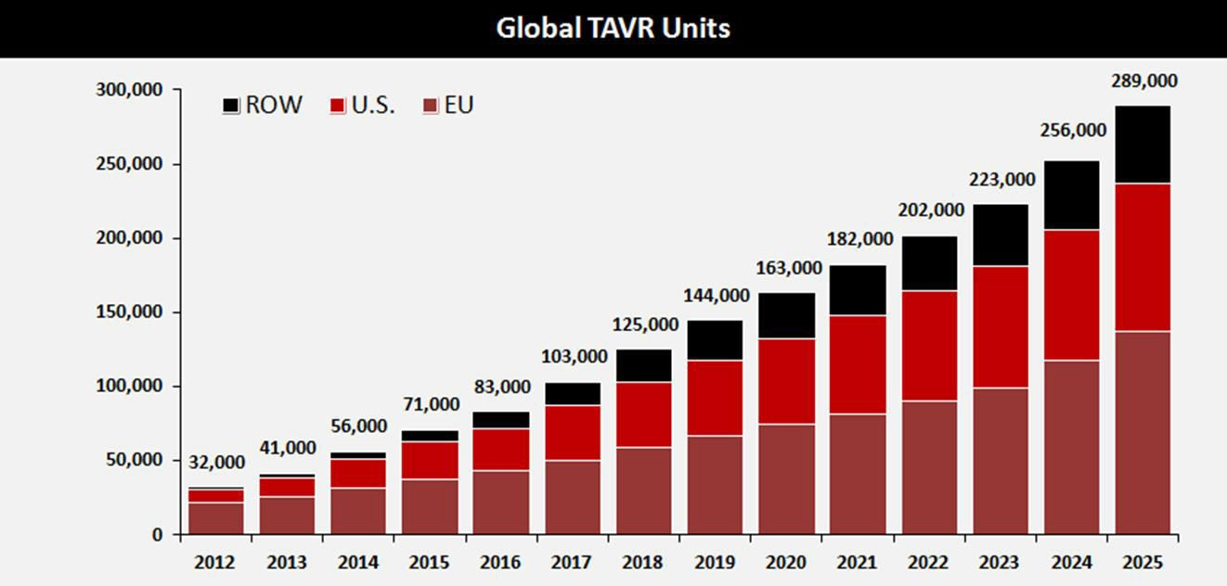

TAVI: Expected Worldwide Growth
Source: Credit Suisse TAVI Comment – January 8, 2015. ASP assumption for 2024 and 2025 based on analyst model. Revenue split assumption in 2025 is 45% U.S., 35% EU, 10% Japan, 10% ROW
In the next 10 years TAVI growth is expected to increase x4

Slide 9
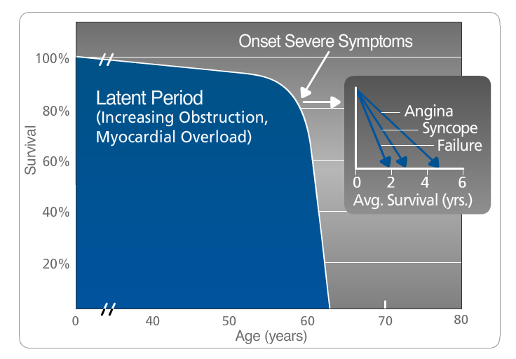
Sostituzione valvolare aortica transcatetere (TAVI)
Cosa c’è di nuovo?
Valvular Aortic Stenosis
Survival after onset of symptoms is 50% at two years and 20% at five years ¹
“Surgical intervention [for severe AS] should be performed promptly once even…minor symptoms occur” ²
C.M. Otto, “Valve Disease: Timing of Aortic Valve Surgery,” Heart 2000
Braunwald E. Aortic Stenosis. Circulation 1968; 38 (Suppl 1): 61-67
¹ S.J. Lester et al., “The Natural History and Rate of Progression of Aortic Stenosis,” Chest 1998

Slide 10
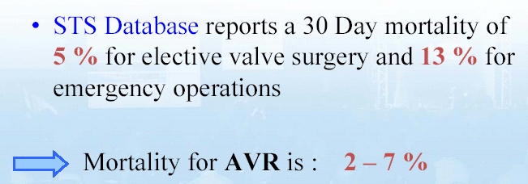
Sostituzione valvolare aortica transcatetere (TAVI)
Cosa c’è di nuovo?
Current status of cardiac surgery

Slide 11
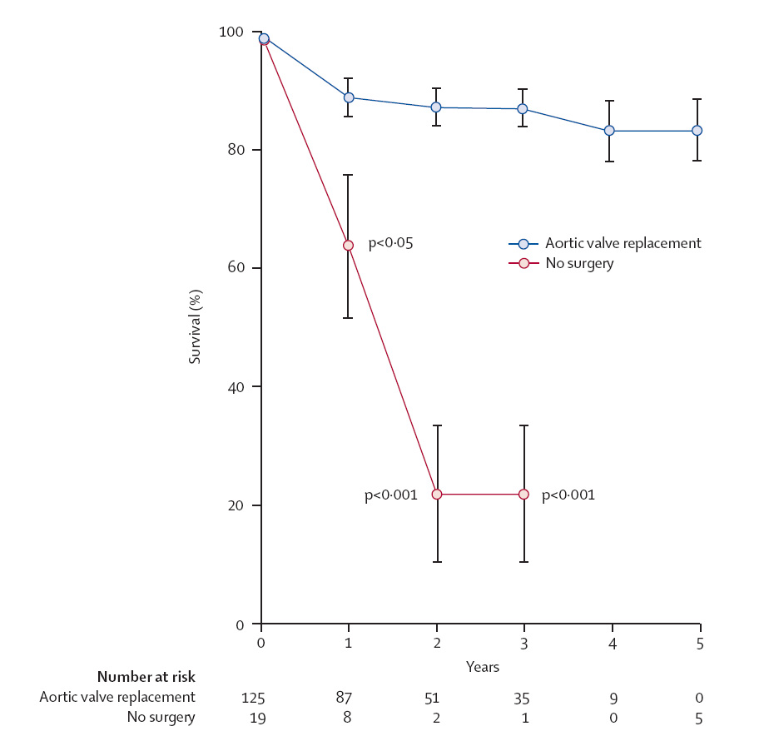


Sostituzione valvolare aortica transcatetere (TAVI)
Cosa c’è di nuovo?
Mean survival of patients with symptoms of AS
L. Menicanti
A. Frigiola
Schwarz F. Circulation 1982; 66: 1105–1110

Slide 12
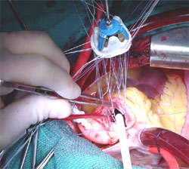
Sostituzione valvolare aortica transcatetere (TAVI)
Cosa c’è di nuovo?
Aortic Valve Replacement (AVR)
In the absence of serious comorbid conditions, AVR is indicated in “virtually” all symptomatic pts with severe AS
Because of the risk of sudden death, AVR should be performed promptly after the onset of symptoms
Age is not a contraindication to surgery
ACC/AHA 2006 guidelines for the management of patients with valvular heart disease: a report of the American College of Cardiology/American Heart Association Task Force on Practice Guidelines (Writing Committee to Develop Guidelines for the Management of Patients With Valvular Heart Disease)

Slide 13

Sostituzione valvolare aortica transcatetere (TAVI)
Cosa c’è di nuovo?
Sostituzione valvolare aortica (AVR)
Assistiamo progressivamente all’invecchiamento della popolazione con indicazione a sostituzione valvolare aortica
Il paziente anziano ha
    maggiori patologie associate
    peggiori condizioni cliniche generali
    peggiori condizioni psicologiche
    ridotta autonomia
    ridotta mobilità
Questi pazienti possono tollerare l’intervento ma non le complicanze

Slide 14
Sostituzione valvolare aortica transcatetere (TAVI)
Cosa c’è di nuovo?
No Surgery
Surgery
≈ 33% of pts with severe symptomatic AS (requiring AVR) are considered too old for an invasive procedure, or because they are affected by concomitant co-morbidities that noticeably increase the operative risk (too high risk for hospital mortality and/or onset of severe postoperative complications . Fraility is a major psycological problem in denihing possible surgery.
Bouma et al. Heart 1999;82:143-148
Iung et al. Eur Heart J 2005;26:2414-2720
Pellikka et al. Circulation 2005;111:3290-3295
Charlson et al. J Heart Valve Dis 2006;15:312-321
Bach et al. J Am Coll Cardiol 2007;50:2018-2019

Slide 15
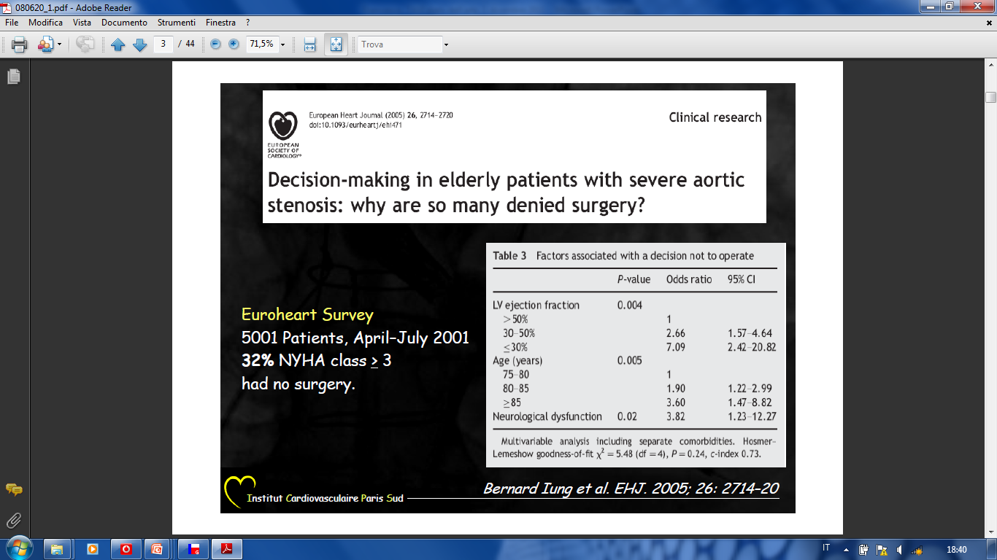
Sostituzione valvolare aortica transcatetere (TAVI)
Cosa c’è di nuovo?
The Euro Heart Survey
5001 pts (April-July 2001)
32% NYHA Class ≥ 3 had no surgery
Iung B et al. EHJ 2005; 26: 2714-2720

Slide 16
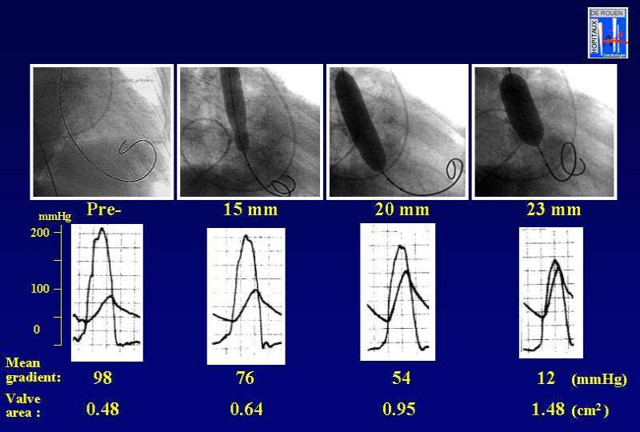
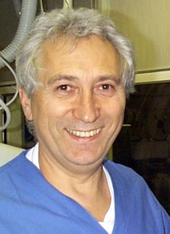
Sostituzione valvolare aortica transcatetere (TAVI)
Cosa c’è di nuovo?
Percutaneous Aortic Valve Ballooning (Valvuloplasty)
« tra il 1983 e la metà degli anni ‘90 ho effettuato circa 100 procedure di valvuloplastica aortica per patologia stenotica (in pazienti pediatrici ed adulti)»
« nella popolazione adulta la procedura era gravata da un tasso di restenosi elevata a 3 mesi»
…« per questa ragione, tale procedura, sia in Italia che in Francia (dr. Cribier), è stata poi progressivamente abbandonata”…»
L. Inglese

Slide 17
Sostituzione valvolare aortica transcatetere (TAVI)
Cosa c’è di nuovo?
“Revival” della valvuloplastica Aortica
“Ponte” alla Chirurgia (“brigde to surgery”) o alla TAVI (“bridge to TAVI”)
  Area valvolare <0.4 cmq
  FE <35%
  Classe NYHA IV
Pazienti in scompenso cardiaco refrattario e disfunzione multi-organo
Pazienti in shock
Pazienti sintomatici che devono essere sottoposti ad interventi chirurgici urgenti per altra patologia
Indicazioni
(raccomandazione di classe IIb, livello di evidenza C)
(raccomandazione di classe IIb, livello di evidenza C)

Slide 18
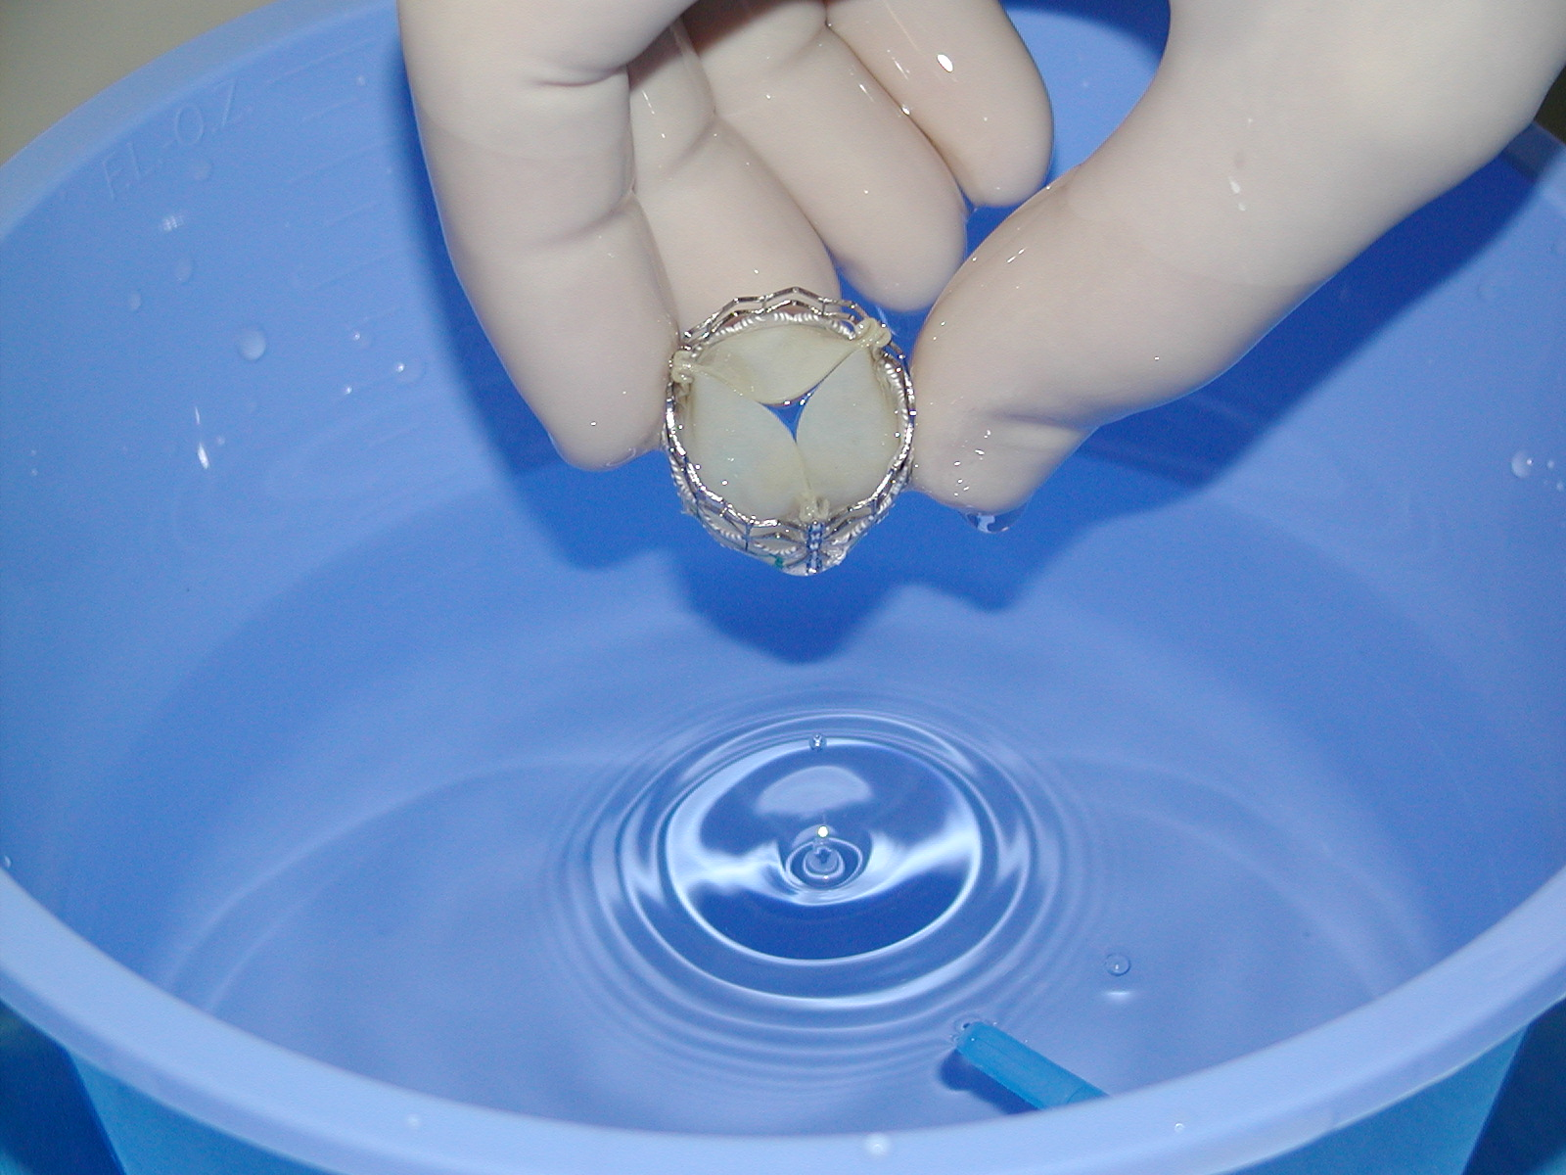
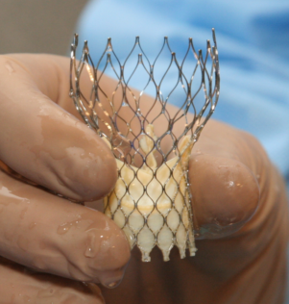
2
Sostituzione valvolare aortica transcatetere (TAVI)
Cosa c’è di nuovo?
Current status of TAVI
Edwards SAPIEN family
CoreValve

Slide 19

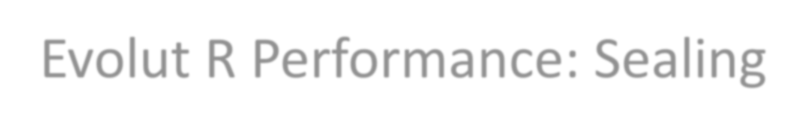
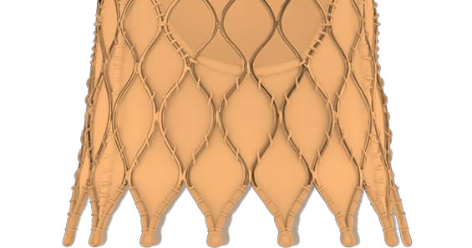
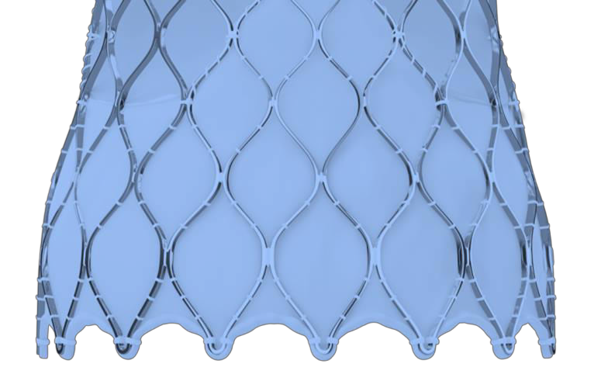
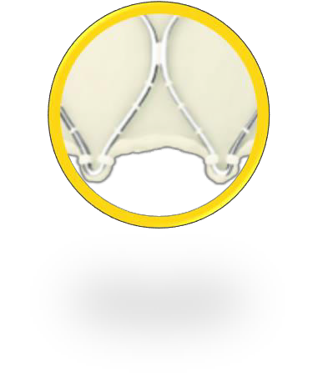

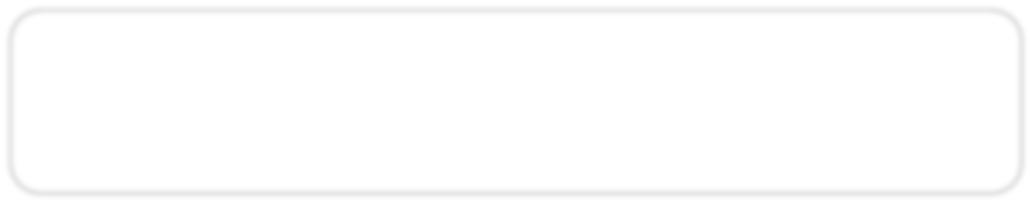
Evolut R Performance: Sealing
Enhanced Sealing with a More Conformable Frame *
Increased Oversizing
More Consistent Radial Force
Extended Sealing Skirt
CoreValve 29 mm
Evolut R 29 mm
Low Rate of Moderate & Severe PVL**
Note: images may not be to exact scale and are for illustration purposes only.
*CoreValve Evolut R 26 and 29 mm only
**CoreValve Evolut R CE Study - 30 days

Slide 20

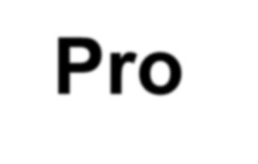

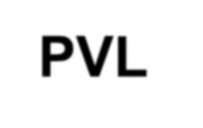
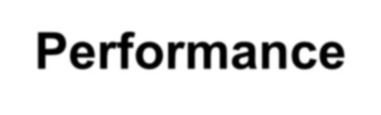
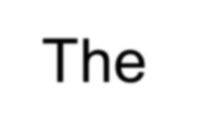
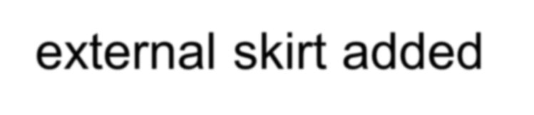

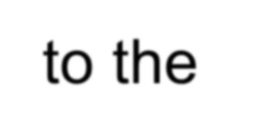
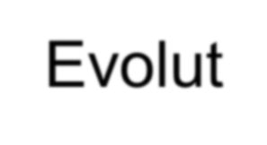
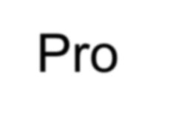
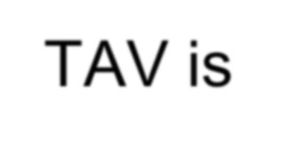
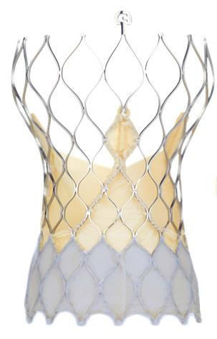
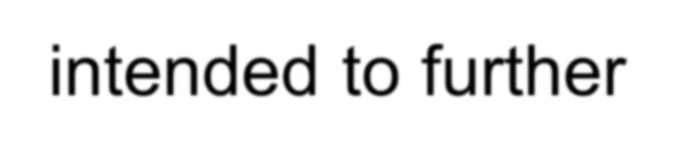
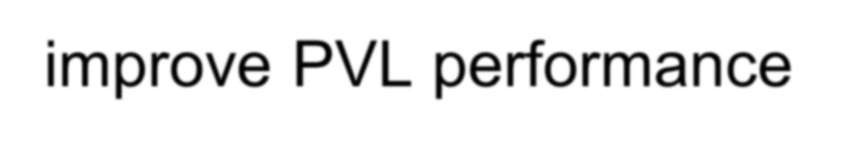
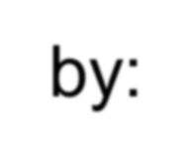
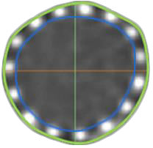
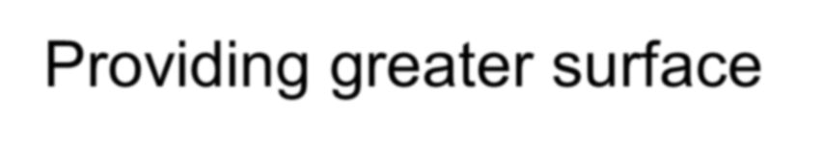
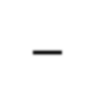
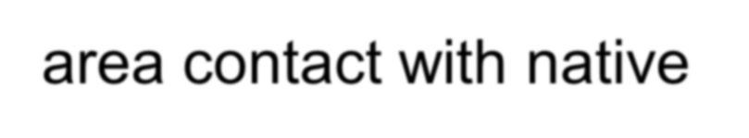
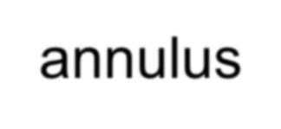
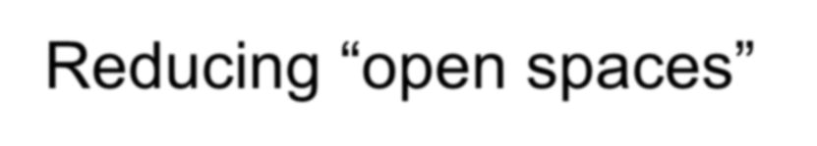
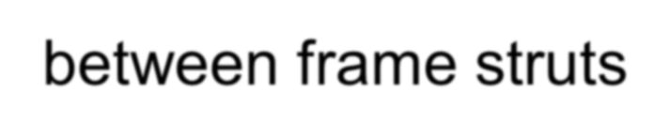
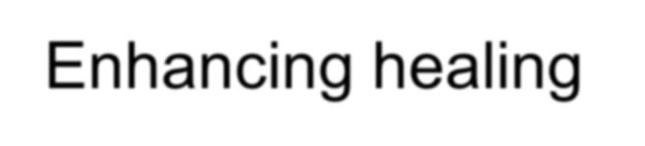
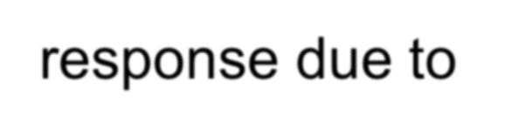
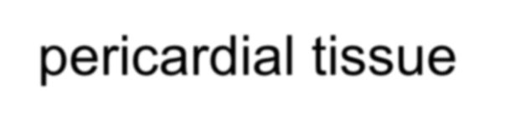
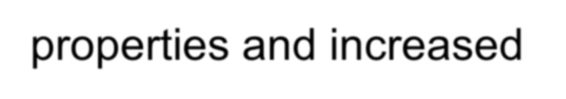
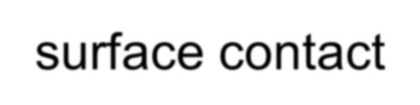
Evolut Pro Bioprosthesis
PVL Performance
The external skirt added to the Evolut Pro TAV is intended to further improve PVL performance by:
  Providing greater surface area contact with native annulus
  Reducing “open spaces”
between frame struts
  Enhancing healing
Reduced
Open Space
response due to pericardial tissue properties and increased surface contact
Greater Surface Area
8

Slide 21
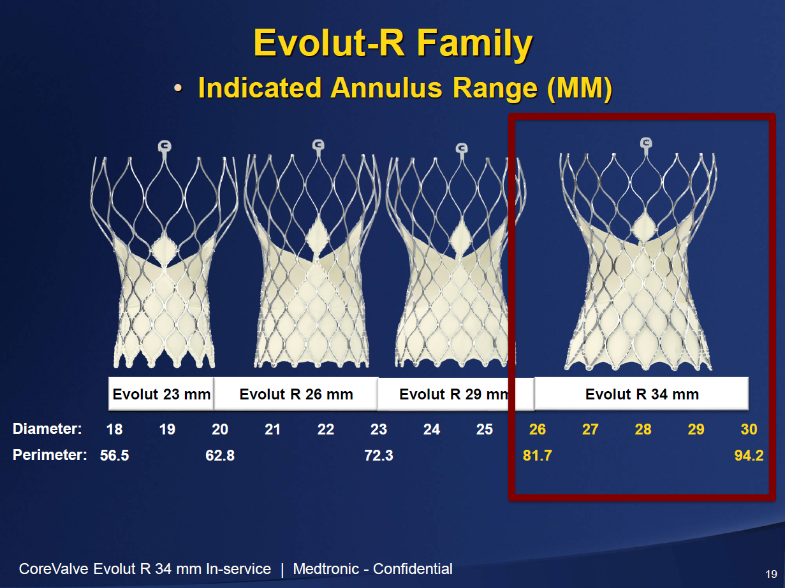

Slide 22





Sostituzione valvolare aortica transcatetere (TAVI)
Cosa c’è di nuovo?
Balloon Expandable Delivery

Slide 23


Sostituzione valvolare aortica transcatetere (TAVI)
Cosa c’è di nuovo?
SAPIEN XT

Slide 24









The Edwards SAPIEN 3 Ultra System
Further Streamlines the TAVI Procedure
SAPIEN 3 Valve
SAPIEN 3 Ultra
Delivery System
Axela Sheath
On-balloon design - removes valve alignment step
14F compatible for all valve sizes including the 29mm
Pusher eliminated - reduces steps required during deployment
Seamless sheath design
CE Mark Approval Expected in 2H 2017
SAPIEN 3 Ultra System and Axela Sheath are not approved for sale.

Slide 25


How SAPIEN 3 delivers these game changing outcomes
Events associated with increased mortality:
1.
Significant
PVL
2.
Major Vascular
Complications
3.
Life-Threatening Bleeding
4.
Acute Kidney Injury
5.
Disabling Stroke

Slide 26











Edwards Portfolio of Balloon Expandable and
Self-Expanding Devices
Balloon-expandable Pipeline
SAPIEN
SAPIEN XT
SAPIEN 3
Next-
Generation
SAPIEN
Future
2007
2010
2020
Self-expanding Pipeline
CENTERA
Next-
Generation
CENTERA
Future
15

Slide 27

Sostituzione valvolare aortica transcatetere (TAVI)
Cosa c’è di nuovo?

Slide 28

LOTUS Edge System
Designed to improve deliverability
Key features of the Lotus Valve are conserved including:
Full Repositionability
Full Retrievability
Adaptive Seal™
New Features
Increased flexibility, trackability, and coaxial alignment
Enhanced delivery and
deployment
LOTUS Edge
Lotus

Slide 29





LOTUS Edge Valve System Features
Design Feature | Current Lotus | LOTUS Edge
Delivery System | Pre-shaped | Flexible Pre-shaped
Sheath | 18-20 F | 14-15 F iSleeve
Locking
Verification
Multiple views
Single view
21mm, 23mm, 25mm,
27mm, 29mm
Valve Sizes
23mm, 25mm, 27mm
-
+
DepthGuard
UUnnddeer rdedveevleolpompemnet,nnto,tnaovtaailavbalielafbolresfaoler sale. *Subclavian access & bicuspi indication n planning ta es.

Slide 30
Summary Edge
Full Repositionability/Retrievability and Adaptive Seal
Smaller profile, more flexible delivery catheter with improved
deliverability
14-15F Expandable sheath allowing 5.5mm vascular access
Improved visualization of locking process (simplified locking)
DepthGuard technology with improved deployment

Slide 31



Sostituzione valvolare aortica transcatetere (TAVI)
Cosa c’è di nuovo?
The transfemoral approach (TF)
T.E. 82 aa
PSD Cath Lab
18-05-2010

Slide 32



Sostituzione valvolare aortica transcatetere (TAVI)
Cosa c’è di nuovo?

Slide 33




Sostituzione valvolare aortica transcatetere (TAVI)
Cosa c’è di nuovo?
Left anterolateral mini-thoracotomy through the 5th or the 6th intercostal space
After opening the pericardium, typically two concentric purse string sutures (2-0 or 3-0 polypropylene sutures with 1×0.5 cm large Teflon pledgets) have to be prepared on the left lateral wall of the cardiac apex
33F
26F
24F
22F
Ascendra 1
Ascendra 2

Slide 34


Sostituzione valvolare aortica transcatetere (TAVI)
Cosa c’è di nuovo?
The transapical approach (TA)
B.A.A. 82 aa
PSD OR
21-07-2010

Slide 35





Sostituzione valvolare aortica transcatetere (TAVI)
Cosa c’è di nuovo?
Patient-Focused Multidisciplinary Heart Team Approach
Radiologist
Echocardiographist
Cardiologist
Cardiac Surgeon
Anesthesiologist
Patient
Selection
Successful THV PROGRAM
Patient Management
Quality Visualization
Procedure Planning

Slide 36
Estensione della TAVI?
Low flow-low gradient con
    EF severamente ridotta
    scarsa / assente risposta alla dobutamina
Valve in valve per bioprotesi degenerata
Popolazione a medio rischio (dopo studi clinici randomizzati?)

Slide 37





Sostituzione valvolare aortica transcatetere (TAVI)
Cosa c’è di nuovo?
RCA
LM
Paravalvular
Leak (PVL)
Below
Above

Slide 38
Sostituzione valvolare aortica transcatetere (TAVI)
Cosa c’è di nuovo?
Impatto sulla mortalità legato al rigurgito aortico
20
18
P < 0.001
16
14.1
14
12
In-hosptial Mortality %
10
8
6
5.9
4
2
0
Residual AI 0-I (82%)
Residual AI ≥ II (18%)
Zahn R. The German TAVI Registry, EuroPCR 2010

Slide 39

Sostituzione valvolare aortica transcatetere (TAVI)
Cosa c’è di nuovo?

Slide 40


Slide 41




Why optimizing TAVI ?
TAVI volume is increasing steadily with moderate reduction in SAVR**
- Germany -
The trend is expected to continue due to
the positive results for lower risk patients
- Germany -
TAVR SAVR
16000
15594
10441 ₉₈₉₉ |  |  |  |  | 9953 |  |  | 9502
13264
12000
8000
4000
0
2013
2014
2015
TAVI
SAVR
Patients 75– 79 yr of Age
**AQUA database- Aortenklappenchirurgie, isoliert (Kathetergestützt) – IQTIG May 2016
Reinöhl et al; N Engl J Med; Volume 373(25):2438-2447; December 17, 2015

Slide 42
Why optimizing TAVI ?
Waiting time EU countries varies by
country with avg = 8 weeks*
(18 centers : UK, FR, SP, Pt, NL)
80
60
40
20
0
Increasing TAVI numbers have a massive
effect on health care expenses
- Germany -
+ 50%
400
200
0
Overall UK Median (25-75%)
F E+P NL
Average (stand. dev.)
2013 2014 2015
TAVI in-hospital costs
(health care payer perspective)
*2015 Survey in 18 centers in France, the Netherlands, Portugal, Spain, and the United Kingdom

Slide 43


TAVI leaflet coaptation
The clinical importance of THV eccentricity or underex- pansio
is unknown
However, there is indirect evidence to suggest that valve distortion may lead to accelerated calcification and fibrosis in an animal model.
Wilson et al J Am Coll Cardiol Intv 2012;5:525–32 van Nooten et al J Heart Valve Dis 1999;8: 34–41. Mohammadi et al J Thorac Cardiovasc Surg 2006;132:401–6

Slide 44




TAVI failures
TAVI failures have been described in the literature: 87 pts
(between 2002 to 2014)
Mylotte et al Eur Heart J. 2015;36:1306-27.

Slide 45







Remaining Issues
Mortality
SAPIEN 3 TAVI compared with Surgery in Intermediate-Risk Patients:
A Propensity Score Analysis
16.6%
8.4%
8.0%
2.0%
Thourani et al Lancet 2016;387:2218-25

Slide 46







Remaining Issues
Mortality
Mortality all-cause at 1 year
TAVI SAVR
35
30,7
26,8
24,9
30
25
22,1
25
19,1
20
15,9
12,3
14,2
15
13
10
7,4
5
0
P IB(TF)
P IA
P IA(TF)
CoreValve
P 2A(TF)
S3

Slide 47






Remaining Issues
STROKE
Stroke 1 year
TAVI SAVR
12
10,6
10
8,3
8
5,8
5,9
4,3
5
6
4
2,3
2
0
P IB(TF)
P IA
P 2A
S3

Slide 48


Remaining Issues
STROKE
Lower profile while traversing the arch and crossing the
native valve
Less post-dilation
Less manipulation within the annulus

Slide 49






Remaining Issues
Major vascular
complication
Major vascular complication 30 days
16,2
TAVI SAVR
18
16
14
12
10
8
6
4
2
0
11
7,9
5
6,1
5,4
3,2
P IB(TF)
P IA
P 2A
S3

Slide 50




Remaining Issues
Paravalvular
regurgitation
Moderate to severe AR 30 days
14
12
10
8
6
4
2
0
12
12,2
3,8
3,8
P IB(TF)
P IA
P 2A
S3

Slide 51


Slide 52

Sostituzione valvolare aortica transcatetere (TAVI)
Cosa c’è di nuovo?
Conclusioni
“San Girolamo nello studio”, Antonello da Messina (1474-1475), National Gallery (London)

Slide 53
Conclusion
The results of these new trials seem set to change everyday practice, encouraging the use of TAVI as a better option to SAVR in intermediate risk subjects
These data provide robust evidence required for modification of ESC guidelines to endorse wider and more liberal use of TAVI in symptomatic severe aortic stenosis.

