Slide 1
TRIAL HIGHLIGHT FROM ESC 2016: ACUTE CORONARY SYNDROMES
Antonio G. Rebuzzi
Catholic University – Gemelli Hospital
Rome

Slide 2
Main studies about ACS presented at ESC 2016
Area of research
Intracoronary imaging (DOCTORS, EROSION)
DAPT in elderly or STEMI (ANTARCTIC, LEADERS FREE, PRAGUE 18)
Secondary prevention (IMPROVE IT, HIJ-PROPER, AMERICA)
Reperfusion in STEMI (NACIAM)
5) Early invasive approach in NSTEMI (FRISC 2)
6) MINOCA (Swedheart registry)

Slide 3
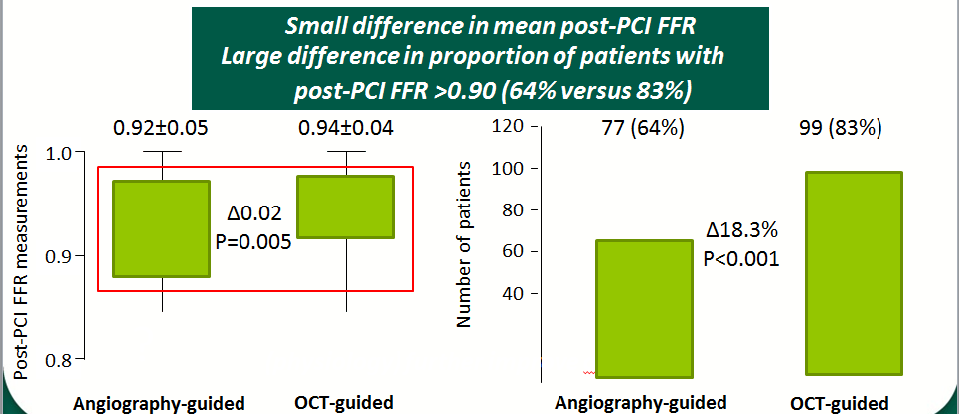
Optical Coherence Tomography to Optimize Results of Percutaneous Coronary Intervention in Patients with Non–ST-Elevation Acute Coronary Syndrome Results of the Multicenter, Randomized DOCTORS (Does Optical Coherence Tomography Optimize Results of Stenting) Study
NSTE-ACS patient (N=1935)
Key inclusion criteria:
Single lesion on the culprit artery
without diffuse disease within the same vessel
NSTE-ACS patient (N=240)
OCT-guided (N=120)
Angiography-guided (N=120)
Meneveau N et al, Circulation 2016

Slide 4
Effective anti-thrombotic therapy without stenting: intravascular optical coherence tomography-based management in plaque erosion (the EROSION study)

Slide 5
EROSION study

Slide 6
Platelet function monitoring to adjust antiplatelet therapy in elderly patients stented for an acute coronary syndrome (ANTARCTIC): an open-label, blinded-endpoint, randomised controlled superiority trial
Largest randomized PCI study in the elderly
Platelet function monitoring to adjust antiplatelet therapy in elderly patients stented for an ACS does not improve their clinical outcomes (ischemic, bleeding or net clinical benefit)
Platelet reactivity is at best a modifiable marker of risk
ESC guidelines still recommend (class IIb, LOE C) platelet function monitoring in high risk situations: ANTARCTIC does not support this recommendation
Cayla G et al, Lancet 2016

Slide 7
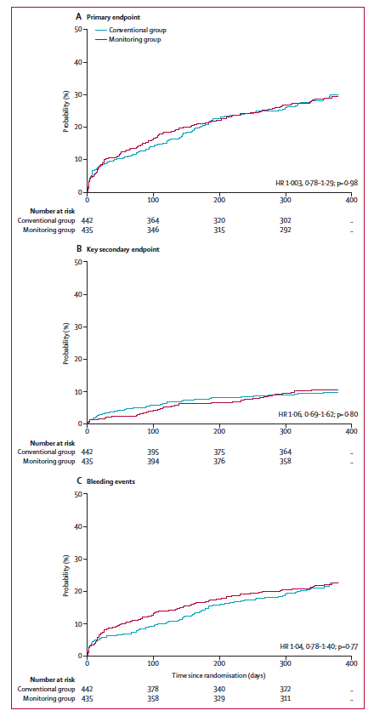
ANTARCTIC study: main results
Cayla G et al, Lancet 2016

Slide 8
Biolimus-A9 polymer-free coated stent in high bleeding risk elederly patients: a Leaders Free ACS sub-study
Morice MC et al, ESC 2016

Slide 9
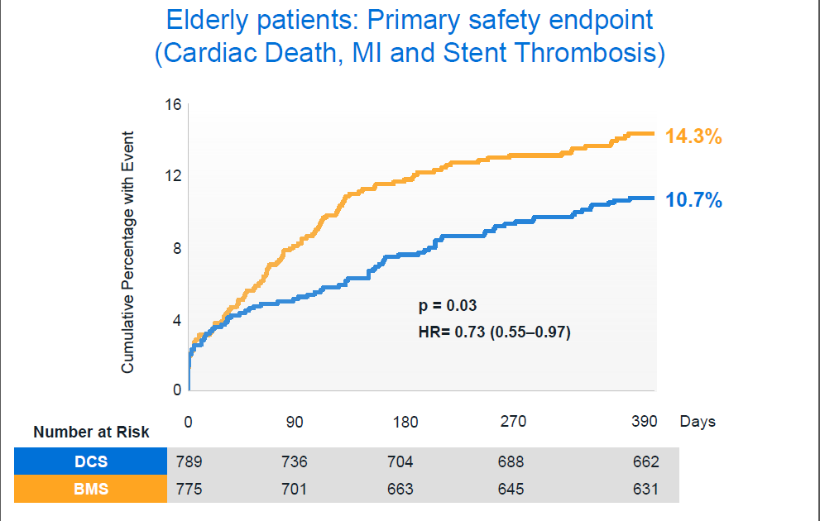
LEADERS free elderly substudy
Morice MC et al, ESC 2016

Slide 10
Prasugrel versus Ticagrelor in Patients with Acute Myocardial Infarction Treated with Primary Percutaneous Coronary Intervention: Multicenter Randomized PRAGUE-18 Study.
Primary end-point:
Combined end-point at 7 days
(or at discharge if earlier):
• Death
• Re-infarction
• Stroke
• Major bleeding
• Urgent IRA revascularization
Motovska Z et , Circulation 2016

Slide 11
IMPROVE-IT study

Slide 12
The Benefit of Adding Ezetimibe to Statin
Therapy in Patients with Prior Coronary
Artery Bypass Graft Surgery in the IMPROVE
-IT Trial
Eisen A et al, ESC 2016

Slide 13
Hagiwara N et al, ESC 2016

Slide 14
Hagiwara N et al, ESC 2016

Slide 15
Hagiwara N et al, ESC 2016

Slide 17
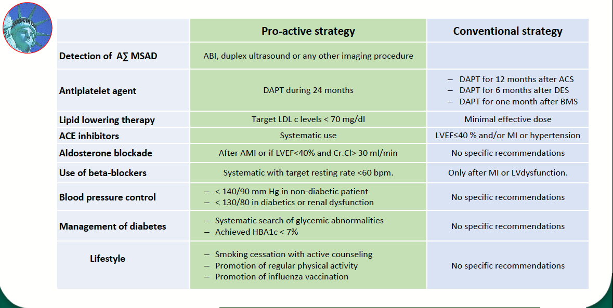

Slide 19
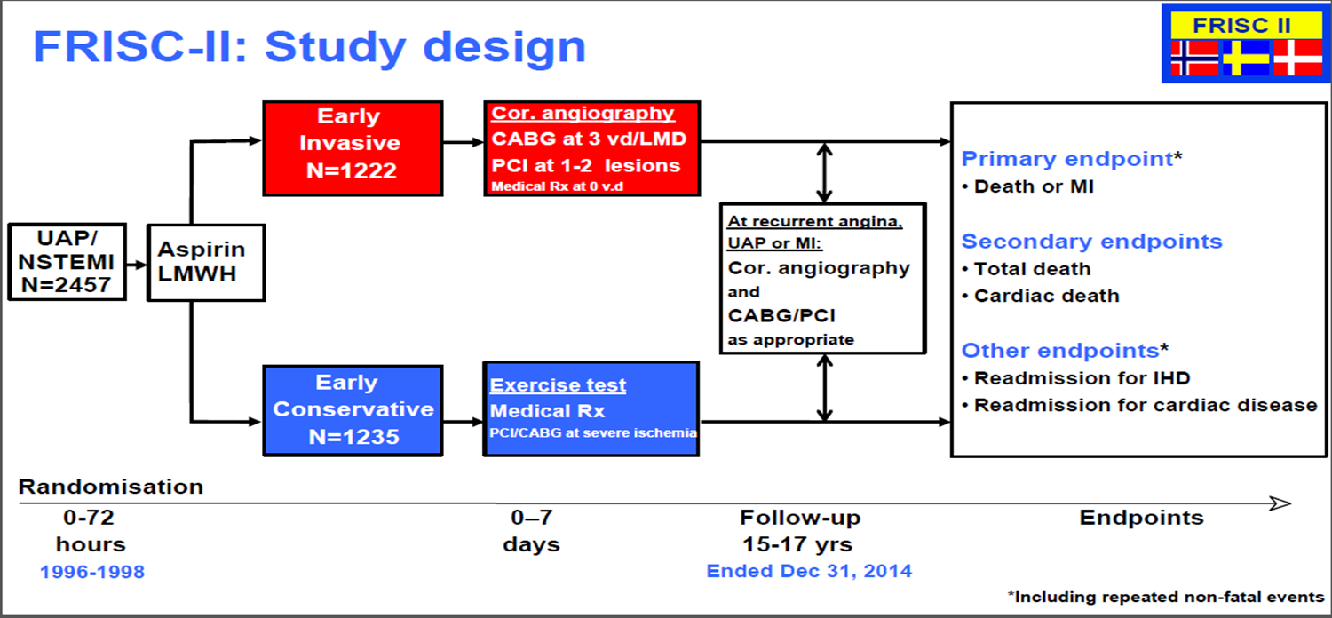
Early invasive versus non-invasive treatment in patients with non-ST-elevation acute coronary syndrome (FRISC-II): 15 year follow-up of a prospective, randomised, multicentre study
Wallentin L et al, Lancet 2016

Slide 20
Early invasive versus non-invasive treatment in patients with non-ST-elevation acute coronary syndrome (FRISC-II): 15 year follow-up of a prospective, randomised, multicentre study
Wallentin L et al, Lancet 2016

Slide 21
Pasupathy S et al, ESC 2016

Slide 23
Pasupathy S et al, ESC 2016

Slide 26
CONCLUSIONS
Many study presented regarding ACS aiming at better management (timing of therapy, new therapies, post discharge prevention)
Precison medicine concept in many study design (elderly, post-CABG, erosion)
New data on area with less coverage (MINOCA) that stimulate additional research

