Slide 1


Angina Refrattaria
ISTRUZIONI PER L’USO
Dott. Luca GRANCINI
Centro Cardiologico
Fondazione 'Monzino', Milano

Slide 2
Definizione
Refractory angina (RA)
is conventionally defined as a chronic condition (≥3 months in duration) characterised by angina in the setting of coronary artery disease (CAD), which cannot be controlled by a combination of optimal medical therapy, angioplasty or bypass surgery, and where reversible myocardial ischaemia has been clinically established to be the cause of the symptoms.
ESC Joint Study Group on the treatment of refractory angina 2002

Slide 3
Preamble (I)
With improvements in survival from coronary artery disease (CAD) and an ageing population, refractory angina (RA) is becoming an increasingly common clinical problem facing clinicians in routine clinical practice.
Although mortality rates are no worse in this cohort, patients experience a significantly impaired quality of life with disproportionately high utilization of healthcare services. It has been increasingly recognized that the needs of RA patients are multifactorial and best provided by specialist multi-disciplinary units.
ECR-Vol 11 Issue 2 Winter 2016 Kewin Cheng et al

Slide 4

Preamble (II)
Patients can develop persistent symptoms and pessimistic health beliefs, translating to negative behaviours and an impaired quality of life. In this regard, a shift in our approach of RA to that of managing a ‘chronic chest pain syndrome’ may help us not only to better appreciate the multifactorial aetiologies that are in operation in any given patient but also encourage the use of a holistic approach to manage these patients more effectively.
ECR-Vol 11 Issue 2 winter 2016 Kewin Cheng et al

Slide 5

“In the USA cardiovascular disease is still the primary cause of mortality, but its natural history has evolved from a rapid, fatal course into a slowly progressive chronic illness”
“In order to compare therapies for chronic stable angina and to assess the impact of the disease on the population, accurate measurements of quality of life (QOL) and symptom scales are required”.

Slide 6

Un po’ di numeri …

Slide 7


Angina pectoris cronica
9 milioni di Americani ( Rosamond Circul 2008; 117: e 25-146 )
3% intera popolazione

Slide 8
Angina pectoris cronica
Malattie cardiovascolari: 869.724 morti (anno 2004)
Mortalità nei portatori di CAD cronica: 1.2 2.4%/anno
Angina pectoris refrattaria
USA: 5-10% dei paziente anginosi equivalenti a 450.000-900.000 paz e a 100.000-200.000 nuovi casi/anno.
In Europa, l’incidenza annuale di RA è stimata essere di 30,000–50,000 nuovi casi per anno
mortalità media: dal 3 al 21%!
EHJ 2002: 23, 355-370

Slide 9
BIAS
Le percentuali sono molto variabili risentendo
della eterogeneità delle popolazioni e dei trattamenti praticati nei vari studi
( multicentrici vs osservazionali )

Slide 10
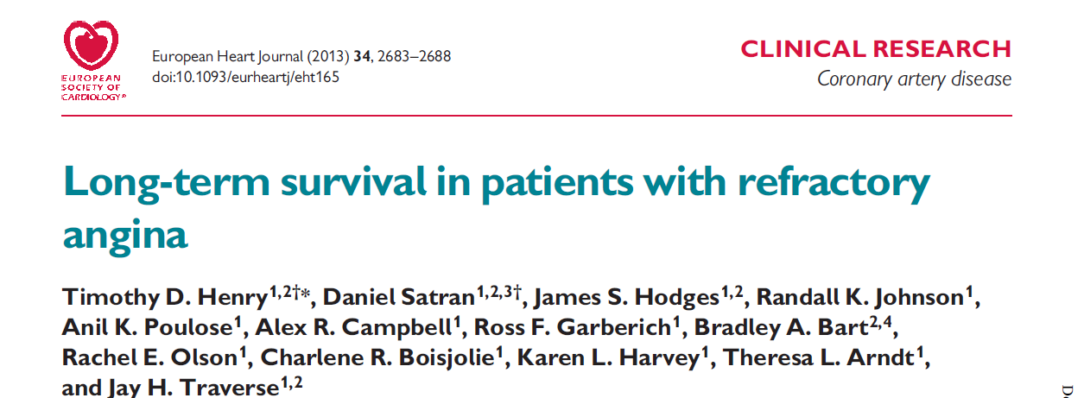
Studio clinico più recente
The OPtions In Myocardial Ischemic Syndrome Therapy
(OPTIMIST) program at the Minneapolis Heart Institute

Slide 11
Premessa
“As the population ages and mortality from coronary artery disease (CAD) decreases, a growing number of patients with severe CAD continue to experience angina which is not amenable to surgical or percutaneous coronary revascularization despite excellent medical therapy.
These patients with refractory angina are frequently labelled ‘no option’ patients with ‘end-stage’ CAD.”

Slide 12
Disegno dello studio
Attivazione a partire dal 1996 di un Centro per lo studio dell’angina refrattaria.
1200 pazienti coinvolti per un follow up medio di 5.1 anni a partire dal 2002 ( OPTIMIST trial )
I pazienti appartenevano prevalentemente al Midwest degli USA ma comprendevano anche pazienti provenienti da 40 stati americani, Puerto Rico, and Canada.
Frequente impiego di trattamenti alternativi (EECP: 21,2%, angiogenesi 15.4%, TMR: 6,5%, spinal cord stimulation: 1.8%).
Valutazione della sopravvivenza a lungo termine e dei suoi predittori

Slide 13
Conclusioni (I)
“Our results demonstrate that long-term mortality in patients with refractory angina is surprisingly low, under 4% per year, and approaches that of patients with chronic stable angina (1.5%) who tend to have fewer comorbidities and preserved LV function.”

Slide 14
Conclusioni (II)
“Multivariate predictors of mortality in patients with refractory angina are similar to those in patients with other cardiovascular conditions: baseline age, DM, angina class, CKD, LV dysfunction, and CHF.”
“Besides age, angina class (3 and 4) and LV dysfunction/CHF were the strongest predictors of mortality and therefore these patients deserve special focus for alternative treatment strategies.”

Slide 15
Conclusioni (III)
“Patients who are not candidates for traditional revascularization do not suffer from excess mortality compared with other patients with CAD.
Cause of death, though predominantly cardiovascular, was non-cardiac in nearly 30% of patients and the incidence of sudden cardiac death was low.”

Slide 16
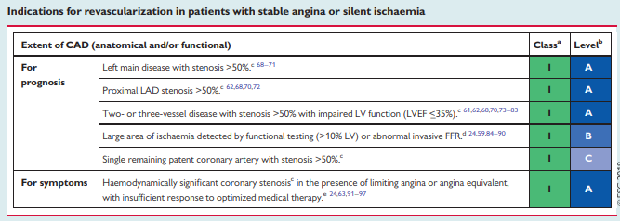
LINEE GUIDA ESC 2018

Slide 17
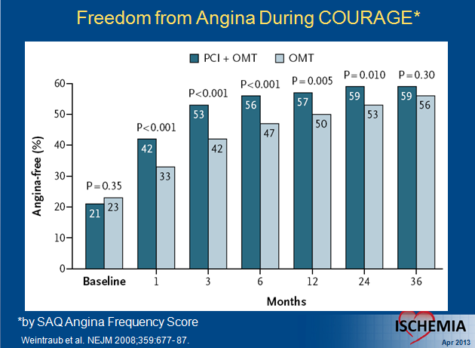


Slide 18
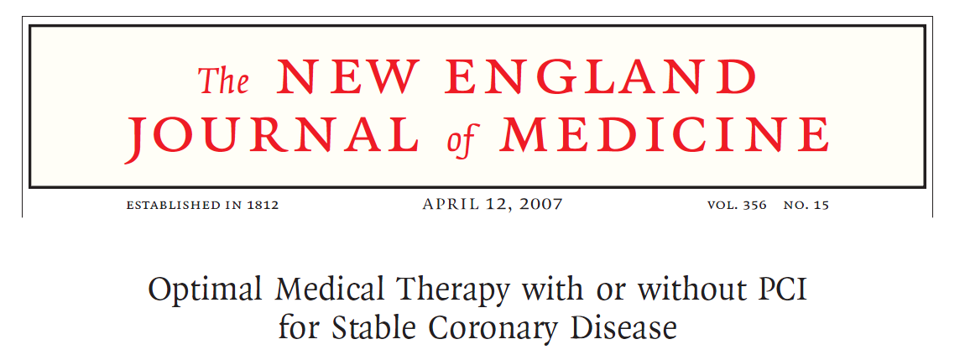


PCI VS OMT
41% vs 44%
anginosi a 3 anni
PCI VS OMT
58% VS 67%
anginosi a 1 anno

Slide 19
Re-appraising post-PCI residual angina
Recently, the presence of residual angina pectoris post-procedure has emerged again as a major target.
In most trials, up to 25% of pts continue to have angina pectoris.
What could be the possible explanations for this?
In many cases we dilate and stent lesions which do not deserve to be treated, for instance when FFR is >0.80
Sometimes we do not treat lesions that deserve to be treated, for instance, when the diameter of the stenosis is <50% and FFR is <0.80
Finally, in current daily practice, we do not assess the microvascular function
Serruys P. Euronitervention 2015;10:1253

Slide 20
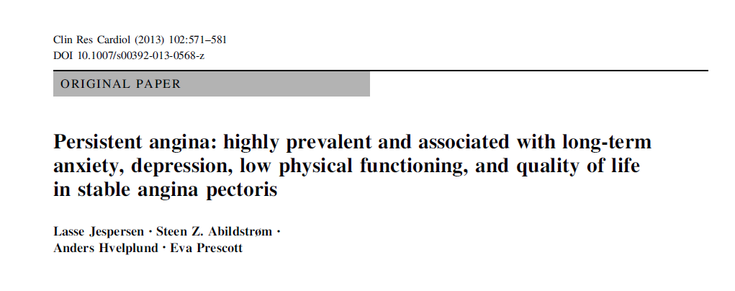
Angina refrattaria …
Concetto virtuale?

Slide 21
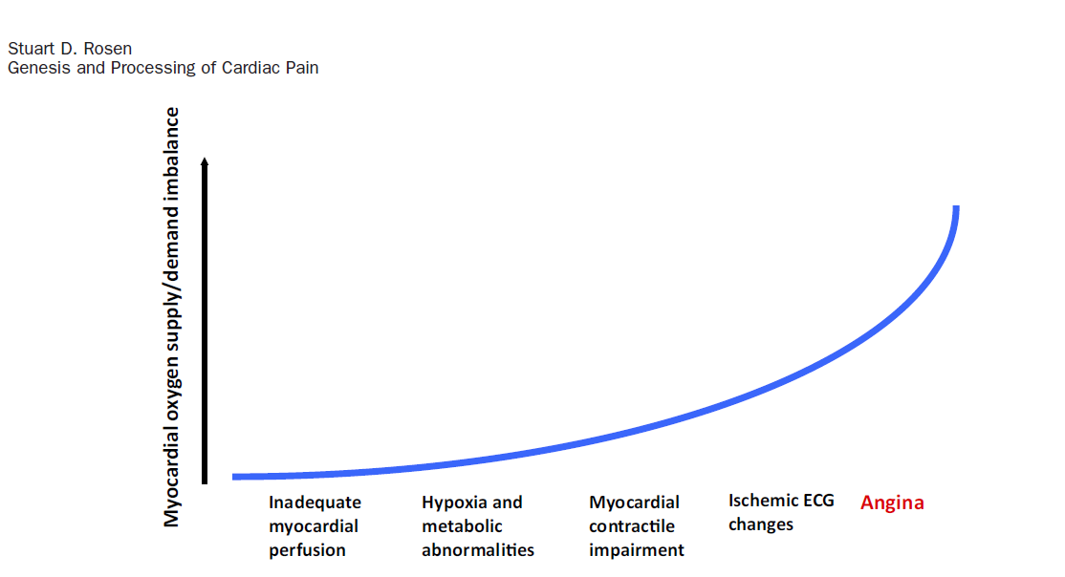
ISCHEMIC CASCADE
RA

Slide 22

ANGINA REFRATTARIA
neuromodulation
imbalance of myocardial oxygen supply and demand
Or both?

Slide 23
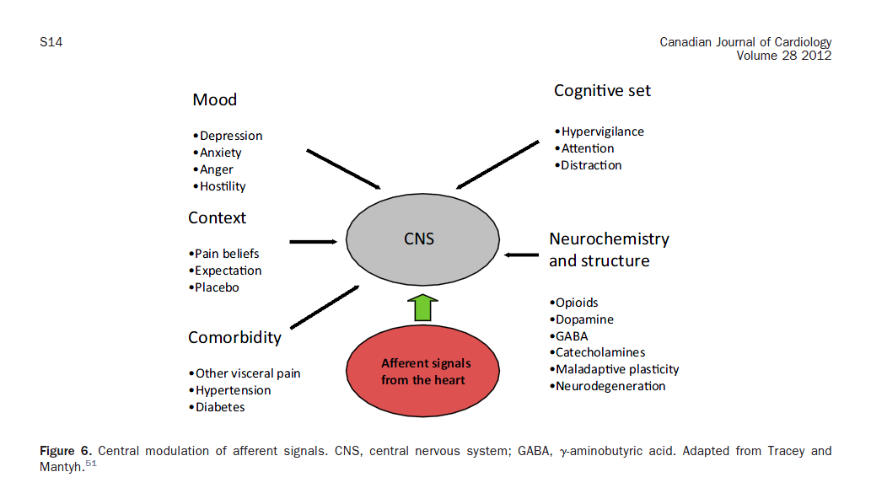
Depression and anxiety increase perceived pain. Foreman and Qin have described an impressive series of studies to demonstrate the presence of glucocorticoidsensitive neurons in the central nucleus of the amygdala, a pathway from which descends to modulate nociception in upper thoracic spinal interneurons. This represents an important potential link between anxiety (which raises glucocorticoid levels) and hypersensitivity to nociceptive input from the heart.

Slide 24
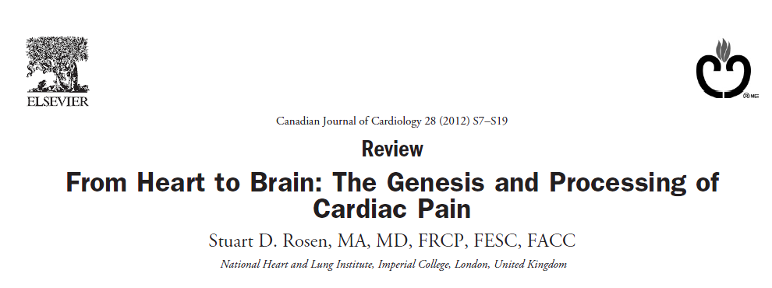
“We suggested that the right insular activation might
be specific for a perception of myocardial pain without ischemic
injury and that this activation is the cortical expression of
the abnormal percept”

Slide 25

“Two clinical features of angina merit consideration. They
are:
- the poor correlation between the severity of symptoms
and the extent of CAD
- the variability in symptoms experienced by an individual patient
it becomes clear that a more sophisticated paradigm is required. “

Slide 26
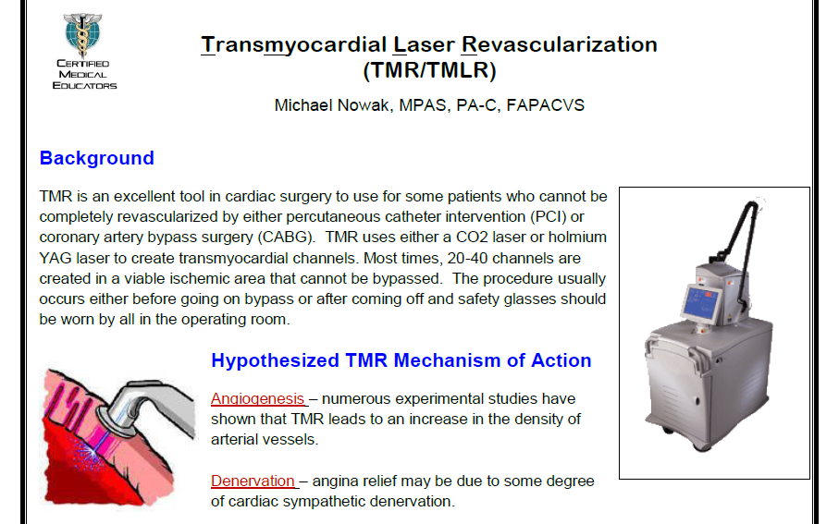
Denervazione cardiaca per angina refrattaria?

Slide 27
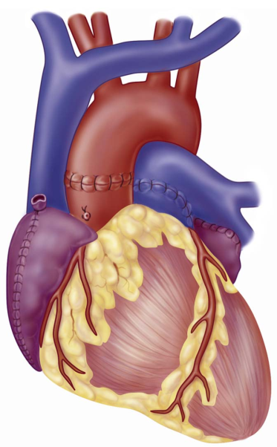
POST HEART TRANSPLANT DENERVATION
Direct sympathetic and parasympathetic innervation is absent
Denervation results in presynaptic supersensitivity to catecholamines which evidence reuptake at the adrenergic nerve terminal.
It seems reinnervation of the left ventricle may occur by efferent sympathetics after a year or more post transplant, but vagal reinnervation is unlikely.
Some transplant patients evidence angina, supposedly due to sympathetic reinnervation.
Chris Hamlin, MD

Slide 28
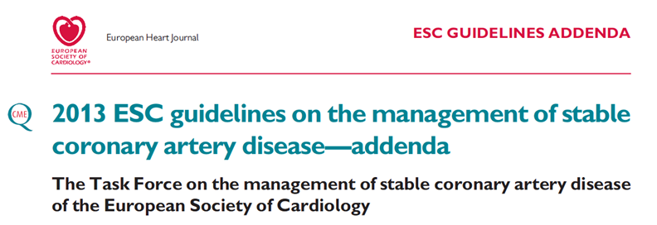
Angina pectoris classe Canadian 3-4
Nonostante OMT
Non possibili ulteriori trattamenti coronarici invasivi.

Slide 29
Qualità di vita compromessa
Pazienti ad alto rischio di mortalità
Frequenti ricoveri ospedalieri
Gruppo di pazienti in rapida crescita

Slide 30
Terapia medica ottimizzata e altri trattamenti
Paziente non ulteriormente rivascolarizzabile
ASA
Beta bloccanti al fine di ridurre la frequenza cardiaca a riposo < 60 bpm/min (considerare Ivabradina)
Nitrati: ‘short e long acting’ per via orale;
Ca antagonisti diidropiridinici (in particolare amlodipina, felodipina)
Ranolazina
Terapia ipolipemizzante
Correzione dei fattori di rischio
Correggere: anemia, FA a rapida risposta ventricolare, ipertensione, distiroidismo.
Riabilitazione cardiorespiratoria

Slide 31
Condizioni comuni per cui non è possibile effettuare una rivascolarizzazione
Paziente non ulteriormente rivascolarizzabile
Anatomia coronarica sfavorevole, inclusa malattia aterosclerotica diffusa con funzione sistolica conservata.
Precedente intervento di CABG/PCI in assenza di beneficio clinico ed impossibilità di successiva rivascolarizzazione.
Peggioramento della funzione sistolica ventricolare successivamente ad intervento di rivascolarizzazione.
Patologie extracardiache che incrementano il rischio preoperatorio e postoperatorio (aterosclerosi, IRC, patologie polmonari)
Età

Slide 32
Trattamenti non convenzionali
Contropulsazione esterna ( EECP )
Trapianto di cellule staminali
Stimolazione midollare
Transcutaneous elettrical stimulation ( TENS )
Shock waves (?)
(Rivascolarizzazione transmiocardica con laser)
Coronary sinus reducer

Slide 33


PCI angina refrattaria …
Concetto assoluto o relativo?

Slide 34
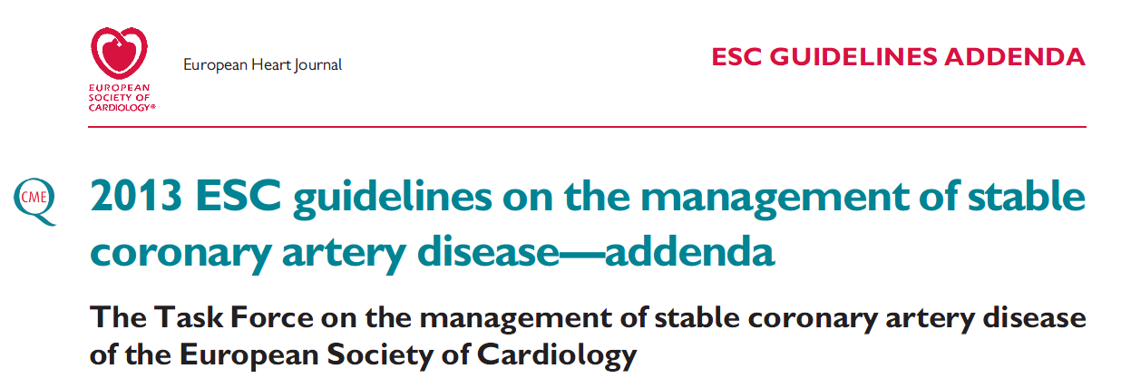
CTO
Patients with CTO are among the few stable angina subgroups with strong indirect evidence that a successful outcome may lead to a mortality benefit.
The comparison of surgical vs. PCI registries identifies
the presence of a persistent occlusion of one or more arteries in the PCI arm as one of the mostpowerful predictors of worse outcome, in comparison with complete surgical revascularization.

Slide 35
Treatment denial, avoiding referral to dedicated centres and operators, appears particularly cruel in symptomatic patients who experience major symptom relief and quality of life improvement post-procedure

Slide 36
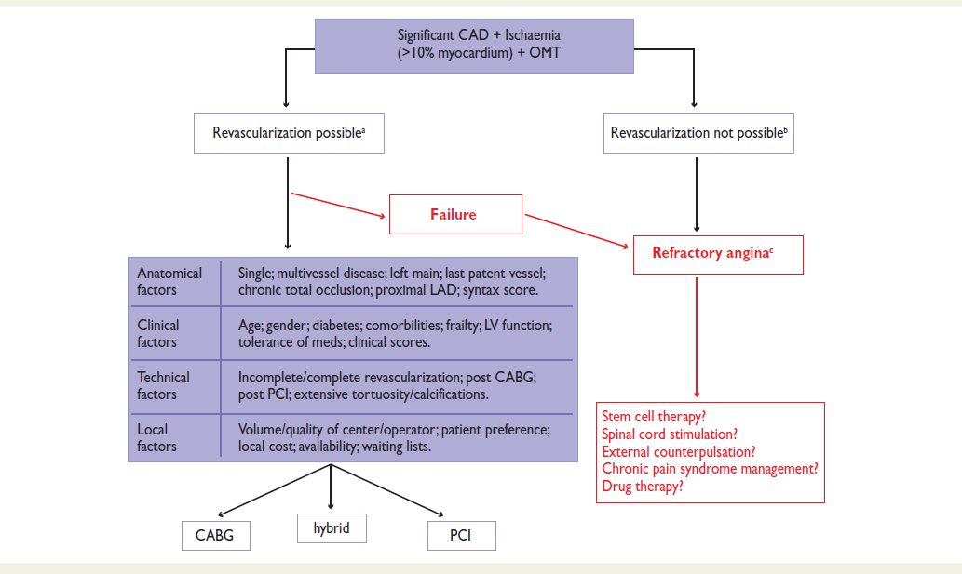



Slide 37
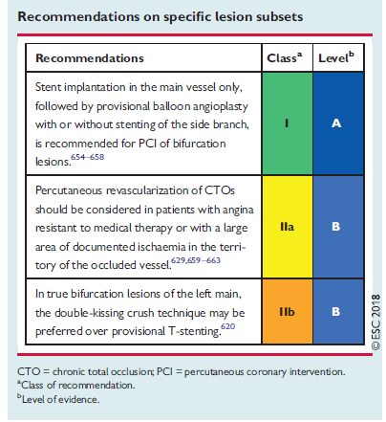
ESC 2018

Slide 38
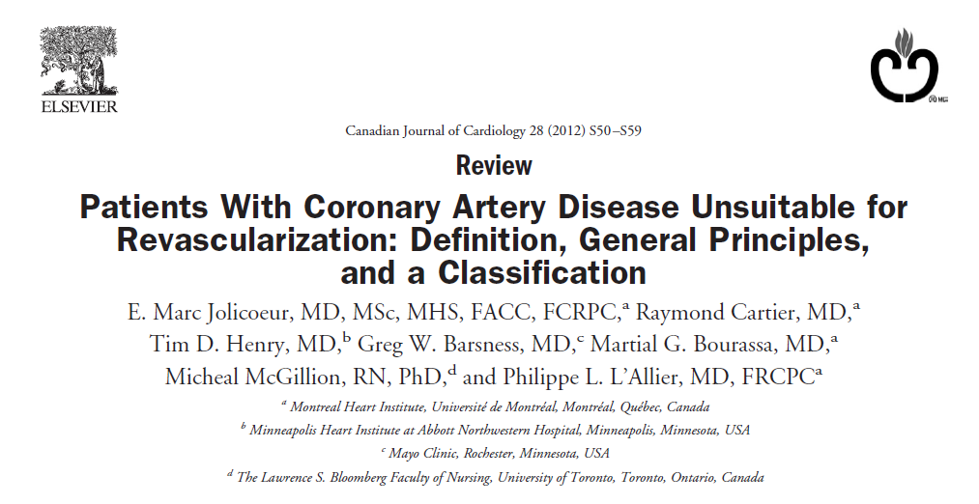

Slide 39
Refractory angina
The concept of «no-option»
Grading angina
↓
Canadian CV Society classification
Cardiac
pain
Myocardial
ischemia
Documenting myocardial ischemia
↓
- EST
- Dobutamine echo
- Myocardial SPECT
- Cardiac NMR w stress
Unsuitability
for revascularization
‘ CAD due to 1 or several significant epicardial stenoses and/or microvascular dysfunction where PCI or bypass cannot reasonable attempted or is nor expected to improve myocardial perfusion’

Slide 40
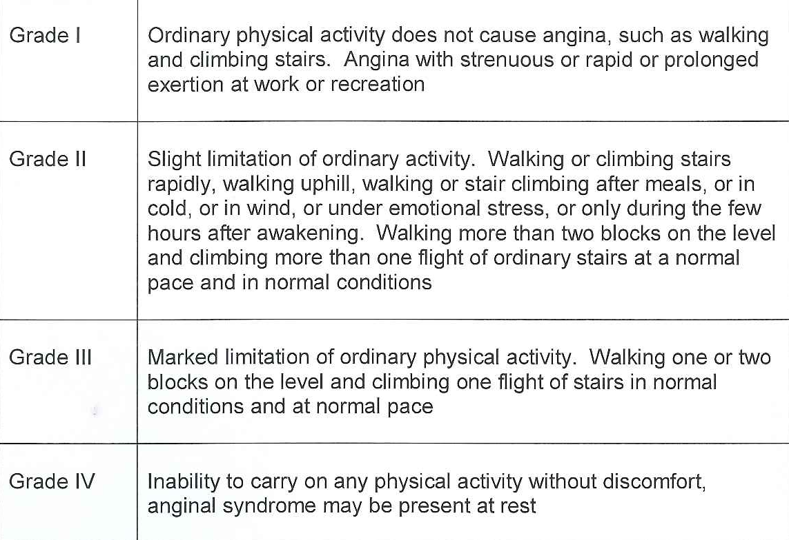
Grading angina pectoris
The Canadian Cardiovascular Society classification
7-8 METs
5-6 METs
3-4 METs
1-2 METs
RA
Campeau L. Circulation 1976;54:522

Slide 41
Fenotipi anatomici dei pazienti non rivascolarizzabili
Profilo A:
Sospetta sindrome X
Profilo B:
Territorio a rischio limitato
Profilo C:
Malattia coronarica diffusa, “thread-like”
Profilo C:
Malattia coronarica diffusa, “thread-like”
Profilo D:
Malattia coronarica end-stage

Slide 42
General principles
1. The status of unsuitability for revascularization can be
temporary.
The “no-option” label may be difficult to remove once it has been affixed to a patient.
Revascularization rates up to 25% have been reported among cohorts of patients enrolled in “nonrevascularizable” RFA trials with longer-term follow-up.
The decision to proceed or not with a coronary revascularization should rely on a recent angiogram ( 1 year).
2. The decision should be the result of multidisciplinary
dialogue.
3. What constitutes an optimal medical therapy should
be explicitly detailed

Slide 43

Contrary to what was initially conveyed, MVA does not necessarily have a benign prognosis. Just like obstructive CAD, dysfunction of the microcirculation results in ischemia and is therefore associated with adverse long-term outcome.
MVA is most frequently evoked in patients with normal coronary angiogram but is frequently present in patients with advanced CAD, including patients with prior CABG surgery.

Slide 44


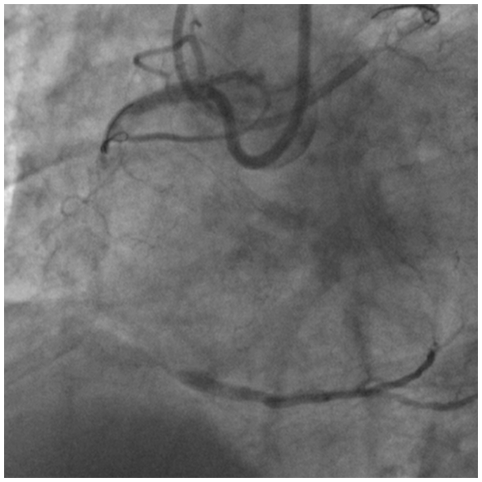

Slide 45

NO PRIOR CABG
In patients with no prior CABG surgery, classic examples of phenotype B are those patients with chronic total occlusions in a single vessel such as the left circumflex or the right coronary artery
- Other examples are side branch stenoses or distal coronary stenoses.
-When a PCI is technically impossible, a coronary operation remains a theoretical option.

Slide 46

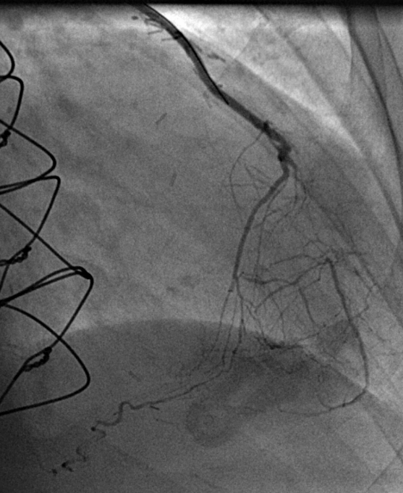


Slide 47
When a PCI is technically impossible, a coronary reoperation
(redo CABG) remains a theoretical option.
The benefits of repeating the surgery on patients with patent
grafts are not well characterized.
The risks associated with reoperation are 2 to 4 times higher
than initial surgery. Consequently, an extensive amount of jeopardized myocardium is expected before reoperation is considered.
This is particularly the case when a patent internal mammary artery (IMA) has been grafted to the LAD

Slide 48

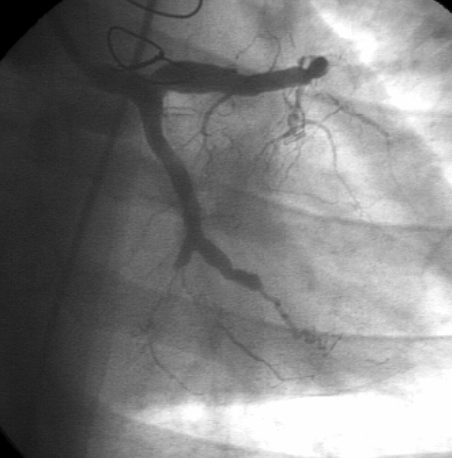
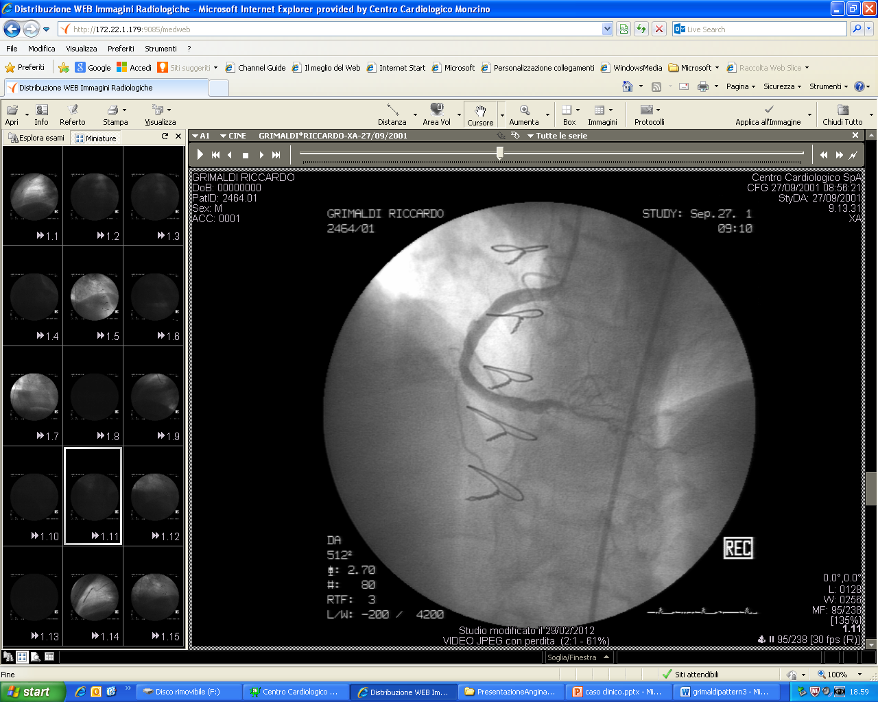

Slide 49

“Angiographically, these coronary arteries have a thread-like
appearance.
The coronary arteries are steadily infiltrated from the ostium to the distal beds, but the lesions are rarely occlusive.
Phenotype C is the prominent angiographic presentation of nearly 30% of people of South Asian origin with ischemic heart disease.
Anedoctally, diffuse coronary atherosclerosis has been associated with systemic vasculitides. There are no specific prognostic data for patients showing angiographic features of phenotype C. “

Slide 50

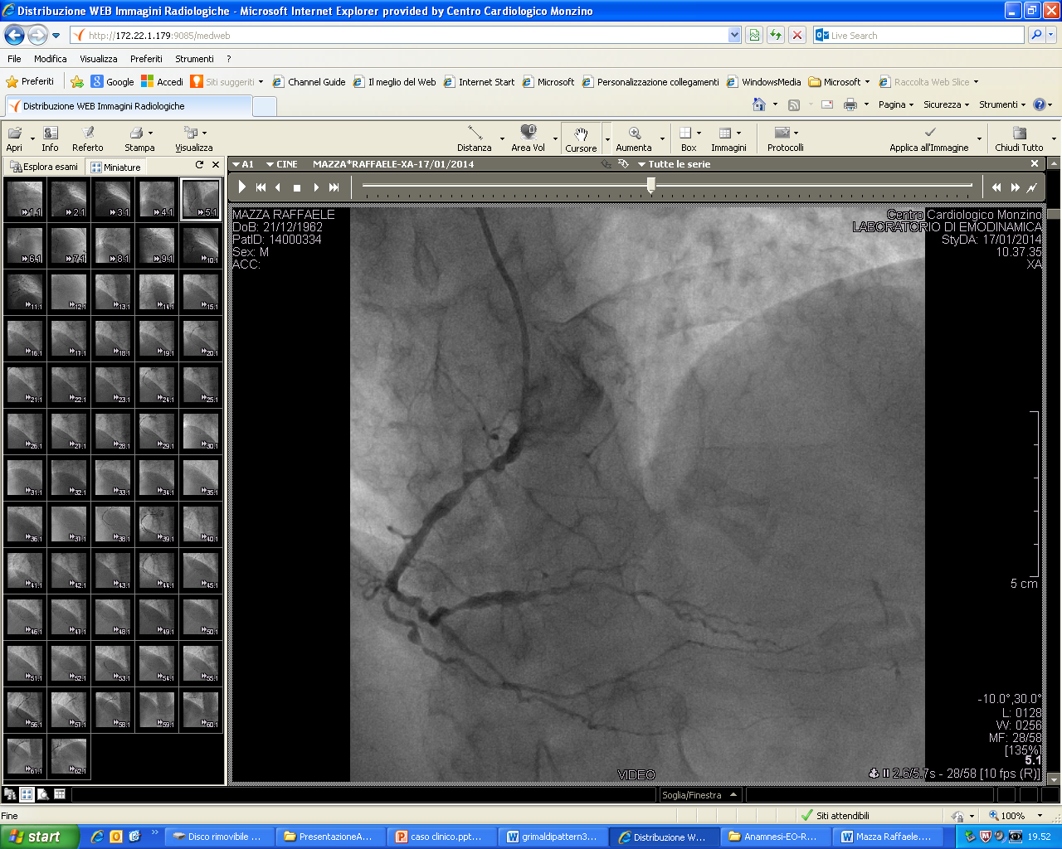
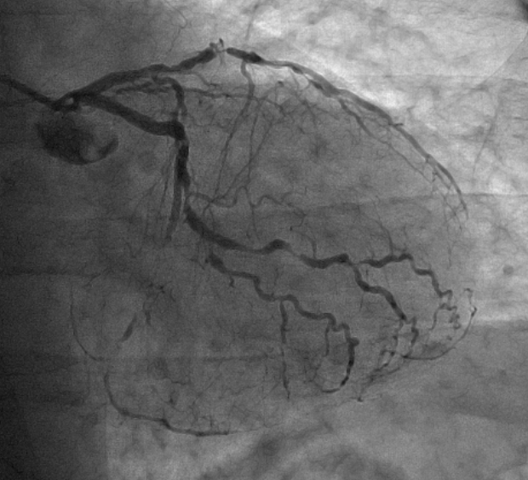

Slide 51

In the proximal to mid coronary segments,normal or near normal calibre arteries are interrupted by severe epicardial atherosclerotic plaques.
In the distal coronary segments, a more diffuse infiltration is possible. An extensive network of coronary collaterals is frequently visible on angiogram.
In phenotype D, segments of coronary artery with a normal calibre are still present.
Normal or near normal calibre arteries are interrupted by segments of severe epicardial atherosclerotic plaque.
Frequently, patients with type D phenotype have had prior CABG which has allowed them to survive despite a slow but inexorable progression of atherosclerosis.
The accelerated progression of atherosclerosis in the grafted coronary vessels is a well-known contributory phenomenon.

Slide 52
Likewise, disease progression in nongrafted native vessels can occur at a rate up to 40% over a decade.
Data are scarce on the prevalence and natural history of patients with phenotype D, mainly because, historically, series presenting “no-option” patients have regrouped heterogeneous populations.

Slide 53
Caso clinico
78 anni uomo
Familiarità positiva per CAD
Ipertensione arteriosa in terapia
Ipercolesterolemia in terapia
LVEF 30-50%
Portatore di pacemaker ICD
Anamnesi positiva per angina per sforzi lievi moderati
Pregresso Bypass: nel 1989 bypass aortocoronarico su D2 e IVA (sequenziale), su PL di CFX ed MO (sequenziale) e su IVP. Nel 2002, per riscontro di occlusione sul graft per IVA-D2, nuovo CABG con LIMA su IVA ed arteria radiale su PL di CFX.
Multiple PCI: SVG>M0, radiale su PL ed SVG> IVP nel 2003 e nel 2008, PCI sul ramo interventricolare posteriore.
2011 Failure PCI: CTO of CFX; riscontro di occlusione della radiale su PL

Slide 54
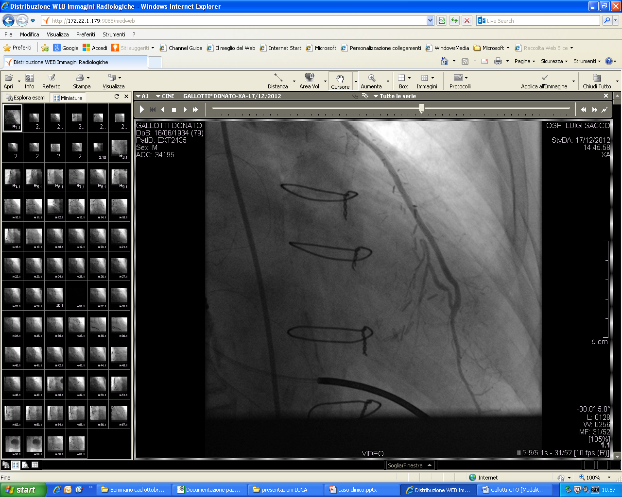
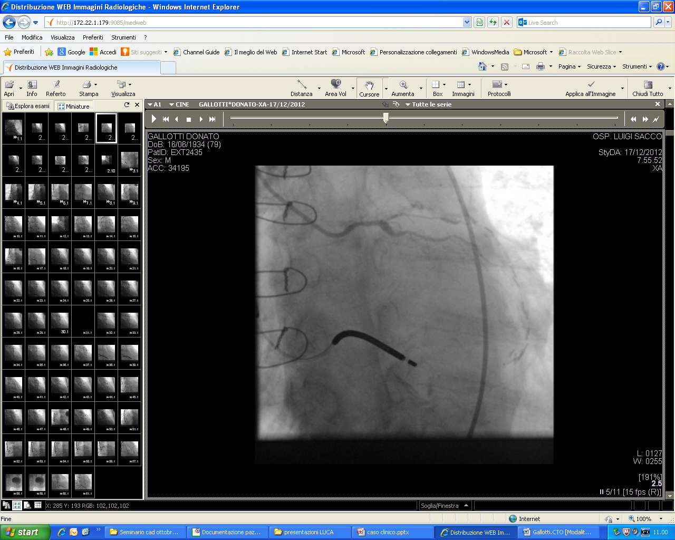
Permane malattia critica trivasale e CTO di CFX
Tentativo fallito di PCI su radiale>PL
2011

Slide 55
Il paziente continua a riferire episodi subentranti di angina per sforzi lievi, sensibile all’ assunzione di nitrati SL.
ASA 100 mg
Ticlopidina 250 mg 1 cp x2
Amiodarone 200 mg
Furosemide 25 mg
Spironolattone 100 mg
Monoket 80 mg 1 cp x2
Rosuvastatina 10 mg
Pantoprazolo 40 mg
Carvedilolo 25 mg 1 cp x2
Ranolazina 375 mg 1 cp x2
Ivabradina 5 mg 1-½ + 1 cp
Nitrati SL 5/die

Slide 56
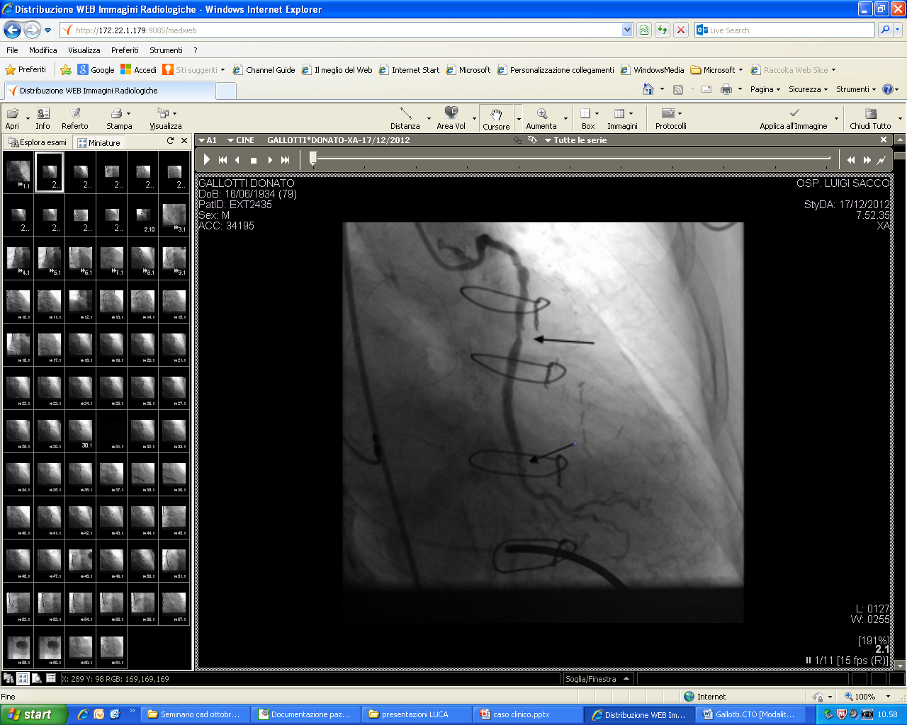
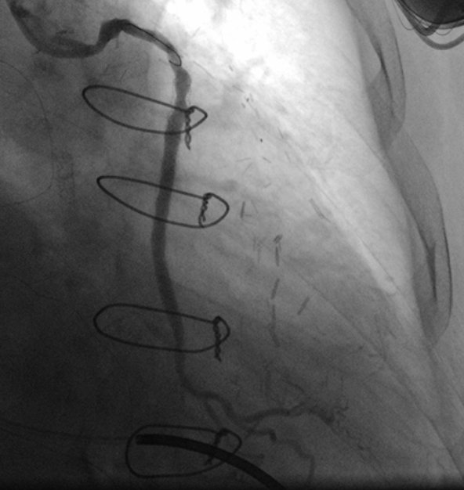
Dicembre 2012 PCI ed impianto di DES di SVG su MO

Slide 57
Nel maggio 2013 peggioramento della soglia anginosa con comparsa di sintomatologia a riposo parzialmente responsiva ai nitrati.
In considerazione dell’ impossibilità di effettuare una MRI da stress per la presenza di ICD, si effettuava AngioTC perfusion che risultava non valutabile per la presenza di aritmie.
Nel sospetto di una ISR della SVG su MO si decideva di procedere ad un ricovero urgente

Slide 58
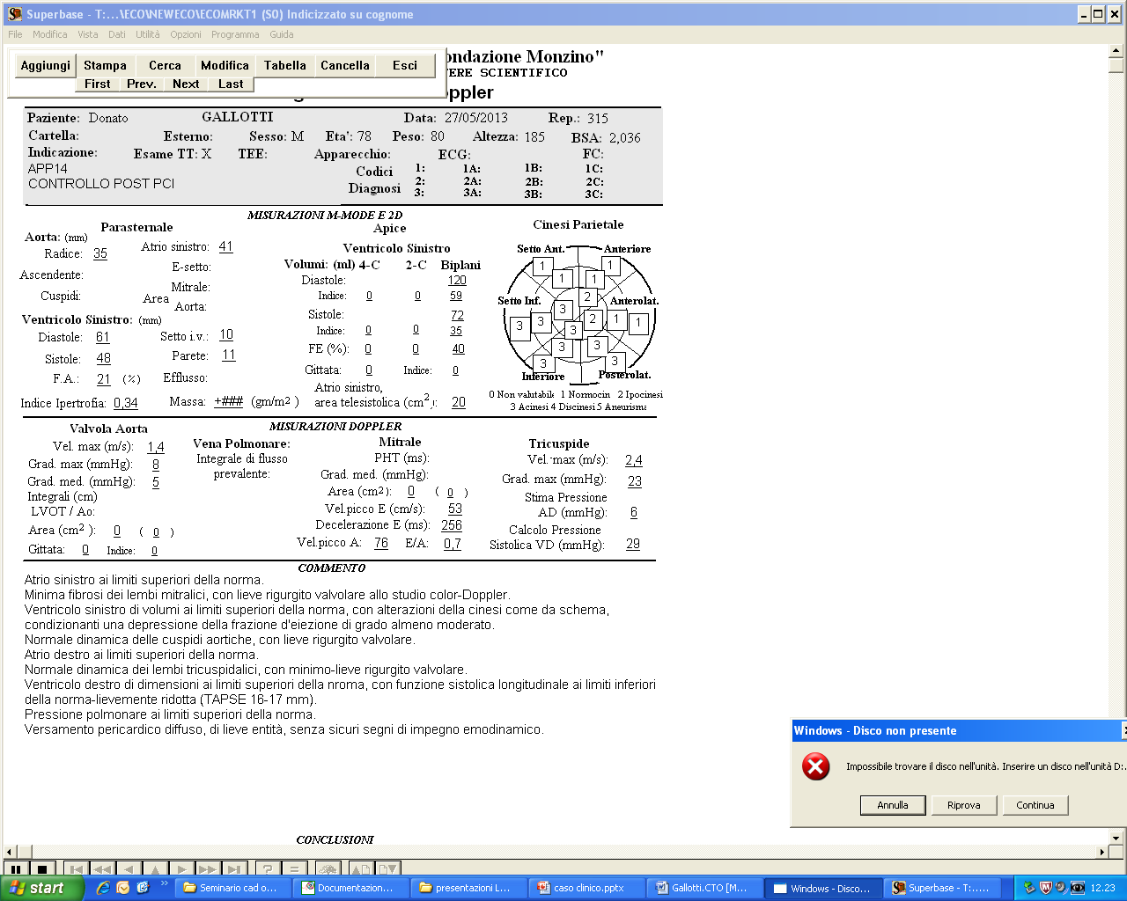
Ecocardiogramma pre procedura.

Slide 59
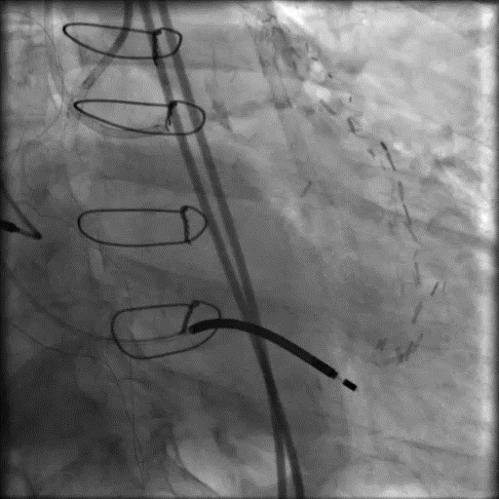
CGF: quadro coronarografico stazionario

Slide 60
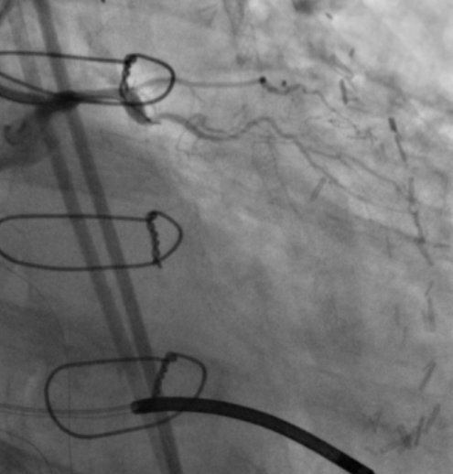
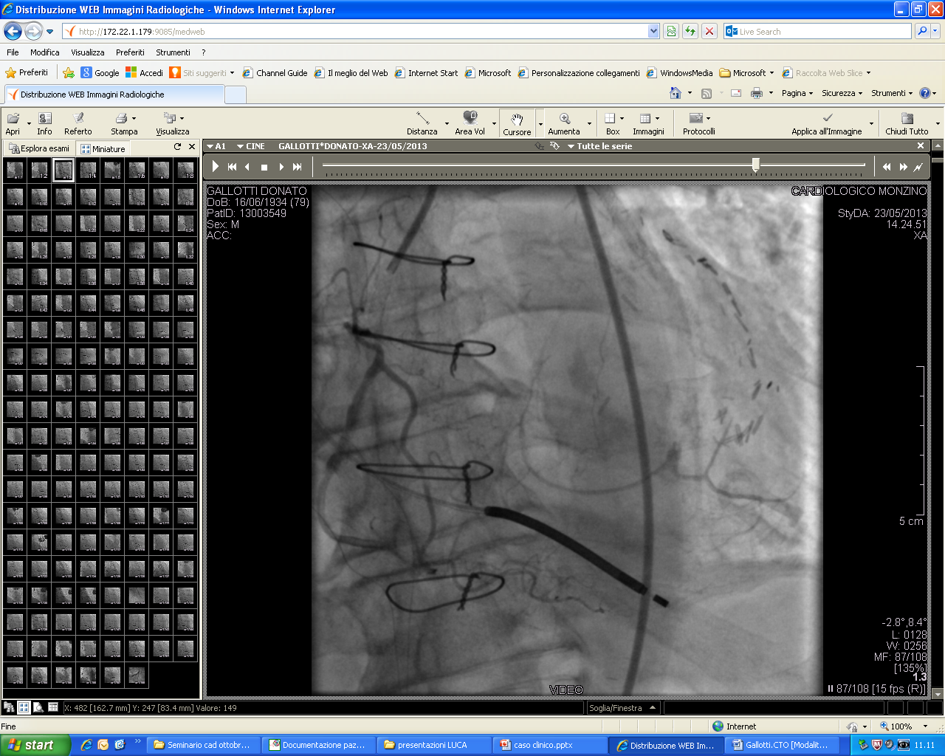
CGF: quadro coronarografico stazionario
TC
M1
CTO

Slide 61
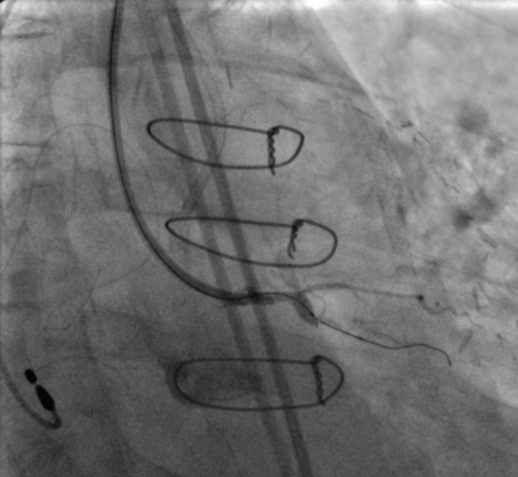
Approccio Anterogrado
Finecross 130 cm +
Conquest pro 12 +
Ryujin 1,25 mm di ancoraggio
failure

Slide 62
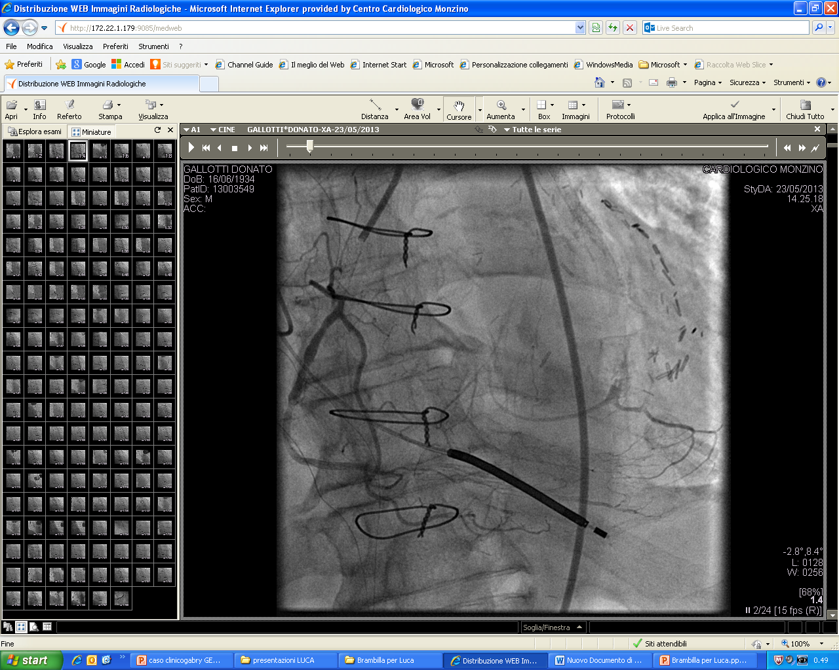
Approccio retrogrado attraverso circolo epicardico
IVP > PL
Finecross 150 + Sion

Slide 63
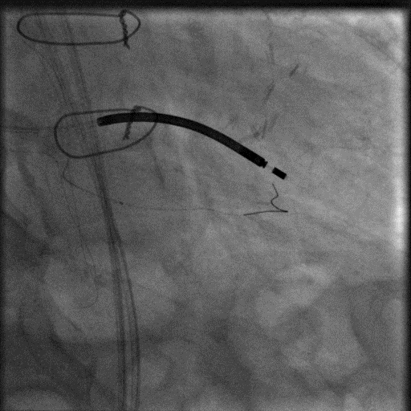
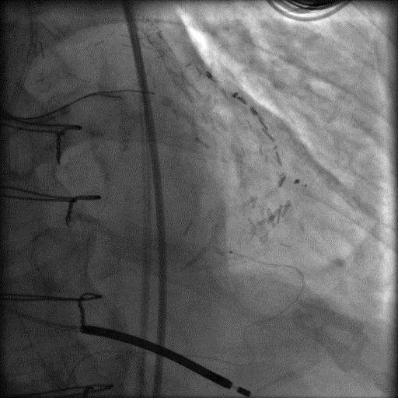
Approccio retrogrado attraverso circolo epicardico

Slide 64
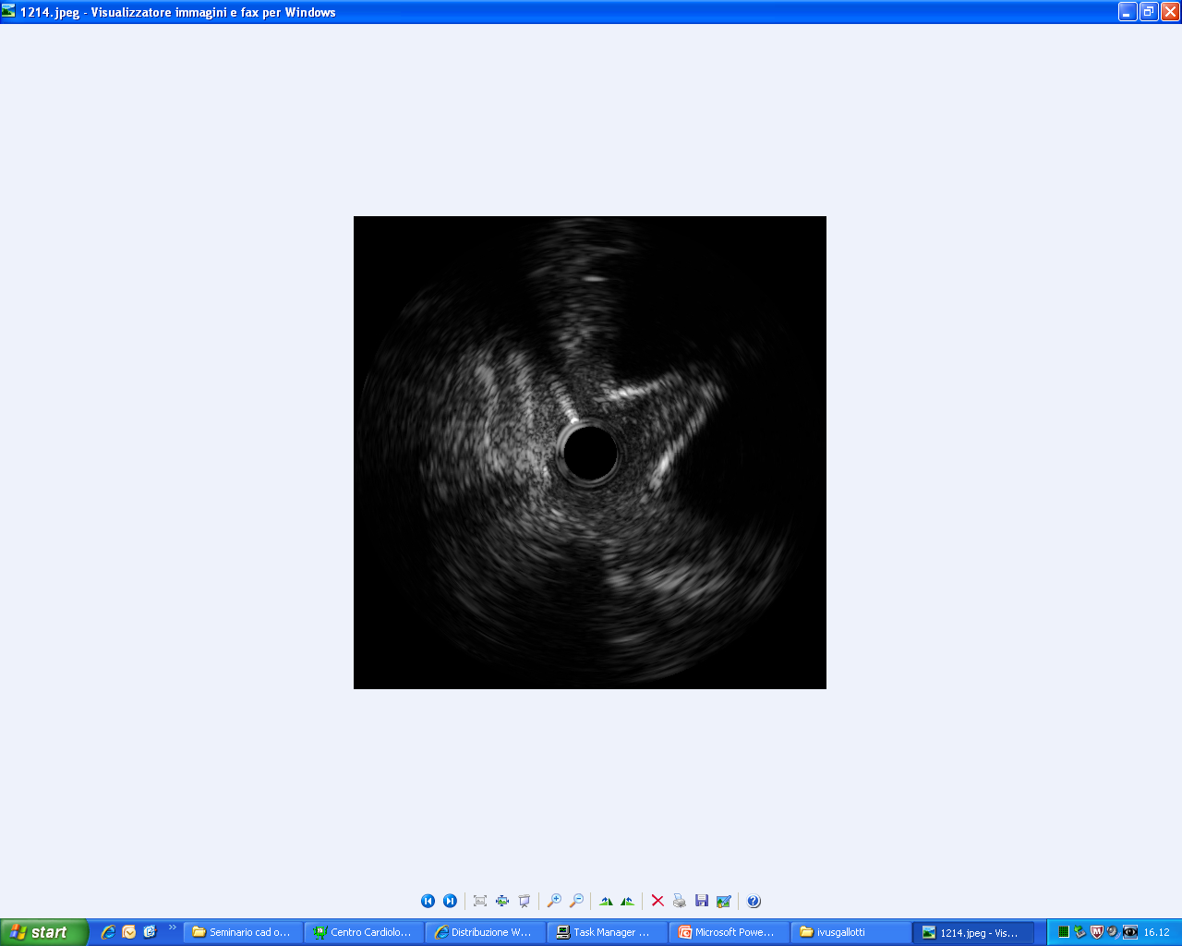
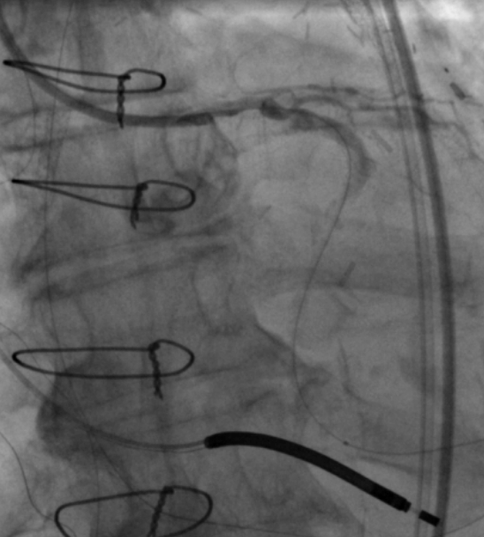
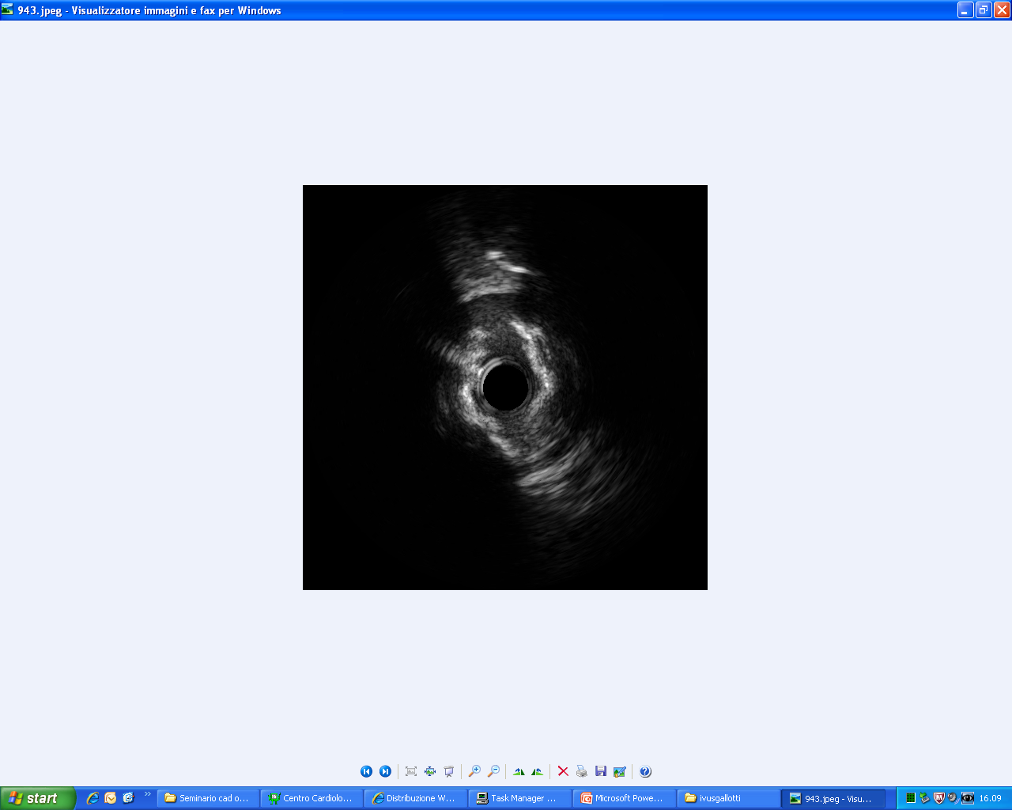
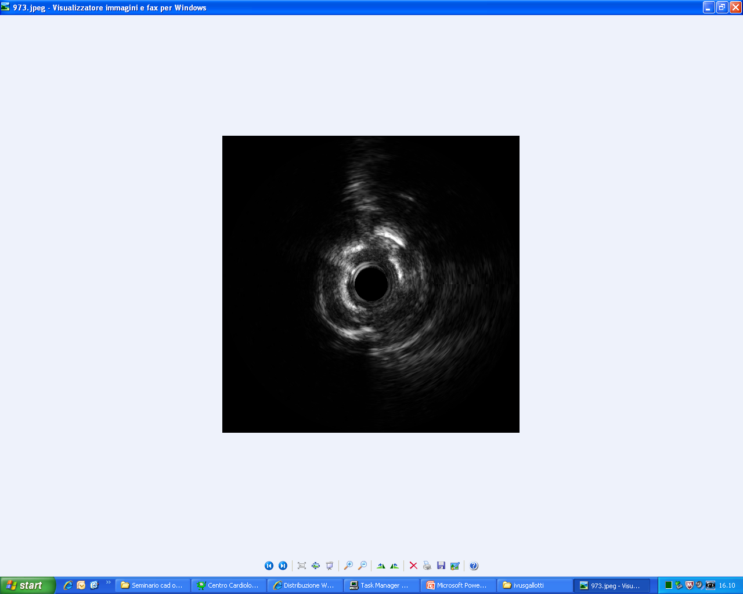

Slide 65
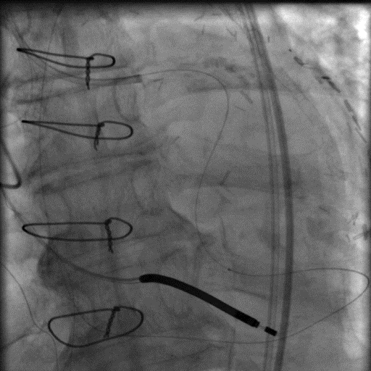

Slide 66
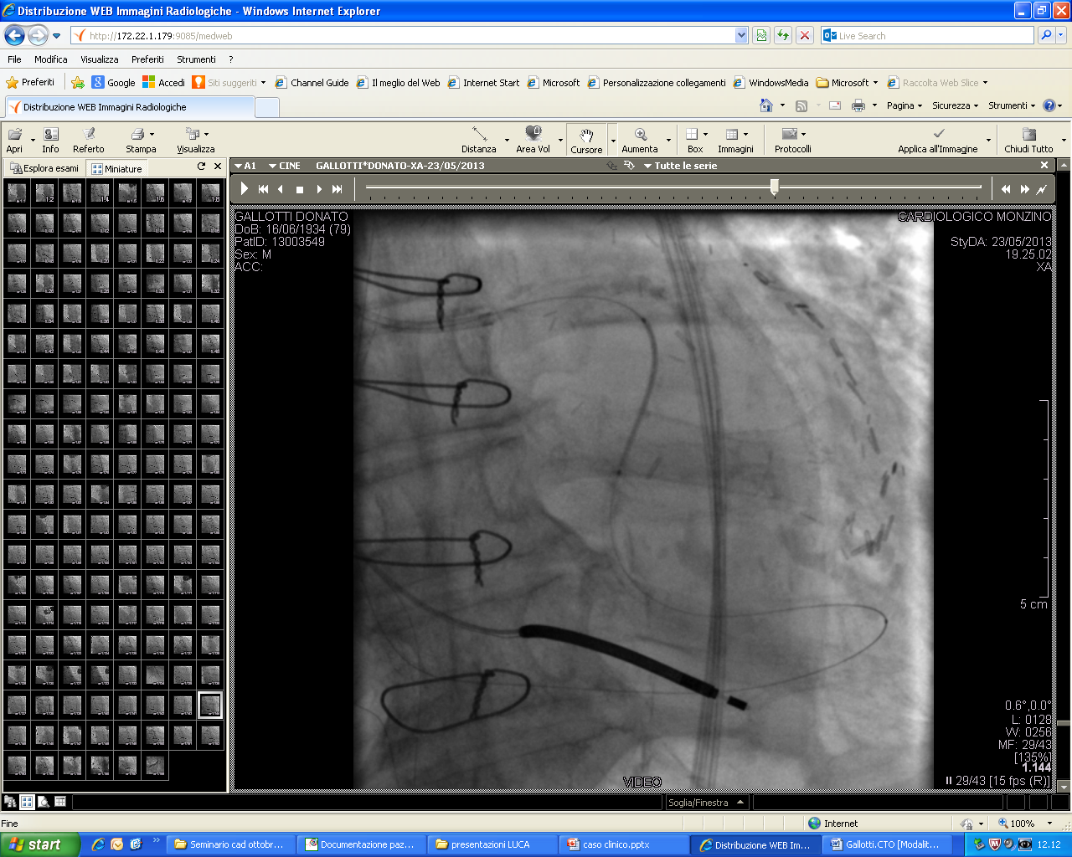
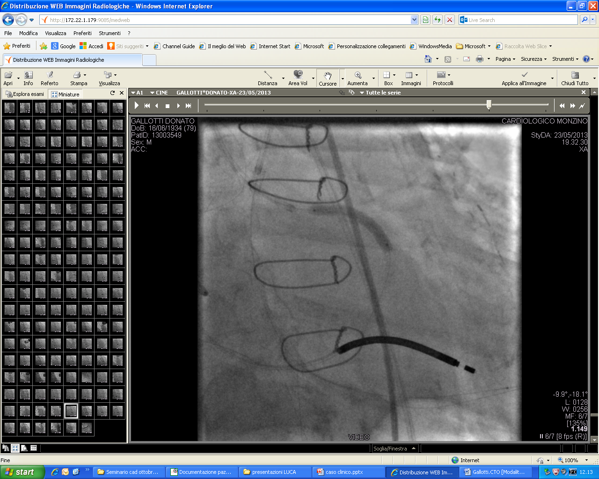
Impiantati 3 DES a rilascio di zotarolimus: 98 mm totali

Slide 67
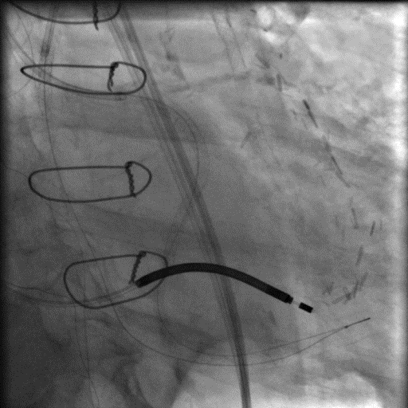
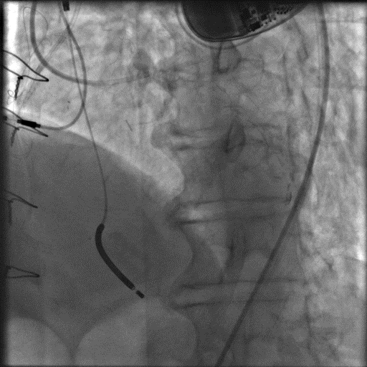
Risultato Finale

Slide 68
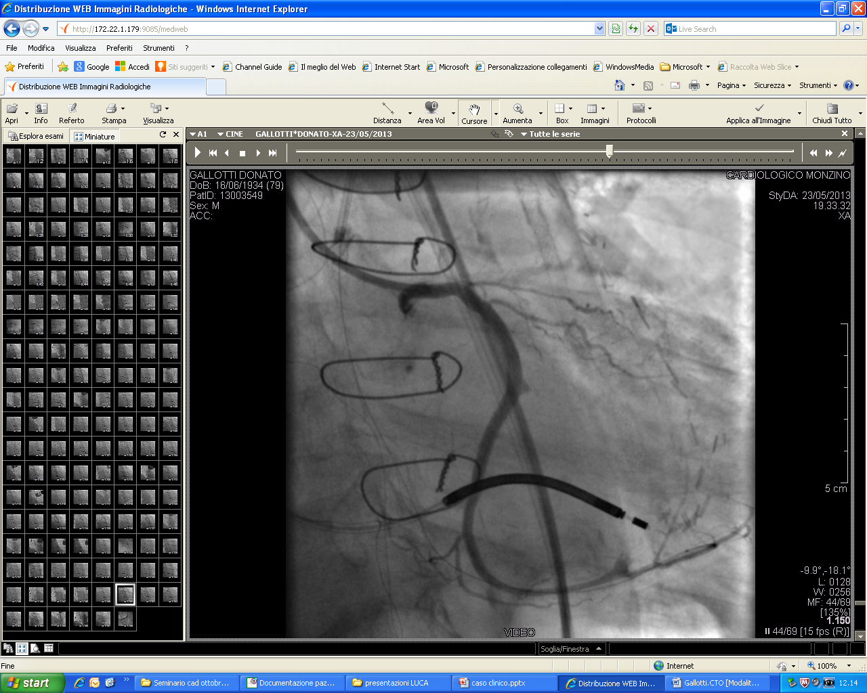
Risultato Finale
CFX codominante !!!

Slide 69
Follow up a 6 mesi
Paziente asintomatico ( classe Canadian 0 ).
Sospesi nitrati post dimissione
Non assume più Nitrati S.L.

Slide 70
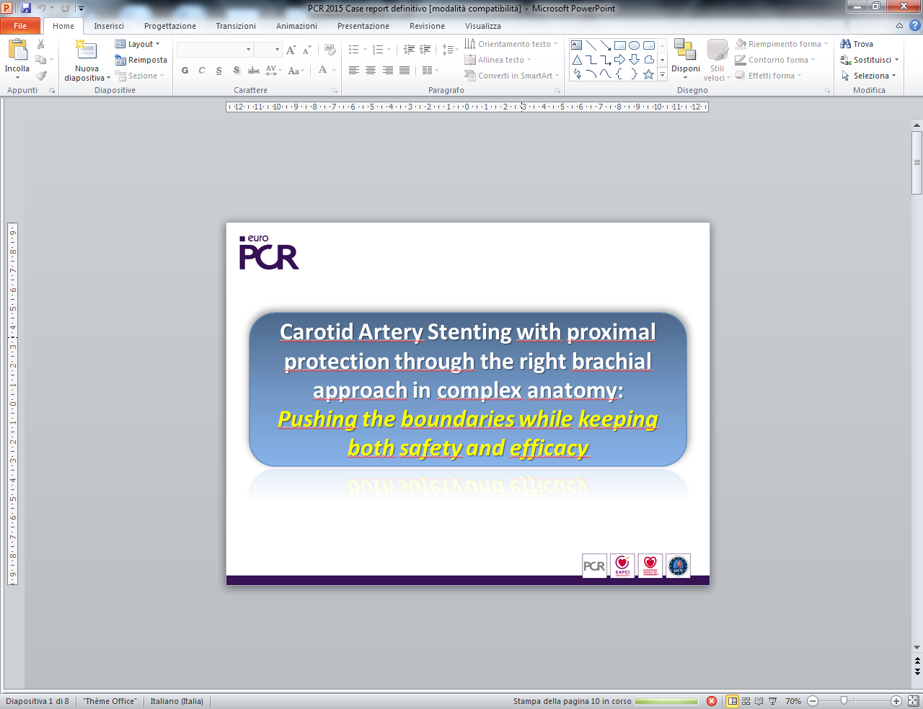
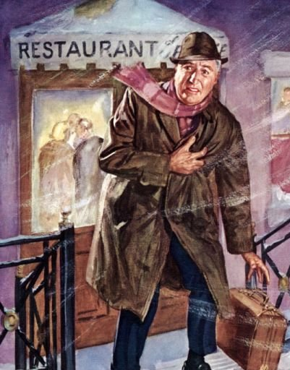
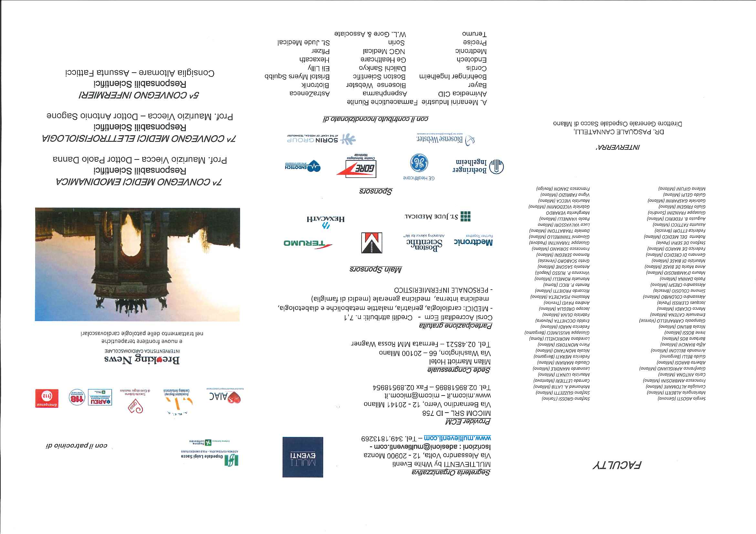
Refractory Angina
Piero Montorsi, MD
Deartment of Clinical Sciences and Community Health, University of Milan
Centro Cardiologico Monzino, IRCCS

Slide 71
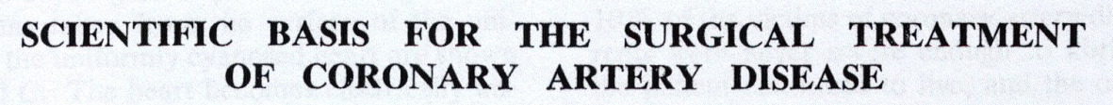
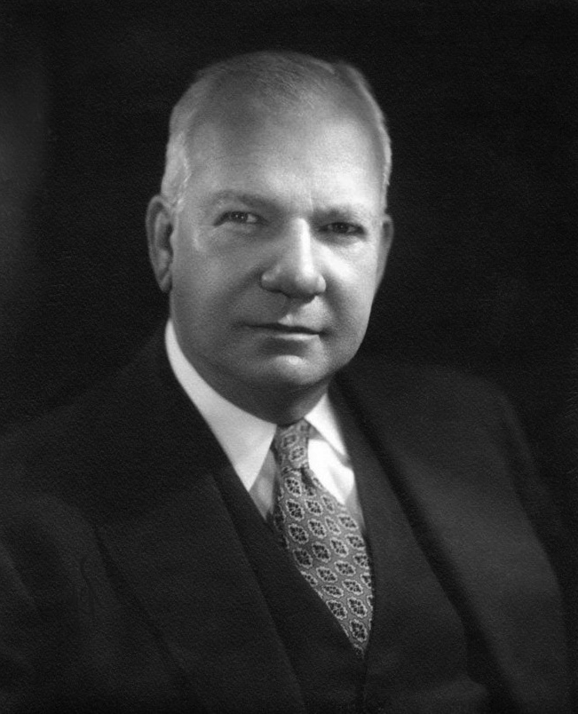
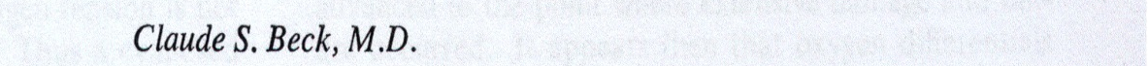


Treatment options for refractory angina
Narrowing the coronary sinus
1894-1971
The purpose of the intervention was to redistribute myocardial BF into ischemic territories in pts with disabling AP
Significant relief of angina
Improved functional class
Reduced 5 year mortality
Beck CS. JAMA 1955,159 (13):1264

Slide 72



Narrowing the coronary sinus
Normal perfusion
Higher BF Endo vs Epi.
Stress-induced Epi vasoconstriction leading to better Endo perfusion and increase in contractility
Reduced perfusion w CAD
BF redistribution to subepi areas. Under stress, less BF to Endo, ischemia, impaired contractility, ↑ LVEDP w further Endo BF reduction and angina
Reduced perfusion + CSN
Pressure in venules & capillaries w ↑ diameter and ↓ R to flow in Endo with
Endo/Epi ratio restored → improved LV contractility and reduced LVEDP

Slide 73



Narrowing the coronary sinus
The Coronary Sinus Reducer
Balloon-expandable stainless steel hourglass-shaped metal mesh available in a single model designed to fit a range of anatomy (9.5-13 mm, 2-4 bars)
OTW balloon with different diameters in the proximal and distal portion. Slight oversizing to achieve 1.1:1.0 Reducer to CS diametrs ratio to
Prevent migration
Trigger a injury-induced hyperplastic response in 3-6 weeks → covering mesh struts
Central part non in contact with the CS wall → no injury & hyperpalsia → patent lumen

Slide 74





Narrowing the coronary sinus
The Coronary Sinus Reducer
A
B
C
OM vein
PD vein
D
E

Slide 75

Narrowing the coronary sinus
The COSIRA Trial
104 consecutive pts with:
- Canadian Cardiovascular Society (CCS) class III-IV angina
- Full treatment in the last 30 days before screening
- No option for coronary revascularization by local heart team
- Evidence of reversible myocardial ischemia + EF>25%
Randomly (1:1) assigned to Reducer implantation (n=52) or sham-procedure (n=52) in 11 clinical centers
Primary end-point: improvement of at least 2 CCS angina at six months
NEJM 2015;372:519

Slide 76

Narrowing the coronary sinus
The COSIRA Trial
Characteristics of the patients
65% of pts received 0-2 antianginal drugs
No ranolazine treatment

Slide 77



Narrowing the coronary sinus
The COSIRA Trial
Improvement in CCS class
Mean Change in CCS class
P=0.003
P=0.001
Primary
end-point
P=0.02

Slide 78
Narrowing the coronary sinus
The COSIRA Trial
Quality of life as assessed with the use of the Seattle Angina Questionnaire
(improvement on a 100-point scale)
17.6 (Reducer) vs. 7.6 (Placebo) points (p=0.03)
No significant difference between groups in improvement in exercise time or in the mean change in the wall-motion index as assessed by means of dobutamine echocardiography

Slide 79
Narrowing the coronary sinus
The COSIRA Trial: conclusions
In this small clinical trial, implantation of the coronary-sinus reducing device was associated with significant improvement in symptoms and quality of life in patients with refractory angina who were not candidates for revascularization
Pros: High-quality trial, well defined population, rigorous determination of lack of suitability for revascularization, refractory angina, substantial ischemia in the left circulation
Cons: the small number of pts does not allow to provide definitive information neither on the primary end-point nor on non-invasive end-point.

Slide 80

Narrowing the coronary sinus
Potential limitations to the device implantation
Wide variability in CS anatomy
suggesting up to 20% ineligible pts
↓
<3% pts excluded for anatomical
reasons, mainly CS too large
Close proximity with the CFx artery
potential risk of AMI
↓
Reducer usually implanted in proximal CS far away form LCx
Vieussens/Thebesain valve may impede advancement in the CS
↓
Addressed by different wires/catheters

Slide 81






Narrowing the coronary sinus w the Reducer TM
Patients with pace-maker leads

Slide 82
Narrowing the coronary sinus w the ReducerTM
Personal experience
N=5
I
I
N=1
II
N=1
x2
II
N=1
III
N=2
x2
III
IV
N=2
IV
N=1
Pre
6 month-f/U

Slide 83




Slide 84


Slide 85





Slide 86
Take home message (I)
L’angina refrattaria è una sindrome clinica complessa e variegata.
In una percentuale difficile da determinare non dipende dalla paradigma classico del rapporto domanda/offerta di O2.
Bisogna quantificare nella maniera più accurata possibile l’entità del territorio miocardico ischemico e la sua correlazione con il quadro anatomico.
Il giudizio di non trattabilità chirurgica e/o percutanea va da un Heart Team ‘dedicato’

Slide 87
Take home message (II)
Nonostante la OMT e la completa rivascolarizzazione miocardica il paziente a volte lamenta il persistere dell’angina per disturbi del microcircolo e/o della nocicezione
L’introduzione di questionari relativi alla QoL e una valutazione psicologica del paziente in casi selezionati potrebbero chiarire il reale status anginoso del paziente per avviarlo a trattamenti alternativi.

Slide 88

Take home message (III)
Ci rivediamo tra 2 anni per approfondire i rimedi alternativi …..
20 febbraio 2018
Quella luce intorno a noi: una ricerca «cattura» i biofotoni
Partito al Bellaria di Bologna uno studio che coinvolgerà 600 persone per verificare se esiste una relazione tra emissione di biofotoni e benessere percepito

