Slide 1
Il paziente anziano influenza le scelte terapeutiche delle malattie cardiovascolari?
Andrea CORSONELLO
IRCCS INRCA Cosenza

Slide 4
The multimorbidity conceptual framework

Slide 7
Multimorbidity: definitions
Co-occurrence 2 or more chronic diseases
Coexistence of two or more chronic conditions, where each must be a non-communicable disease, a mental health disorder or an infectious disease of long duration (WHO 2016)
Presence of 2 or more long-term health conditions, which can include:
  defined physical and mental health conditions such as diabetes or schizophrenia
  ongoing conditions such as learning disability
  symptom complexes such as frailty or chronic pain
  sensory impairment such as sight or hearing loss
  alcohol and substance misuse (NICE 2016)
Notes:
No agreement sulla definizione di multimorbilità….esempi

Slide 8

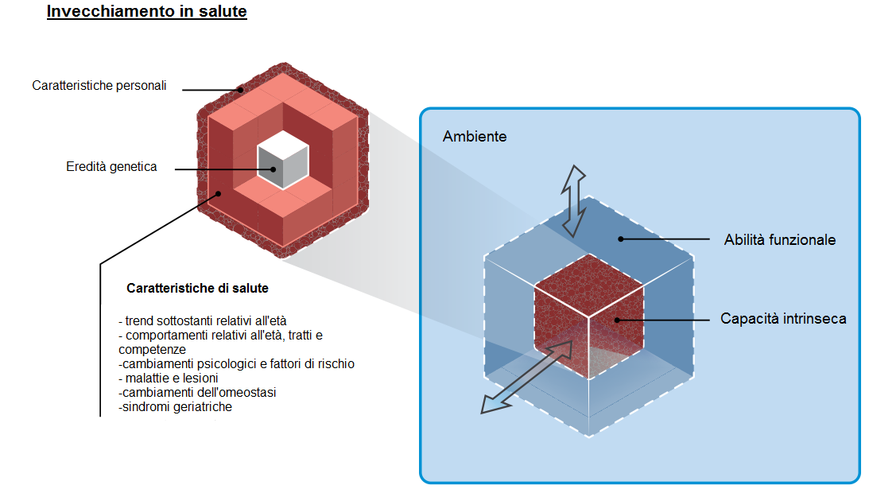
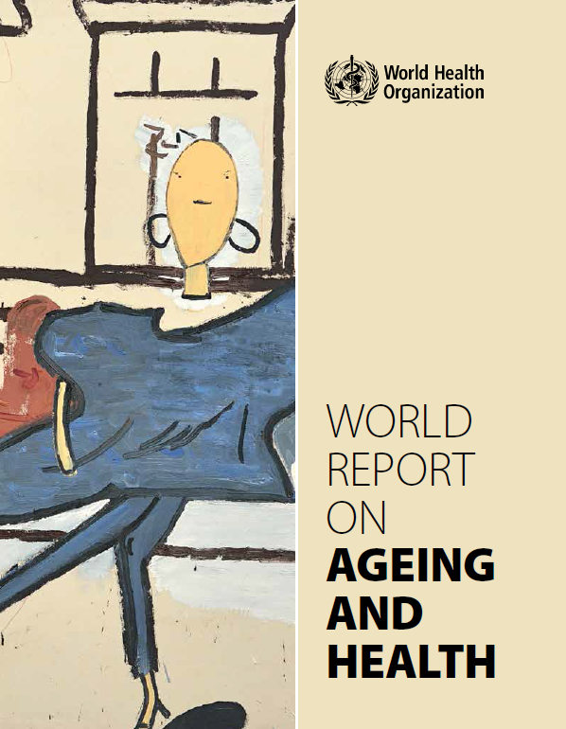
WHO - World report on ageing and health
Notes:
Importanza dell’ambiente, dello stato socioeconomico e dell’assetto familiare: se la capacità intrinseca dipende da fattori «biologici» l’abilità funzionale, se vogliamo l’invecchiamento in salute, dipende dall’interazione tra la capacità intrinseca e l’ambiente.
IMPORTANTE STUDIARE ED INTERVENIRE SIA SULL’INDIVIDUO CHE SULL’AMBIENTE

Slide 9
Identifying an at-risk older population: FRAILTY
Frailty is a common geriatric syndrome associated with aging
Around 10% of people aged over 65 years have frailty, rising to between a quarter and half of those aged over 85 years.
Frailty is defined as a state of increased vulnerability resulting from aging and often disease associated decline in reserve and function across multiple physiologic systems such that the ability to cope with acute stressors is reduced
Frailty is associated with increased risk of adverse health outcomes such as: functional decline, disability, repeated falls, reduction of the quality of life, repeated hospitalizations, nursing home admission and death.
Notes:
Fragilità….altro mostro.
DEFINIZIONE e accento sul suo stupefacente potere predittivo

Slide 10
Notes:
Queste due entità coesitono nella popolazione anziana e risultano indipendentemente associate.
I dati finora disponibili, pochi invero, suggeriscono una relazione bidirezionale tra fragilità e multimorbilità. NECESSARIO FARE PIU’ RICERCA PER CAPIRE FATTORI DI RISCHIO E MECCANISMI.

Slide 12

OLDER PATIENTS
Functional impairment
  Physical
  Cognitive
  Mood
Malnutrition
Sarcopenia
Multimorbidity
Polypharmacy
Worsening health status
Reduced quality of life
Adverse outcomes
Increased use of healthcare resources
COMPLEXITY

Slide 13
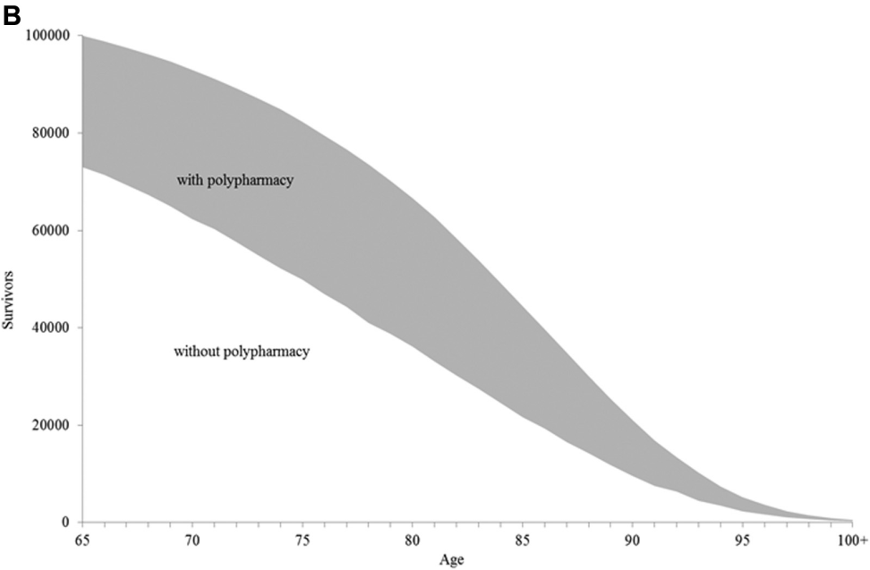
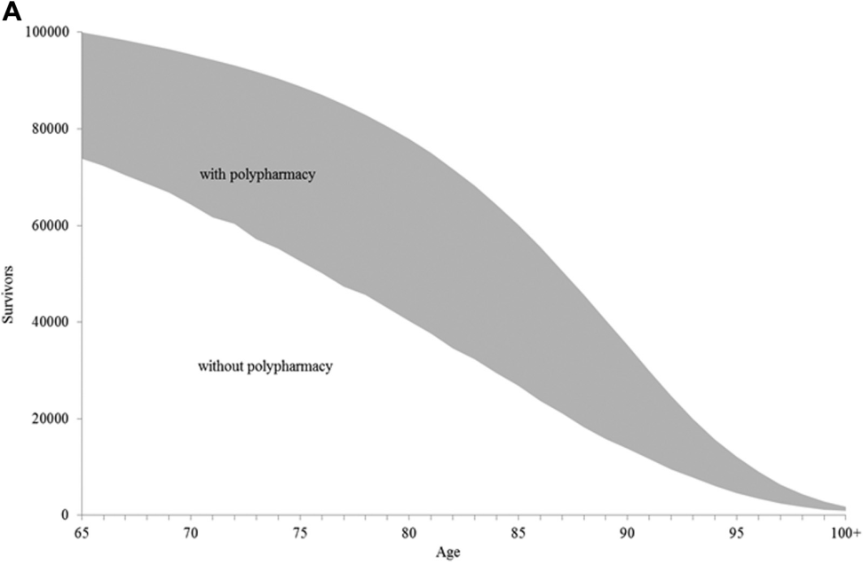
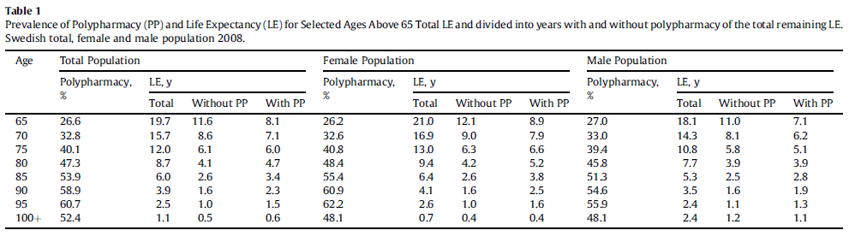
Older people spend most of their remaining life expectancy with polypharmacy
Males
Females

Slide 20
Males
Females

