Slide 1
Azienda Ospedaliera Universitaria S. Giovanni di Dio e Ruggi d’Aragona – Salerno ( Italy )
Cattedra di Malattie dell’Apparato Cardiovascolare
Dipartimento di Medicina, Chirurgia, Odontoiatria
Scuola Medica Salernitana
UNIVERSITÀ DEGLI STUDI DI SALERNO
La rivascolarizzazione coronarica nel grande anziano
Prof. Federico Piscione

Slide 3
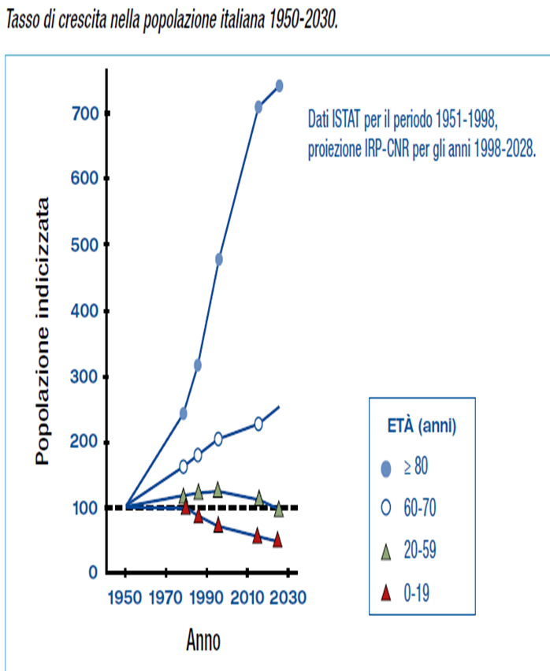
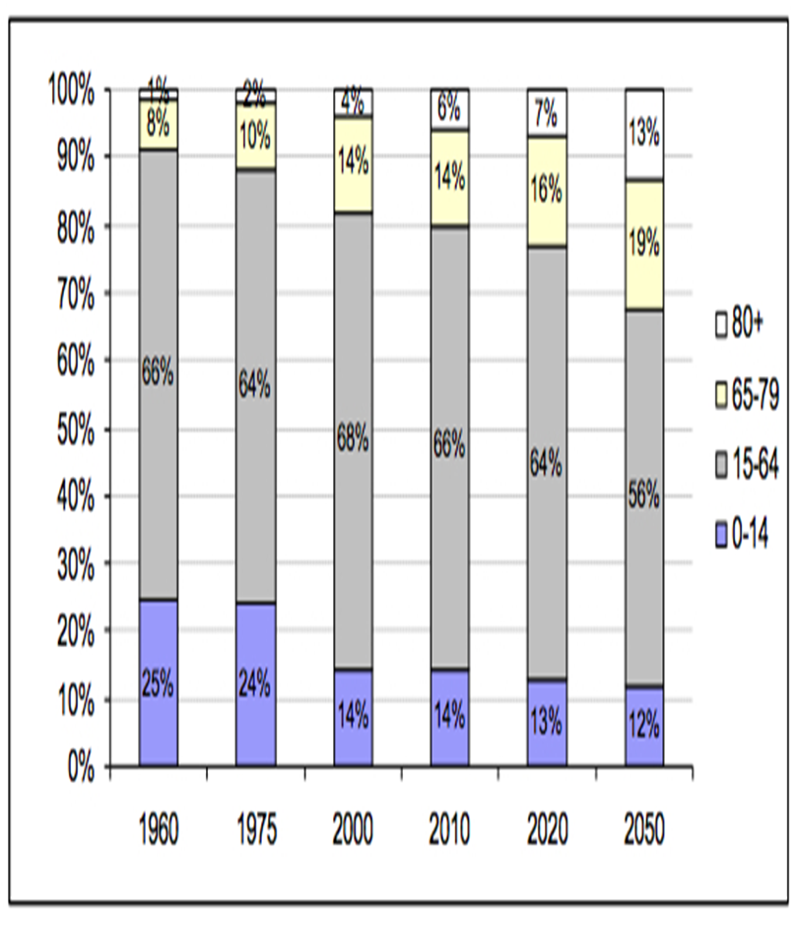
“ ELDERLY BOOM ”

Slide 4
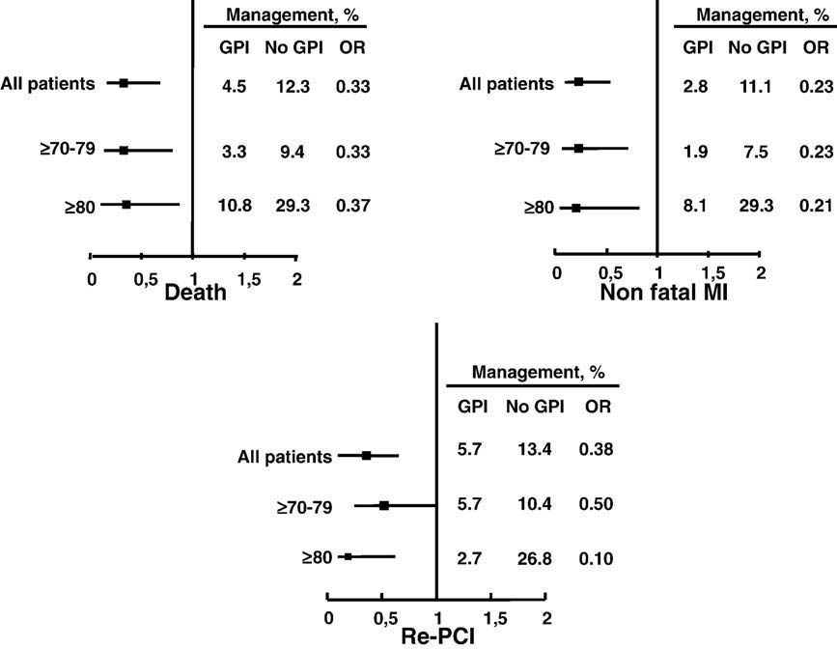
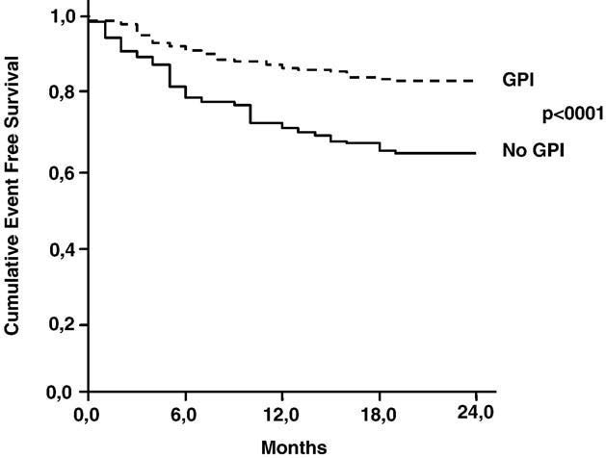
Abciximab in elderly with Acute Coronary Syndrome invasively treated: Effect on outcome .
Gennaro Galasso , Federico Piscione , Fulvio Furbatto , Dario Leosco , Adele Pierri ,Roberta De Rosa , Plinio Cirillo a, Antonio Rapacciuolo ,Giovanni Esposito , Massimo Chiariello
Long-term follow-up. This figure reports the incidence of death, non-fatal MI and pre-PCI at long-term follow-up in the two groups. Patients treated with
abciximab showed a significant reduction in any considered adverse events compared with patients treated with stenting alone. This difference was confirmed
also in patients divided by age.
Kaplan–Meier analysis on event-free survival. Analysis of
cumulative MACE in the two groups of patients. Elderly treated with PCI and abciximab showed a significant reduction in overall MACE.
International Journal of Cardiology xx (2008) – IJCA 10835

Slide 5
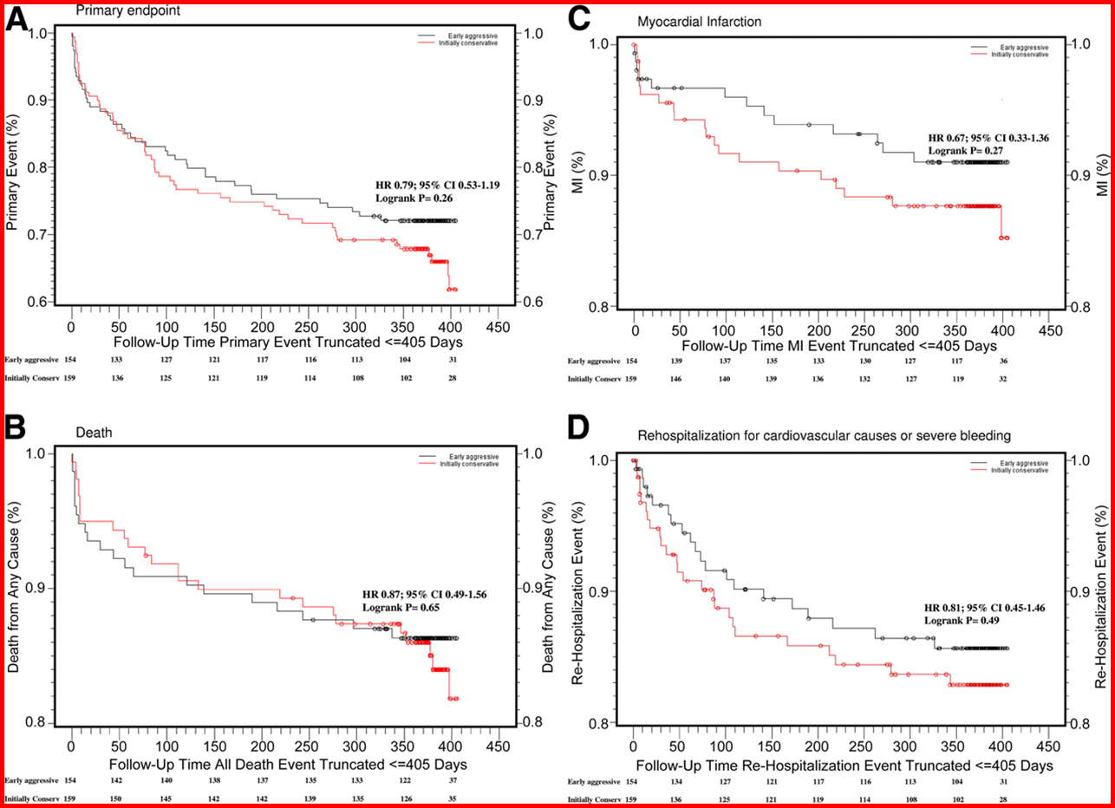
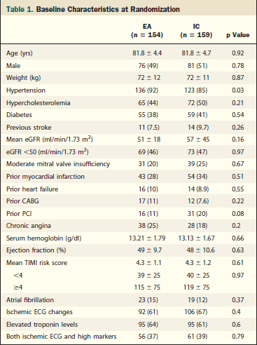
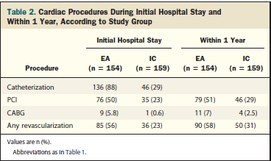
A Randomized Controlled Trial
Stefano Savonitto, MD,* Claudio Cavallini, MD,† A. Sonia Petronio, MD,Ernesto Murena, MD,§ Roberto Antonicelli, MD, Alice Sacco, MD,Giuseppe Steffenino, MD,# Francesco Bonechi, MD,** Ernesto Mossuti, MD,††Antonio Manari, MD,* Salvatore Tolaro, MD,‡‡ Anna Toso, MD,Alessandro Daniotti, MD, Federico Piscione, MD,¶¶ Nuccia Morici, MD,Bruno M. Cesana, MD,## M. Cristina Jori, MD,*** Stefano De Servi, MD,for the Italian Elderly ACS Trial Investigators.
Italian Elderly ACS Study; NCT00510185 (J Am Coll Cardiol Intv 2012;5:
906–16) © 2012 by the American College of Cardiology Foundation
Notes:
The present study does not allow a definite conclusion about the benefit of an EA approach
when applied systematically among elderly patients with NSTEACS. The finding of a significant
interaction for the treatment effect according to troponin status at baseline should be confirmed
in a larger size trial. (Italian Elderly ACS Study; NCT00510185) (J Am Coll Cardiol Intv 2012;5:
906–16) © 2012 by the American College of Cardiology Foundation

Slide 6
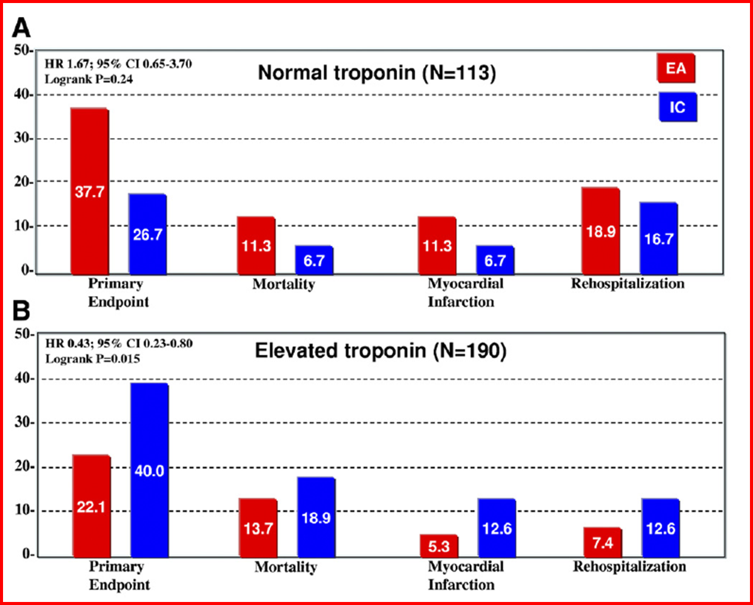

Slide 7
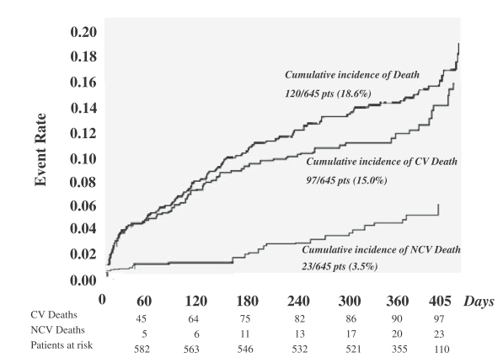
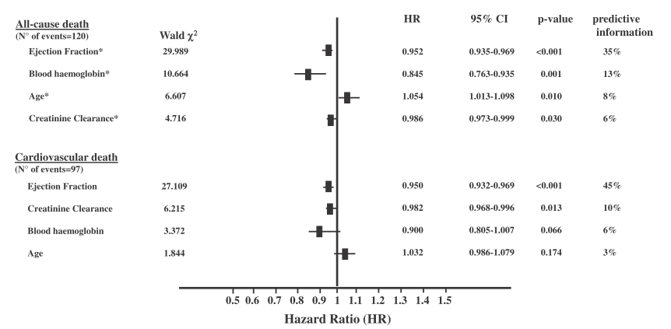
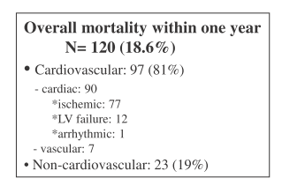
Am J Cardiol 2013

Slide 8
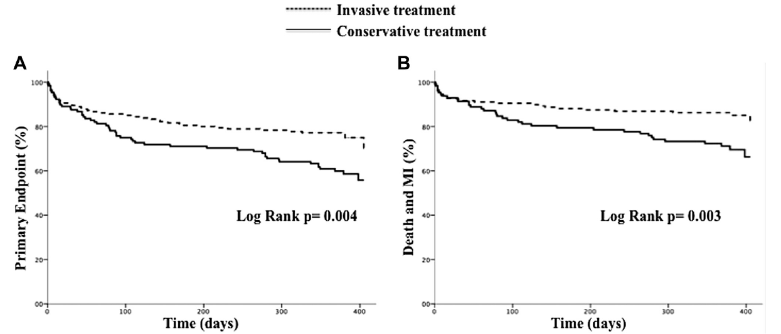
313 pts
Primary end point was the composite of death, myocardial infarction, disabling stroke, and repeat hospital stay for cardiovascular causes or bleeding within 1 year

Slide 9
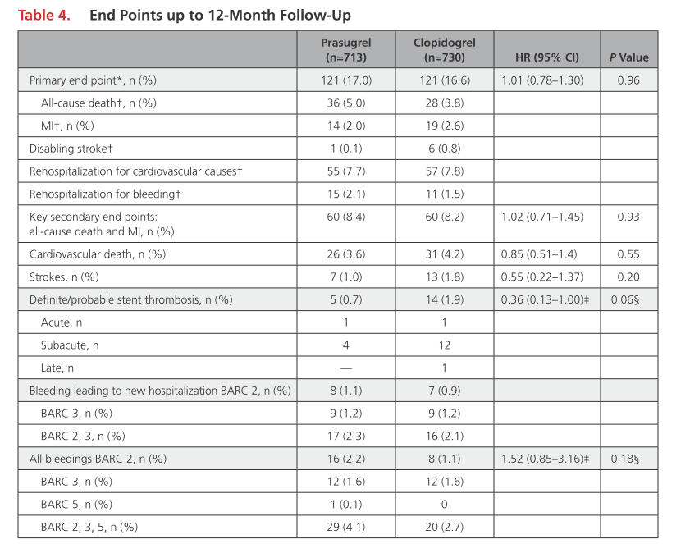
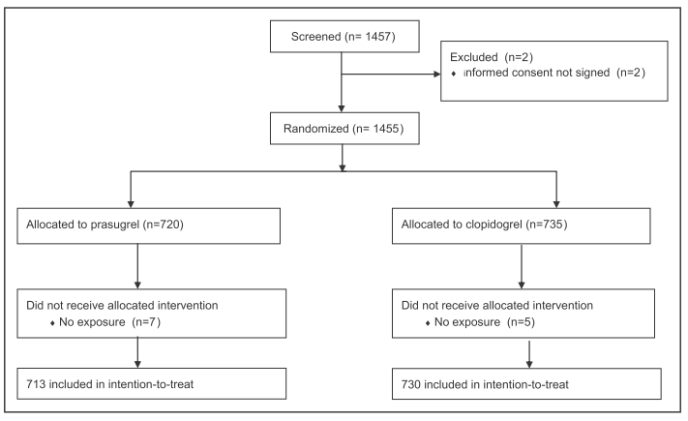
prasugrel 5 mg vs clopidogrel 75 mg
Savonitto et al. Circulation 2018
Notes:
The present study in elderly patients with ACS showed
no difference in the primary end point between re-
duced-dose prasugrel and standard-dose clopidogrel.
However, the study should be interpreted in light of the
premature termination of the trial. The study adds clinical data to the existing guideline recommendations 12,13
that a reduced 5-mg prasugrel dose can be used as an
alternative to clopidogrel in elderly patients with ACS
after PCI, although without overall clinical benefit. In
terms of actual event rates and complications, the pres-
ent trial provides original information on the antiplatelet
therapy of elderly patients with ACS treated with PCI,
reducing the knowledge gaps 33 in this growing popula-
tion that is still poorly represented in clinical trials.

Slide 10
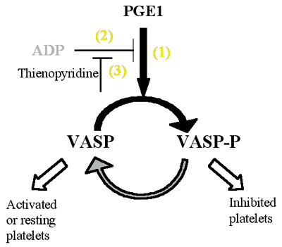
> 50% --> HPR
Platelet Reactivity Index (PRI)
≤ 50% --> no HPR
Baseline
At discharge
At 1 month

Slide 11
HPR and clinical outcome in elderly vs non-elderly patients
De Rosa et al. International Journal of Cardiology 2018;259:20-25

Slide 12
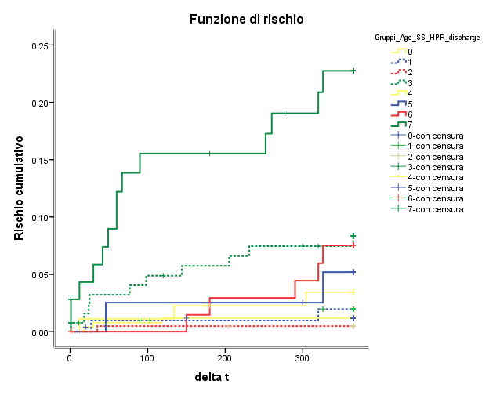
Overall risk of MACE up to 1 year according to age, HPR and Syntax Score
A) Risk of MACE between discharge and 1 year according to HPR at discharge.
B) Risk of MACE between 30 days and 1 year according to HPR at 1 month.
25
Log Rank (Mantel-Cox)
p<0.001
20
Log Rank (Mantel-Cox)
p<0.001
20
15
15
MACE (%)
MACE (%)
10
MACE (%)
10
5
5
0
0
30
120
210
365
discharge
100
200
300
365
300
48.1
17.2
MACE (%)
Age < 75, HPR-, SS < 15
MACE (%)
22.7
6.8
HPR+
20.5
20.7
SS ≥ 15
6.2
4.4
HPR + and SS ≥ 15
2.9
Age ≥ 75
1.4
1,7
4.9
5.7
1.7
De Rosa et al. International Journal of Cardiology 2018;259:20-25

Slide 13
Predictors of MACE up to 1 year in elderly patients
Outcome between discharge and 1 year
Outcome between 1 month and 1 year
 | Univariate |  | Stepwise multivariate
Variable | Hazard ratio (CI) | p | Hazard ratio (CI) | p
Male gender | 1.312 (0.931-1.848) | 0.121 | - | -
Diabetes | 2.708 (1.368-5.359) | 0.004 | 2.597 (1.305-5.168) | 0.007
LVEF | 1.004 (0.974-1.034) | 0.821 | - | -
NSTEMI-presentation | 1.413 (0.685-2.915) | 0.349 | - | -
Chronic kidney disease | 1.261 (0.586-2.714) | 0.552 | - | -
SYNTAX Score ≥ 15 | 1.999 (1.002-3.988) | 0.049 | 1.626 (0.807-3.276) | 0.174
HPR pre-discharge | 3.343 (1.440-7.759) | 0.005 | 3.191 (1.373-7.417) | 0.007
HPR at pre-discharge and SS < 15 | 5.748 (1.82-18.110) | 0.003
No HPR at discharge and SS ≥ 15 | 1.209 (0.292-5.011) | 0.794
HPR at discharge and SS ≥ 15 | 4.376 (2.086-9.184) | <0.001
CYP2C19*2 681 G>A - AA (8/223) - GA (61/223) - GG (154/223) | 0.731 (0.288-1.853) 1.121 (0.149-8.427) 1.361 (0.607-3.053) | 0.510 0.911 0.455 | - - - | - - -
 | Univariate |  | Stepwise multivariate
Variable | Hazard ratio (CI) | p | Hazard ratio (CI) | p
Male gender | 1.104 (0.711-1.714) | 0.661 | - | -
Diabetes | 3.433 (1.446-8.148) | 0.005 | 3.560 (1.499-8.454) | 0.004
LVEF | 1.002 (0.964-1.041) | 0.935 | - | -
NSTEMI-presentation | 1.149 (0.476-2.772) | 0.757 | - | -
Chronic kidney disease | 1.704 (0.688-4.223) | 0.249 | - | -
SYNTAX Score ≥ 15 | 3.033 (1.224-7.515) | 0.017 | 2.347 (0.925-5.888) | 0.062
HPR at 1 month | 3.281 (1.273-8.458) | 0.014 | 3.542 (1.373-9.137) | 0.009
HPR at 1 month and SS < 15 | 11.3 (3.049- 42.29) | < 0.001
No HPR at 1 month and SS ≥ 15 | 0.425 (0.149-1.211) | 0.109
HPR at 1 month and SS ≥ 15 | 3.771 (1.653-8.601) | 0.002
CYP2C19*2 681 G>A AA (8/223) GA (61/223) GG (154/223) | 1.291 (0.422-3.945) 2.602 (0.325-20.808) 2.356 (0.854-6.498) | 0.655 0.367 0.098 | - - - | - - -

Slide 14
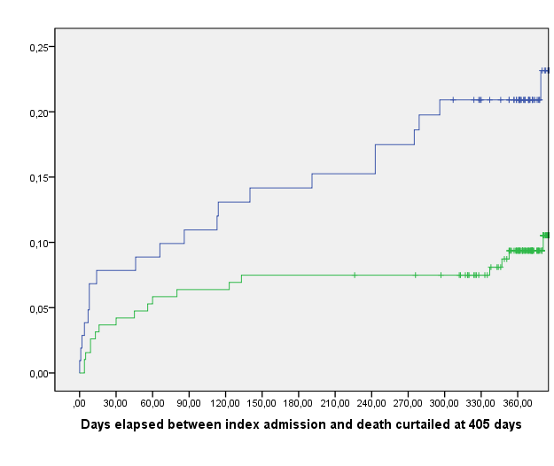
Clearance <45 ml min
Clearance >45 ml min
Log-rank=0.015
Deaths in patients 8 11 13 14 15 20
with renal dysfunction (n=108)
Deaths in patients
without renal dysfunction (n=198) 8 12 12 14 14 17

Slide 15
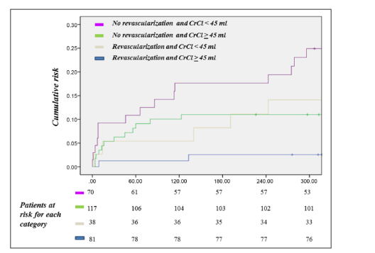
Cumulative Risk of Overall Death stratified according renal dysfunction and coronary revascularization

Slide 16
Preliminary Results…
Baseline characteristics between patients presenting with STE-ACS or NSTE-ACS
 | STE-ACS (N=711) | NSTE-ACS (N=1225) | p
Age | 81.0±4.7 | 80.8±4.5 | 0.510
Male gender | 373 | 727 | 0.006
Diabetes - IDDM | 178 46 | 389 125 | 0.002 0.006
Hypertension | 512 | 903 | <0.001
Dyslipidemia | 270 | 537 | <0.001
Current smoker | 78 | 82 | 0.001
BMI | 25.2±5.2 | 25.6±5.0 | 0.073
Overweight (BMI>25)
Previous MI | 72 | 282 | <0.001
Previous PCI | 81 | 253 | <0.001
Previous CABG | 26 | 141 | <0.001
COPD | 29 | 75 | 0.004
Family history of CVD | 96 | 137 | 0.943
Atrial fibrillation | 7 | 49 | <0.001
Creatinine clearance | 54.8±20.0 | 52.8±19.7 | 0.050
Chronic kidney disease - moderate (eGFR<40) - severe (eGFR<30)
Blood haemoglobin | 12.1±4.3 | 13.1±2.0 | <0.001
LV-EF | 42.6±13.7 | 48.1±12.1 | <0.001
Previous therapy - aspirin -P2Y12 inhibitors - statins | 235 47 159 | 641 233 435 | <0.001 <0.001 <0.001
Multivessel disease
Number of critically diseased vessels | 1.9±1.0 | 2.1±1.1 | <0.001
In-hospital and long-term clinical outcome of patients presenting with STE-ACS or NSTE-ACS
 | STE-ACS (N=711) | NSTE-ACS (N=1225)) | p
In-hospital all-cause death | 16 | 13 | 0.050
In-hospital cardiovascular death | 14 | 10 | 0.224
1-y all-cause death | 54 | 64 | 0.032
1-y cardiovascular death | 36 | 40 | 0.052
12months All-cause death (n=118)
Variable | HR | 95% CI | p Value
Age | 1.056 | 1.017-1.096 | 0.005
Male gender | 1.037 | 0.721-1.491 | 0.846
Diabetes - IDDM | 1.741 2.006 | 1.207-2.511 1.228-3.277 | 0.003 0.005
BMI | 0.972 | 0.943-1.002 | 0.071
Creatinine clearance <60 <40 <30 | 0.977 | 0.966-0.987 | <0.001
Blood hemoglobin | 0.959 | 0.913-1.007 | 0.096
LV-ejection fraction | 0.988 | 0.974-1.002 | 0.095
Atrial fibrillation | 1.533 | 0.626-1.756 | 0.350
ACS type | 1.477 | 1.028-2.121 | 0.035
Number of critically diseased vessels | 1.048 | 0.893-1.230 | 0.564
Multivessel disease | 1.138 | 0.781-1.659 | 0.501
P2Y12-inhibitor during index hospitalization | 1.111 | 0.926-1.334 | 0.256

Slide 17
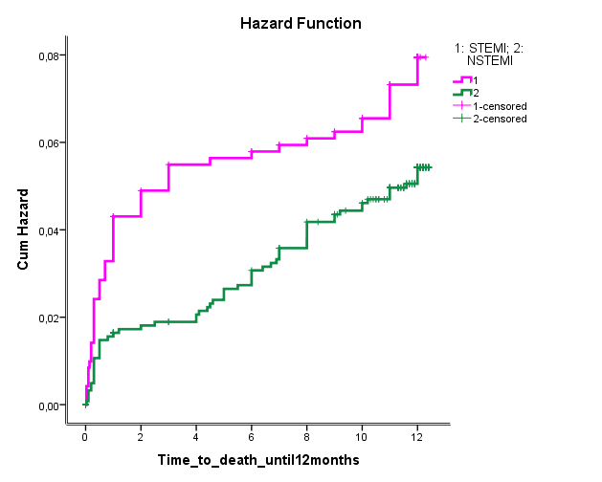
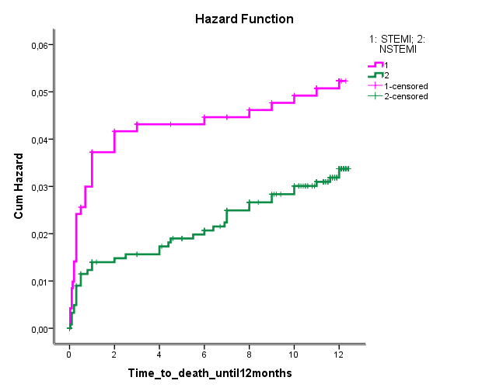
Cumulative all-cause death hazard at 12 months in elderly patients presenting with STE- or NSTE-ACS
Cumulative cardiovascular death hazard at 12 months in elderly patients presenting with STE- or NSTE-ACS
Log Rank (Mantel-Cox)= 0.033
Log Rank (Mantel-Cox)= 0.046

Slide 18
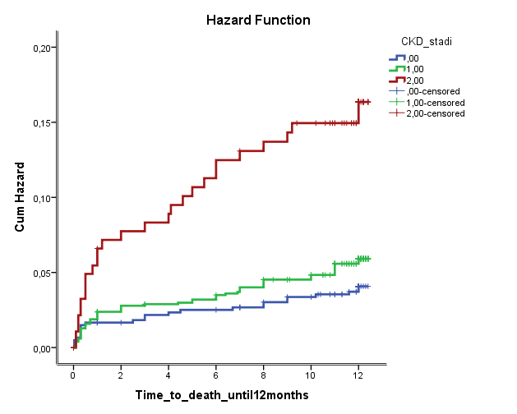
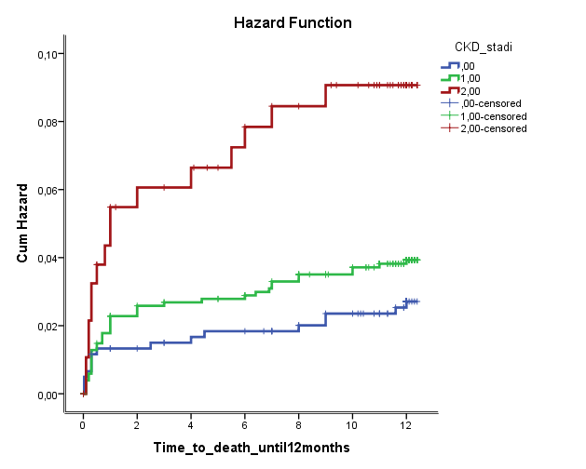
Cumulative all-cause death hazard at 12 months in elderly ACS patients according to eGFR
Cumulative cardiovascular death hazard at 12 months in elderly ACS patients according to eGFR
Log Rank (Mantel-Cox)<0.001
Log Rank (Mantel-Cox)=0.001
0= eGRF>60
1=eGFR 30-59
2=eGFR<30

Slide 19
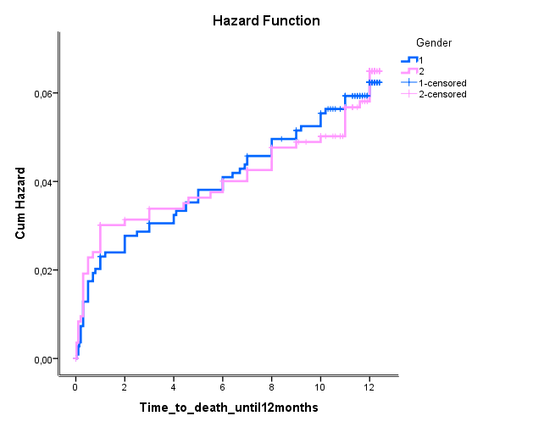
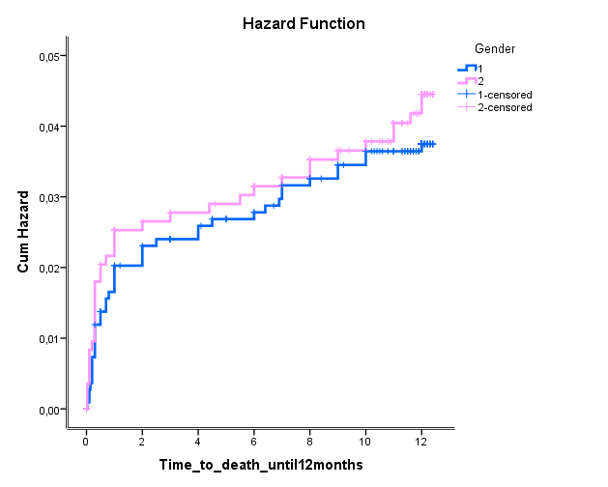
Cumulative all-cause death hazard at 12 months in elderly ACS patients according to gender
Cumulative cardiovascular death hazard at 12 months in elderly ACS patients according to gender
Log Rank (Mantel-Cox)=0.846
Log Rank (Mantel-Cox)=0.464
1=male
2=female

Slide 20
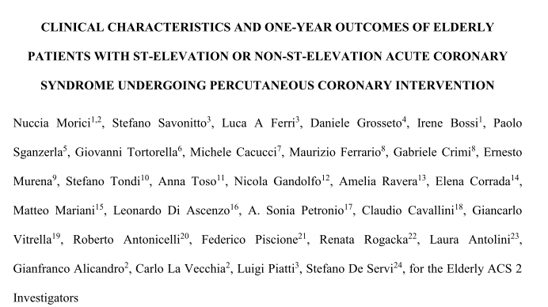
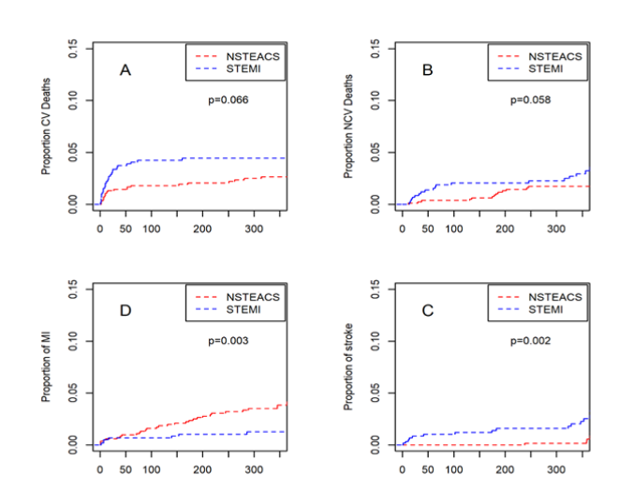

Slide 21
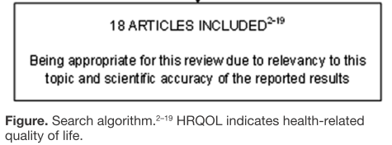
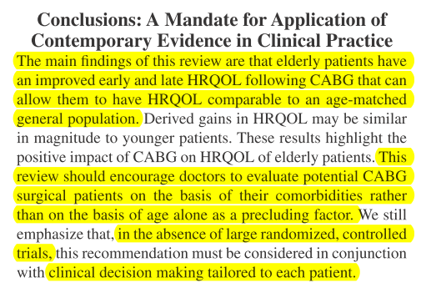
7972 patients
Almost 25% of all patients undergoing CABG are
>70 years of age.
Notes:
health-
related quality of life (HRQOL) following CABG

Slide 22
Conclusions
La rivascolarizzazione nel grande anziano è fortemente raccomandata, in particolare in presenza di sindromi coronariche acute.
La reattività piastrinica, il Sintax score e la funzione renale sono importanti determinanti dell’outcome clinico a lungo termine.
Nel grande anziano, a differenza di quanto osservato finora in letteratura nella globalità dei pazienti, l’outcome clinico a distanza è peggiore nei pazienti STEMI.
La chirurgia coronarica nel grande anziano è possibile, indipendentemente dall’età ma è fortemente dipendente dal profilo clinico del paziente.

Slide 23
GRAZIE
CardioUnisa 2017

Slide 24
Back up Slides

Slide 25
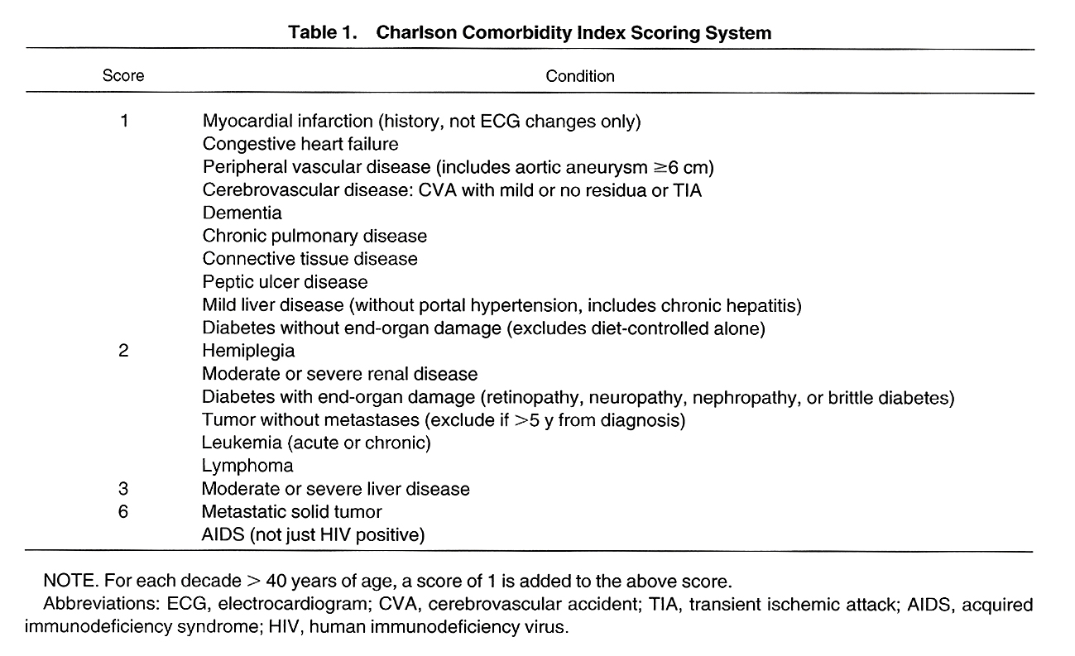
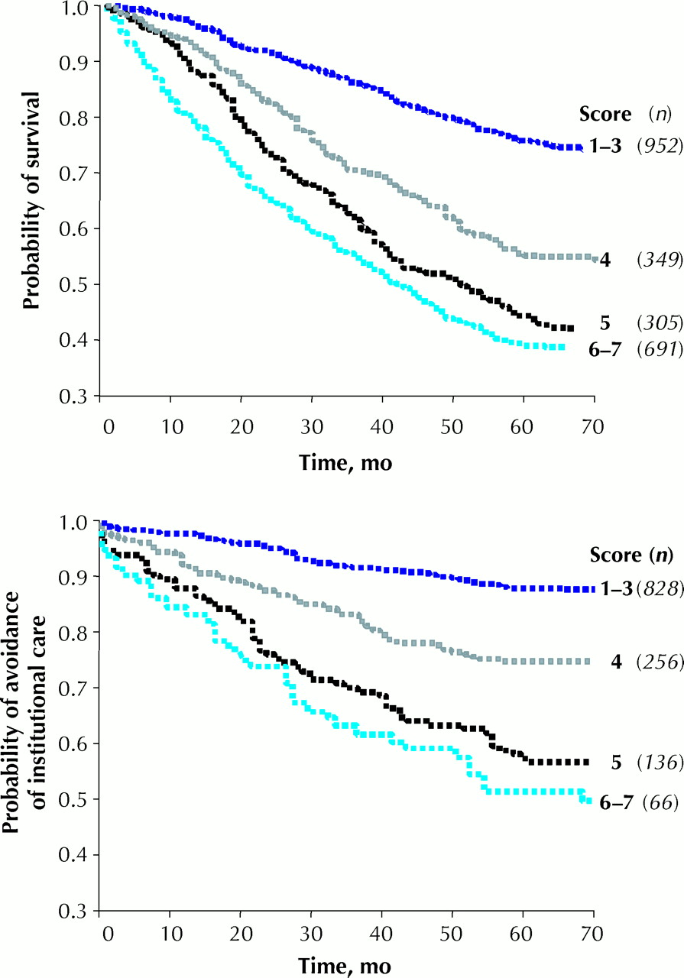
A global clinical measure of fitness and frailty in elderly people
Kenneth Rockwood, Xiaowei Song, Chris MacKnight, Howard Bergman, David B. Hogan, Ian McDowell, Arnold Mitnitski
Fig. 1: Kaplan–Meier curves, adjusted for age and sex, for study participants (n) over the medium term (5–6 years), according to their scores on the CSHA Clinical Frailty Scale.
Roc
Fig.1l. CMAJ 2005;173:489-495
(CMAJ-August 30,2005 )
Notes:
Fig. 1: Kaplan–Meier curves, adjusted for age and sex, for study participants (n) over the medium term (5–6 years), according to their scores on the CSHA Clinical Frailty Scale. Some scores were grouped. Top: Probability of survival. Bottom: Probability of avoidance of institutional care.

Slide 26
Ma esiste anziano e anziano!
Notes:
Background: There is no single generally accepted clinical definition of frailty. Previously developed tools to assess frailty that have been shown to be predictive of death or need for entry into an institutional facility have not gained acceptance among practising clinicians. We aimed to develop a tool that would be both predictive and easy to use.
Methods: We developed the 7-point Clinical Frailty Scale and applied it and other established tools that measure frailty to 2305 elderly patients who participated in the second stage of the Canadian Study of Health and Aging (CSHA). We followed this cohort prospectively; after 5 years, we determined the ability of the Clinical Frailty Scale to predict death or need for institutional care, and correlated the results with those obtained from other established tools.
Results: The CSHA Clinical Frailty Scale was highly correlated (r = 0.80) with the Frailty Index. Each 1-category increment of our scale significantly increased the medium-term risks of death (21.2% within about 70 mo, 95% confidence interval [CI] 12.5%–30.6%) and entry into an institution (23.9%, 95% CI 8.8%–41.2%) in multivariable models that adjusted for age, sex and education. Analyses of receiver operating characteristic curves showed that our Clinical Frailty Scale performed better than measures of cognition, function or comorbidity in assessing risk for death (area under the curve 0.77 for 18-month and 0.70 for 70-month mortality).
Interpretation: Frailty is a valid and clinically important construct that is recognizable by physicians. Clinical judgments about frailty can yield useful predictive information.

Slide 27
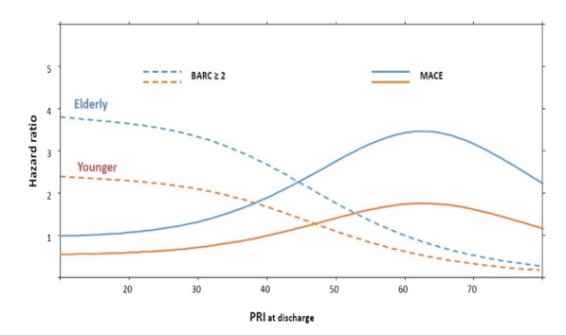
De Rosa et al. International Journal of Cardiology 2018;259:20-25

Slide 29
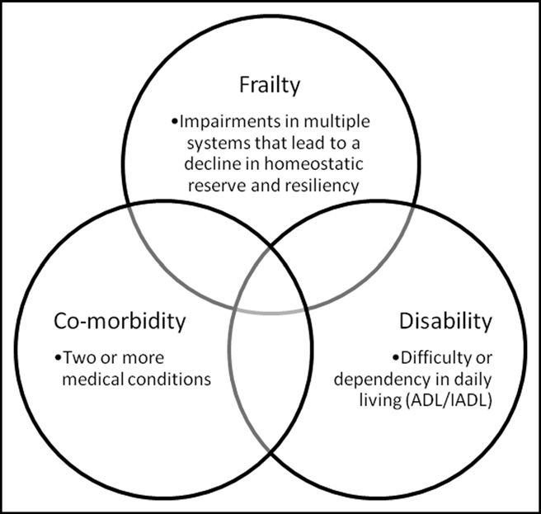
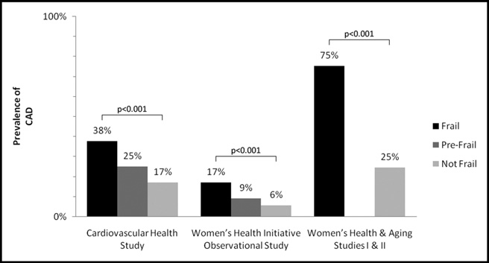
Role of Frailty in Patients With Cardiovascular Disease
Jonathan Afilalo, MD, Sathya Karunananthan, MS, Mark J. Eisenberg, MD, MPH,
Karen P. Alexander, MD, and Howard Bergman, MD.
Overlap between frailty, co-morbidity, and disability. ADL
activities of daily living (basic self-care tasks); IADL instrumental ADL (household management tasks).
Prevalence of cardiovascular disease stratified by frailty status.
Depicted studies used the same definition of frailty, based on Fried’s
criteria, with 3 of 5 criteria required for a diagnosis of frailty and 1 or 2 of 5 criteria for a diagnosis of prefrailty. CAD coronary artery disease.
(Am J Cardiol 2009;103:1616 –1621)
Notes:
the domains of strength,
function, nutrition, mobility, and cognition.
Using the most
often cited construct, frailty is associated with a two- to
threefold increase in the prevalence of CVD

Slide 30
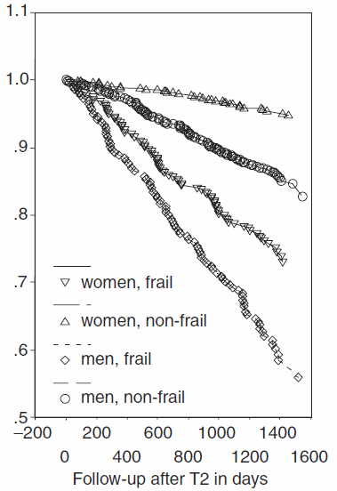
La fragilità ha un effetto indipendente sulla mortalità rispetto alla presenza di comorbidità e disabilità
Survival
Puts TE, J Am Geriatr Soc 2005

Slide 31
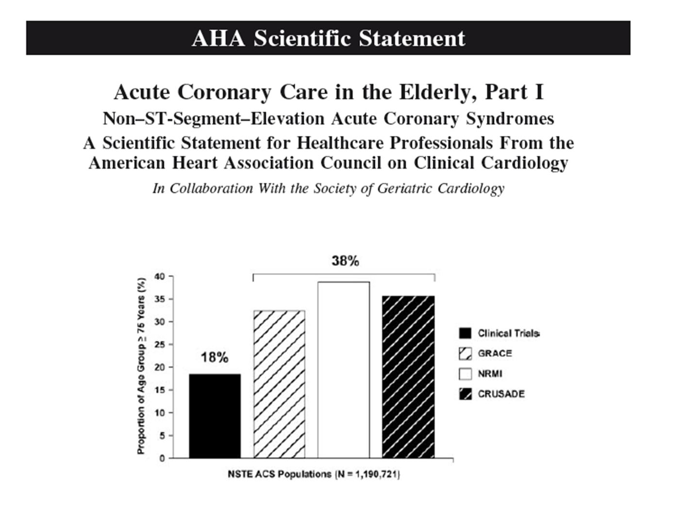

Slide 32
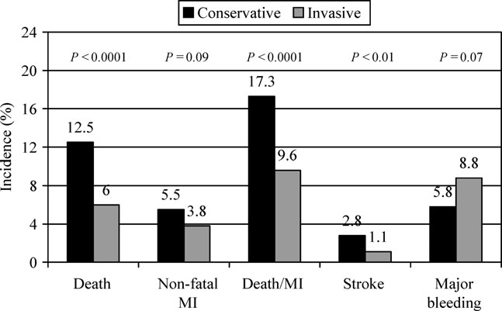
1936 pts > 75 years with NSTEMI
Bauer et al. EHJ 2007

Slide 33
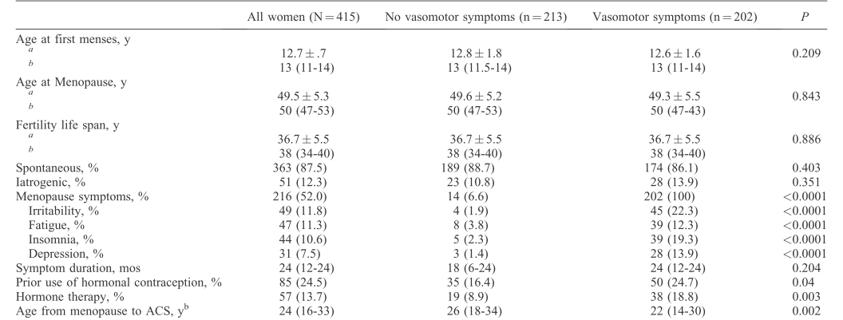
Ferri et al. Menopause, Vol. 25, No. 6, 2018
Notes:
In postmenopausal women with an acute coronary syndrome, a history of VMS was associated
with younger age at presentation, despite a lower vascular disease burden and similar angiographically defined
coronary disease as compared with women without VMS. No difference could be found in terms of overall clinical
outcomes. These results should be interpreted cautiously as all analyses were unadjusted and did not account for risk
factor differences between women with and without a history of VMS.

Slide 34
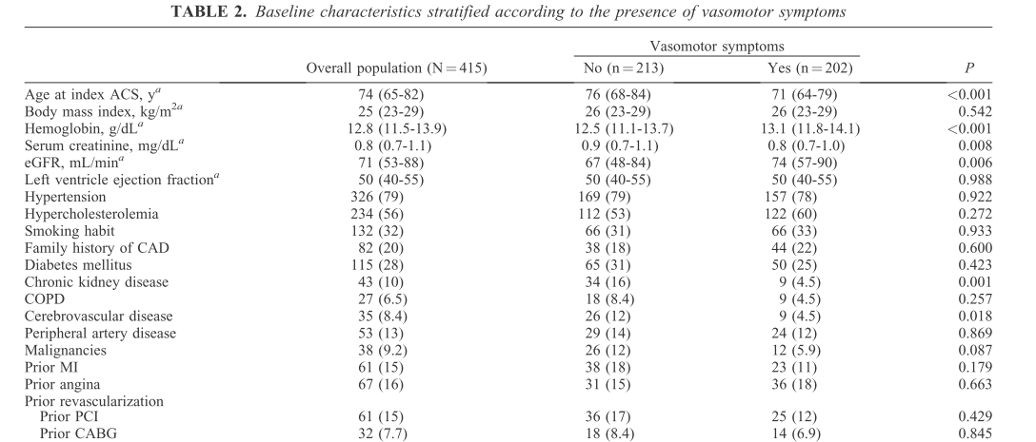

Slide 35
SO…
WHICH STENT ?

Slide 36
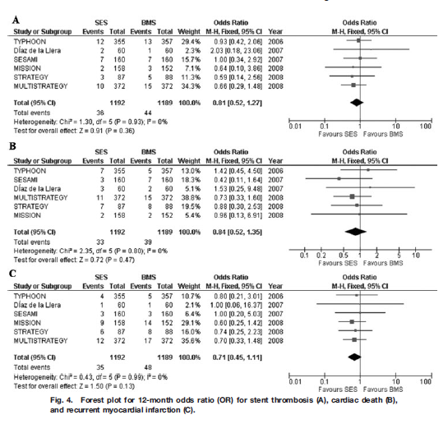
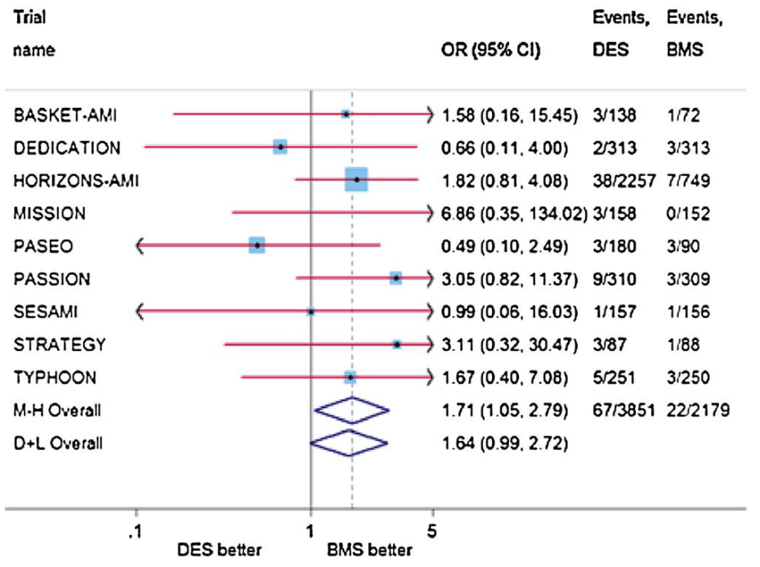
Revascularization strategies
Drug-eluting stents (DES) reduce the need for reintervention when compared to bare-metal stents (BMS):
Piscione F. et al Eurointervention (2010) 5:853-860
Without increasing the risk for death,
MI and stent thrombosis
But with a higher risk for very late stent thrombosis (after 1 year)
Piscione F. et al Cath Card Interv (2009) 74:323-332
Piccolo R., Piscione F. et al Atherosclerosis (2011) 74:149-157

Slide 37
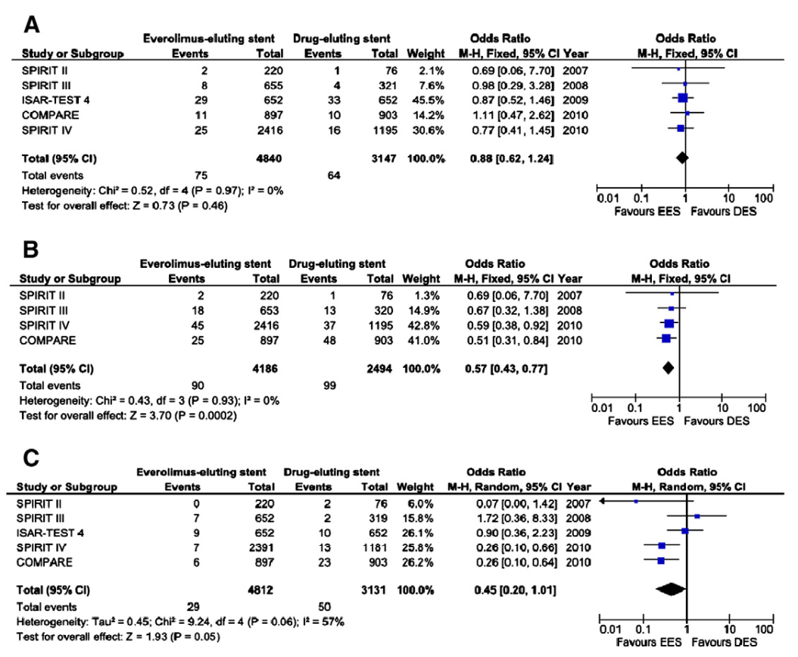
Reintervention
Death
Re-IM
Int J Card (2011) 150:84-89
Notes:
Second-generation DES (everolimus-eluting stent) as compared first-generation DES further reduce reintervention (upper panel), myocardial infarction (B), without a significant difference in death (A).

Slide 38
Stent thrombobis
Second-generation DES have the potential to reduce stent thrombosis
Int J Card (2011) 150:84-89

Slide 39
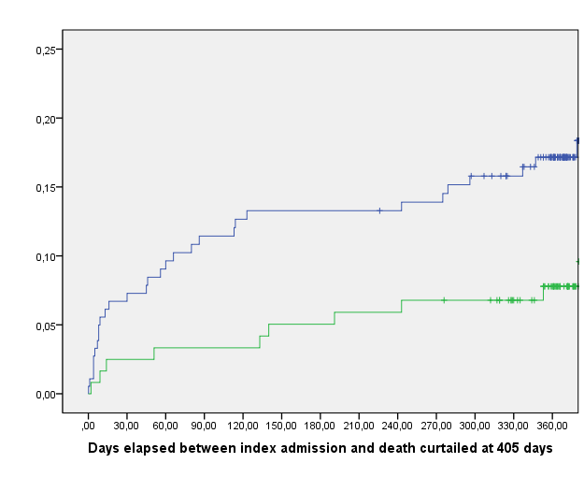
Cumulative Risk of Overall Death in patients with and without coronary revascularization during index admission and at discharge
Log-rank=0.028
Coronary revascularization not performed
Coronary revascularization performed
Deaths in patients 3 4 4 6 7 9
with revascularization (n=124)
Deaths in patients
without revascularization (n=189) 12 20 22 23 23 29

Slide 40
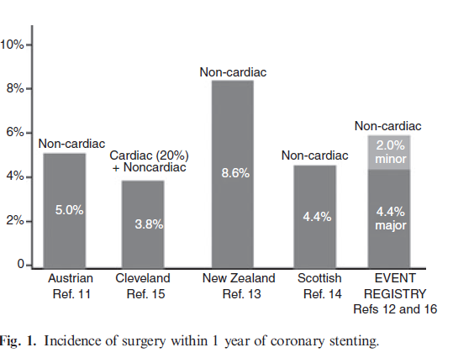

Slide 41
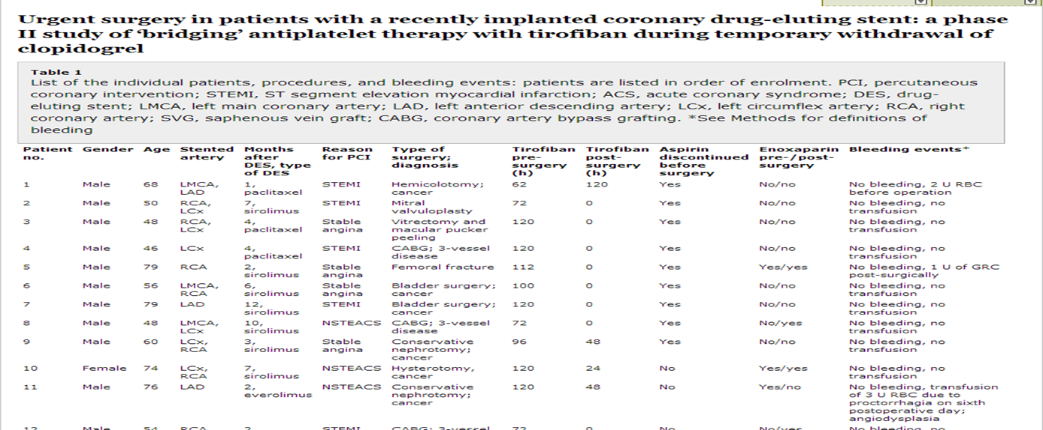
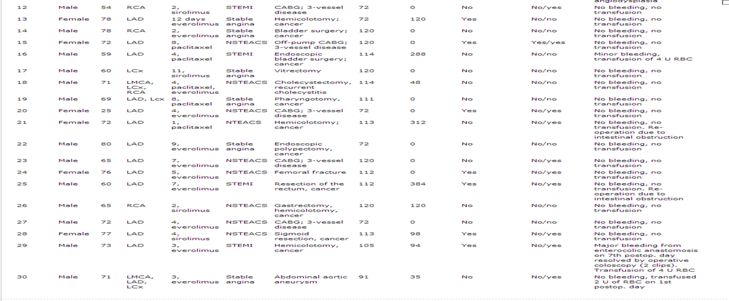
NO bleeding
NO ischaemic events

Slide 42
