Slide 1



“Sapienza” University of Rome
Department of Heart and Great Vessels “A. Reale”
Prof. Francesco Barillà
Presidente e Direttore Scientifico
Dott. Domenico Monizzi
Simposio “ALCMEONE”
Doppia antiaggregazione a lungo termine dopo l’infarto miocardico

Slide 2


Notizie storiche su DAPT e PTCA
1974 I° PTA periferica (A. Gruentzig)
1976 PTCA su coronarie canine (A. Gruentzig)
1977 PTCA (solo POBA) su IVA su giovane di a. 38 A. Gruentzig
1986 PTCA con impianto del I° stent coronarico (uomo di 63 anni con restenosi dell’IVA) Jacques Puel (Toulouse)
Dal 1980 al 1995:
«gli anni bui della PTCA»
1995 trattamento con DAPT in pazienti sottoposti a PTCA delle coronarie con impianto di stent (A. Colombo)
Stenting (STARS): The combination of ASA and a thienopyridine (Ticlopidina) was more effective than warfarin plus ASA after coronary stents
Atrial Fibrillation (ACTIVE W): The combination of aspirin and clopidogrel is not as effective as warfarin in patients with AF

Slide 3
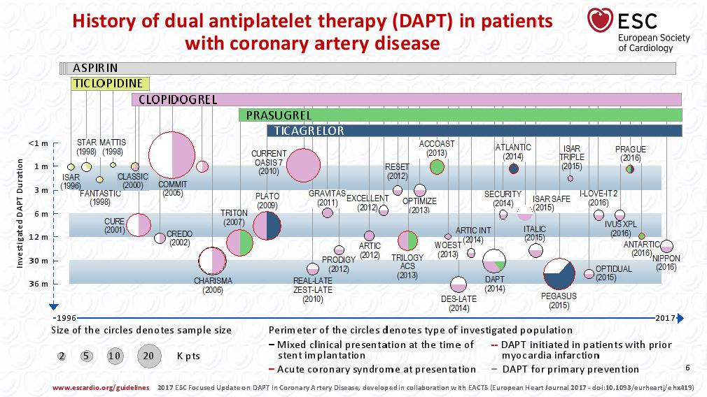

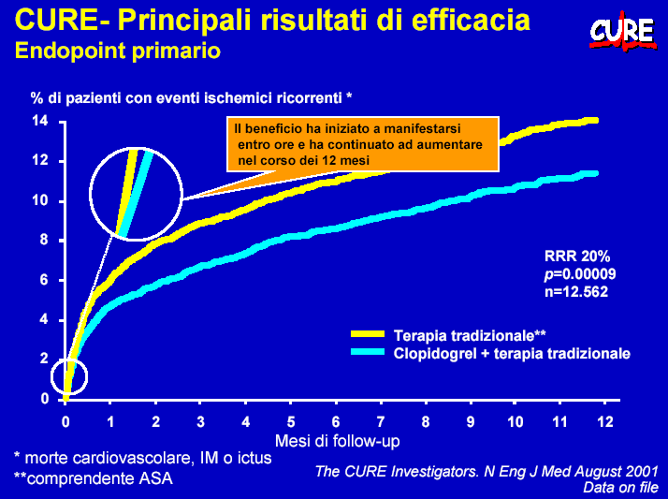
Prior studies of antiplatelet therapy in
pts with CHD in the last two decades
The objective of most clinical studies was to evaluate the effect of DAPT by reducing the risk of stent thrombosis and emphasized the importance of antiplatelet therapy in the reduction of CV events in the follow-up (3-6 months) after stent implantation
The treatment with DAPT after an ACS exerts the majority of its benefit by reducing the rate of CV events from the acute phase to the the follow-up, which is associated with mortality rates of 15%

Slide 4
Key factors for DAPT strategy after ACS
• Treatment modality: PCI, CABG, Medical therapy alone
• Bleeding risk: Low, intermediate, high
• Devices used: DES/BMS or BRS
• Concomitant therapies: OAC
• Choice the optimal DAPT strategy
• Duration in the follow-up post-ACS

Slide 5

Indications for the use of P2Y12 receptor inhibitors in ACS based on thrombotic/hemorrhagic risk
(Clopidogrel/Ticagrelor/Prasugrel)
Choice of P2Y12 inhibitor
Clop 600 mg, plus 75 mg /d in CAD treated with PCI and in ACS pts who cannot receve Tic or Pras including intracranial bleeding
ClopidogrelClasse I-A
CURE, CLARITY,
COMIT,
CHARISMA
CURRENT
-High bleeding risk
previous haemorragic stroke
patients on OAC or NOAC
severe renal failure
Clop 300 mg, + 75 mg/d in STEMI patients treated with thrombolysis
Prasugrel
Ticagrelor
- By-pass strategy
- Conservative strategy
Classe I-B
Classe I-B
TRITON
TRILOGY
PLATO
SWEDEHEART
Clopid and
Ticagrelor
intollerance
Mild to moderate renal impairment
-Clop no resp
-Stent Throm
- Diabetes

Slide 6
Should we use up-stream P2Y12 inhibitor in ACS pts?
Time of starting
STEMI pts Yes!
Guidelines uncertain,
Bleeding risk can increases,
Ischemic risk reduction is uncertain
NSTEMI pts…
….Yes!
GPIIb/IIIa inhibitors may continue to be used regardless of the guidelines, at discretion of the operator during PCI
Clopidogrel is still the P2Y12 inhibitor most commonly used in upstream.
Ticagrelor and prasugrel are often used after PCI by switching from clopidogrel to these drugs

Slide 7

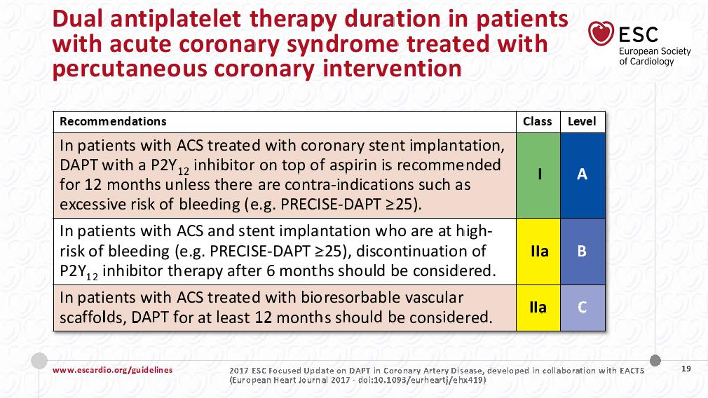
Duration in the follow-up post-PCI
The « optimal » DAPT duration for ACS??
New
CURE
Perchè la DAPT oltre i 12 mesi
e per quali pazienti?

Slide 8

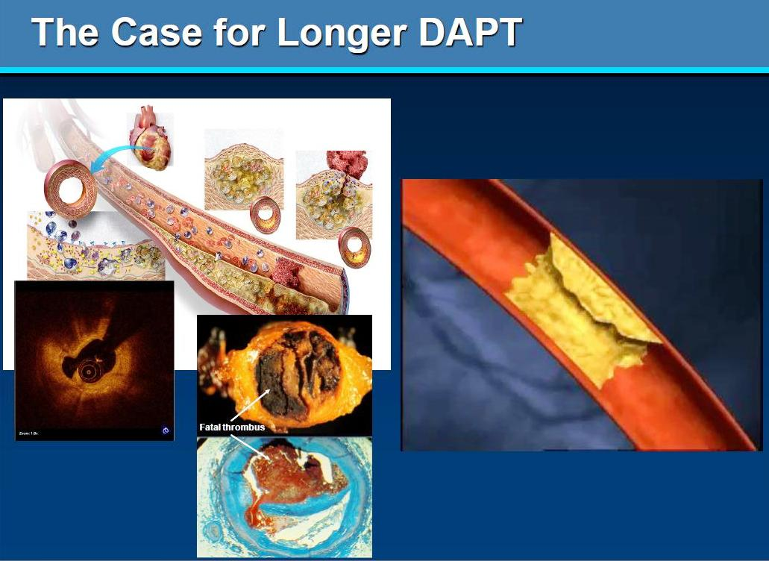
Look beyond the stent…
It’ about atherothombosis!!

Slide 9
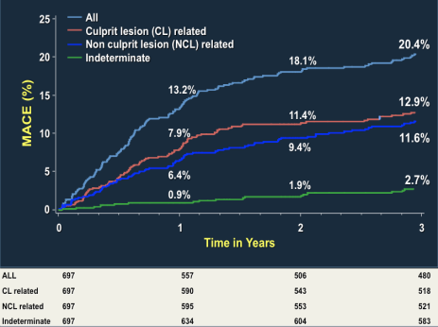
Reason to prolonged DAPT >12 months
Look beyond the stent… about atherothombosis!!
Duration in the follow-up post-PCI
EVIDENCE!!
Nearly half of the recurrent MACE after PCI for ACS are associated with non-culprit lesions at the time of PCI
  The long-term risk of very late thrombosis after PCI does not decrease over time
PROSPECT study: MACE
Wenaweser P et al. JACC 2008;52
  Stone G et al. N Engl J Med 2011;364

Slide 10
EVIDENCE!!
La fisiopatologia della trombosi dello stent è da ascrivere a diversi fattori alcuni dei quali aumentano anche il rischio di nuovi eventi
1) fattori procedurali; 2) fattori relativi allo stent impiantato;
3) fattori relativi al paziente
“high on-treatment
platelet reactivity”
Journal of Cardiovascular Medicine 2016

Slide 11

La stratificazione del rischio trombotico/emorragico diventa indispensabile nei pazienti di età avanzata
Condizioni che > il rischio trombotico
♥ Diabete
♥ Insufficienza renale
♥ Lesioni multivasali o sul TC
♥ PCI su biforcazioni o vasi di piccolo calibro
♥ Vasculopatia periferica
♥ ACS durante il follow-up
Valutare il rischio
trombotico
Valutare il rischio
emorragico
Condizioni che >il rischio emorragico
♥ Età avanzata >70-75 anni
♥ Sesso femminile
♥ Basso peso corporeo
♥ Insufficienza renale
♥ Storia di sanguinamento maggiore
♥ Anemia, Piastrinopenia
♥ Associazioni di farmaci antitrombotici
♥ Gastro-duodenopatie o patologie vie urinarie
♥ Recente trauma maggiore/intervento chirurgico maggiore
La presenza di ≥ 2 o più delle caratteristiche elencate aumenta il rischio emorragico
Notes:
11

Slide 12
Balance between ischemic
vs bleeding risk
Because treatment with DAPT both within and beyond 1 year is associated with increased bleeding risk, is mandatory to evaluate this risk against the potential benefit with prediction models
Hb; WBC; Age;
CrCl; Prior Bleed
New

Slide 13
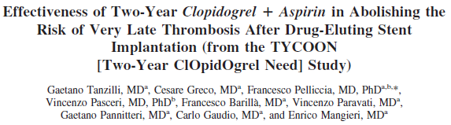
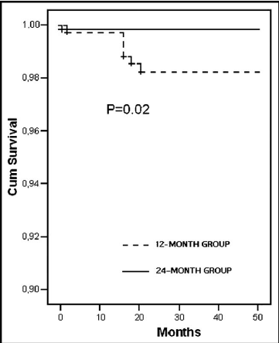
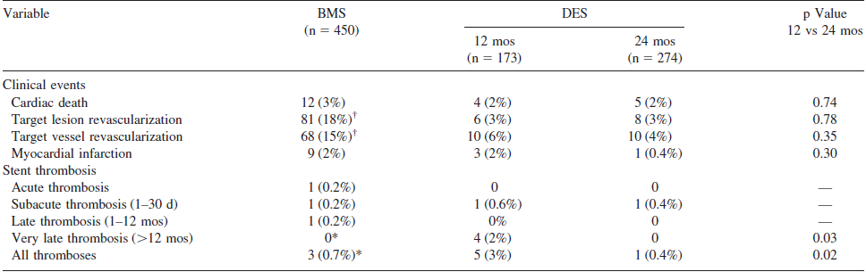
The registry enrolled 897 consecutive patients who underwent PCI with stenting from January 1, 2003, to December 2004, and had dual antiplatelet therapy. All patients had a 4-year clinical follow-up
.. Dual antiplatelet regimen after PCI with DES was given for 12 months in 173 pts (12-month group) and for 24 months in 274 pts treated in 2004 (24-month group).
To address the hypothesis that in the real world the risk of very late thrombosis after PCI with DES can be decreased by an extended use of clopidogrel, we set up the Two-Year ClOpidOgrel Need (TYCOON) registry and prospectively investigated the impact on very late thrombosis of 12- versus 24-month dual antiplatelet regimens in an unselected population
Survive curve in the follow-up
Clinical events during follow-up
* p 0.05, BMS versus 12-month DES group; † p 0.05, BMS versus 12- and 24-month DES groups.
Am J Cardiol 2009;104:1357-1361

Slide 14
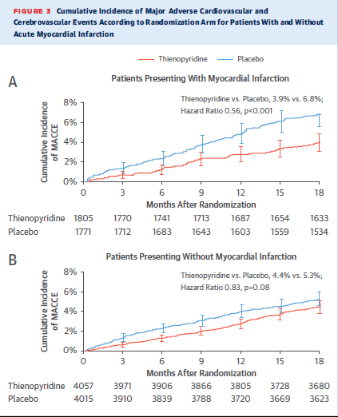
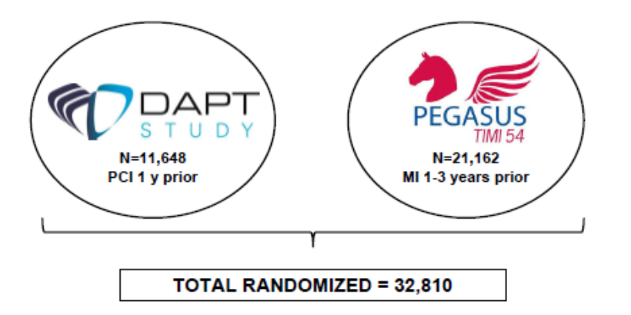
Duration in the follow-up post-PCI
12 vs 30 months of DAPT after PCI + stent: non only ACS
CHARISMA: Prior MI (a post-hoc alalysis)
23% risk reduction if prior MI
The most important antiplatelet therapy trials of prolonged DAPT
CHARISMA
3846 pts A vs A+C
23% risk reduction if prior MI

Slide 15


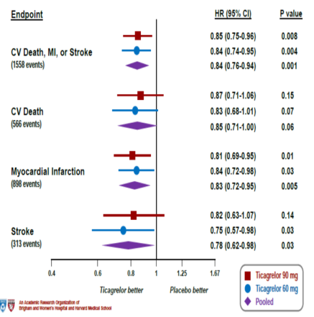
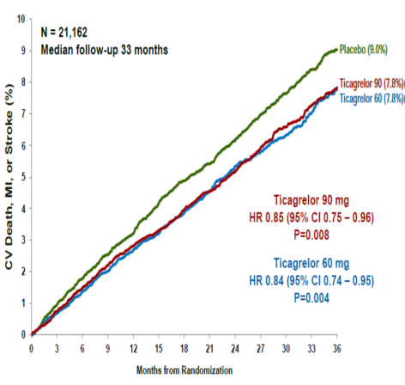
Duration in the follow-up post-PCI
Pts aged ≥50 years with a history of spontaneous MI 1–3 years prior to enrolment and at least one additional atherothrombosis risk factor; (N=21,162)
Primary Endpoint
(CV death, MI or stroke)
Median follow-up 33 months from randomization
Efficacy Endpoints
Bonaca MP et al. N Engl J Med 2015

Slide 16
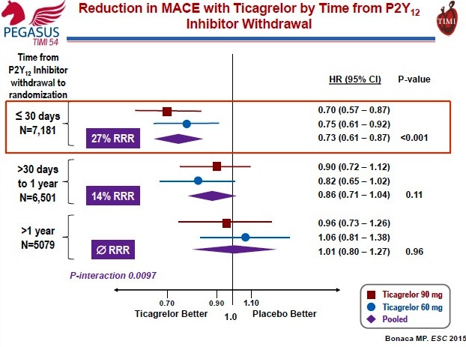
Duration in the follow-up post-PCI
Insights from PEGASUS-TIMI 54
Long term ticagrelor 60 mg bid reduced the incidence of MACE and stroke in:
1)Any type of stent
2) Diabetics
3) PVD
And reduce also the risk of intracardiac thrombosis
Ticagrelor 60 mg bid > 12 months
is recommended (Class IIb; level B),
in patients at high ischemic risk,
with a low bleeding risk.
Bonaca MP et al. N Engl J Med 2015

Slide 17
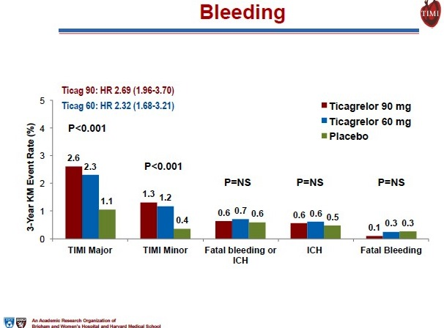
Safety Endpoint

Slide 19
Hight risk ACS Pts

Slide 20

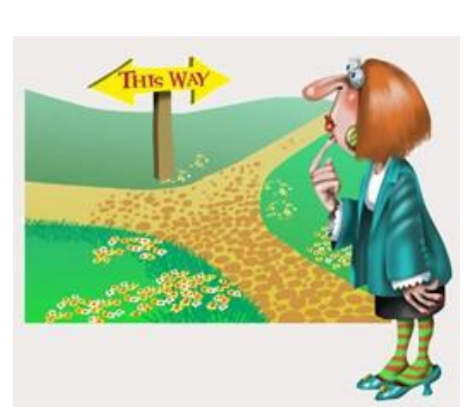

FOLLOWING PCI + STENT
in patients with ACS and AF
NAO/OAC
+
1 antiplatelet agent (ASA or clopidogrel) | 2 antiplatelet agents (ASA and clopidogrel)
Possible antithrombotic strategies in the follow-up after an ACS treated with PCI and stent implantation
The rigth way!!
Warfarin + ASA + Clop
No ASA → Warf + Clop
No ASA → NOAC+ Clop
No warf → NOAC + ASA + Clop
No ASA → New more potent P2Y12 inhibitor + NOAC

Slide 21
Is ASA necessary in patients with NVAF treated with PCI and stent implantation or patients with ACS that develop an AF after invasive procedure?

Slide 22
More evidence for Antithrombotic Double Therapy in anticoagulated patients, treated with PCI
ORIGINAL ARTICLE

Slide 23
New evidence from WOEST, PIONEER AF-PCI/Re-DUAL-PCI on the use of DOAC in patients with NVAF and ACS treated with PCI
Evidence!!
In patients on oral anticoagulants that underwent to PCI for ACS the combined treatment with clopidogrel and VKA or DOAC, was associated with a significantly lower risk of bleeding than triple therapy that included also ASA
In addition the trials showed no evidence of increased in stent thrombosi/MI without the use of ASA
The Rivaroxaban 15 mg/day or dabigatran 110/150 mg BID in dual therapy with P2Y12 inhibitor, mainly clopidogrel (without ASA) are safer in terms of bleeding risk than triple therapy with VKA, clopidogrel, and low-dose ASA
Rivaroxaban 2.5 mg BID in triple therapy with ASA and clopidogrel is safer in terms of bleeding risk than triple therapy with VKA, clopidogrel, and low-dose aspirin
What is unknown
Whether the doses of Rivaroxaban used in PIONEER AF-PCI (i.e. 2.5 mg BID or 15mg OD) are sufficient for stroke prevention, compared with standard dose-adjusted VKA or with the 20 mg OD Rivaroxaban, that normally in used in patients with a normal renal clearance.
The effect of dual therapy (i.e. Rivaroxaban 15 mg OD or dabigatran 110/150 mg BID in combination with a more potent P2Y12 inhibitor), in term of safety end efficacy (IMA, CV death and ST)
Whether dual therapy strategies combining (NOAC with clopidogrel) is safer in terms of bleeding than a dual therapy with a VKA plus clopidogrel (this is currently being addressed in the AUGUSTUS study with Apixaban)

Slide 24
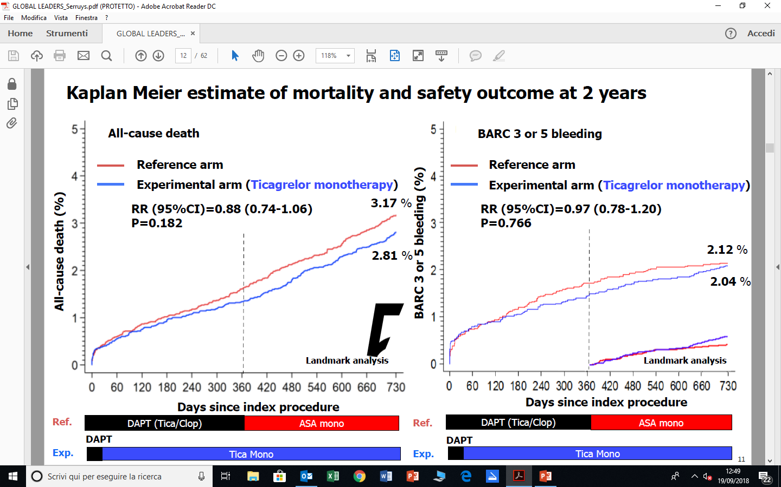
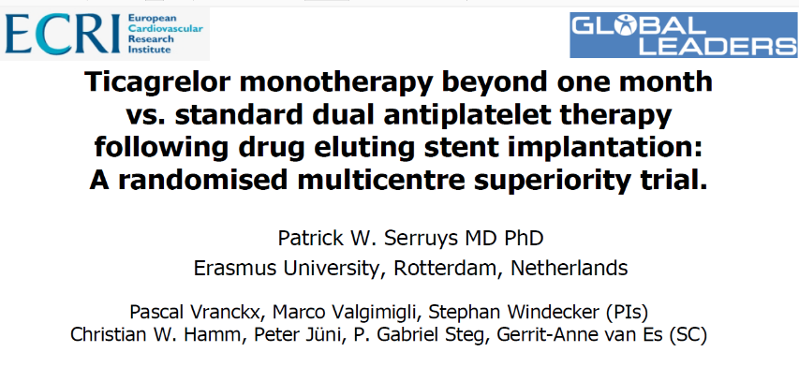
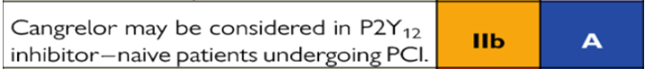
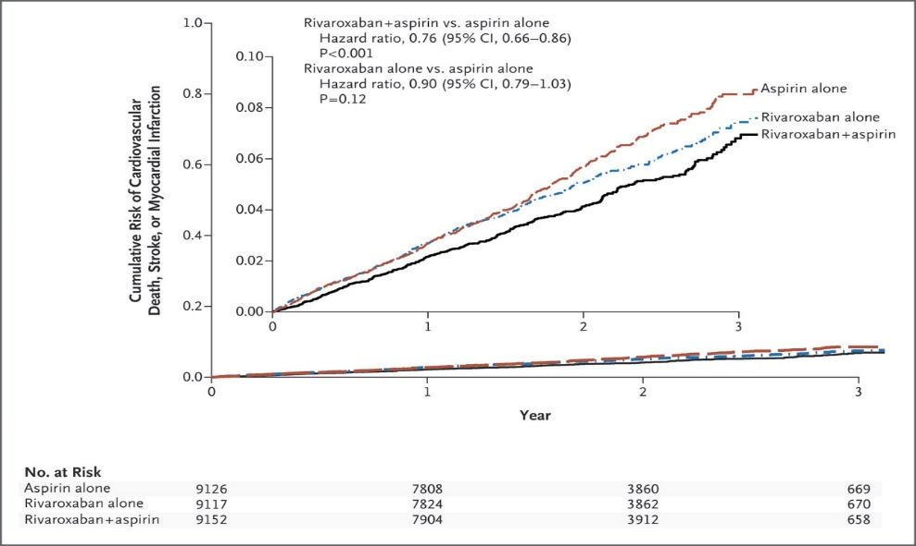
Future Direction for Research in Platelet P2Y12-inhibition in ACS
Should we skip ASA?
Future role of IV and oral Cangrelor?
Combination of ASA with DOAC?
COMPASS study

Slide 25
Considerazioni sulla triplice terapia antitrombotica
Nonostante che le raccomandazioni delle LG sul trattamento antitrombotico dei pazienti con FA e CAD/ACS sottoposti a PCI si basano ancora sul consenso di esperti, le evidenze dei trials clinici nonché l’esperienza acquisita nella pratica clinica, ci danno delle indicazioni più chiare sulla strategia antitrombotica da adottare in questi pazienti
Management for AF patients with CAD or ACS undergoing PCI
The future?
DOAC + more potent P2Y12 inhibitors

Slide 26
What is new in the 2017 ESC update on DAPT?
New
New
Up-grade
New
Up-grade
New
Up-grade
Up-grade
New
2017 ESC Focused Update on DAPT in Coronary Artery Disease, developed in collaboration with EACTS
(European Heart Journal 2017 - doi:10.1093/eurheartj/ehx419)

Slide 27
The WOEST Trial:
What is the Optimal antiplatElet and anticoagulant therapy in patients with oral anticoagulation and coronary StenTing
Open-label WOEST study (N=573) compared safety outcomes with triple therapy (VKA + clopidogrel + ASA) vs dual therapy (VKA + clopidogrel) 69% of WOEST patients had AF, included prosthetic heart valves
573 pazienti: dual terapy 284 pts. Triple terapy 289 pts.
«Pitfalls» on SAFETY
Open label study
Safety results driven by non-major bleeds
Femoral approach in 74% of pts
PPI in 20% of pts
Target INR was 2-3 (and not 2-2.5)
TTR in warfarin pts?
«Pitfalls» on EFFICACY
Driven by non-cardiac death
Underpowered for ST
70% of pts had stable angina
Low clopidogrel response unknown
The WOEST Trial: Implication
This randomised trial showed that patients taking oral anticoagulants and undergoing percutaneous coronary intervention for ACS, the combined treatment with clopidogrel and anticoagulants was associated with a significantly lower risk of bleeding and complications than triple therapy that included also ASA.
The trial also showed no evidence of increased thrombotic risk without the use of ASA
Lancet 2013; 381: 1107–15

Slide 28
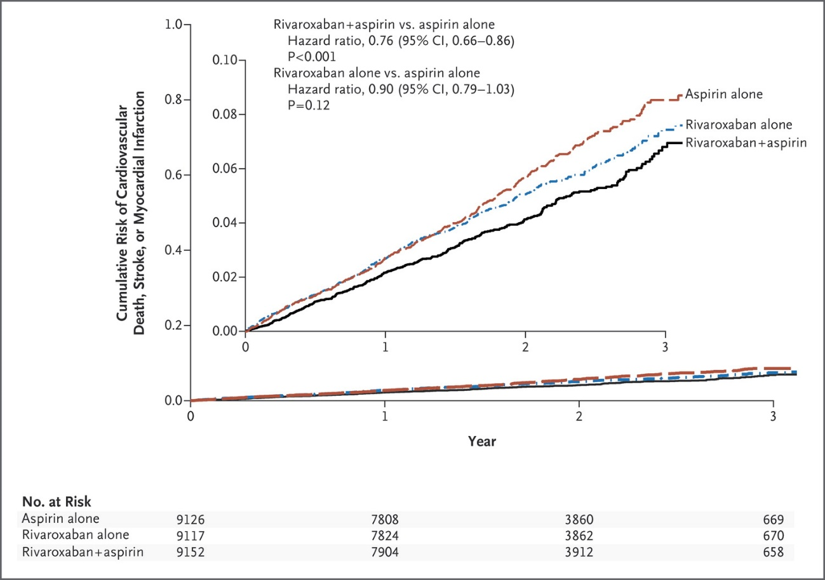
Future Direction for Research in Platelet P2Y12-inhibition in ACS
COMPASs study
Combination with
oral anticoagulants?
Should we skip aspirin? (Global leaders trial e TWILIGHT study; Ticagrelor plus ASA for 6-12 months flollowed by Ticagrelor beyond 12 months)
Future role of IV cangrelor?

Slide 29
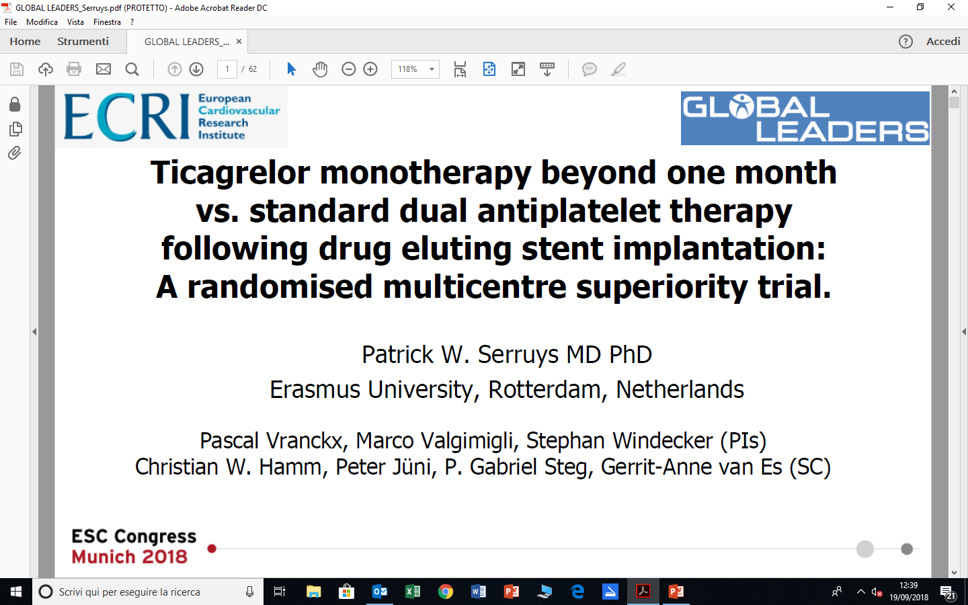

Slide 30




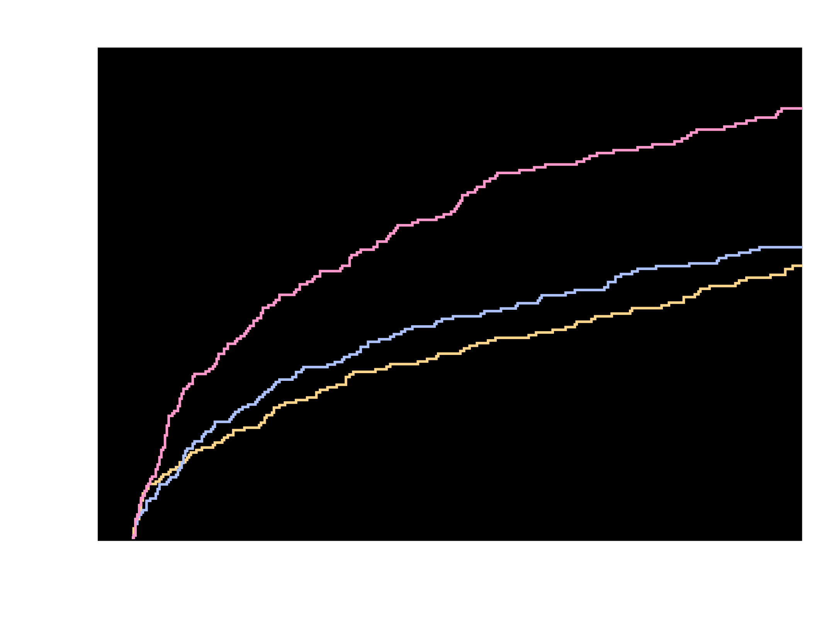
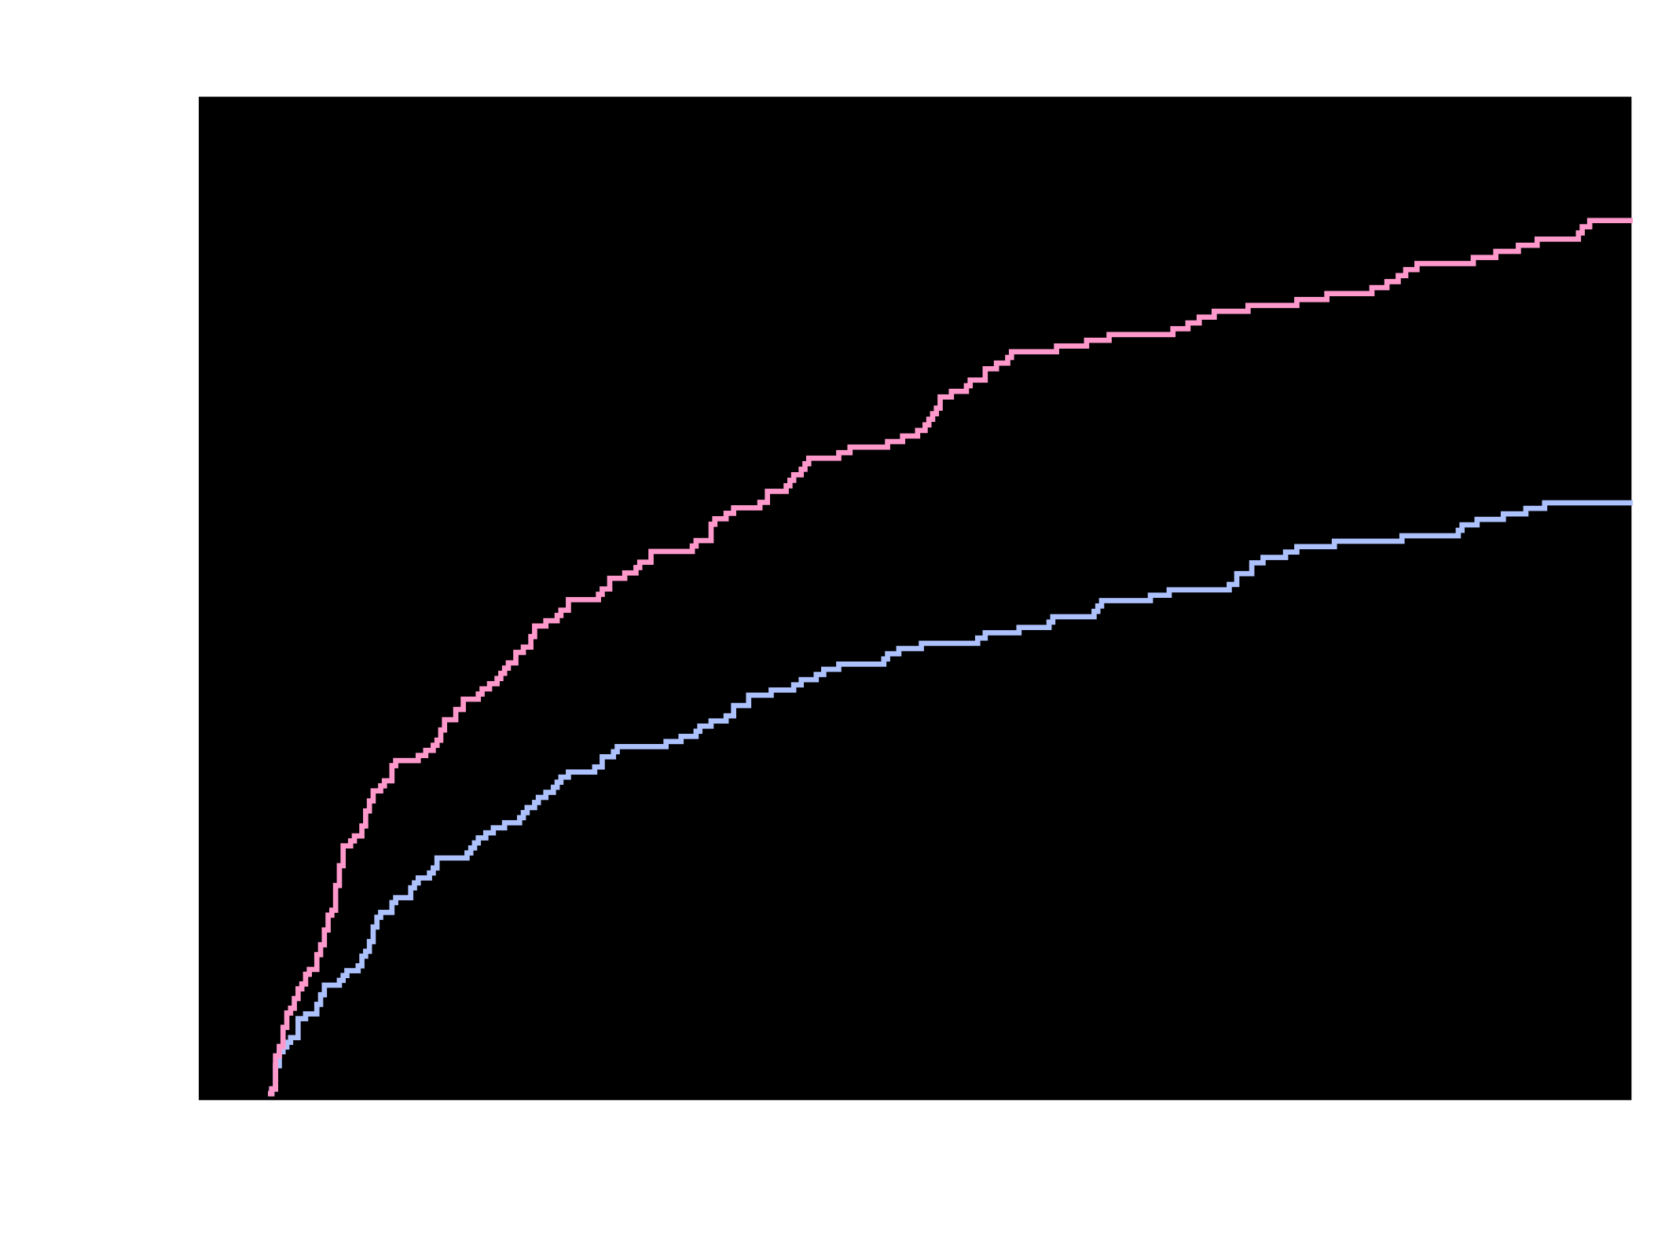
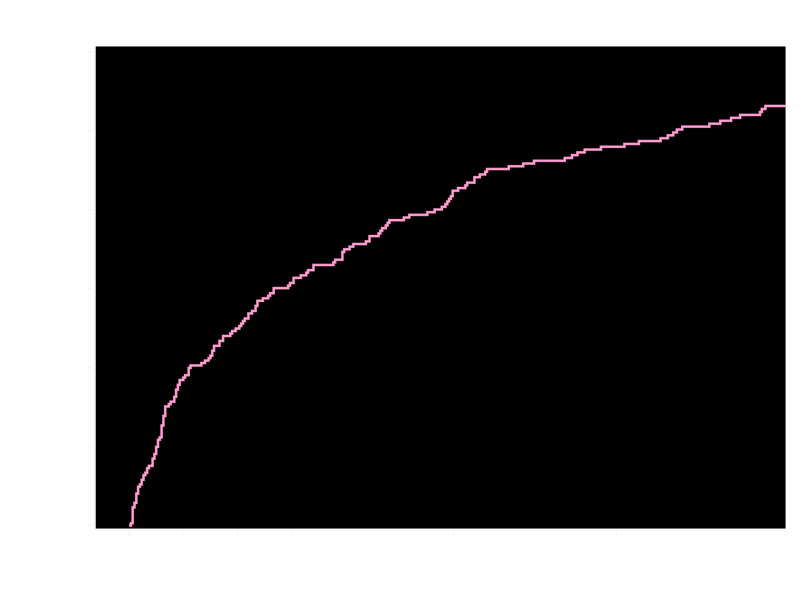
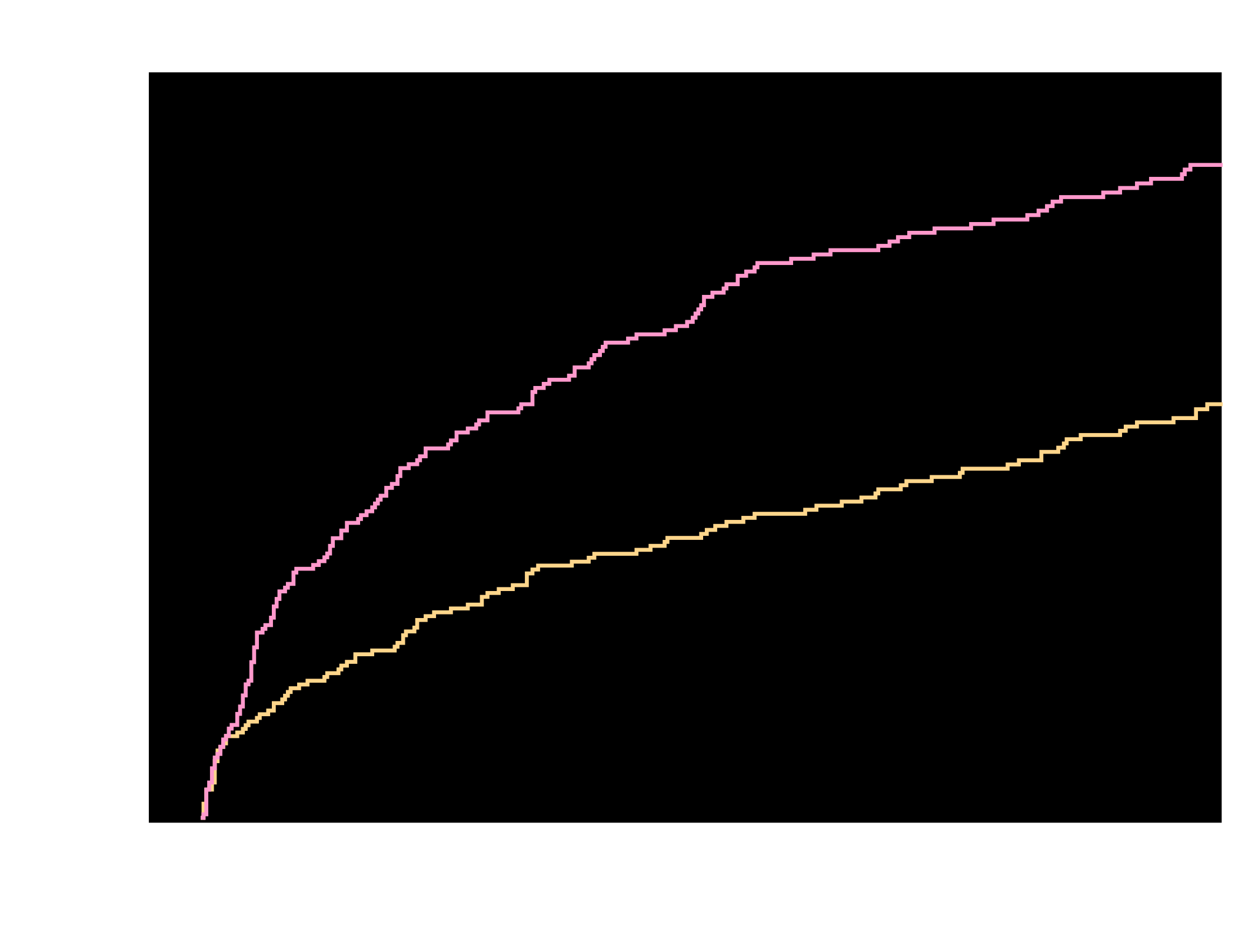
Kaplan-Meier Estimates of First Occurrence
of Clinically Significant Bleeding Events
TIMI Major, TIMI Minor, or Bleeding Requiring Medical Attention (%)
26.7%
p<0.00018
p <0.00018
p<0.000013
p <0.000013
18.0%
VKA + DAPT
16.8%
VKA + DAPT
VKA + DAPT
VKA + DAPT
Riva + DAPT
Riva + DAPT
Riva + P2Y₁₂
Riva + P2Y₁₂
HR = 0.63 (95% CI 0.50-0.80)
ARR = 8.7
NNT = 12
HR = 0.59 (95% CI 0.47-0.76)
ARR = 9.9
NNT = 11
Riva + P2Y₁₂ v. VKA + DAPT
HR=0.59 (95% CI: 0.47-0.76)
p <0.000013
ARR=9.9
NNT=11
Riva + DAPT v. VKA + DAPT
HR=0.63 (95% CI: 0.50-0.80)
p <0.00018
ARR=8.7
NNT=12
Days
No. at risk
VKA + DAPT
Riva + DAPT
VKA + DAPT
Riva + P2Y₁₂
VKA + DAPT
Riva + P2Y₁₂
Riva + DAPT
VKA + DAPT
697
706
697
696
697
696
706
697
593
636
593
628
593
628
636
593
329
409
329
383
409
329
555
383
329
600
555
606
555
606
600
555
521
579
521
585
521
585
579
521
461
543
461
543
461
543
543
461
426
509
426
510
426
510
509
426
Treatment-emergent period: period starting after the first study drug administration following randomization and ending 2 days after stop of study drug.
Clinically significant bleeding is the composite of TIMI major, TIMI minor, and BRMA.
Hazard ratios as compared to the VKA group are based on the (stratified, only for Overall, 2.5 mg BID/15 mg QD comparing VKA) Cox proportional hazards model.
Log-Rank P-values as compared to VKA group are based on the (stratified, only for Overall, 2.5 mg BID/15 mg QD comparing VKA) two-sided log rank test.
Gibson et al. AHA 2016

Slide 31
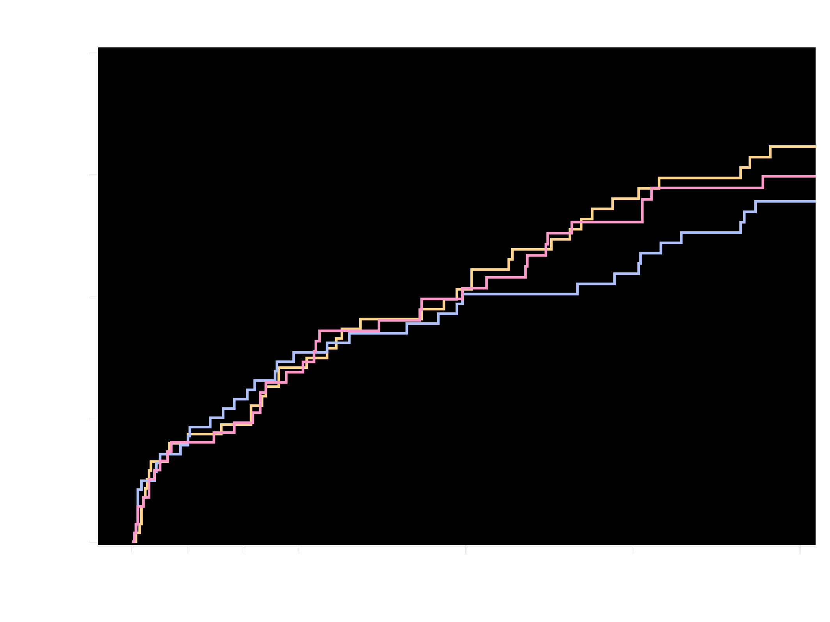
Kaplan-Meier Estimates of First
Occurrence of CV Death, MI or Stroke
Cardiovascular Death, Myocardial Infarction, or Stroke (%)
6.5%
Riva + P2Y₁₂
6.0%
5.6%
Riva + DAPT
VKA + DAPT
Riva + P2Y₁₂ v. VKA + DAPT
HR=1.08 (95% CI: 0.69-1.68)
p=0.750
Riva + DAPT v. VKA + DAPT
HR=0.93 (95% CI: 0.59-1.48)
p=0.765
No. at risk
Days
Riva + P2Y₁₂
Riva + DAPT
VKA + DAPT
694
704
695
648
662
635
633
640
607
621
628
579
590
596
543
562
570
514
430
457
408
Treatment-emergent period: period starting after the first study drug administration following randomization and ending 2 days after stop of study drug.
Composite of adverse CV events is composite of CV death, MI, and stroke.
Hazard ratios as compared to VKA group are based on the (stratified, only for the Overall, 2.5 mg BID/15 mg QD comparing VKA) Cox proportional hazards model.
Log-Rank P-values as compared to the VKA group are based on the (stratified, only for Overall, 2.5 mg BID/115 mg QD comparing VKA) two-sided log rank test.
6 Subjects were excluded from all efficacy analyses because of violations in Good Clinical Practice guidelines
Gibson et al. AHA 2016

Slide 32
Primary Endpoint: Time to first ISTH major or clinically relevant non-major bleeding event

Slide 33
Time to death or thromboembolic event, or unplanned revascularization

Slide 34
Areas for future research
Dual antithrombotic therapy by omitting ASA in secondary prevention after ACS
in patients with NVAF
Although both the PIONEER-AF and RE-DUAL PCI trials
have shown a benefit of DAT (i.e. a NOAC in combination with clopidogrel)
over TAT some questions still remain and need to be answered.
Both studies miss a DAT comparator with VKA plus Clopidogrel.
Moreover, 15mg rivaroxaban in combination with clopidogrel does not reflect current guidelines that the NOAC should be used in the lowest dose that has been tested for stroke reduction.
Finally, the use of potent P2Y12-inhibitors (ticagrelor or prasugrel) in combination with a NOAC in this indication is still not sufficiently proven, given that only 12% of patients in RE-DUAL PCI and a minority in PIONEER-AF had these drugs. A particular patient group for further research with these newer agents includes those with high on clopidogrel platelet reactivity, especially in patients with a high prevalence of comorbidity.
Such high on treatment platelet reactivity may have implications for prognosis, and optimal management remains uncertain

Slide 35
How to individualise the choice
of how long to maintain DAPT after ACS?
Choise based on:
I. Clinical scores systems for ischemic or hemorragic risk?
(TIMI, GRACE, SYNTAX, DAPT, HAS- BLED, OBRI, ORBIT, CRUSADE)
II. Clinical conditions of the Pts?
(Thrombotic/hemorragic risk, need for surgery, mental status ecc.)
III. Type of treated lesion or type of implanted stent?
(LM, bifurcations, proximal LAD ecc.)
IV. DAPT tailored by platelet function test?
(No evidence from many study GRAVITAS, ARCTIC, ANTARCTIC)

Slide 36
Conclusioni sulla DAPT
La DAPT è un trattamento non solamente per la prevenzione della trombosi dello stent, ma un trattamento utile per ridurre gli eventi aterotrombotici e migliorare la prognosi dopo una SCA
La strategia per l'uso della DAPT (trattamento up o down stream, scelta del farmaco, interruzioni, durata) deve essere accuratamente valutata e dinamica
Nell’impostare questa strategia devono essere prese in considerazione le condizioni cliniche dei pazienti, il trattamento per ACS o CAD stabile, il tipo e la lunghezza dello stent impiantato e soprattutto: comorbidità, terapie concomitanti e rischio di possibili emorragie
Triplice terapia antitrombotica
Secondo le LG la triplice terapia con OAC più ASA-clopidogrel rimane il trattamento raccomandato, ma la mia opinione personale è che…………
Nel futuro visto i dati dei nuovi trials (WOEST, PIONEER, RE-DUAL), la doppia terapia antitrombotica (NAO + P2Y12 inhibitor) è l'opzione da preferire specie nei pazienti a rischio elevato di sanguinamento

Slide 37
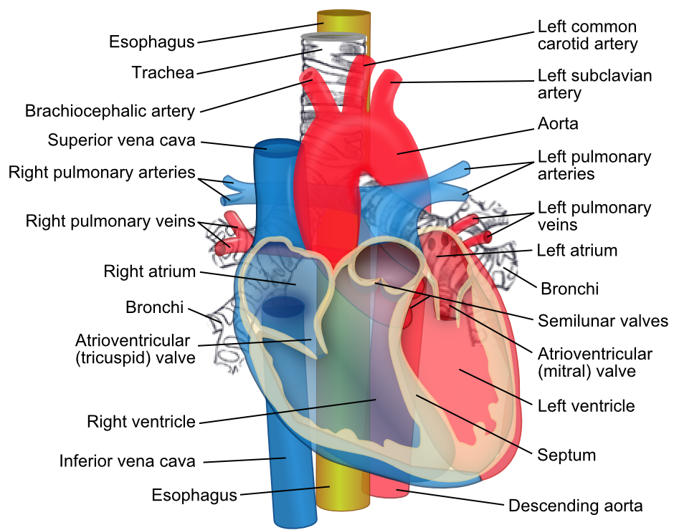

Slide 38
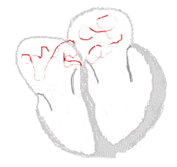
Prevention of new thrombotic events in patients
with Atrial Fibrillation and ACS
Atrial Fibrillation (ACTIVE W): The combination of aspirin and clopidogrel is not as effective as warfarin in patients with AF
As well as….
Stenting (STARS): The combination of aspirin and a thienopyridine is more effective than warfarin in patients with coronary stents
Stroke
ACS
Interruption of VKA may lead to increased risk of stroke
Invasive procedures increase risk of bleedeng under NAO/OAC
Addition of VKA to single antiplatelet or DAPT → 3–4
fold increase in major bleeding

Slide 39
Time of starting
Timing for starting treatment of P2Y12 in ACS :
in the past
contemporary practice
STEMI
NSTEMI
Invasive
Reduction of MACE after ACS
Sten thrombosis
CG
PCI
Fibrinolisys
Clopidogrel
Improve reperfusion efficacy

Slide 40
Clinical and procedural factors that may increase the ischemic/hemorrhagic risk in elderly.
Monaldi Archives for Chest Disease 2018; 88:952]

Slide 41
Time of starting
Treatment before angiography of NSTEMI pts with DAPT
NSTE-ACS in the Real World:
A lot of pts are elderly, with multivessel coronary disease and comorbidities
Bleeding Events and death in NSTEMI patients treated in upstream with antithrombotic drugs
Redfors, B. et al. J Am Coll Cardiol. 2016;68(24):2608–18.

Slide 42
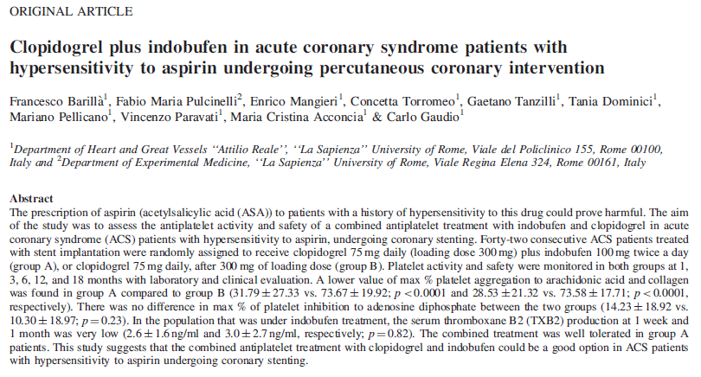
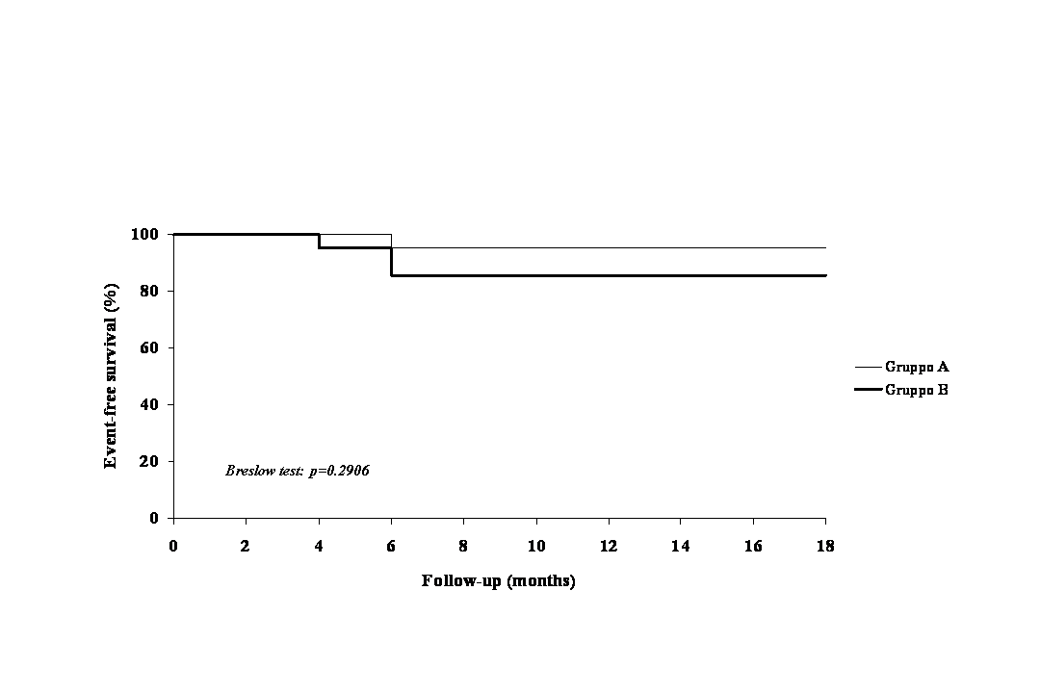
gruppo A = Ind+Clopidogrel
gruppo B = Clopidogrel
1 evento nel gruppo A; 3 eventi nel gruppo B,
Ottima tollerabilità , nessun caso di sanguinamento
Platelets may 2012

