Slide 1
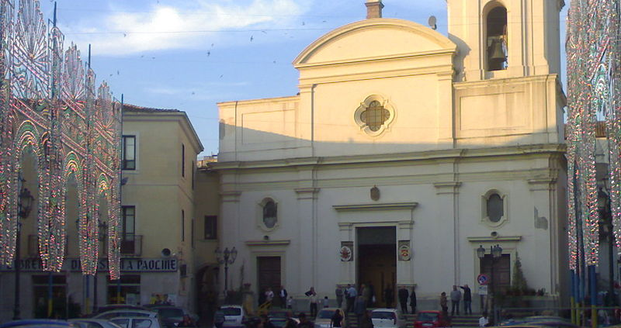
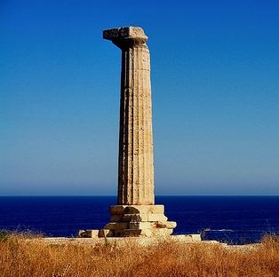
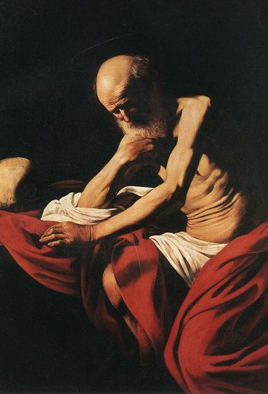
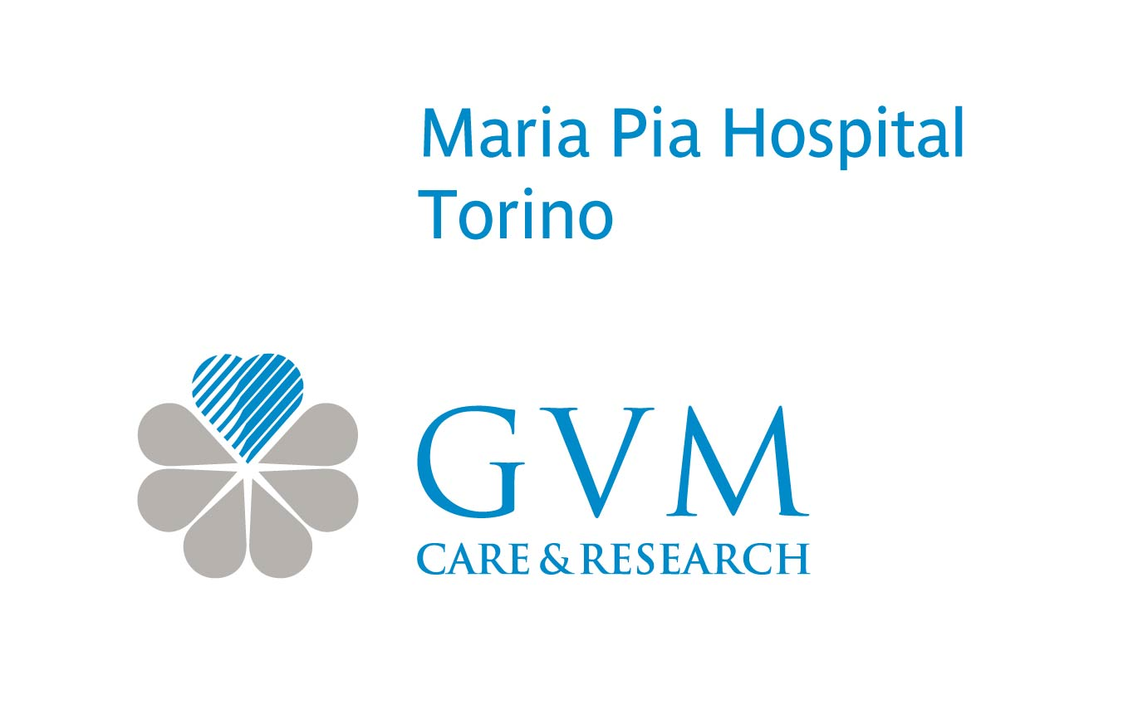
Crotone
12-13 ottobre 2018
Incontri Pitagorici Cardiologia 2018
Prof. Luigi Inglese
DIRETTORE MEDICO
DIPARTIMENTO MALATTIE CARDIOVASCOLARI
MARIA PIA HOSPITAL TORINO
"La complessità delle malattie in età adulta"
Great expectations:
poor results.History
of failures in endovascular therapy

Slide 2

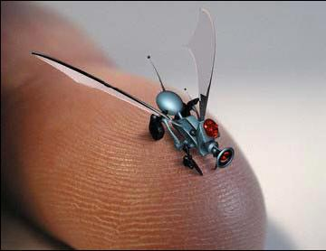
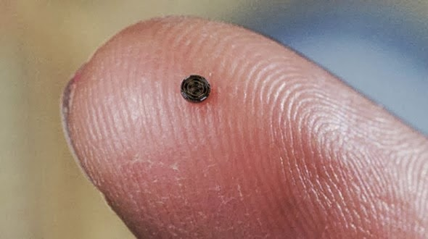

Slide 3

Nuove indicazioni
Insuccessi

Slide 4
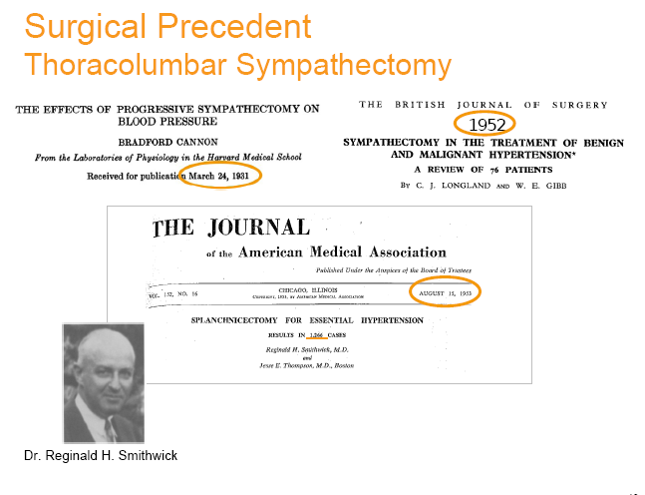
Renal Denervation for Resistant Hypertension
Notes:
La necessità di denervazione renale ha trovato già negli anni venti come pioneri chirurghi spinti ad effettuare tecniche di denervazione , partendo da modelli animali in cui si dimostarvano netti risulati di riduzione della PA.Smithwick fu il primo ad eseguire la splanctectomia e la simpaticectomai renale, partendo dai risultai di altri studi preliminari che dimostrarono riduzione della PA e delle complicanze ad essa correlate.

Slide 5
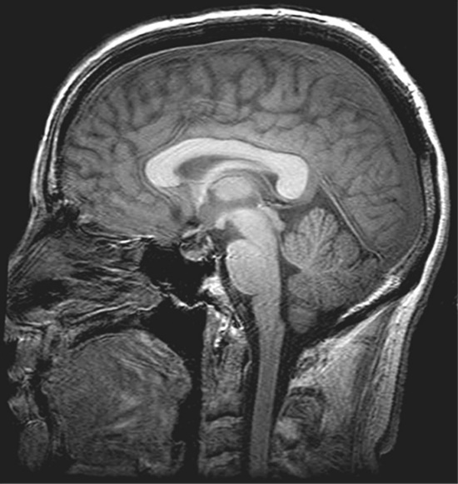
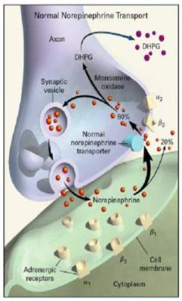
Central Sympathetic
Nerve Activity
Muscle Sympathetic
Nerve Activity (MSNA)
Renal Sympathetic
Nerve Activity
Norepinephrine
Spillover

Slide 6
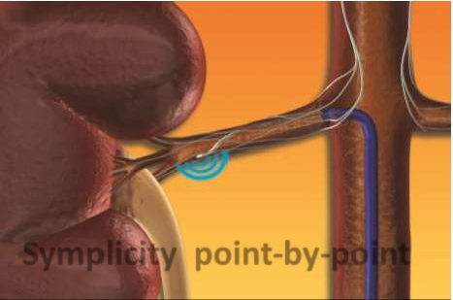
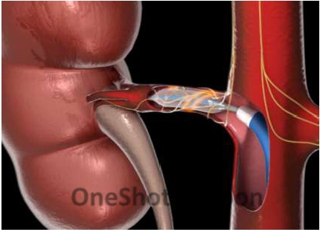
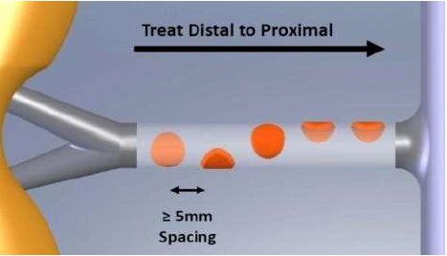
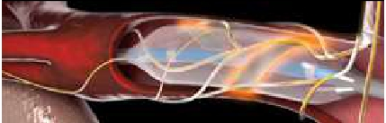
Point-by-Point System vs OneShot™ System
Helical Ablation Pattern

Slide 7


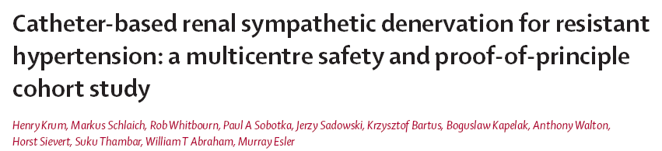
Symplicity HTN-1
Lancet. 2009;373:1275-1281
Hypertension. 2011;57:911-917.
Initial Cohort – Reported in the Lancet, 2009:
First-in-man, non-randomized
Cohort of 45 patients with resistant HTN (SBP ≥160 mmHg on ≥3 anti-HTN drugs, including a diuretic; eGFR ≥ 45 mL/min)
- 12-month data
\
Expanded Cohort – This Report (Symplicity HTN-1in the Hypertension, 2011:
Expanded cohort of patients (n=153)
24-month follow-up
7
Notes:
7

Slide 8


Slide 9
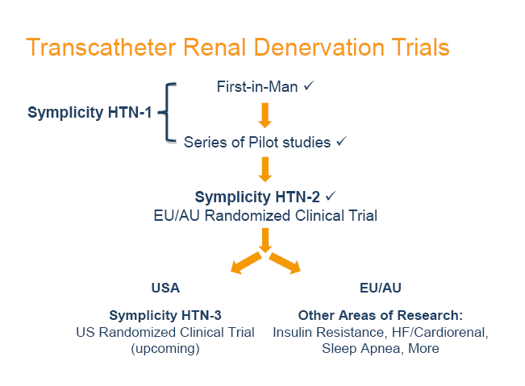

Slide 10
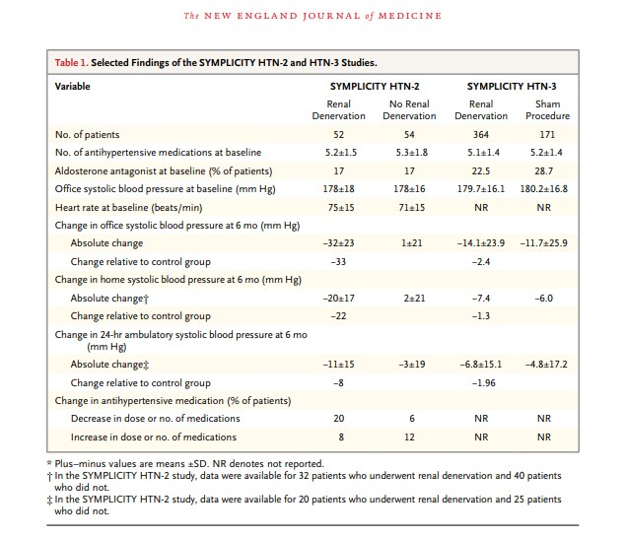

Slide 11
Hypothesis by P.Zamboni :
CCSVI is responsible of clinical MS progression and of its sypmtoms . PTA of stenotic venous valves should ameliorate symptoms and delay its progression.
Chronic Cerebro-spinal Venous Insufficiency
Chronic Cerebro-spinal Venous Insufficiency
(CCSVI) & MS

Slide 12
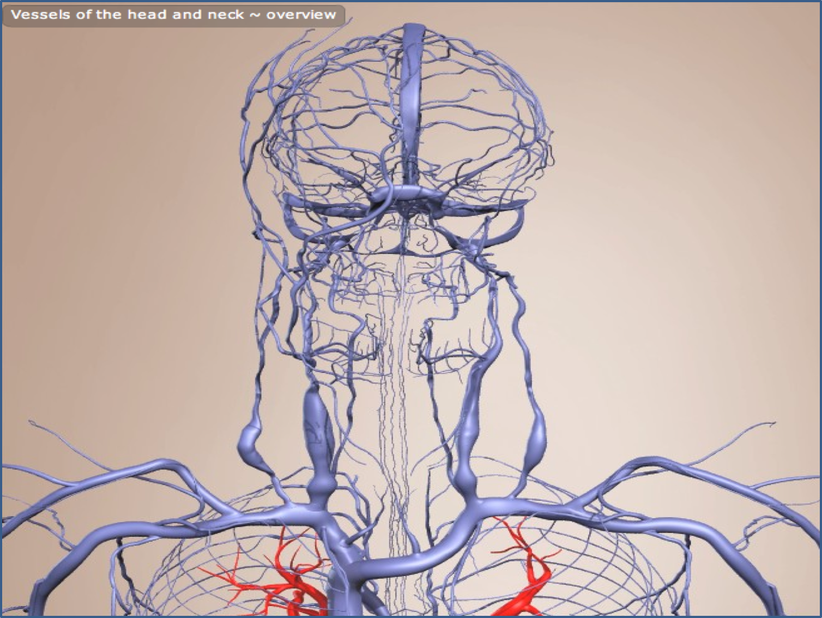

Slide 13
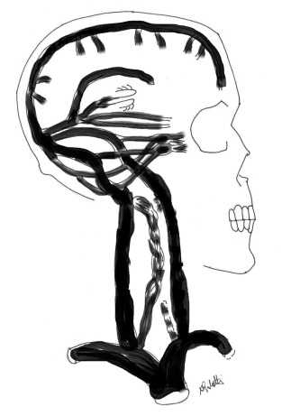
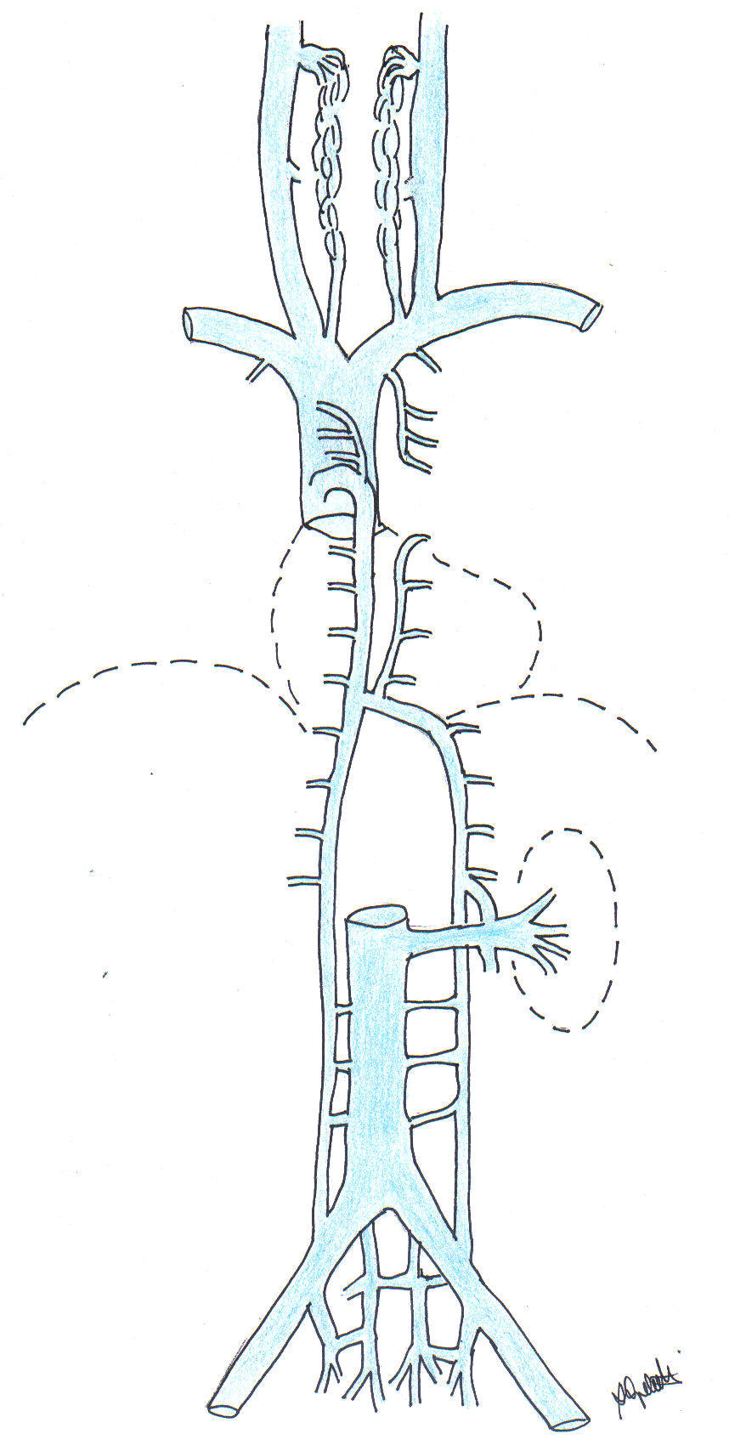
Int. Vertebral plexus
Vert. Art. plexus
C
IJVs
Extracranial main
pathways
Sup. intercost veins
Acc. hemiazygous
Intercostal veins
Hemiazygous
T
Azygous
Reno-azy-lumb v
Extravertebral
main pathways
L
ANATOMIA
(dove?)
Ascend. Lumbar v
Ileo-lumbar v
Sacral veins
S

Slide 14
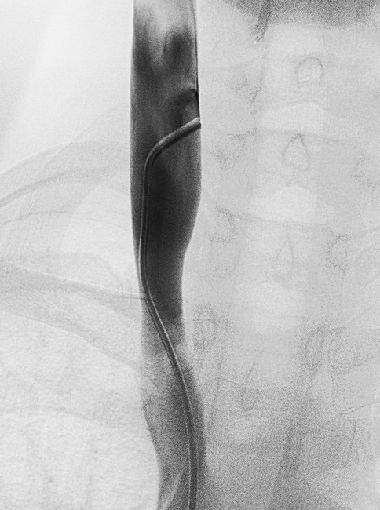
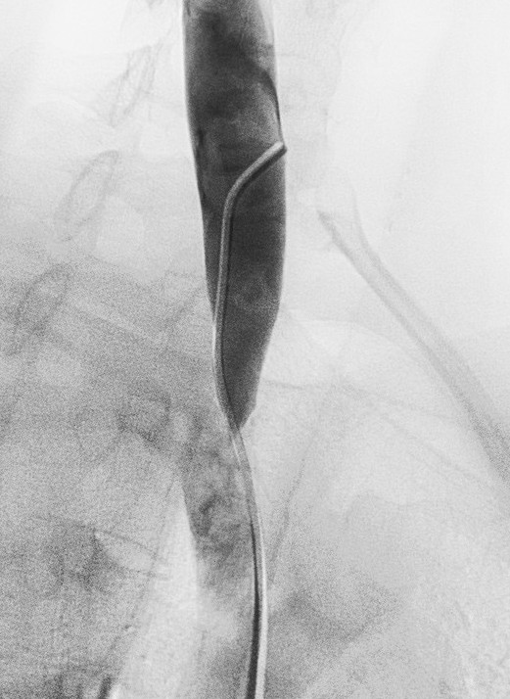
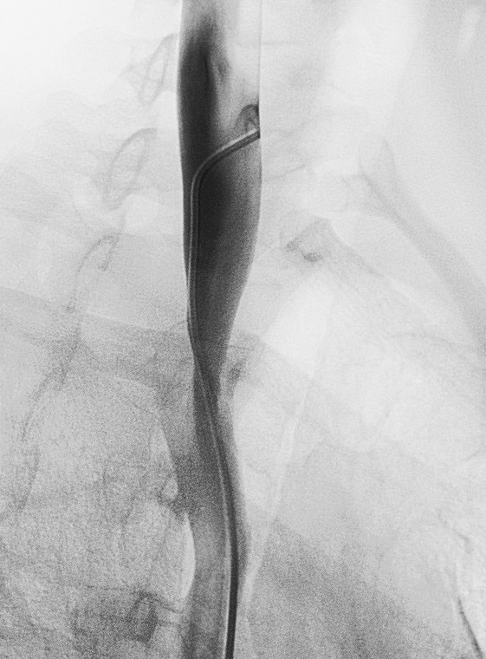
La PTA nel trattamento della CCSVI:
come ?
ANGIODILATAZIONE
pre
post
pre
Obliqua 50°
Obliqua 50°

Slide 15
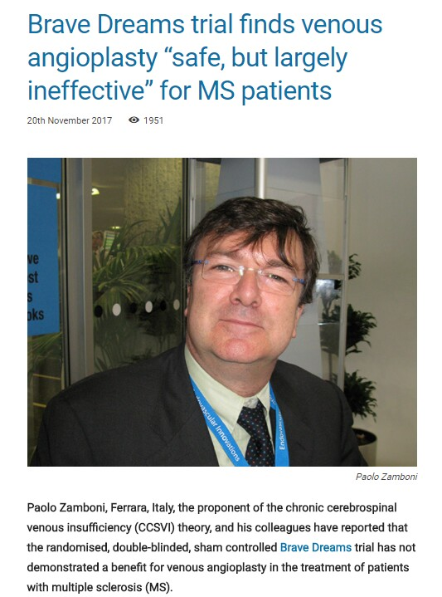

Slide 16
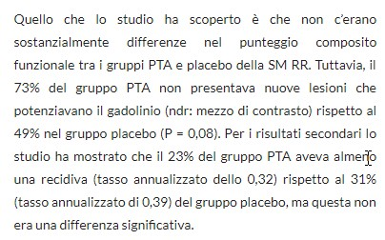

Slide 17
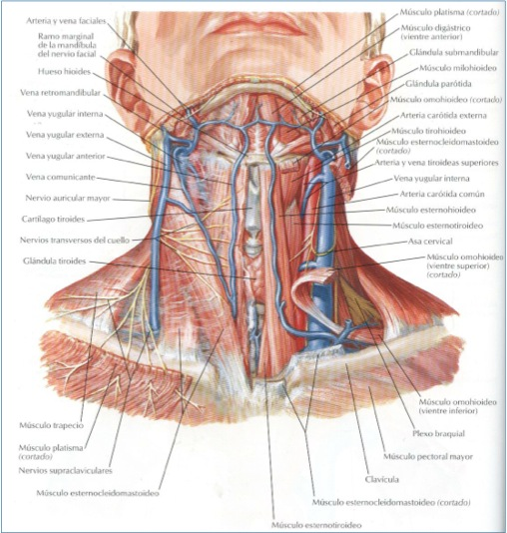
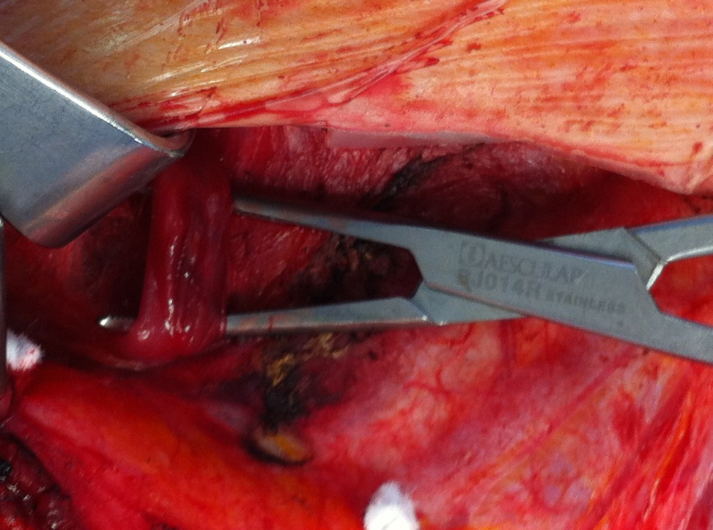
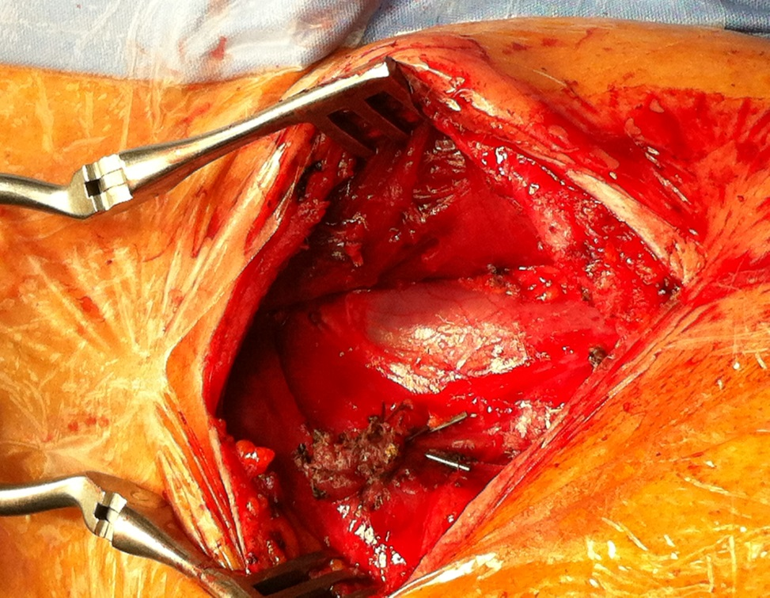
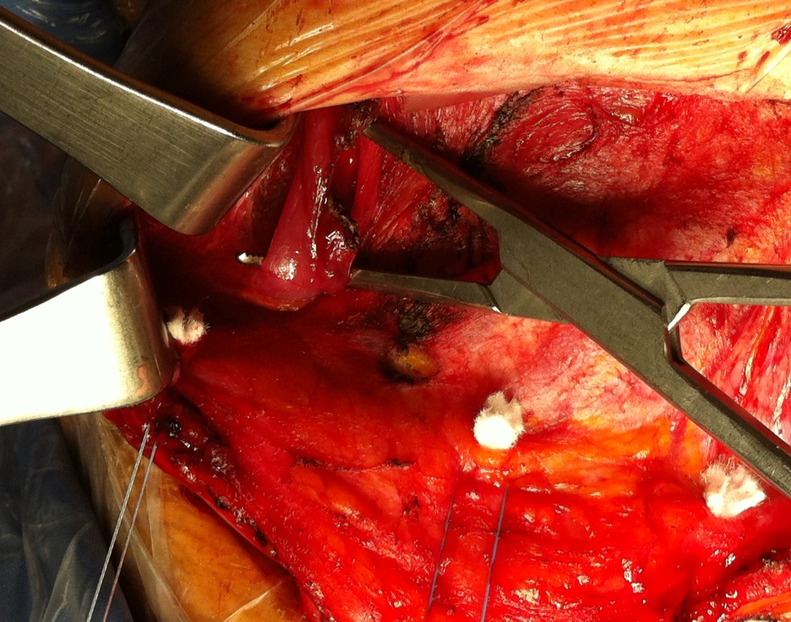
Courtesy by Salvatore Spagnolo, MD

Slide 18
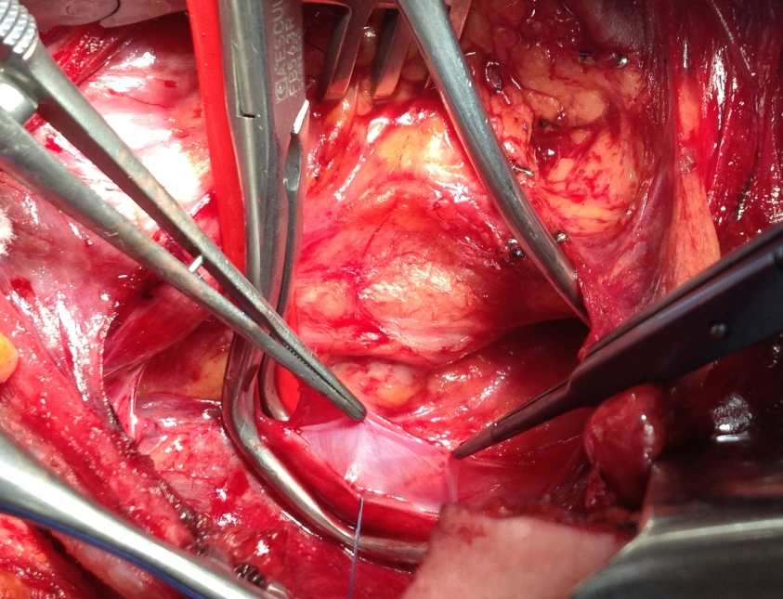
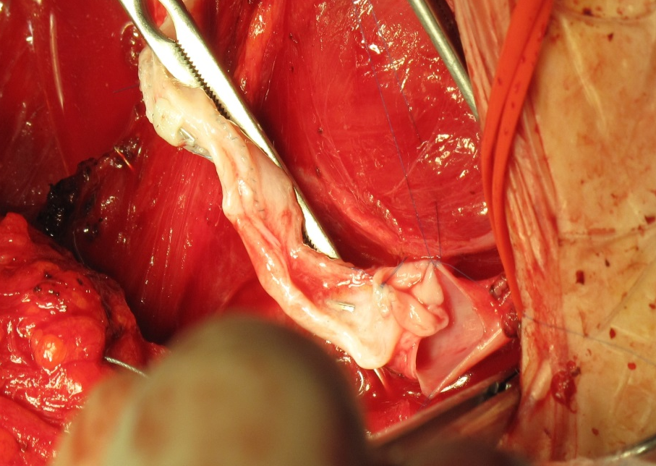
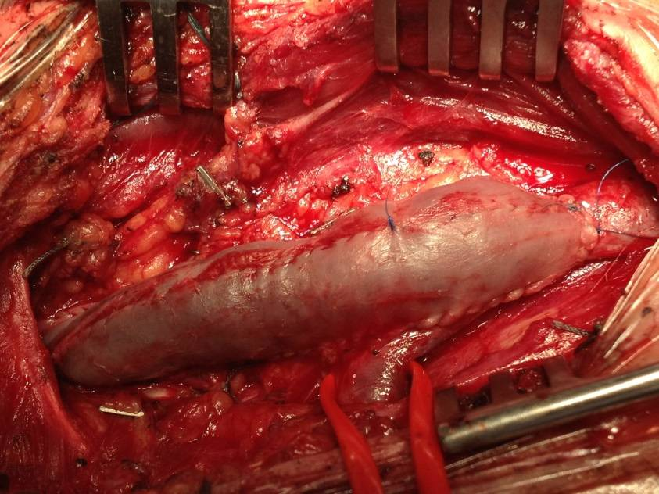
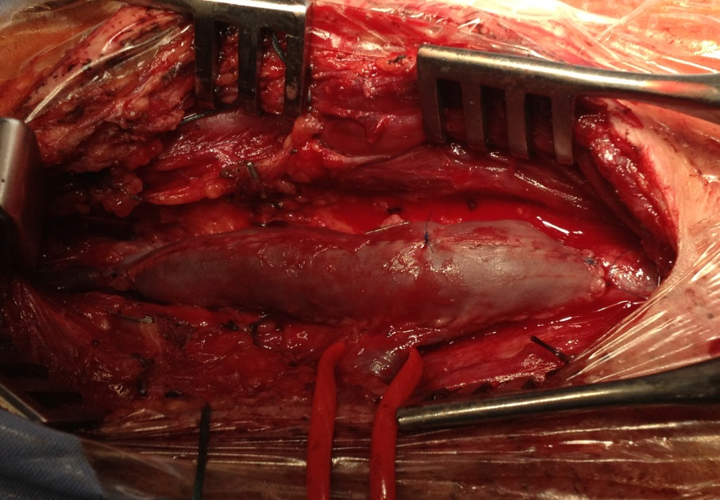
Trattamento chirurgico
della stenosi delle vene giugulari

Slide 19
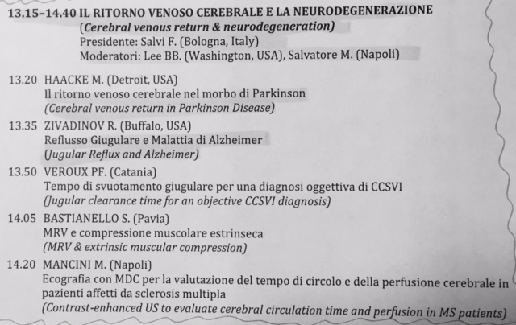
PROGRAMMA SCIENTIFICO VEINLAND - ALBARELLA 16-05-2014

Slide 20

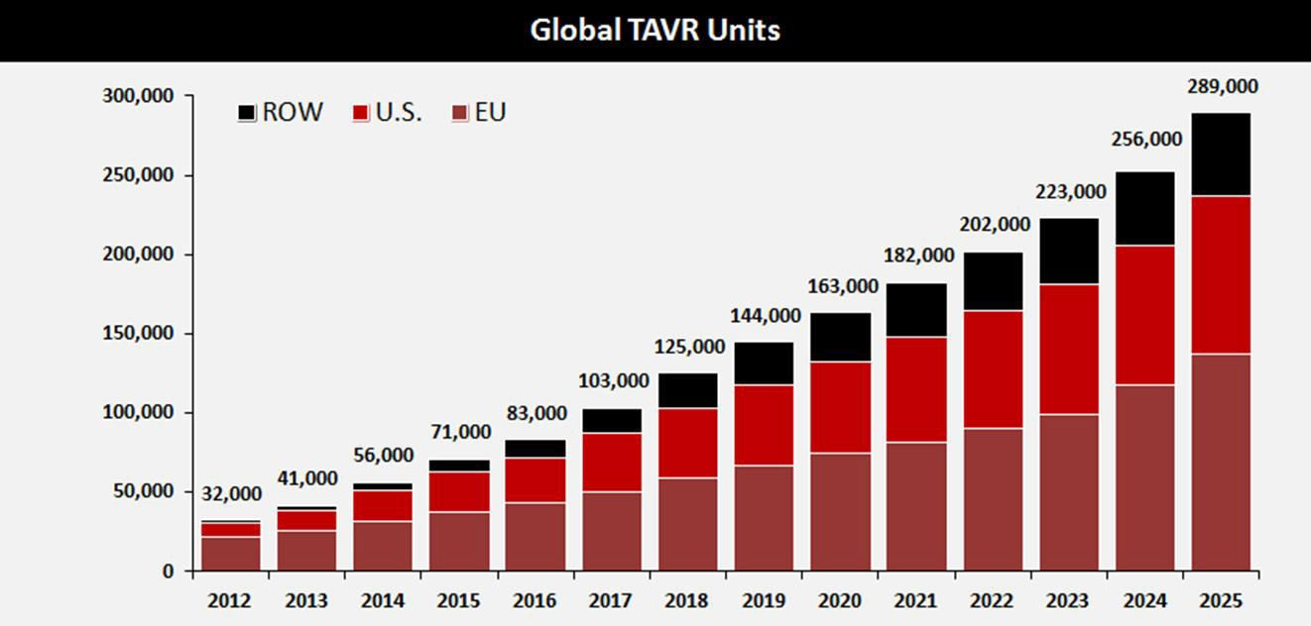


TAVI: Expected Worldwide Growth
Source: Credit Suisse TAVI Comment – January 8, 2015. ASP assumption for 2024 and 2025 based on analyst model. Revenue split assumption in 2025 is 45% U.S., 35% EU, 10% Japan, 10% ROW
In the next 10 years TAVI growth is expected to increase x4

Slide 21
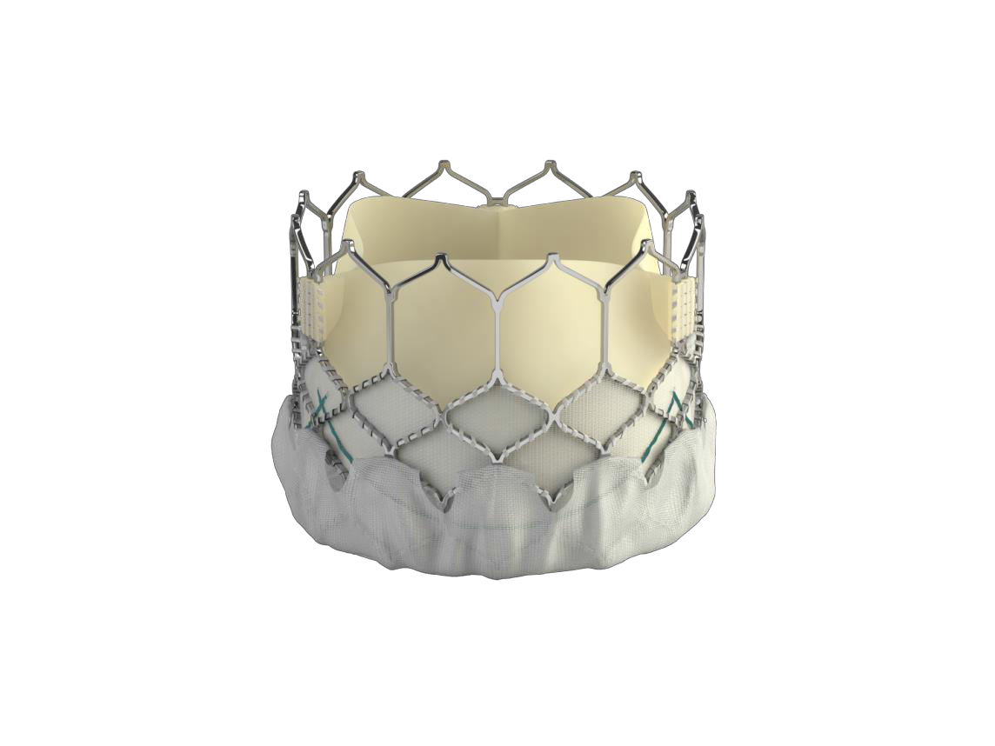




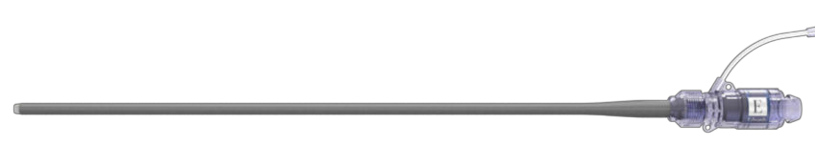
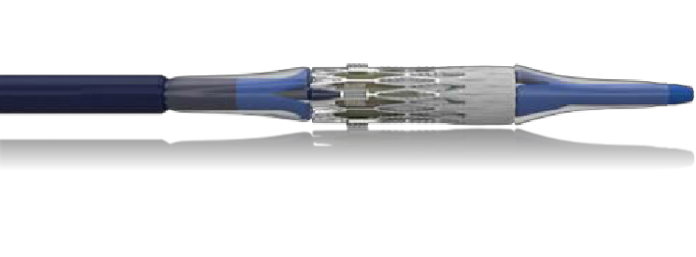


The Edwards SAPIEN 3 Ultra System
Further Streamlines the TAVI Procedure
SAPIEN 3 Valve
SAPIEN 3 Ultra
Delivery System
Axela Sheath
On-balloon design - removes valve alignment step
14F compatible for all valve sizes including the 29mm
Pusher eliminated - reduces steps required during deployment
Seamless sheath design
CE Mark Approval Expected in 2H 2017
SAPIEN 3 Ultra System and Axela Sheath are not approved for sale.

Slide 22
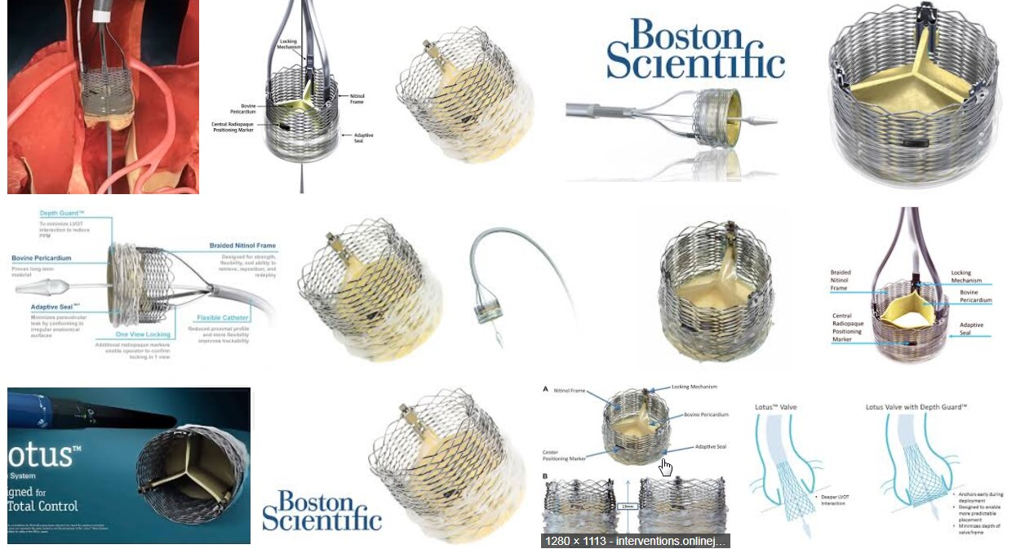

Slide 23
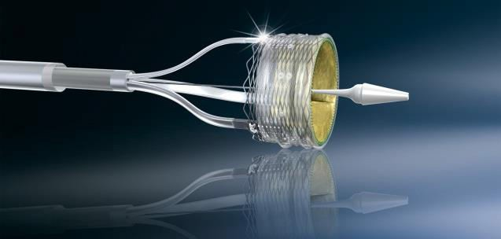
LOTUS Edge System
Designed to improve deliverability
Key features of the Lotus Valve are conserved including:
Full Repositionability
Full Retrievability
Adaptive Seal™
New Features
Increased flexibility, trackability, and coaxial alignment
Enhanced delivery and
deployment
LOTUS Edge
Lotus

Slide 24
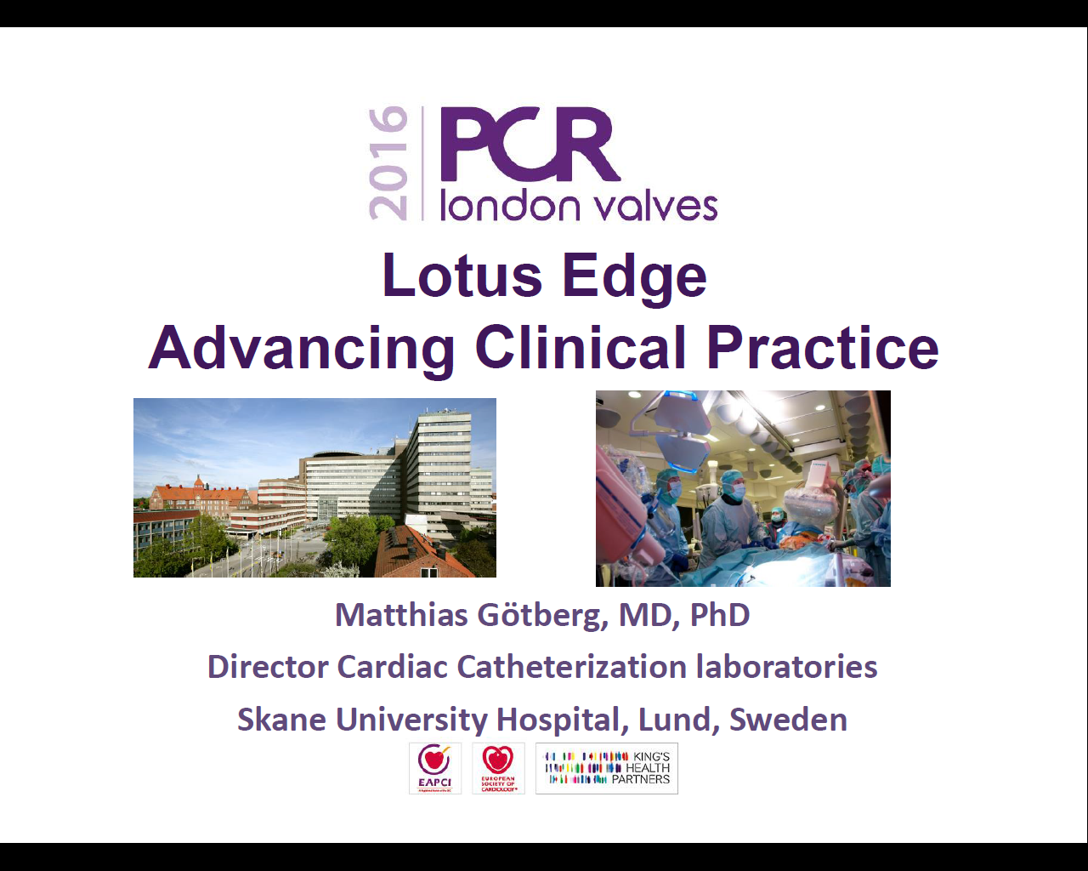

Slide 25
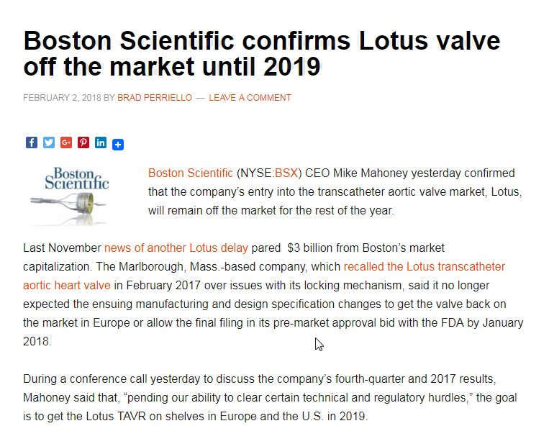

Slide 26
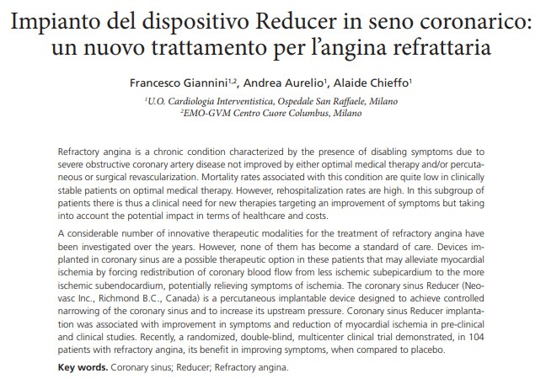

Slide 27
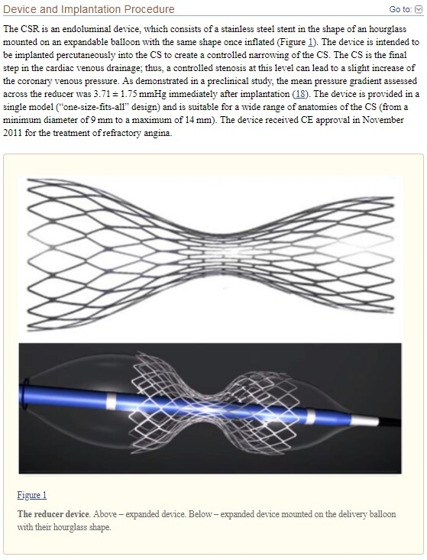

Slide 28
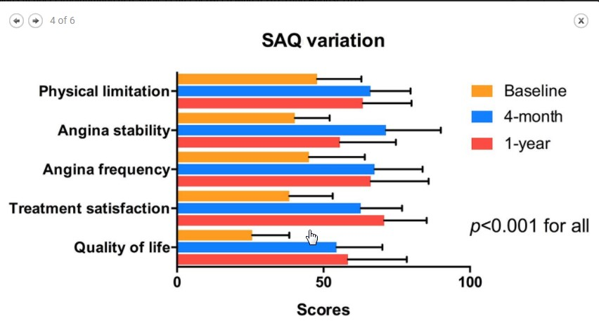
F. Giannini & Coll. JACC Cardiovascular Interventions Vol11, 8 , Apr.2018
Seattle Angina Questionaire (SAQ) reflects for best results the possible presence of a placebo effect

Slide 29
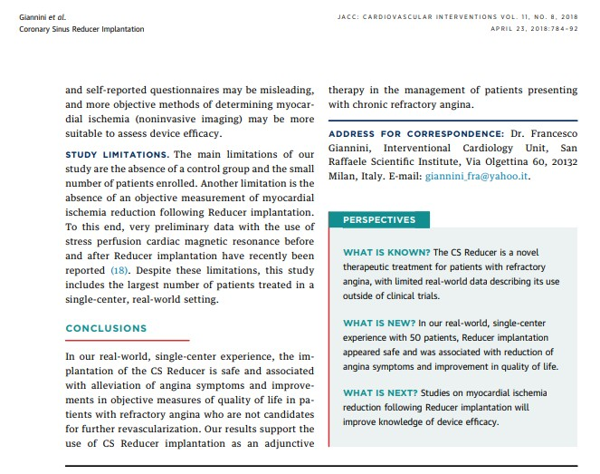

Slide 30
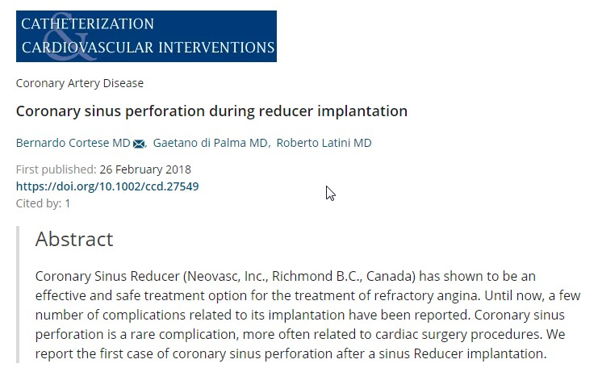

Slide 31
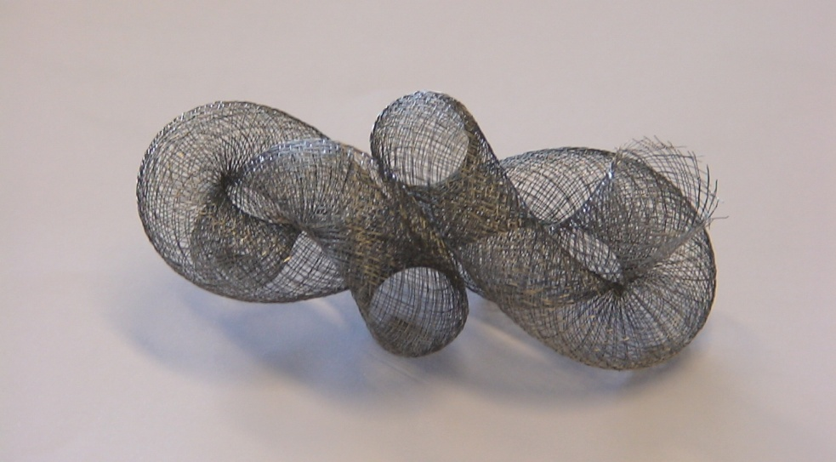
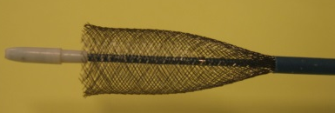
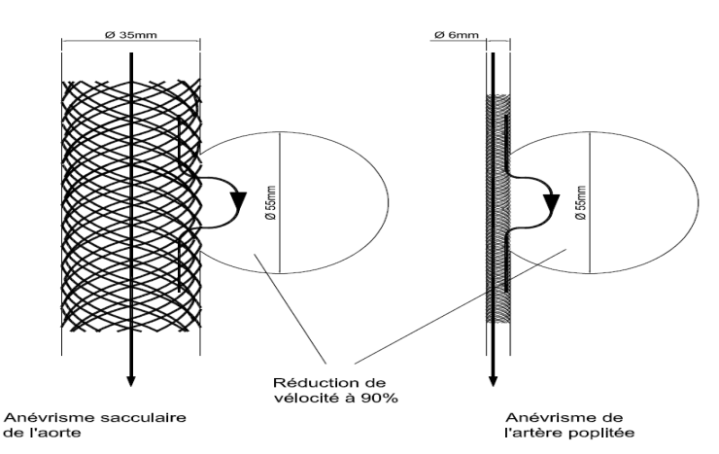
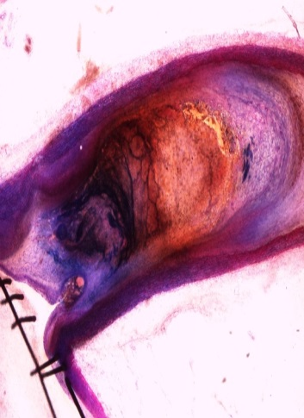
Cardiatis Multilayer Flow Modulator
It is a bare self-expandable device with a three-dimensional scheletal mesh made of metallic cobalt alloy wires interconnected in multiple layers
designed to reduce velocity and pressure of flow vortex within the aneurysm improving laminar flow in the main artery and surrounding vital branches
it allows flow stasis and formation of an organized thrombus
Notes:
According to the laws governing fluid dynamics, a fluid’s velocity must increase as it passes through a stricture to satisfy the conservation of mass, while its pressure must decrease to satisfythe conservation of energy

Slide 32



A theoretical new option
Cardiatis Multilayer Stent is a self-expandable device with a tridimensional mesh made of metallic cobalt alloy wires interconnected in multiple layers: this structure allows the mesh layers number to adapt to diameter, morphology, dimension and course of the target artery
The delivery consists of a guided-catheter with a minimally traumatic soft tip 0.018” (maximum 0.025”) compatible.
The sheath is connected by a hemostatic Y valve to the delivery: when the valve is closed, the sheath is fixed to the support, as a safety lock.

Slide 33






CARDIATIS MULTILAYER FLOW MODULATOR = “dynamic” barrier
can be deployed covering collaterals
without occluding them
can treat aneurysms regardless of their location, with or without side branches arising from sac or close to the neck

Slide 34
2011
Endovascular:
deployment of two Cardiatis stents + distal CP stent
2012
CT control: persistent type I endoleak with slight increase of aneurysm sac volume, good patency of visceral vessels

Slide 35

Endomed 34-20
Cardiatis 40-100
Cardiatis 30-150

Slide 36

Possible explanation of endoleak
Rx strategy:
Open surgery?
Hybrid?
Endovascular?
Conservative Rx?

Slide 37



Sept 29, 2012
CT control: persistent type I endoleak with slight increase of aneurysm sac volume

Slide 38


DEBATE:
The Multilayer Stent Is Not Going To Work For The Treatment Of Complex Aneurysms:
Theoretical & Practical Considerations
Luigi Inglese, M.D.
Polyclinic San Donato - Milan - Italy

Slide 39


Slide 40


TheAbbot AbsorbBioresorbable Vascular Scaffold ( BVS )

Slide 41



Slide 42


Slide 43


Slide 44
CONSIDERAZIONI
-La Tecnologia è inarrestabile e entusiasmante
-Necessita di verifica clinica accurata e obbiettiva
- La tecnologia è sempre progressiva
-Ma la clinica qualche volta deve tornare
sui suoi passi

Slide 45
GRAZIE PER L’ATTENZIONE

